Slide 1
Congregation Beth Israel 162nd Annual Meeting Wednesday, May 27 2020 18 Iyar 5780
Rabbi Michael Z. Cahana | Cantor Ida Rae Cahana | Rabbi Rachel L. Joseph Rabbi Emanuel Rose z”l, Emeritus | Cantor Judith B. Schiff, Emerita

Slide 2
162nd Annual Meeting Agenda
Opening Prayer.....................................................................................Rabbi Michael Z. Cahana
Welcome..........................................................................................................................Glen Levy
Approval of Minutes from the 161st Annual Meeting................................................Glen Levy
State of the Congregation Report.......................................................................Josh Kashinsky
Honoring Retiring Trustees……………............................................................................Glen Levy
Kathleen Doctor, Stacy Friedman, Robin McCoy, and David Sarasohn
Nominating Committee Report....................................................................................Glen Levy
New Nominees for 2 Year Term 2020 – 2022
Sarah Pitman, Meryl Haber, Sandy Lewis, and Shoshanna Lansberg
Trustees Nominated for Re-election for a 2 Year Term 2020 – 2022
Bonnie Davis, Naomi Derner, David Goldwyn, and Bill June
Trustees Continuing Their 2 Year Terms
Jeff Capen, Eric Flamm, Janet Hoffman, Dan Hurwitz, Glen Levy,
Christie Moore, Sally Rosenfeld, Libby Schwartz, and Tony Urdes
Election of Trustees.......................................................................................................Glen Levy
Looking to the Future………………………………………………………........…Rabbi Michael Z. Cahana
Questions………………………………………………………………………………………………... Josh Kashinsky
Adjournment of 162nd Annual Meeting......................................................................Glen Levy

Slide 3
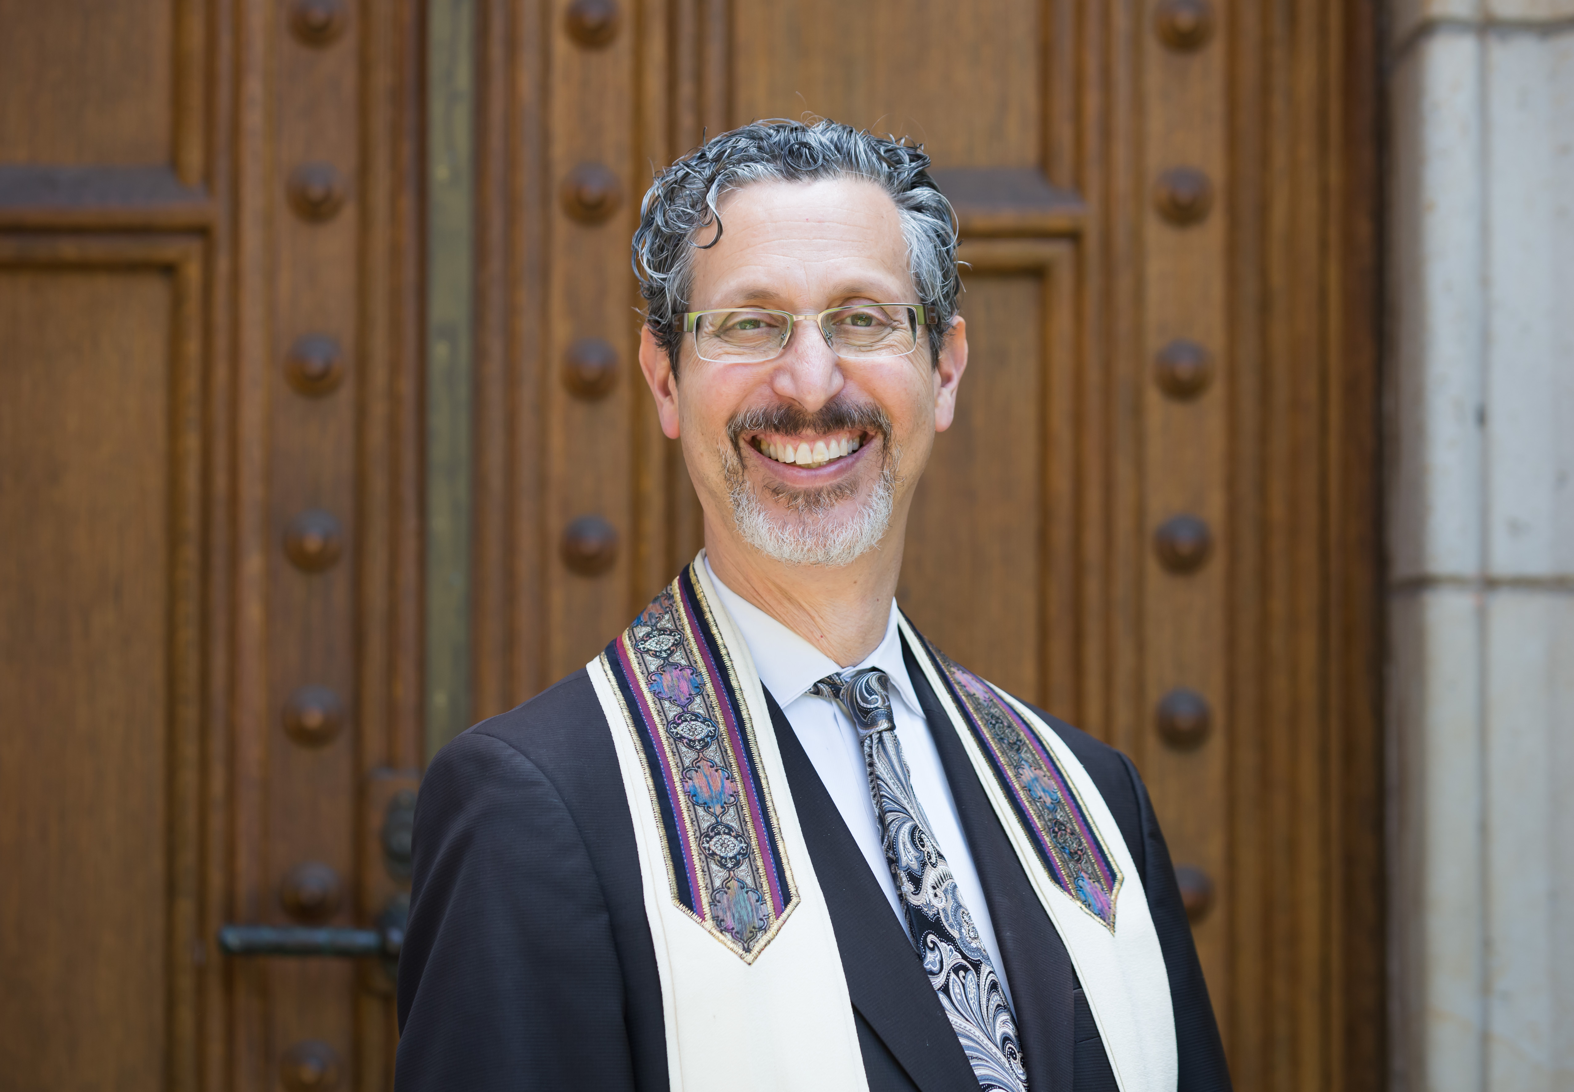
Opening Prayer
Rabbi Michael Z. Cahana, Senior Rabbi

Slide 4
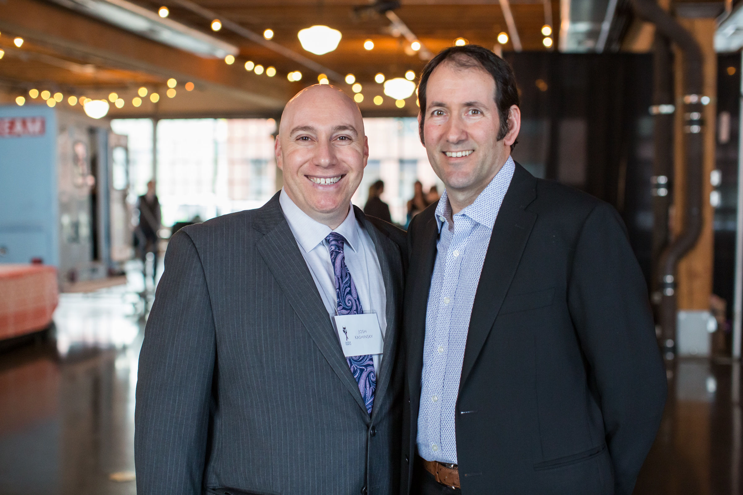
Welcome
Josh Kashinsky, Executive Director (left) and Glen Levy, outgoing President (right)

Slide 5
Approval of 161st Annual Meeting Minutes
President Glen Levy called the annual meeting of Congregation Beth Israel to order at 5:10 pm. Over 20 membership units were present, meeting the required quorum of 10 membership units.
Rabbi Cahana provided a D’Var. In Gematria, 161 can be interpreted as to envelop or surround and biblically has a negative connotation as in “misfortunes envelop me” from Psalm 40. But the psalm continues, “O favor me, Lord, and save me.” We currently are living in a time when it is easy to feel engulfed or surrounded. But the Psalm reminds us that we can respond to hatred not by more hatred, but rather by calling out to Gd. Indeed this has occurred as leaders and congregations of all religions have responded to some of the acts of hate that have occurred. In approaching year 5780 may we all be wrapped and surrounded by our loving community and may our leaders help to create a community of safety and support.
Upon a motion made and seconded, the minutes from the 160th annual meeting of May 12, 2018 were approved unanimously as written.
Glen Levy summarized some of the highlights of the past year for the congregation and answered questions from the members.
Eric Flamm, president of the Brotherhood, provided the members with a summary of the Brotherhood’s activities and future events.
Glen Levy noted that the president of the Sisterhood was unable to attend but has provided a report of the year’s activities for the members.
Glen Levy described the contributions of, and honored, the 3 trustees whose terms have expired - Joanne VanNess Menashe, Ted Nelson, and Mark Peterman.
Glen Levy advised the members that the Nominating Committee has recommended the following slate of trustees for two year terms, 2019-2021:
New to the Board: Eric Flamm, Dan Hurwitz, Christie Moore, and Libby Schwartz
For re-election to the Board: Jeff Capen, Janet Hoffman, Glen Levy, Sally Rosenfeld, and Tony Urdes
Upon a motion made and seconded to approve the above slate for election to the Board of Trustees, the motion passed unanimously.
There being no further business, the meeting was adjourned at 5:30 pm.
Respectfully submitted,
Mark Peterman
Secretary

Slide 6
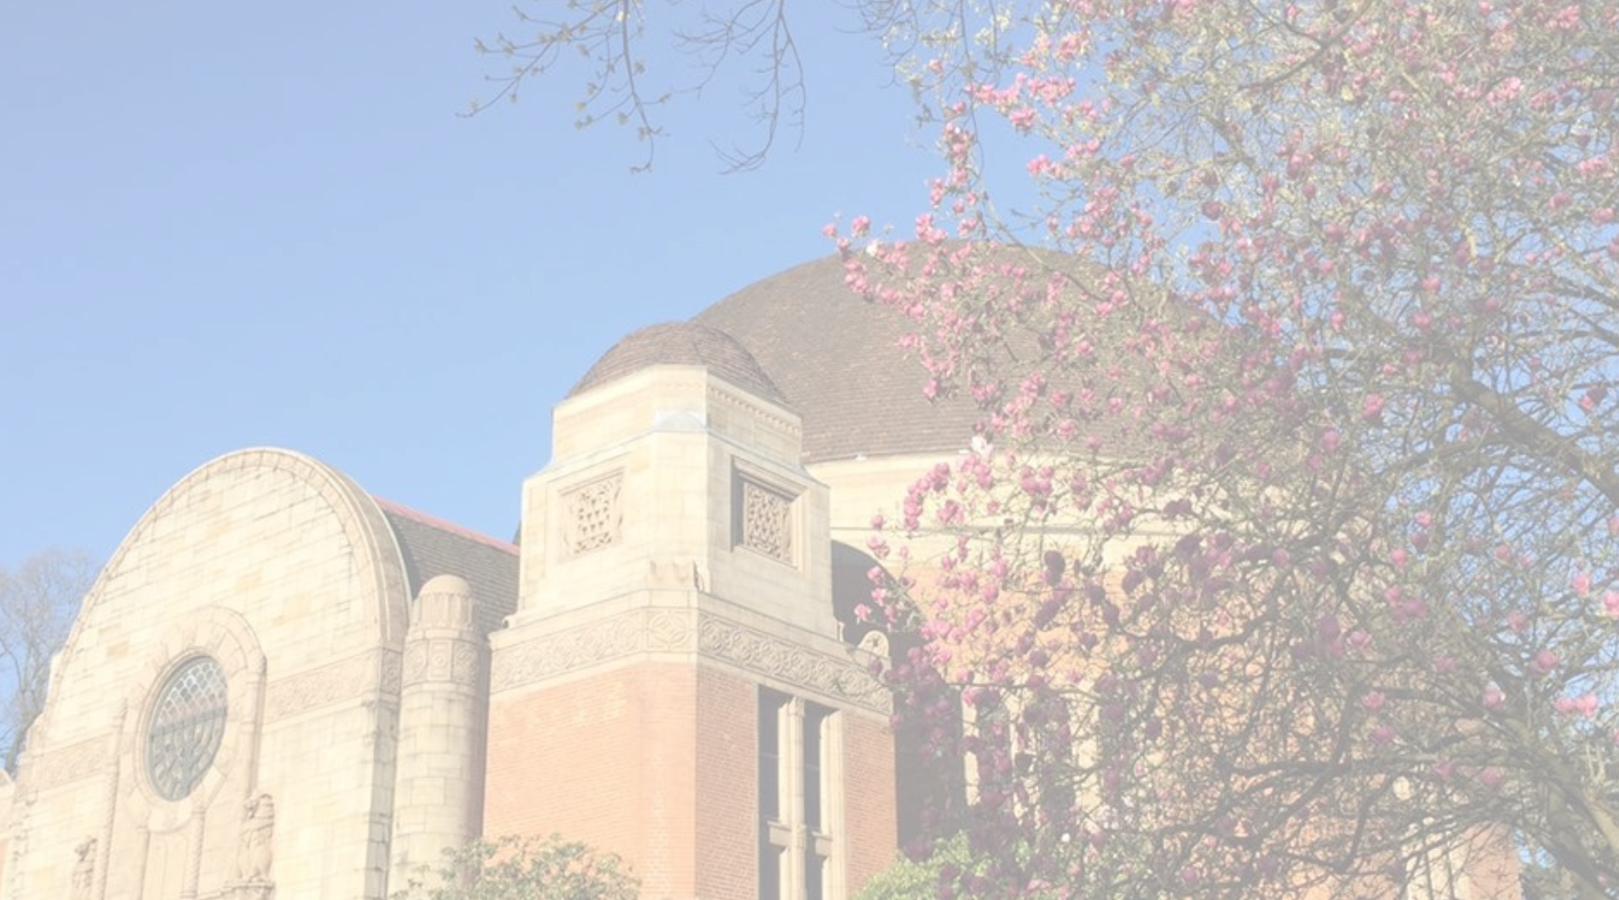
State of the Congregation
In Slides to Follow

Slide 7
Financial Highlights
Fiscal Year End 6/30/19 resulted in an increase of net assets of $302,965. $56,359 of this was an operational budget surplus.
At March 1, 2020, we were projecting meeting or slightly exceeding our FY20 operational budget. As of today, we still anticipate coming close to breaking even for FY20 operations.
On April 16, 2020 we received a PPP loan for $251,200. We expect the majority of this loan to convert to a grant at 6/30/20 and result in a surplus for FY20.
We are anticipating next year’s budget will have significant reductions in membership, tuition, and fundraising revenue.

Slide 8
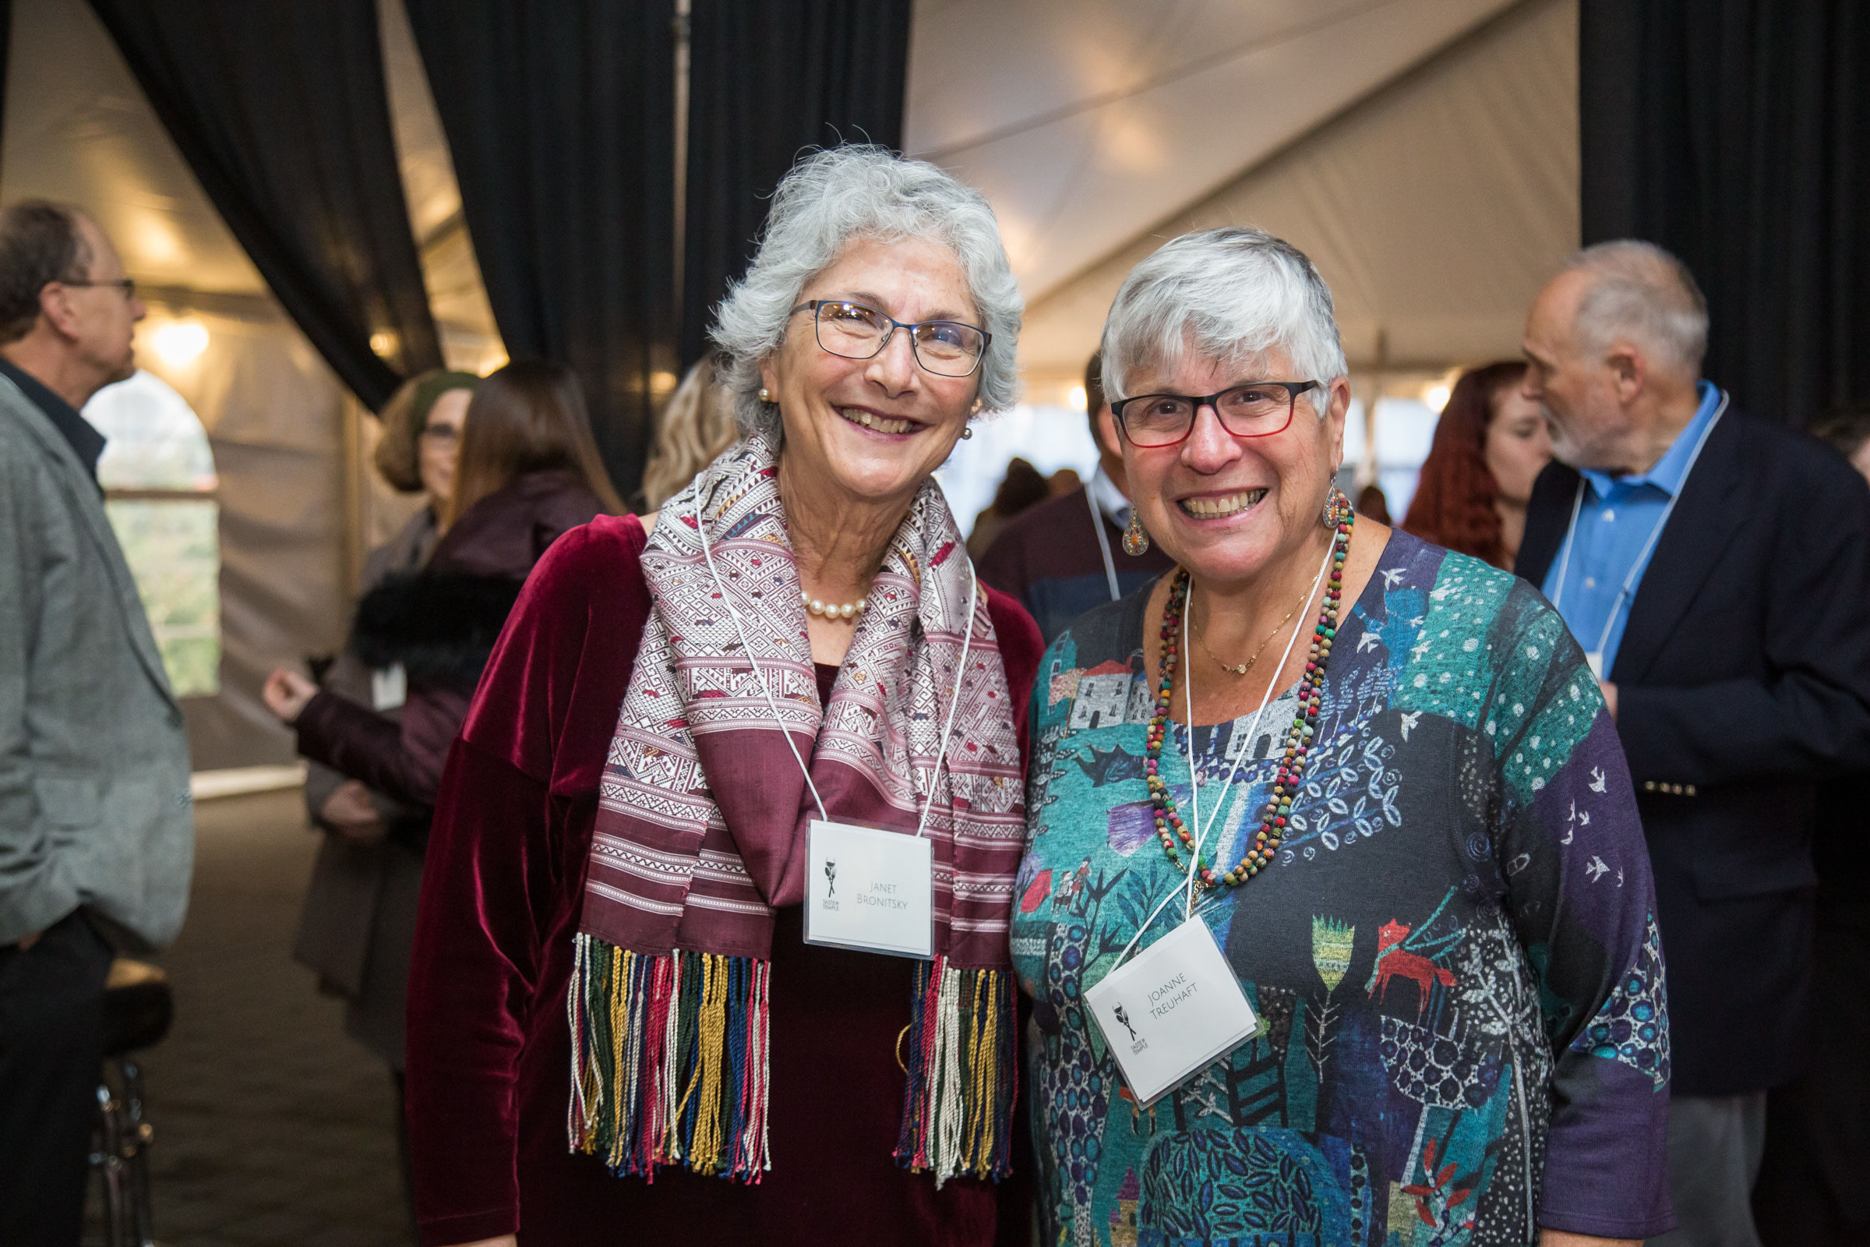
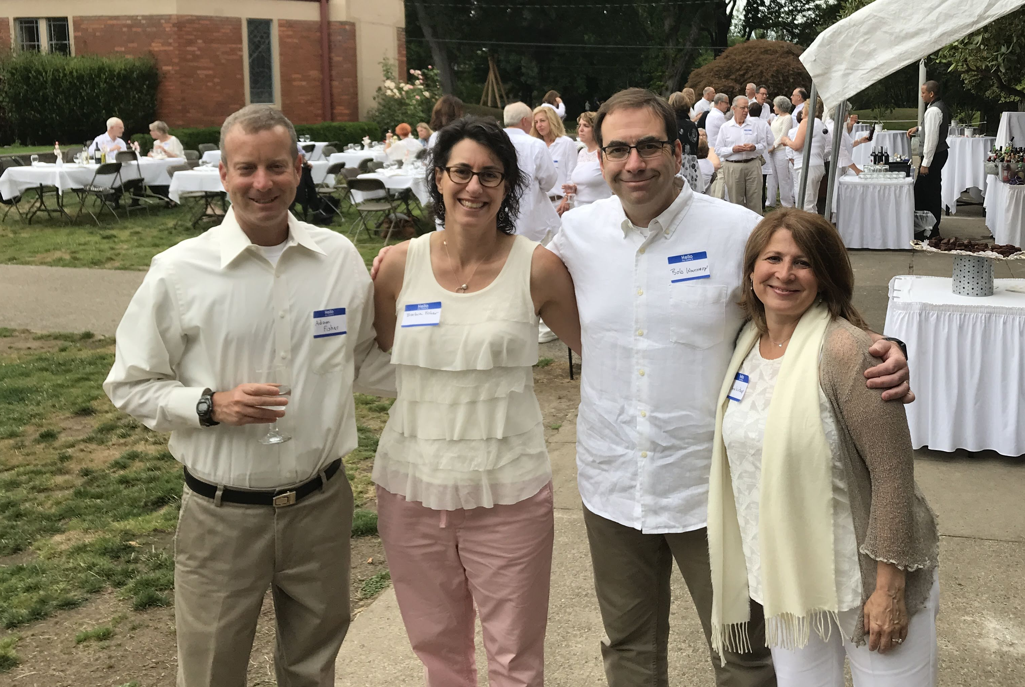
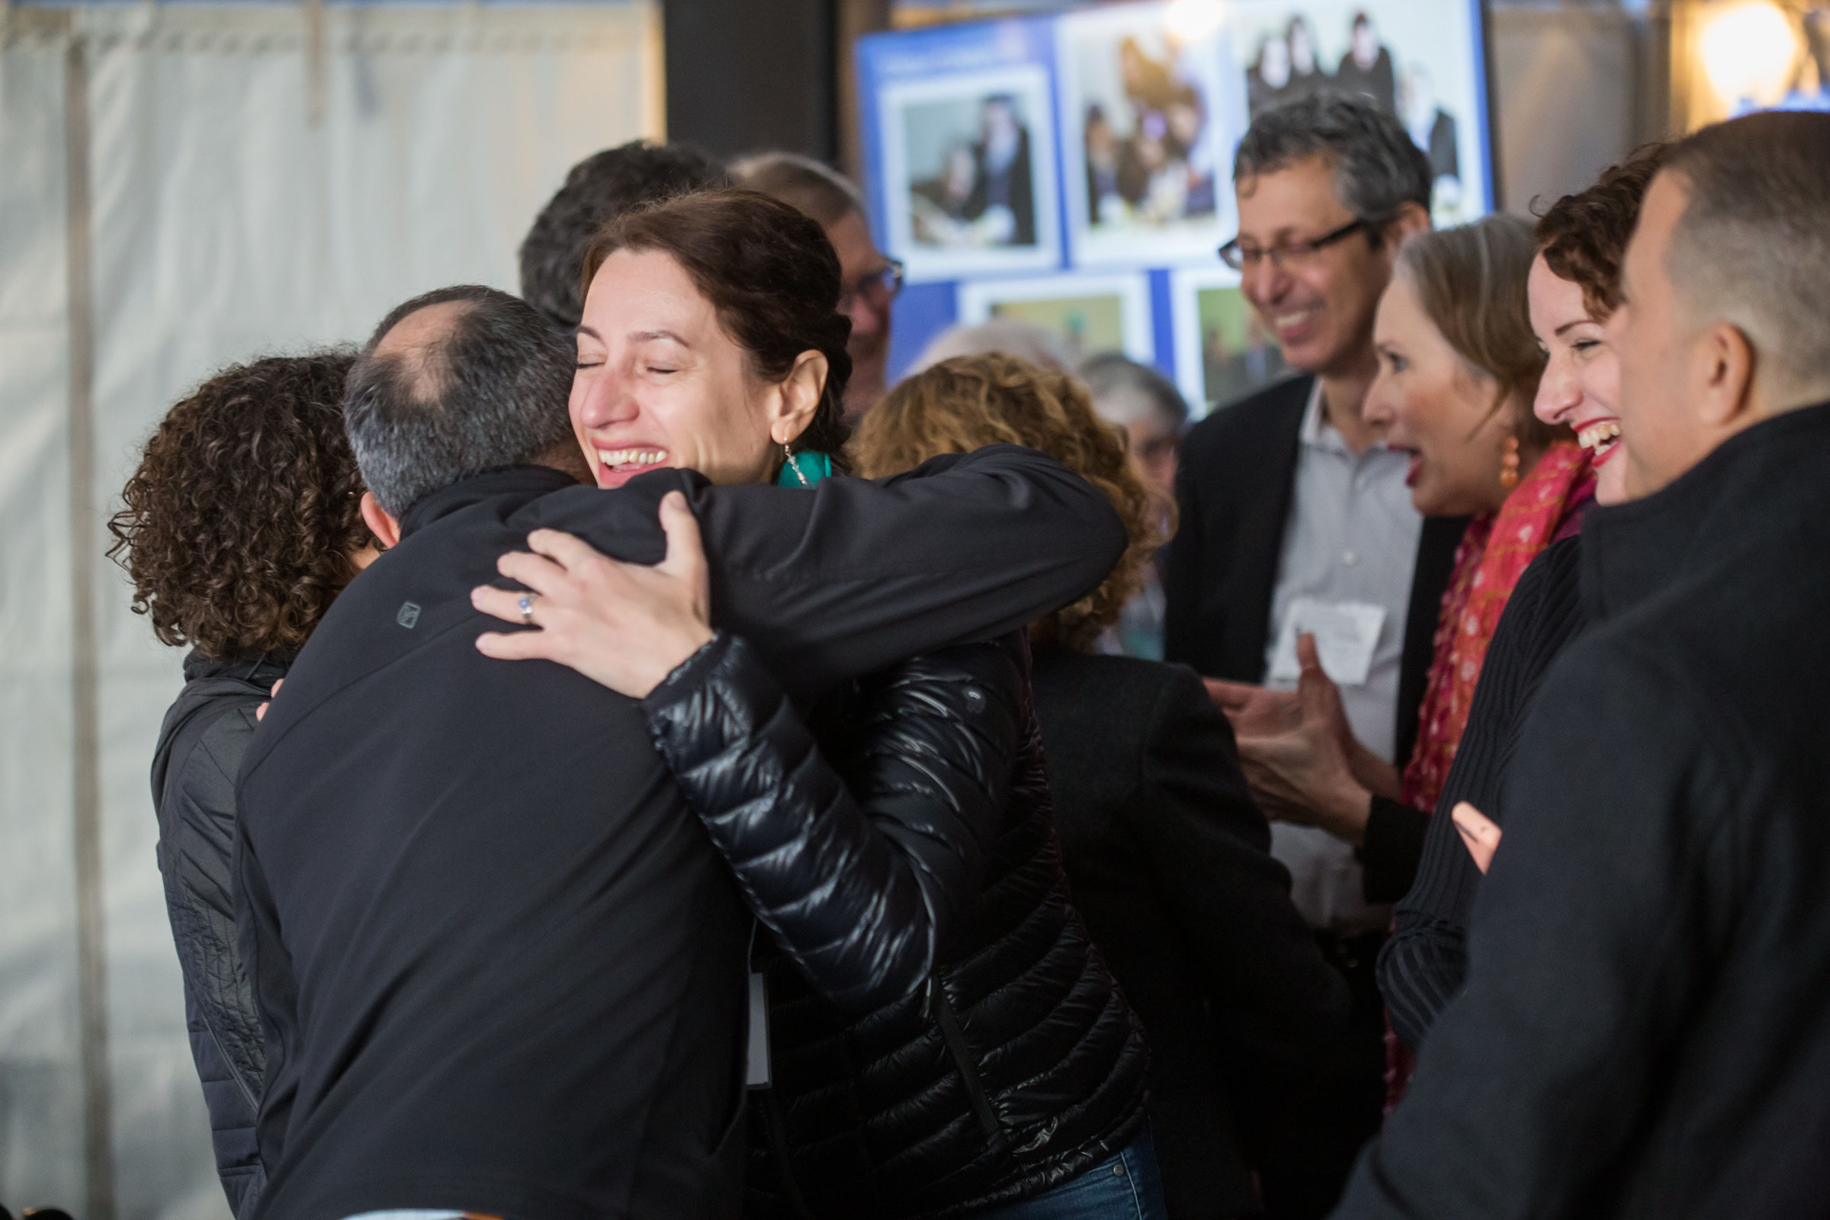
Membership
This year we had 61 families join the congregation, bringing our membership to 868 family units.
38 new families had children. Most new member children were 6 or 7 years old.
The fastest growing demographic are families with adults in their mid 30’s to mid 40’s with children.
26 new members are age 65 or older.

Slide 9
CBI Legacy Circle
Congregation Beth Israel is a participant in the Life and Legacy Program, which is a partnership of the Oregon Jewish Community Foundation and the Harold Grinspoon Foundation.
Congregation Beth Israel is proud to recognize every person/family who decides to create a Jewish legacy. A legacy gift includes any donation that lives on in perpetuity ensuring that CBI will be here to serve the generations to come. Different reasons have motivated each of our Legacy Circle donors to choose CBI as a beneficiary of their life’s work. We are fortunate that many of our members embraced the benefit that becoming a legacy donor brought to their lives and their memory. We continue to be honored by those who are now committing gifts through endowments, trusts, wills, and estate plans. We hope you will consider joining this esteemed and appreciated group and let us know of your intention so that we may include you in this growing list. Executive Director Josh Kashinsky welcomes the opportunity to discuss creating a Jewish legacy with you: (503) 222-1069 or josh@bethisrael-pdx.org.
Joy Alkalay* Anonymous William and Sydney Baer Carole Barkley Monte and Frances Bettman* Philip and Fay Blank* Henry* and Gerel Blauer George and Harriet* Bodner Lynn Bonner Howard and Raquel Byer Rabbi Michael and Cantor Ida Rae Cahana Lance and Deborah Caldwell Bernard Carr* Mandi and Stuart Chestler Daniel J. and Elizabeth O. Cohn* Edward* and Margery Cohn Marcia Colton Roger and Midge Cone James and Ilene Davidson Sylvia Davidson Barry and Bonnie Davis Berta M. Delman* Susan Diamond Nettie Director* Simon and Helen Director* Ned Duhnkrack Barbara Durkheimer Stuart and Leah Durkheimer* Lester Eisendorf* Judith Ann Epstein* Marie Louise Feldenheimer* Jen and Howard Feldman Martin Fishel* Eric and Robin Flamm Lynn and Charlie Gelber Thomas Georges III* and Linda Georges Thomas and May Georges* William and Shirley Gittelsohn* Richard and Beth Glassman Maurice* and Ilene Goldberg Arthur and Martha Goldsmith* David and Tiffany Goldwyn Douglas and Lila Goodman* Michelle and Steve Gradow Rachel Halupowski Craig Hartzman and James John Margaret Hasson Celia Heims* Irwin and Renee Holzman and family Benjamin* and Janice Isenberg Rabbi Rachel L. Joseph James and Rhonda Kennedy Steve and Marilyn Kerman Morris Klein* Charles and Lois Koteen Henry Kunowski and Kerstin Schulz Theodore D. Lachman* Robert and Sally Landauer Gerald and Evelyn Leshgold Glen and Lisa Levy Joan Lindholm* David and Beverly Lipman* Lee Lowenson Rita Lubliner* Arnold Maizels* Richard and Harriet Maizels Howard B and Robin L Marcus Lynn L. Marks Barry and Susan Menashe Joanne Van Ness Menashe and Joe Menashe Ruben and Elizabeth Menashe Robert and Robin Mesher Alan and Lana Miller Edith O. Miller*

Slide 10
CBI Legacy Circle
Congregation Beth Israel is a participant in the Life and Legacy Program, which is a partnership of the Oregon Jewish Community Foundation and the Harold Grinspoon Foundation.
Congregation Beth Israel is proud to recognize every person/family who decides to create a Jewish legacy. A legacy gift includes any donation that lives on in perpetuity ensuring that CBI will be here to serve the generations to come. Different reasons have motivated each of our Legacy Circle donors to choose CBI as a beneficiary of their life’s work. We are fortunate that many of our members embraced the benefit that becoming a legacy donor brought to their lives and their memory. We continue to be honored by those who are now committing gifts through endowments, trusts, wills, and estate plans. We hope you will consider joining this esteemed and appreciated group and let us know of your intention so that we may include you in this growing list. Executive Director Josh Kashinsky welcomes the opportunity to discuss creating a Jewish legacy with you: (503) 222-1069 or josh@bethisrael-pdx.org.
Lloyd and Beverly Miller* Ted Nelson and Curt Shaffstall Robert Neuberger* Jeanne Newmark John and Hulda Neustadter* Kenneth and Debra Novack Jackie and Burton* Nudelman Victor Nudelman* Henry* and Nancy Oseran Raymond and Dorothy Packouz* Mark and Judy Peterman Randie and Mark Peterson Robert and Rita Philip Harold and Jane Pollin Gerald and Lois Poplack* Anita Reinhorn* Philip and Dorothy Reiter Laurie and Bert Rogoway Gayle Romain Millard and Carolyn Rosenblatt* Alan and Eve Rosenfeld Lloyd B. Rosenfeld* Sally Rosenfeld and Andrew Frank Tiffany and Eric Rosenfeld John and Marti Rosenthal Lawrence Rosenthal* Franklin Rosumny Richard and Deanne Rubinstein Arnold* and Rose Rustin Hal Ruthizer* Bunny and Jerry Sadis Ken and Loree Sakai Benjamin Sandler and Laura Jamerson Jeaneatta “Rusty” Sautter* Norman* and Elaine Savinar Ralph and Bernice Schlesinger* Gilbert* and Thelma Schnitzer Harold* and Arlene Schnitzer Harold and Arlene Schnitzer: CARE Foundation Leonard* and Lois Schnitzer Manuel and Edith Schnitzer* Sandra Schnitzer Herbert and Shirley Semler Ruth* and Larry Semler Joel Seres and Sandra Lamer Seres Christopher Setzer Douglas and Dorothy* Sherman Estelle Director Sholkoff* Michael Simon and Suzanne Bonamici Milton and Marilyn Singer* Jill Newman Slansky Mortimer and Alice Mary Solomon* Richard Solomon and Alyce Flitcraft Ladislao and Martha Soltesz Ruth Spear* Bruce Spiegel* Donald Spiegel and Deborah Davis-Spiegel Arthur Steinhorn Frances Stern* Marvin* and Gloria Swire Ron* and Marcy Tonkin Bianca and Tony Urdes Robert P. Weil* Joella Werlin and Robert *Autrey Isam and Rose White* Jeff and Lynn Wolfstone Jennifer and Kenneth Zeidman Jerome and Zelda Zeidman* Alan* and Janet Zell
*Of blessed memory

Slide 11
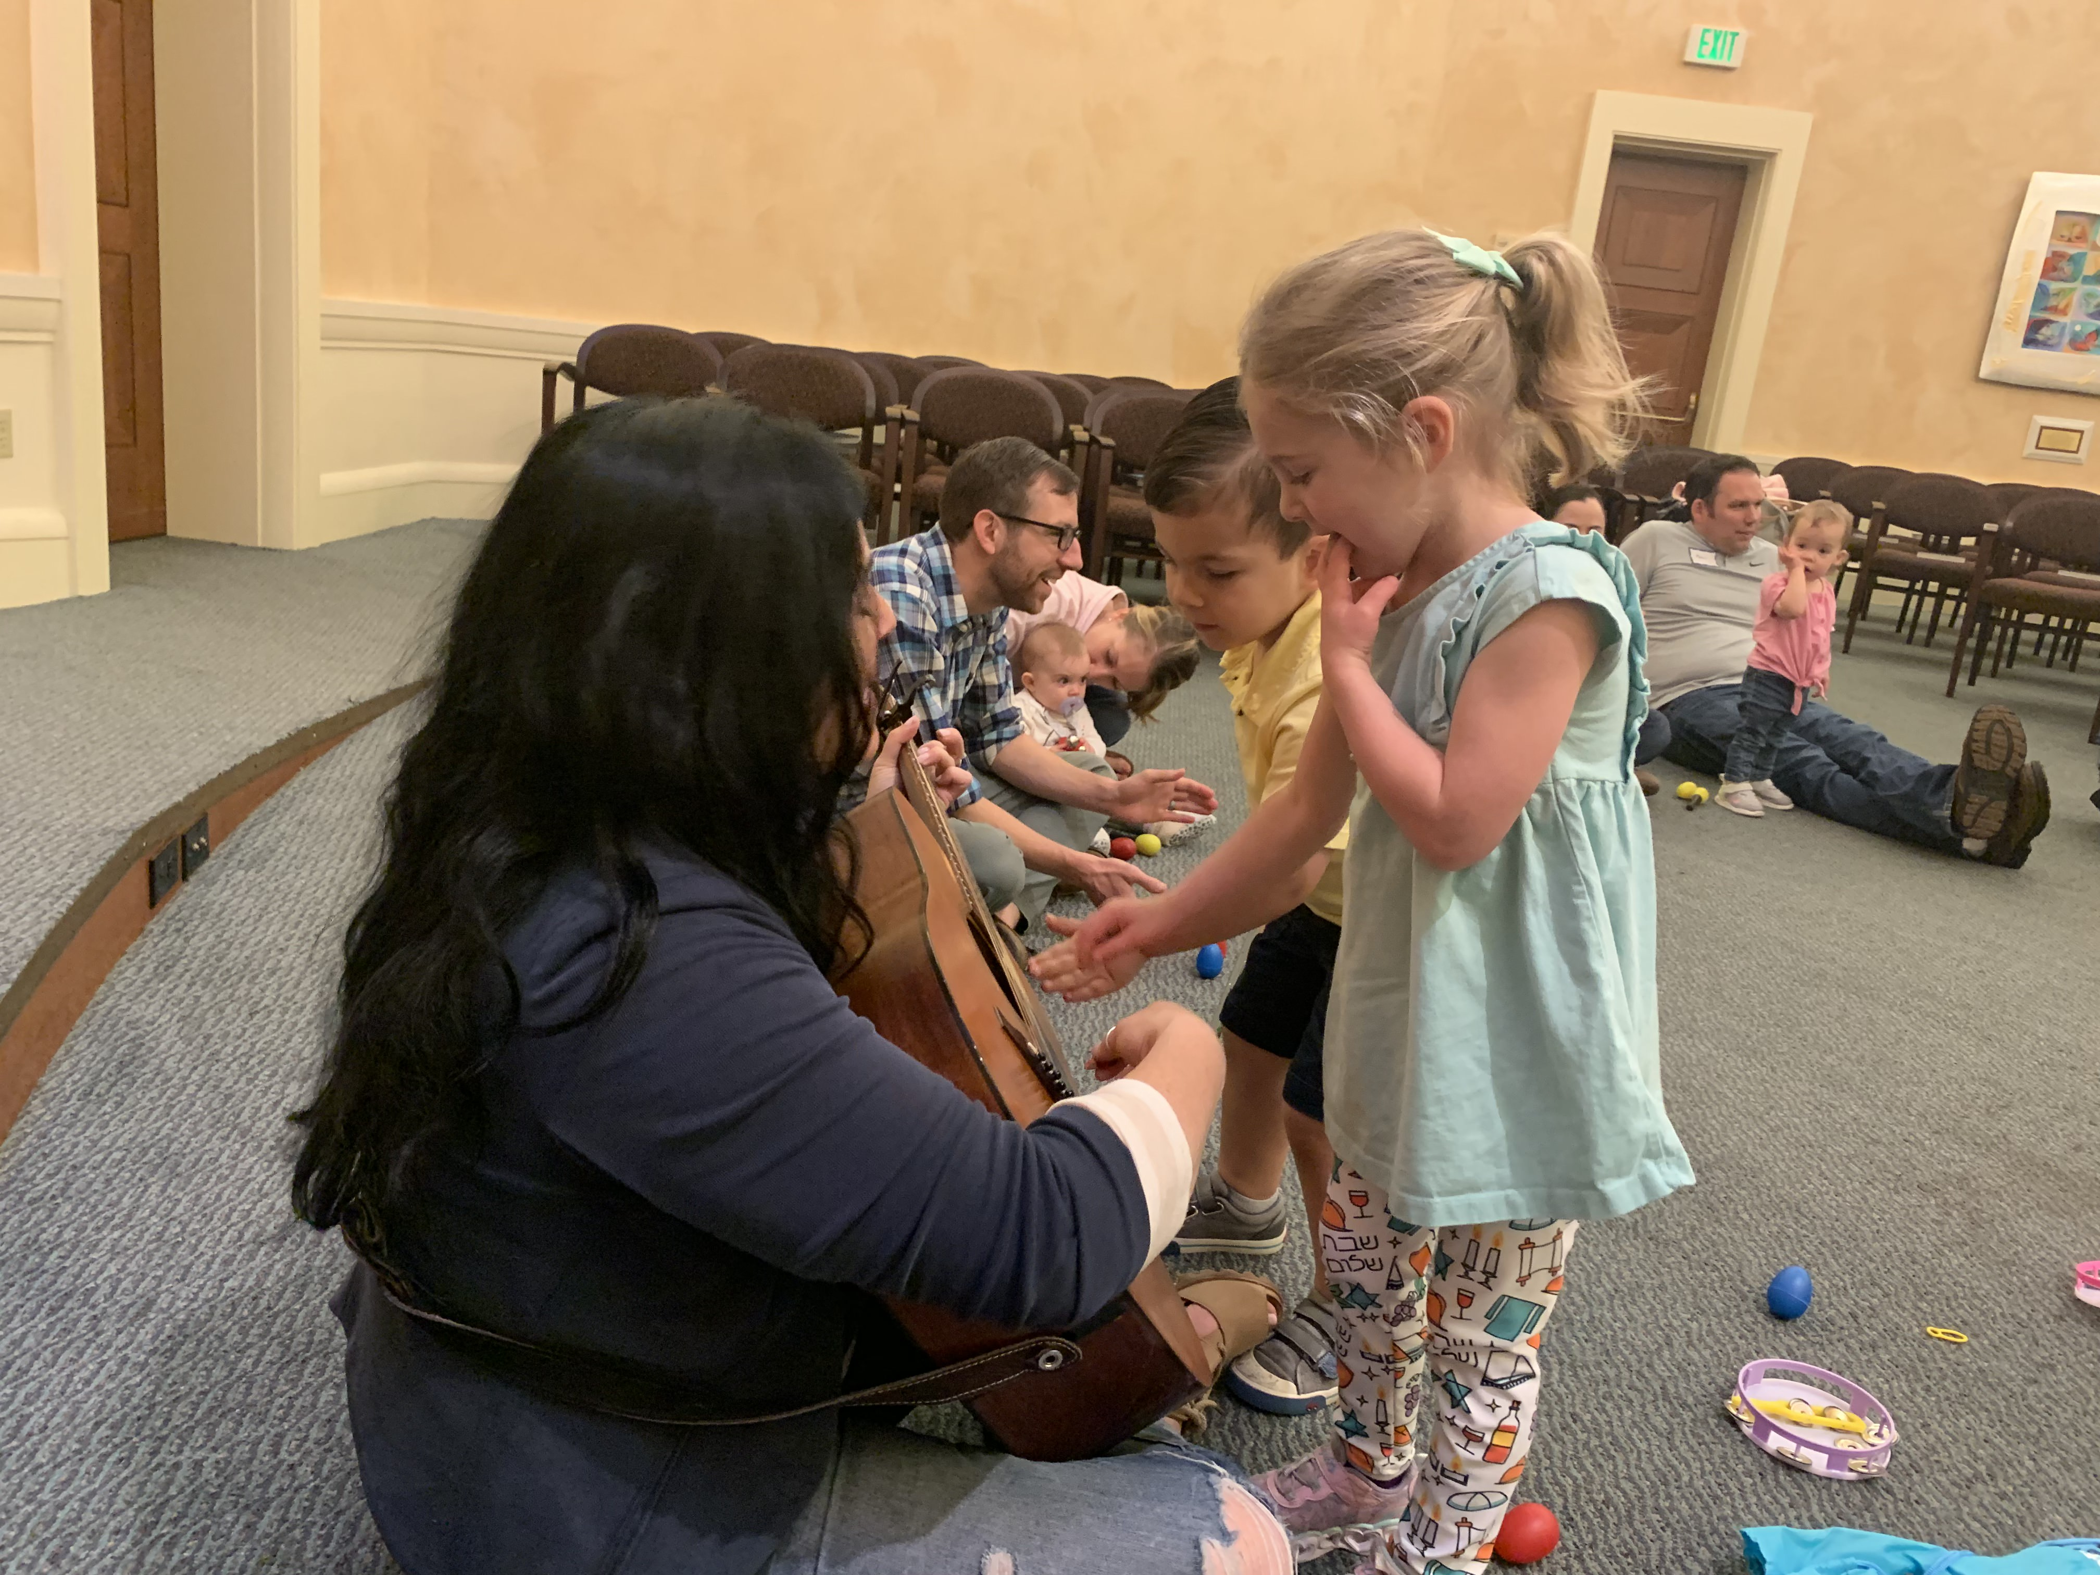
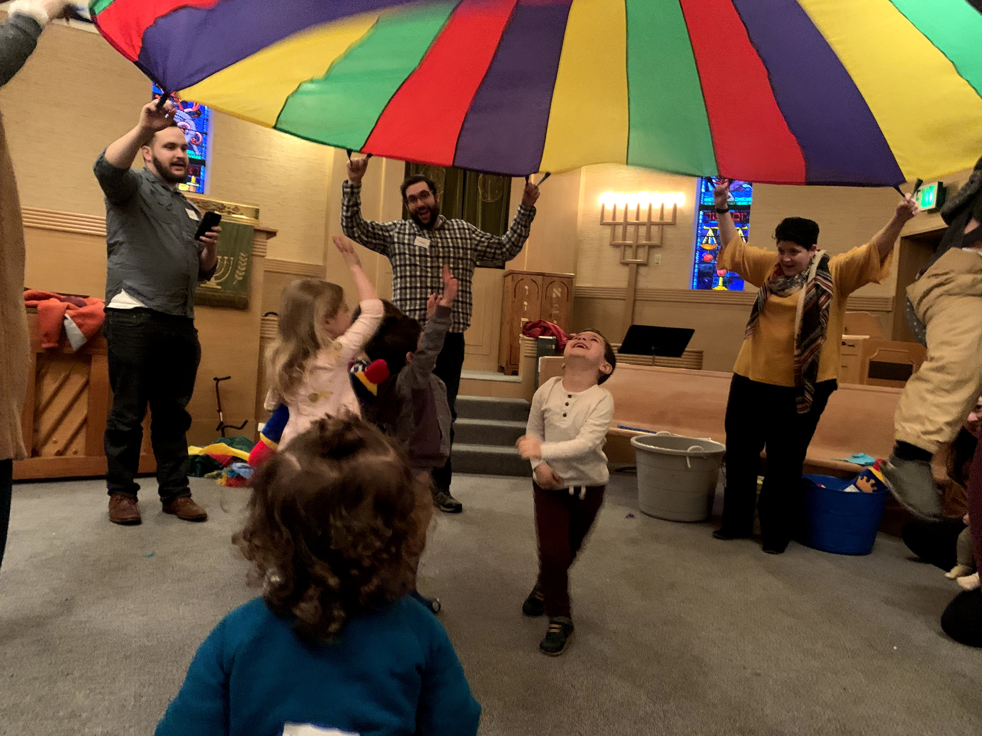
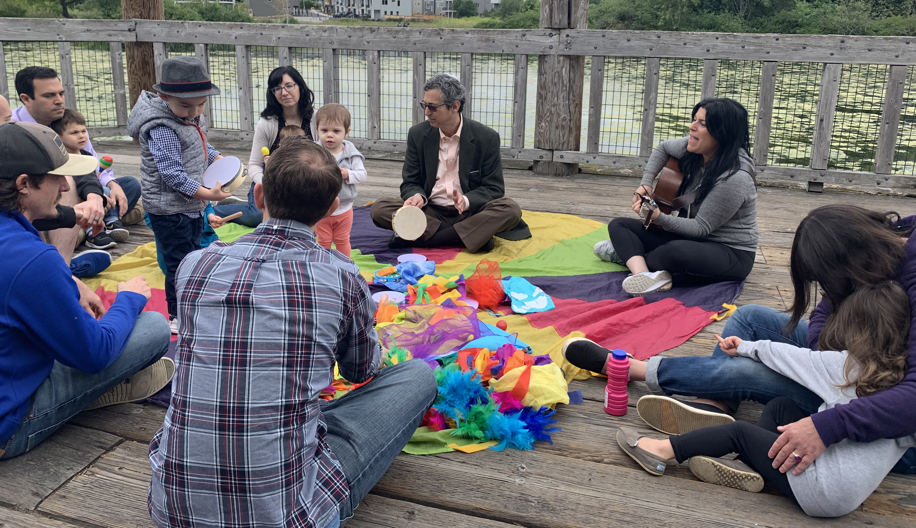
Mini Mensch
Of the 23 students in the Pre-K classroom, 9 started their connect to us through Mini Mensches.
6 families who joined in the last year started their connection to us through Mini Mensches.
Since going online, the pre-recorded Tot Shabbats have had an average of 50 views.
An average of 8 families attended in-person Tot Shabbats.

Slide 12
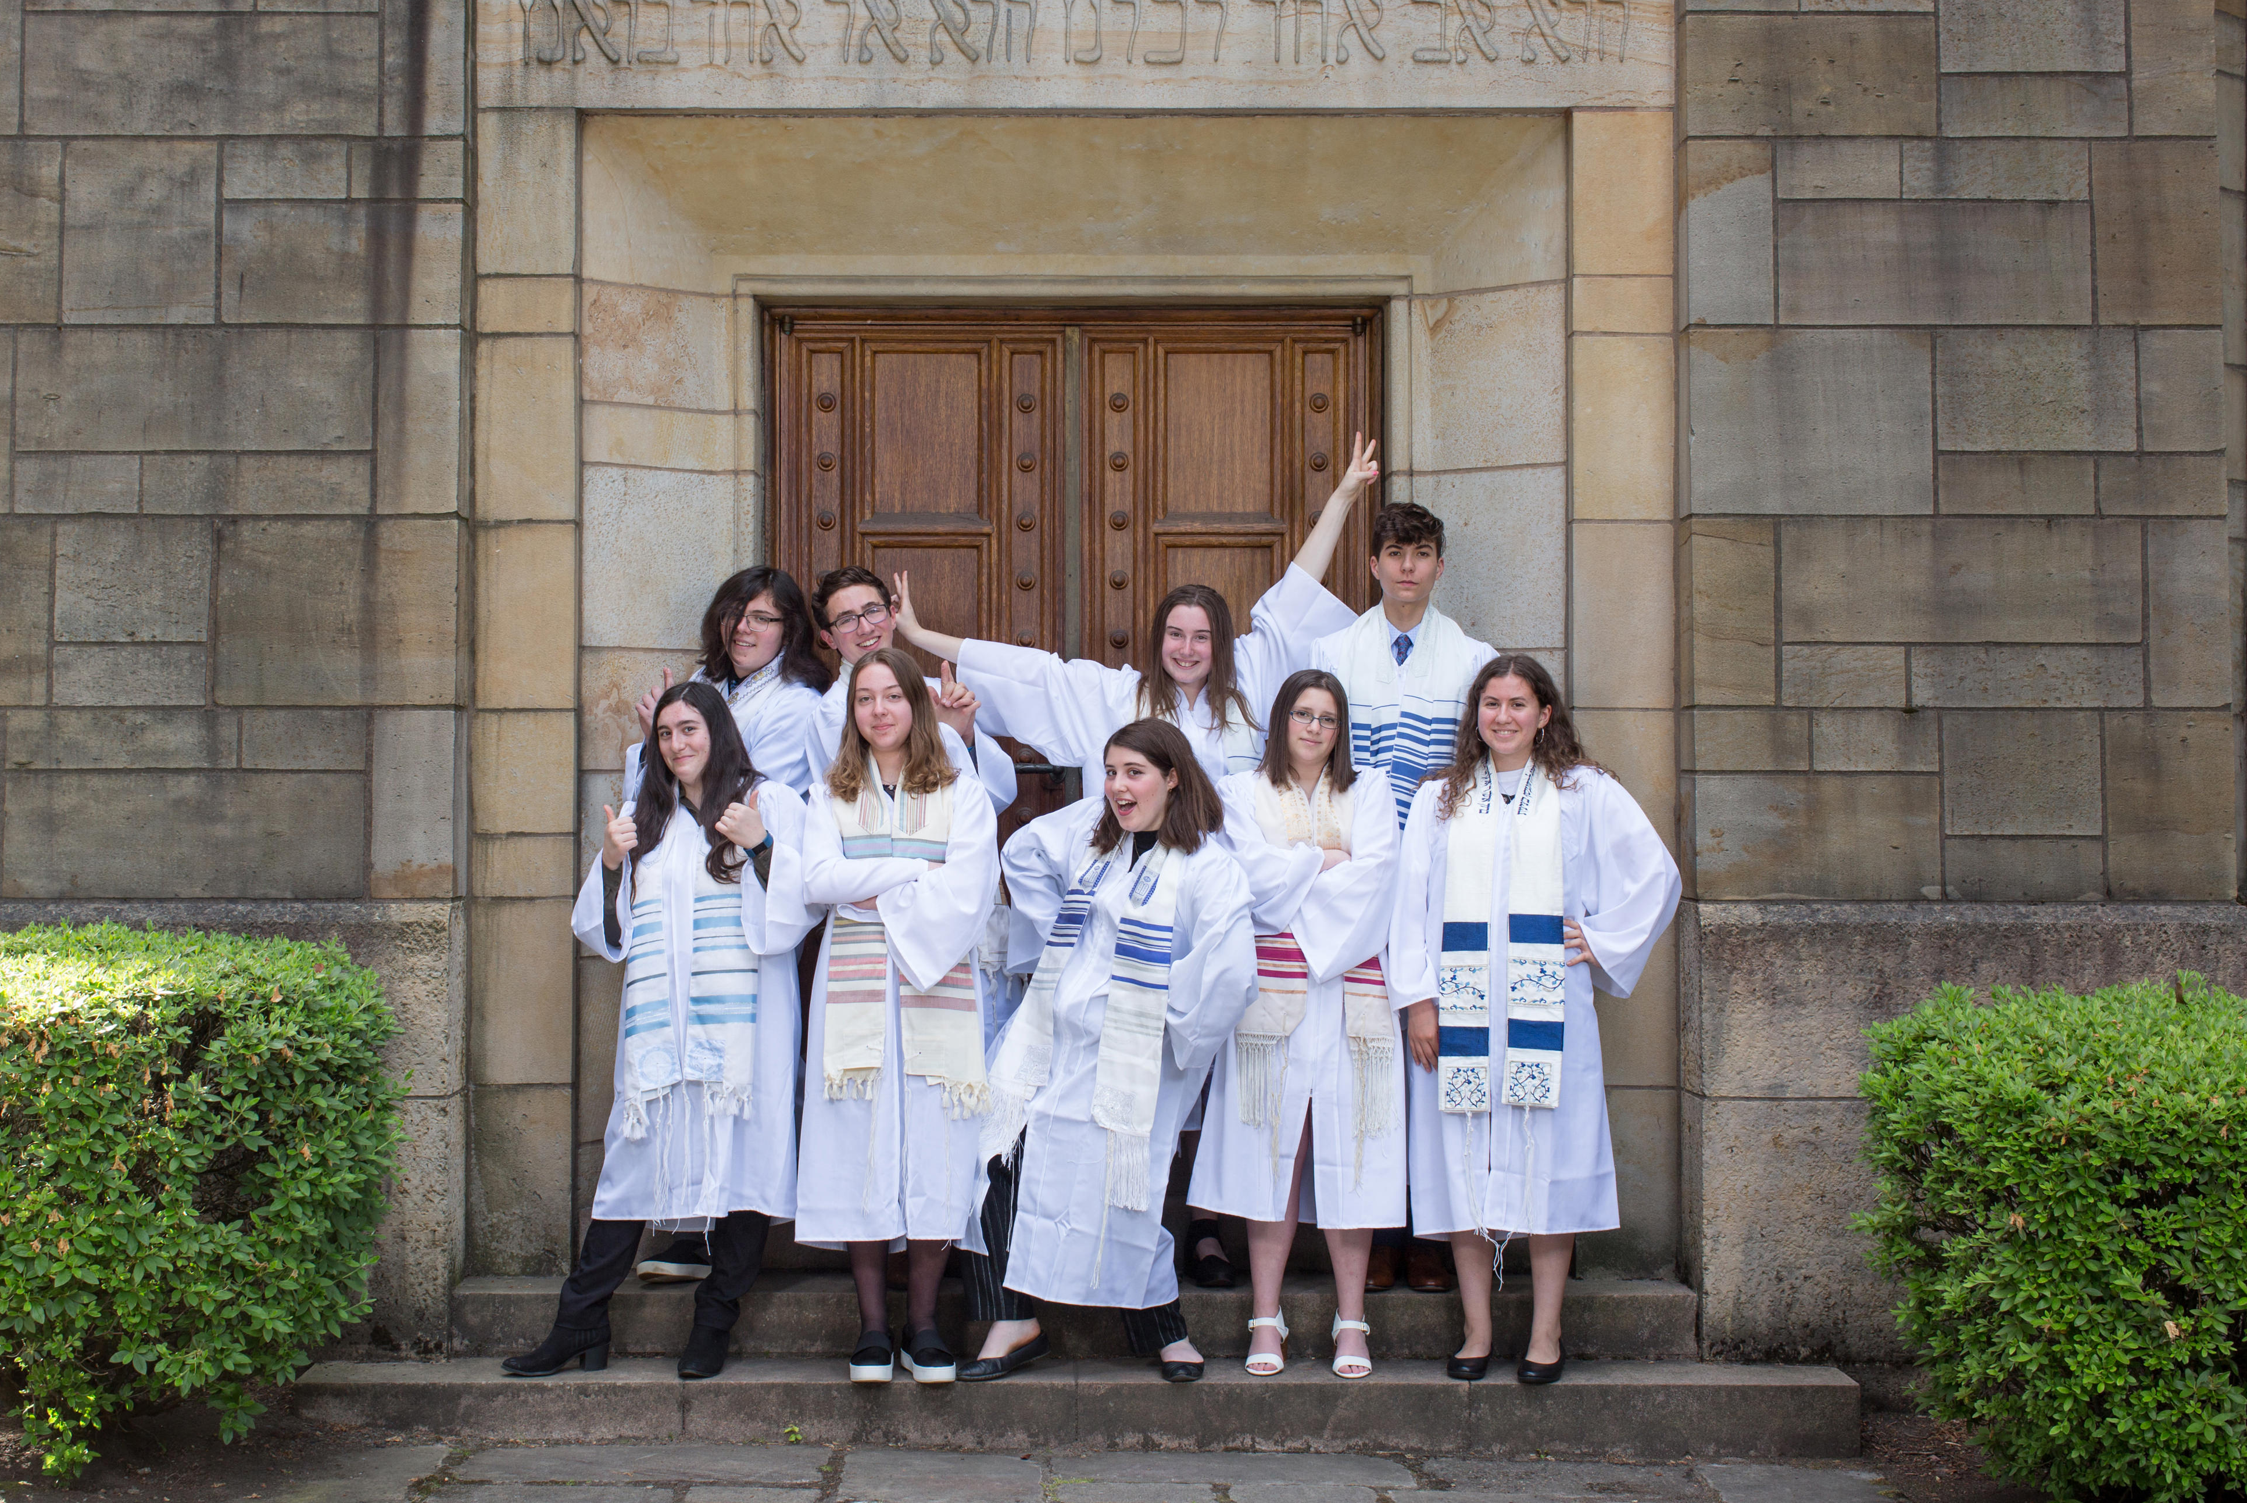
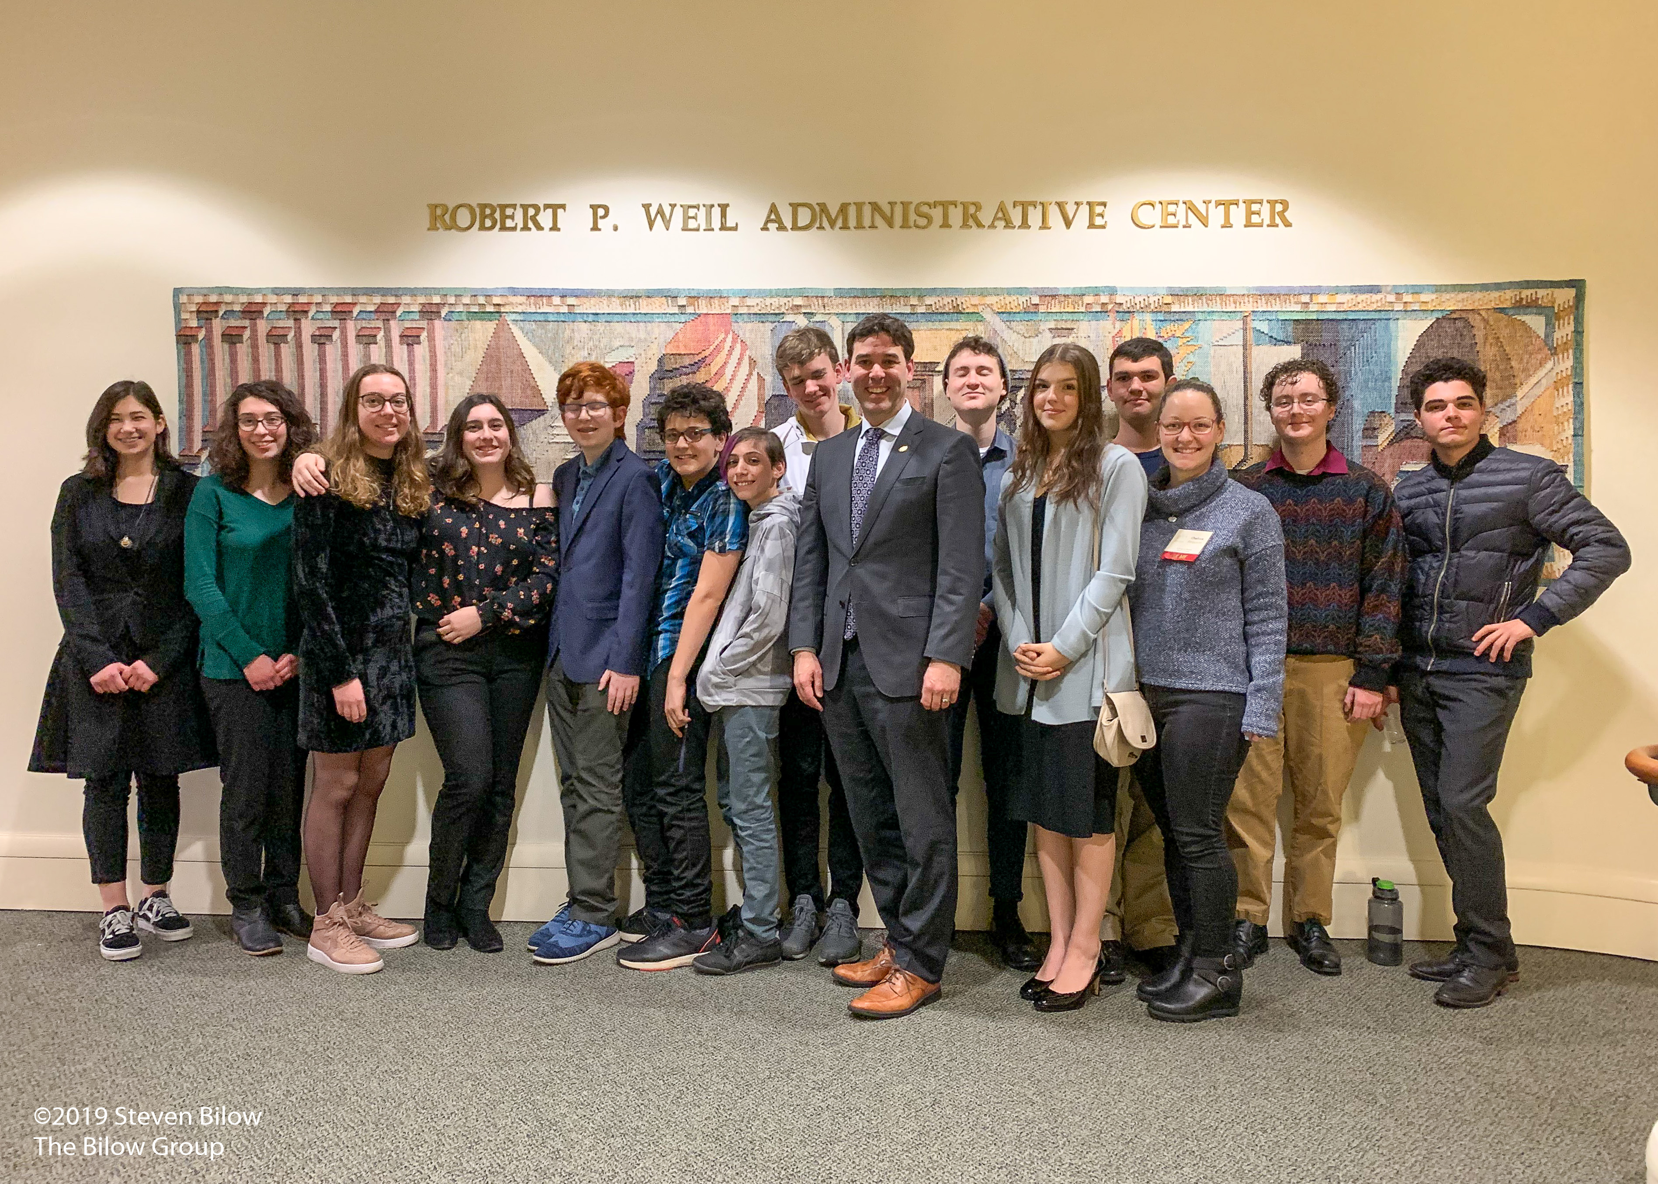
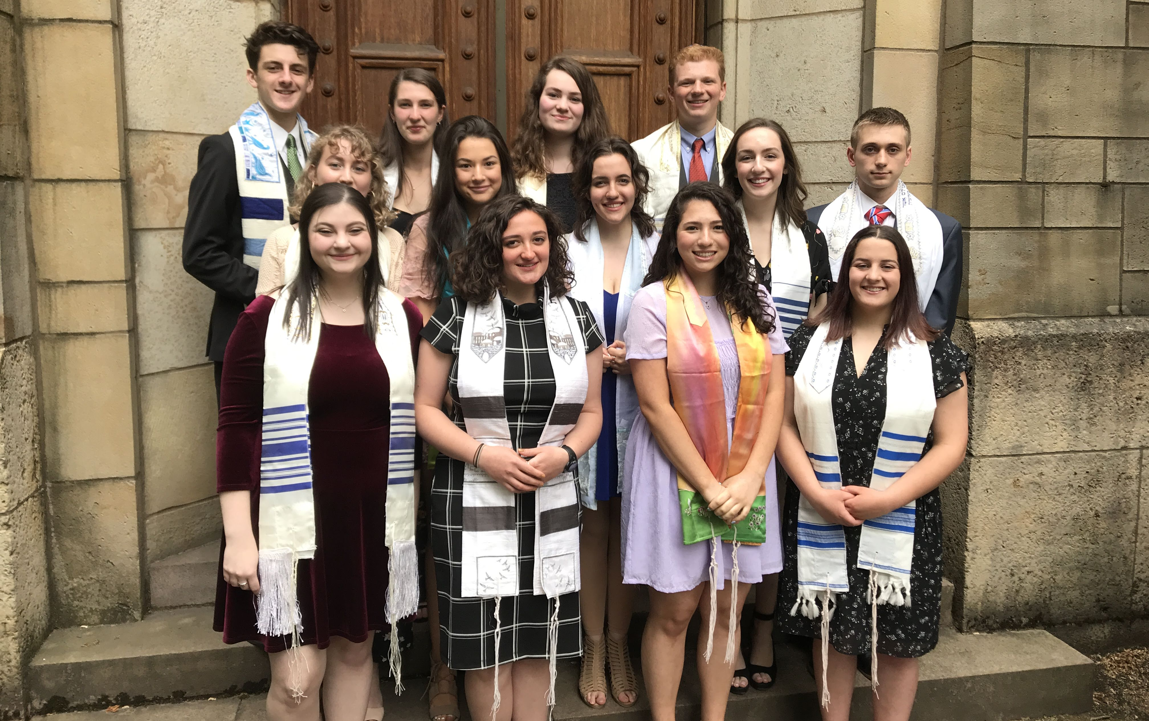
Education
Religious School had 323 students enrolled this year.
Since going online, Mishpacha Minyan has had 60-70 families participate on average.
44 teens went on our out of state trips this year, 9 were not enrolled in Religious School.
PARTY opened Leadership Council as an entryway to teen leadership; all members ran for a position for the 2020-2021 year.
Dor Chadash had an average of 15 students per event.
The first day of virtual religious school had 286 students attend, more than an average day of Religious School.
Average attendance went from 82% to 76% once Religious School went online.

Slide 13
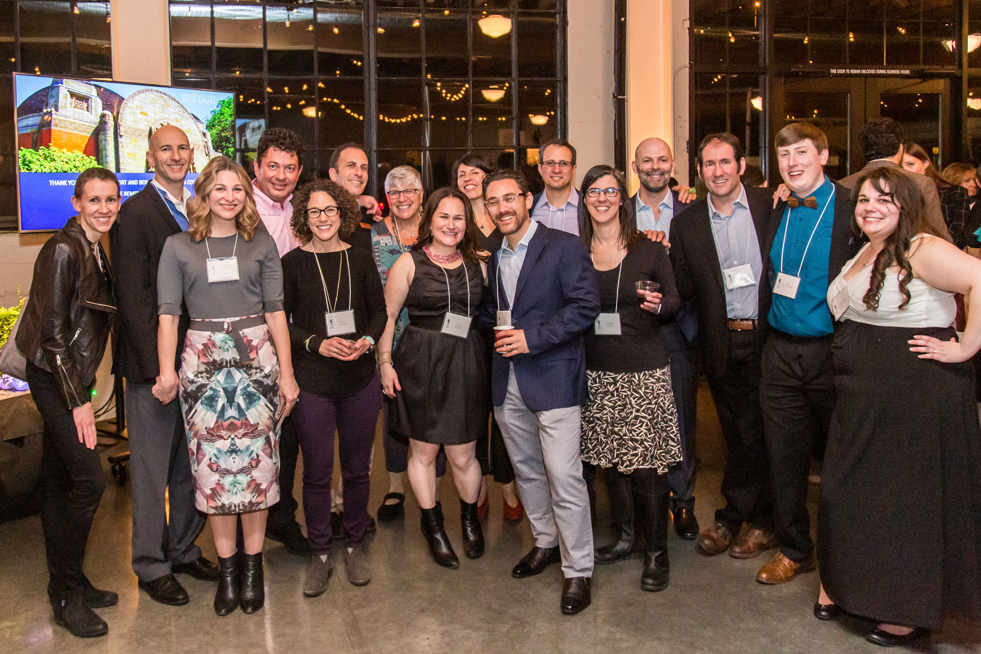
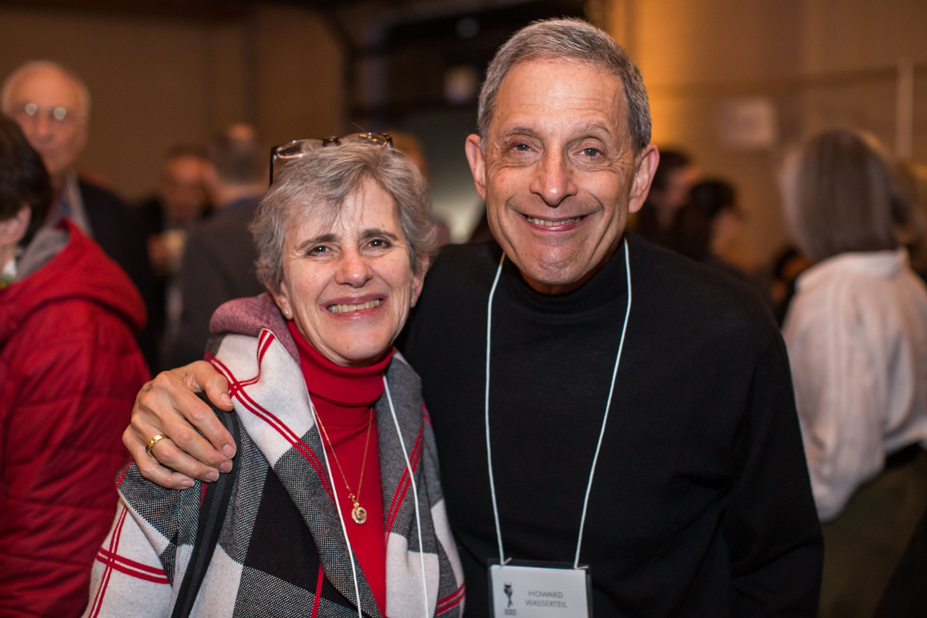
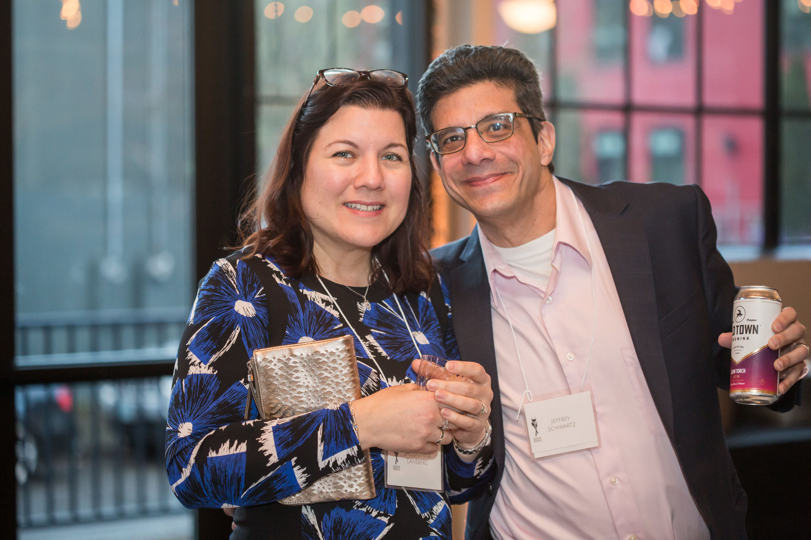
Development
518 families gave tributes this year.
58 families participated in Every Family Initiative (EFI).
Taste of Temple raised $185,000.
361 people attended Taste of Temple.
59 donors gave $132,500 in Taste of Temple sponsorship.
We have 145 Legacy Circle members.

Slide 14
Thank you to our Donors
Michael Adler and Molly Newcomer
George and Sharon Alexander
Michael and Margie Anton
Jonathan and Bonnie Barg
Kevin and Rachelle Barrett
Lester and Heather Baskin
Brad and Janice Berman
Gerel Blauer
Janet Bronitsky and Mark Suprenand
Dan Hurwitz and Debra Brooks
Connie Cambreleng
William and Judy Cappleman
Stuart and Mandi Chestler
David Cohen and Lee Anna Jones
Fred Cohen and Randy Zasloff
Marcia Colton
Will and Melanie Dann
Barry and Bonnie Davis
Dick and Cameron Davis
Dr. Pike Dentistry for Children
Thomas and Susie Desmond
Lou and Kathleen Doctor
James Monteith and Ned Duhnkrack
Richard and Jill Edelson
John and Sarah Epstein
Howard and Jen Feldman
Paul and Sherry Fishman
Eric and Robin Flamm
Andrew Frank and Sally Rosenfeld
Josh and Amy Frankel
Eric and Rebecca Friedenwald-Fishman
Stacy and Sharon Friedman
Morrie Galen
Bill and Bev Galen
Zanley and Claire Galton
Judah and Ali Garfinkle
Linda Georges
Ted and Connie Gilbert
Leonard and Yvonne Gionet
Barbara Glazer
David and Tiffany Goldwyn
Doug Goodman
Greg Goodman and Susan Schnitzer
Mark and Christi Goodman
Bill June and Susan Graber
Steve and Michelle Gradow
Jonathan and Lisa Greenleaf
Craig Hartzman and James John
Dan Henig and Jamie Rice
Andrew Herman and Tina Szczesniak
Gary and Joyce Hoffman
John Harland and Janet Hoffman
Janice Isenberg
Ken and Karen Janoff
Howard Jarvis, DMD, LLC and Tiffany Goldwyn, DMD
Rabbi Sam and Dori Joseph
Josh and Michelle Kashinsky
Leslie Kelinson
Jim and Rhonda Kennedy
Paul and Arlene Koenigsberg
Donald and Judith Kramer
Mrs. Jean Krosner
Irv Levin and Stephanie Fowler
Glen and Lisa Levy
Carol Lewis
Kathleen Lewis
Ken Lewis
Keith Linn and Lisa Ludwig Linn
Dick and Harriet Maizels
Howard and Robin Marcus
Phillip Margolin

Slide 15
Thank you to our Donors
Lynn Marks
Gary and Sheryl Martel
Steve and Robin McCoy
Ruben and Liz Menashe
Page and Lynn Mesher
Barney and Susan Milstein
Christie Moore and Stacy Lewis
Corey Morris-Singer and Andrew Morris-Singer
Doug Muir and Shelley Adams-Muir
Roscoe Nelson III and Debra Nelson
Ted Nelson
Rosalyn Neuberger
Dan and Tracy Oseran
Nancy Oseran
Pete Hammerschmidt and Judith Pakosinski
Bob and Rachel Papkin
Leslie Peltz
Bob and Rita Philip
Allan and Marney Pike
Steven Pike and Allison Sneider Pike
Ryan and Sarah Pitman
Richard and Shirley Plotzker
Harold and Jane Pollin
Joshua and Amy Remick
Jim and Michael Richman
Stephen and Leslie Robinson
Paul and Gayle Romain
Alan and Eve Rosenfeld
James Rosenbaum and Sandra Lewis
John and Marti Rosenthal
Rosemarie Rosenfeld
Warren Rosenfeld and Sheryl Langerman
Eleanore Rubinstein
Rick Rubinstein, Jr. and Jill Rubinstein
Jerry and Bunny Sadis
Michael and Linda Salinsky
Arlene Schnitzer
Dori Schnitzer
Thelma Schnitzer
Lois Schnitzer
Dave Smith and Libby Schwartz
Richard Schwartz
Joel and Sandra Seres
Michael Freeman and Lynda Shapiro
Tom and Megan Shipley
Ron and Sheila Silver
Michael Simon and Suzanne Bonamici
Jonathan Singer
Rodger Sleven and Marcella Flores
Nate Smith and Anna Epstein
Paul Snyder and Amy Malkin Snyder
Martha Soltesz
Bruce Spiegel
Mardi Spitzer
Harley and Robyn Spring
Chester Edwards and Lynn Tobias
Brad and Michelle Tonkin
Cheryl Tonkin
Rena Tonkin
Marcy Tonkin
Bill and Joanne Treuhaft
Tony and Bianca Urdes
Jason Waxman
Sharon Weil
Michael Weiner and Kathy Davis-Weiner
Jeff and Lynn Wolfstone
Ron and Nancy Wyden
Phil Zald and Heh Shin Kwak
Bob Zelinka

Slide 16
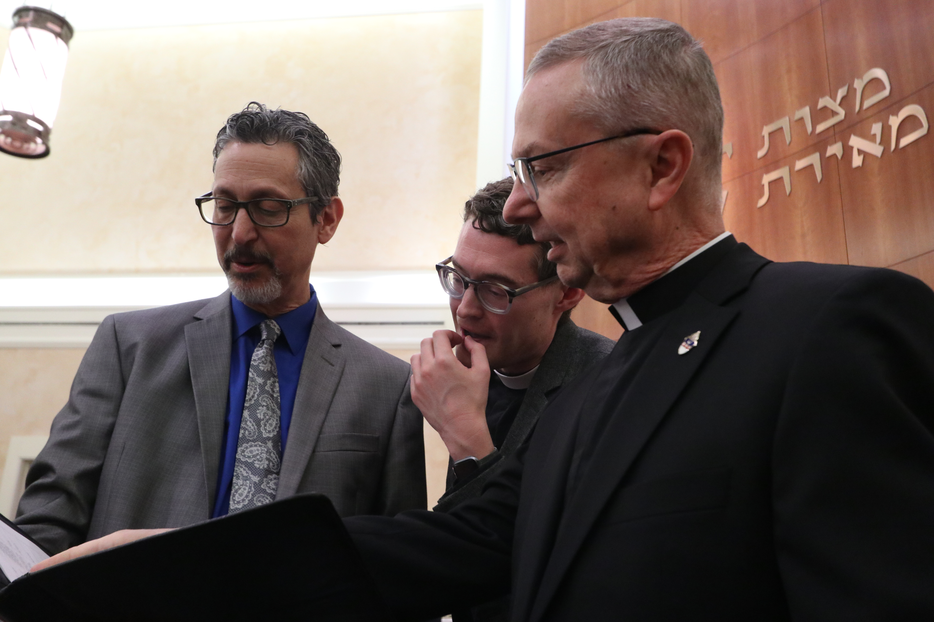
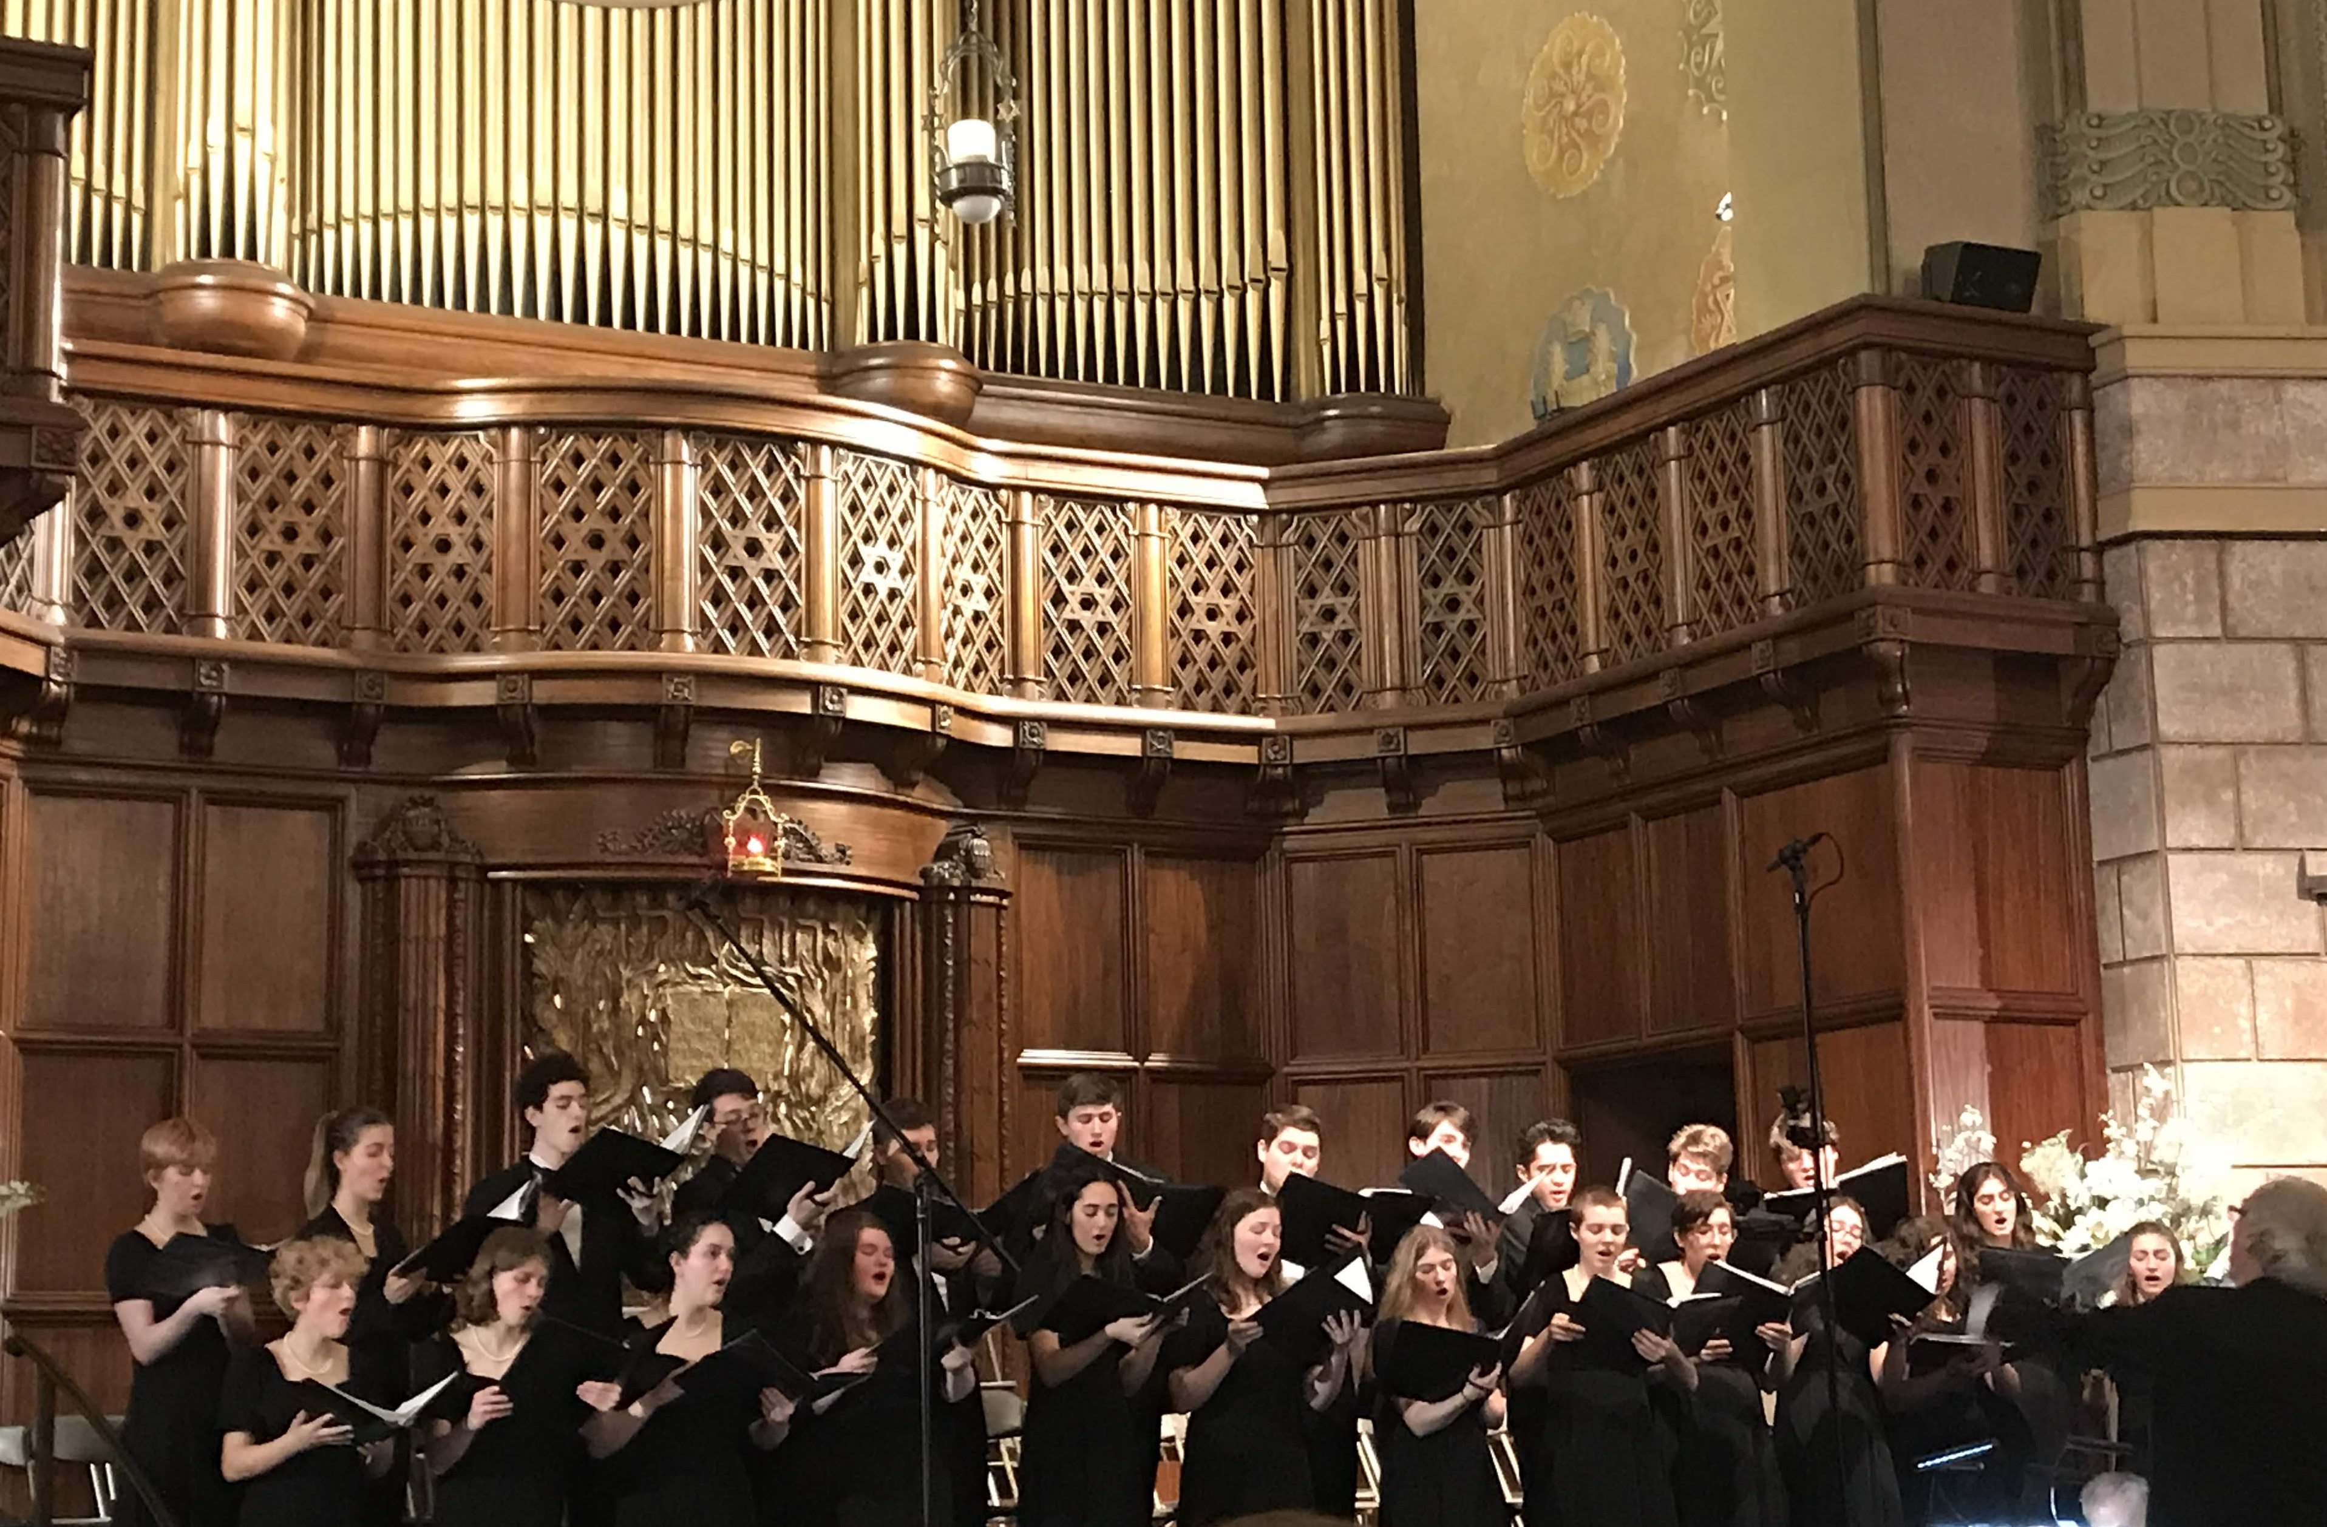
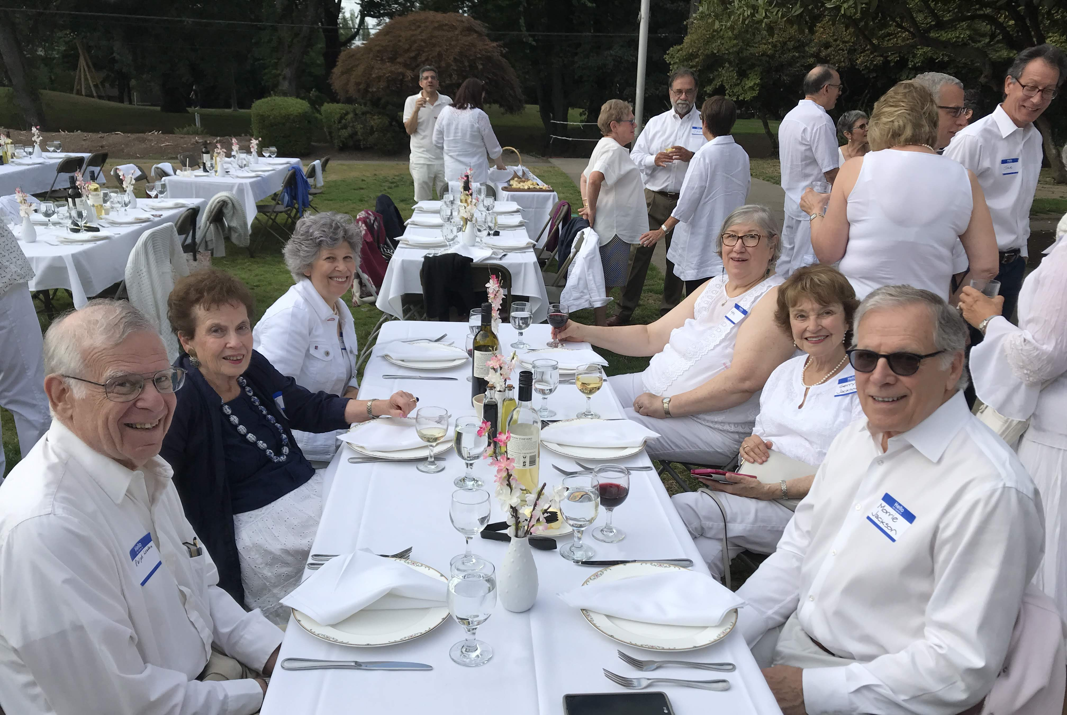
Adult Education
Congresswoman Suzanne Bonamici participated in a Q & A.
Several programs including the Spring 2021 trip to Warsaw, Krakow, Berlin, and Prague were put on hold.
They also engaged in and plan to continue to engage in discussions around prophets of both Judaism and other religions.
A conversation and book signing by investigative reporter and author of “Race Against Time,” by Jerry Mitchel was held.
Architect Henry Kunowski and architectural historian Thomas Hubka presented on the Art of Wooden Synagogues in Poland.
Ron Silver presented on the influence of Jewish Prophets on the Leaders of the Civil Rights Movement.

Slide 17
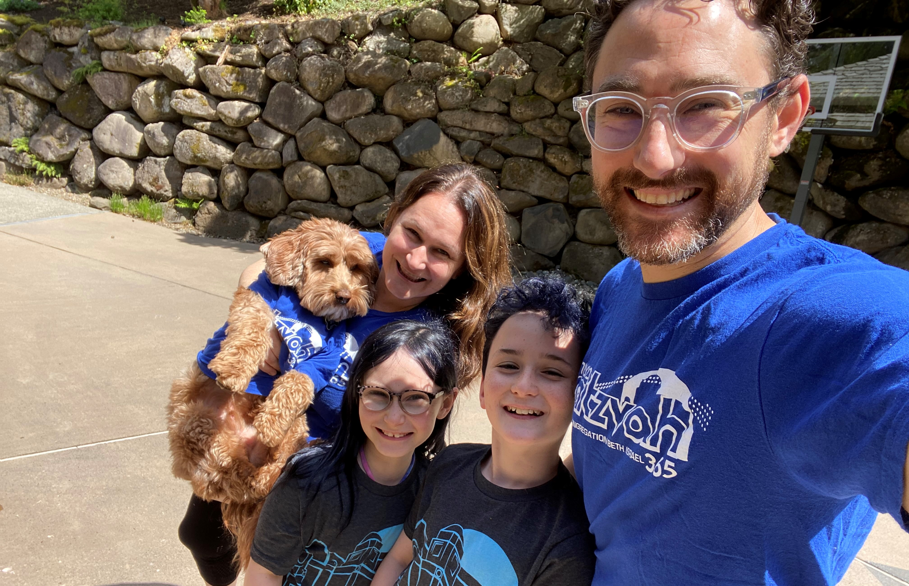
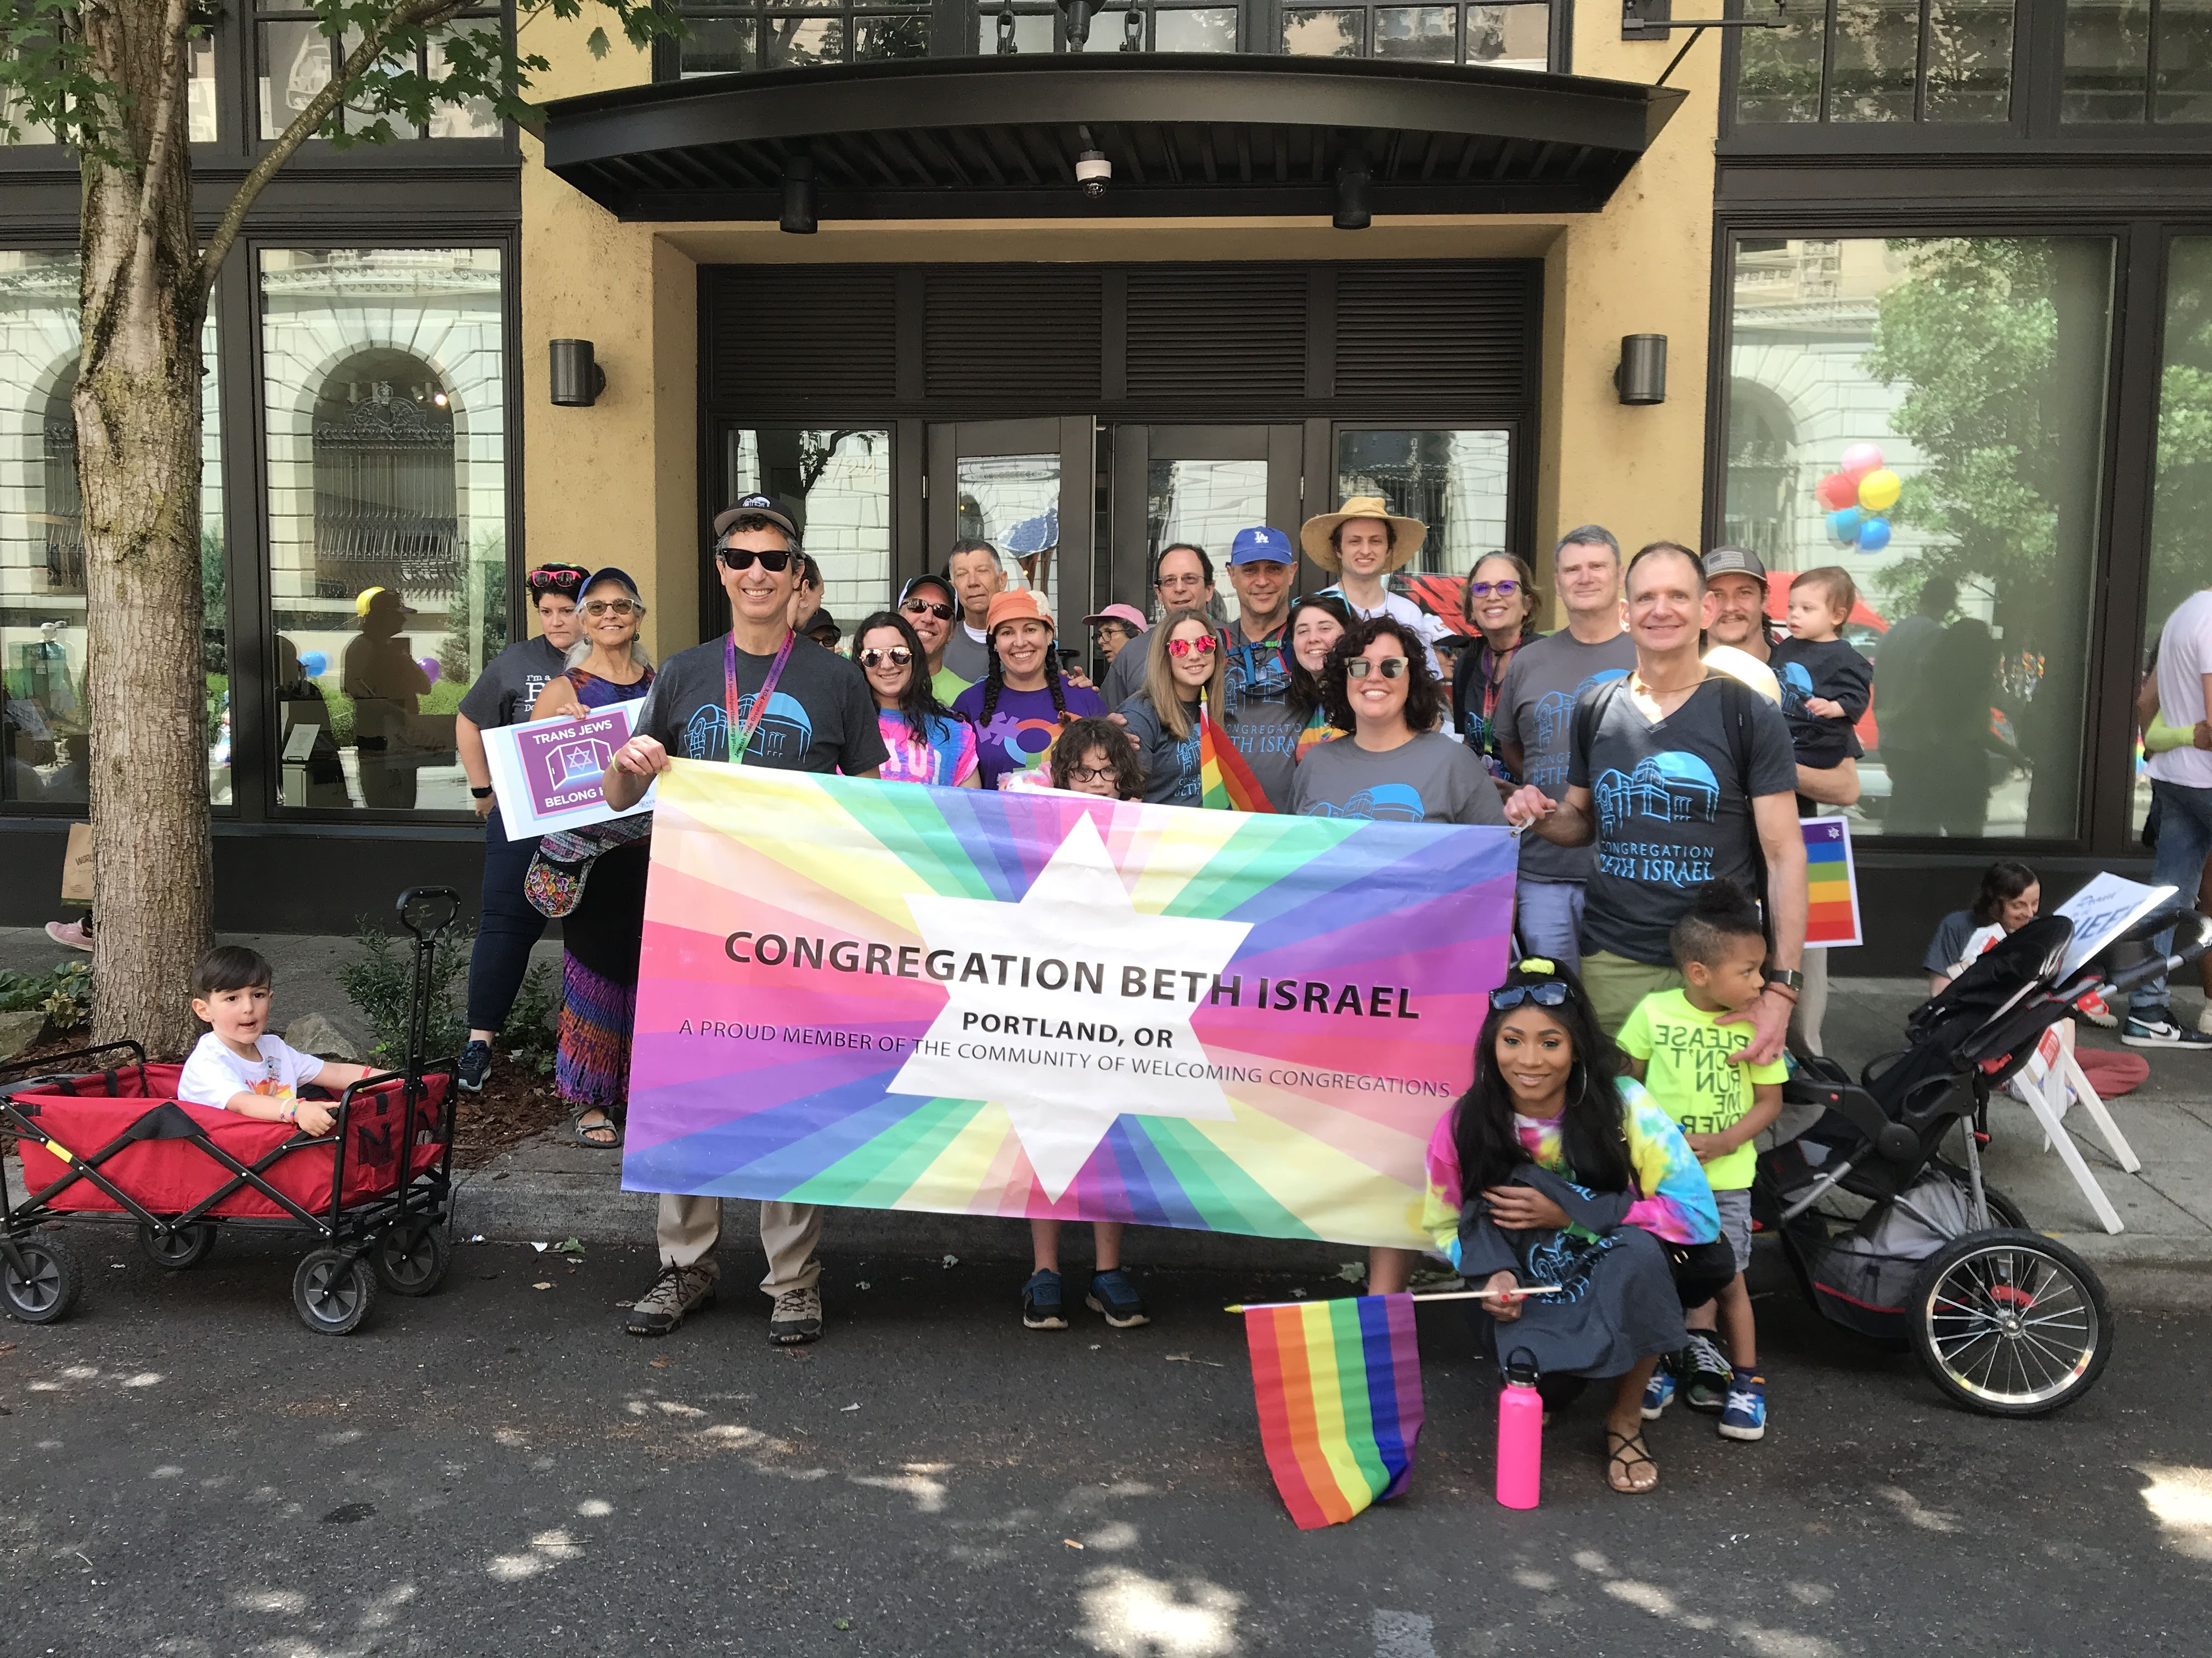
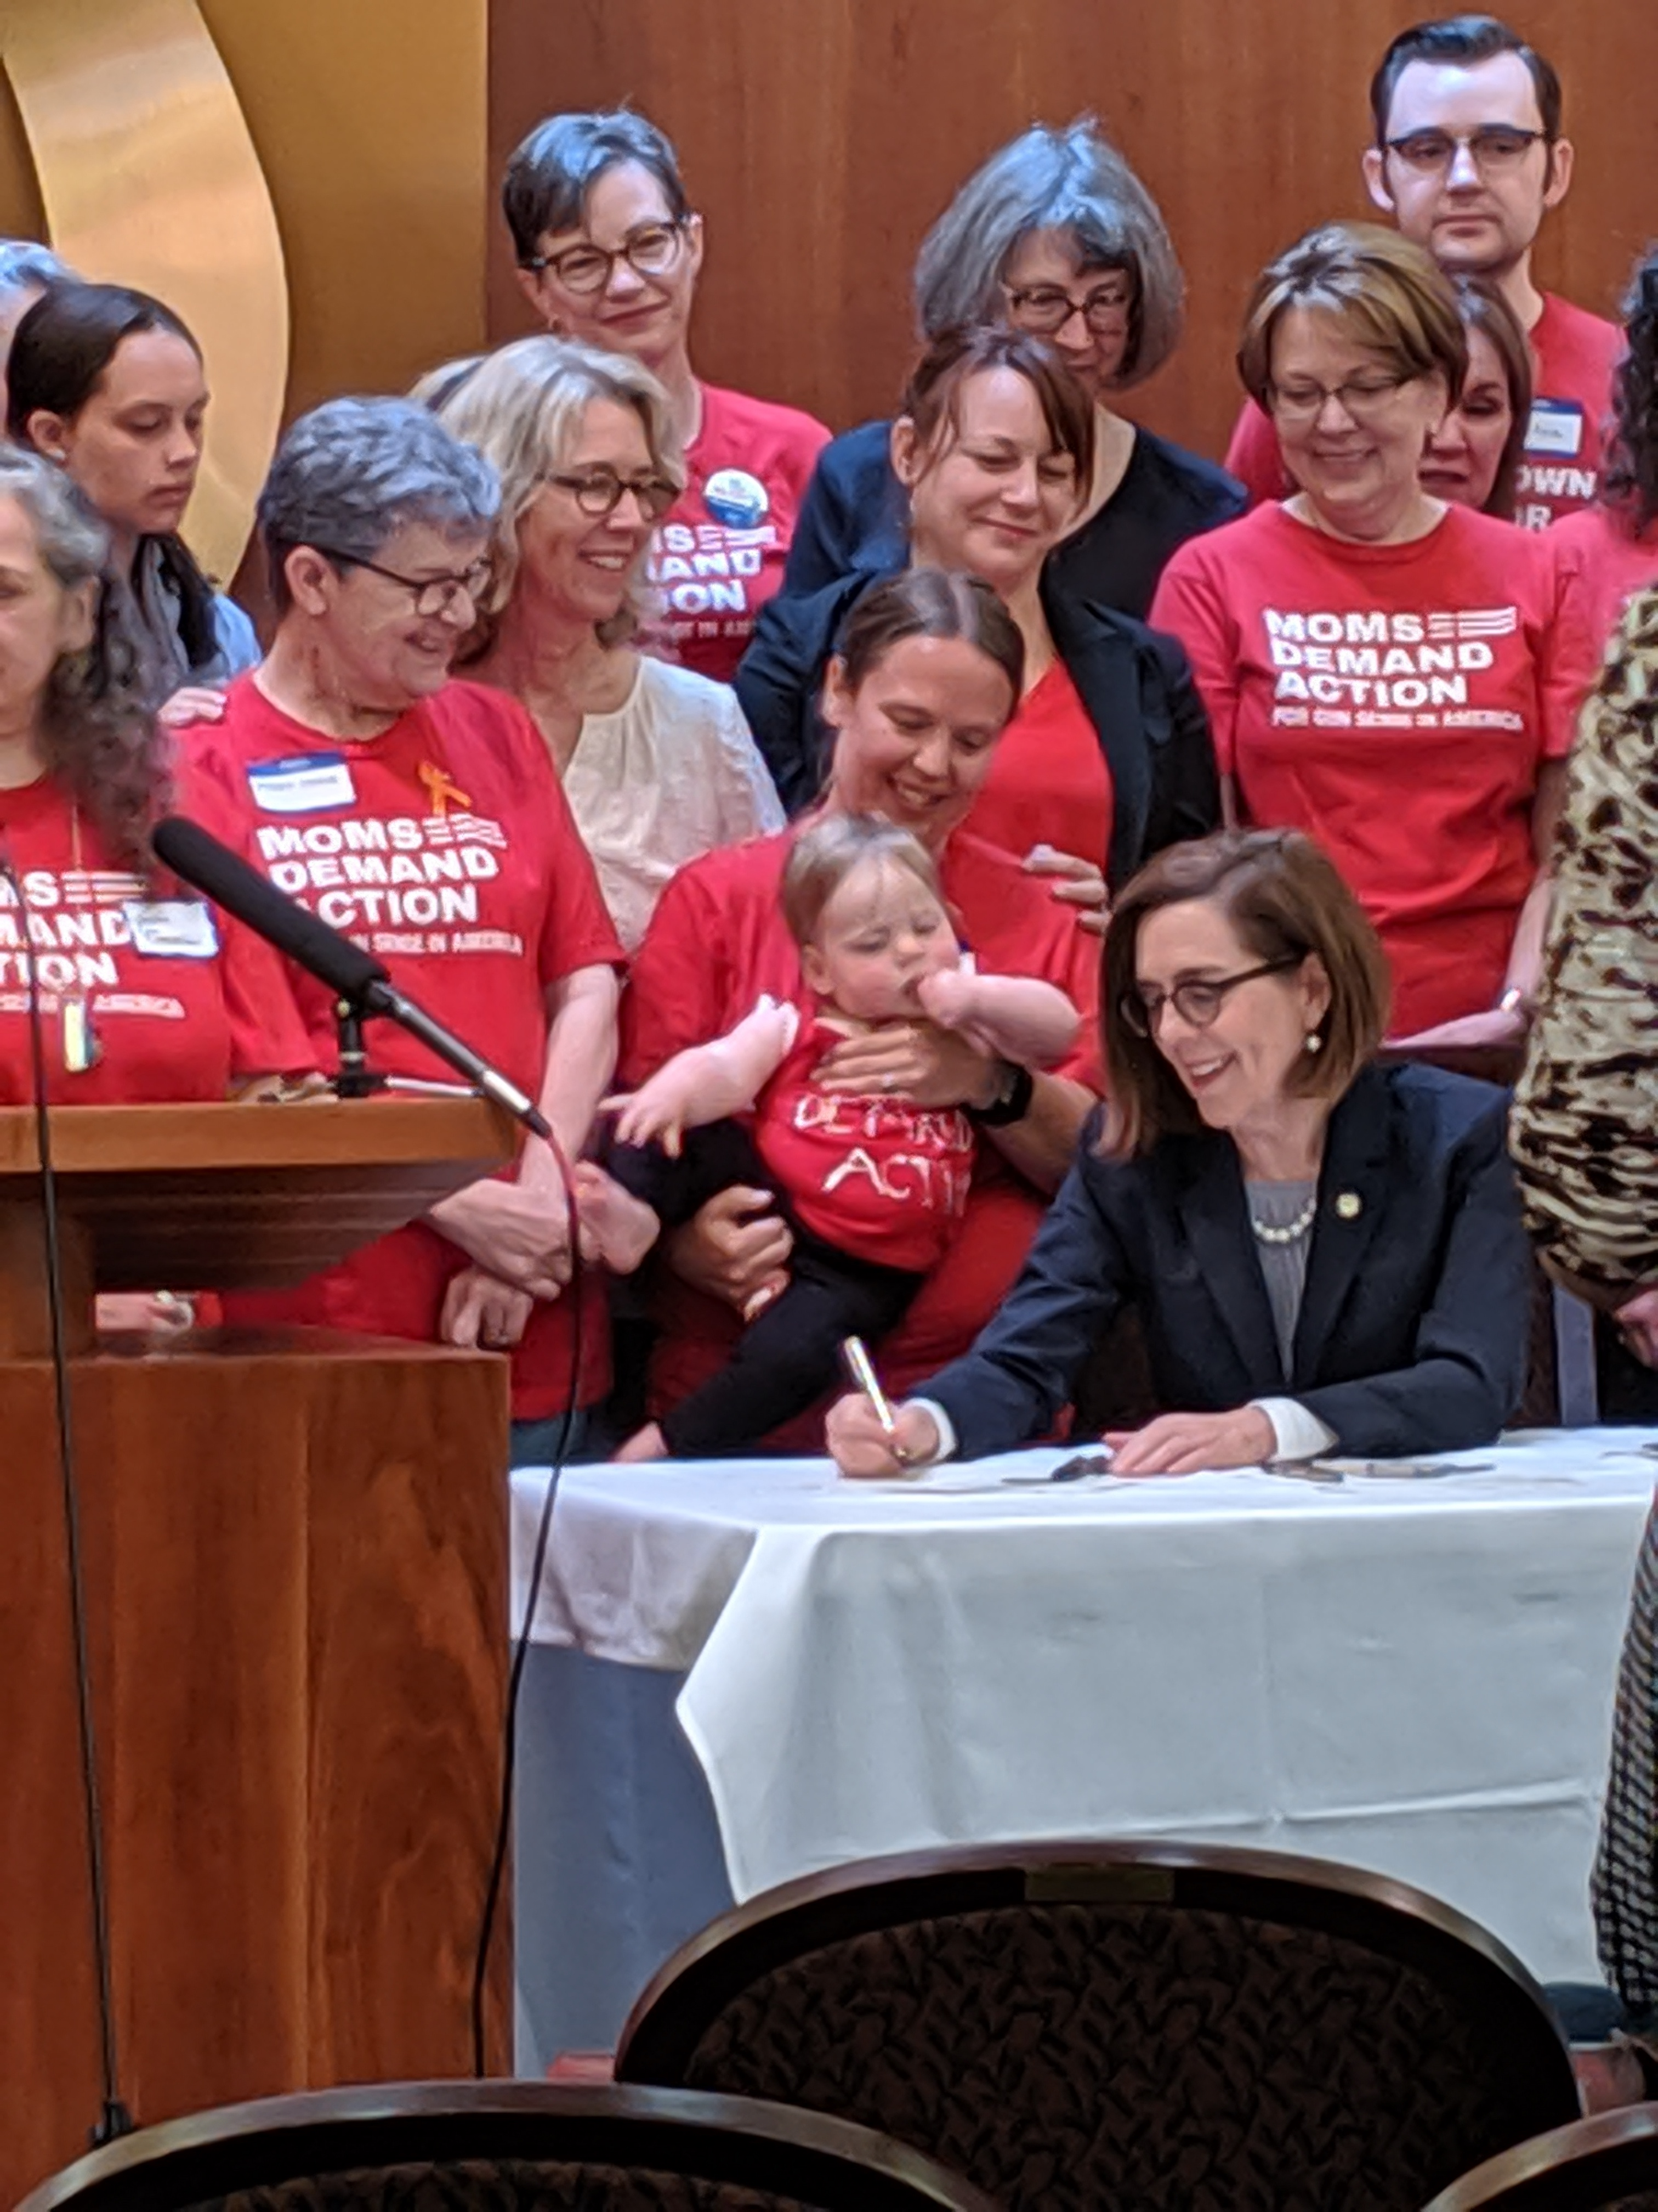
Social Action
Social Action Tribute Fund Allocations
Food Fund
Operation Nightwatch | $ 3,000
Lift Urban Portland | $ 1,500
Portland Backpack Project | $ 1,000
Stone Soup PDX | $ 1,000
Urban Gleaners | $ 3,000
Lift Urban Portland Community Christmas Dinner | $ 2,000
Social Action General Tribute Fund
Partners for Hunger Free Oregon | $ 5,000
CODA (Substance Abuse Treatment) | $ 1,000
HIAS | $ 7,500
High Holidays Funds for Food
Lift Urban Portland Food Pantry | $ 7,800
Sunshine Pantry | $ 7,800
CBI joined the URJ’s Brit Olam initiative and committed to focusing on immigration justice, gun violence prevention, and reproductive health and rights.
CBI was a co-sponsor and host of Lift UP Community Christmas Dinner with 200+ volunteers and ~550 guests.
We continued to support NW Towers and Annex through homework club, Sunday food pantry, holiday meals, and donations. Homework club saw an increase in both students and volunteers this year.
In response to COVID-19, Mitzvah Day was lengthened to become ongoing initiatives. The culminating day had 115 participants.

Slide 18
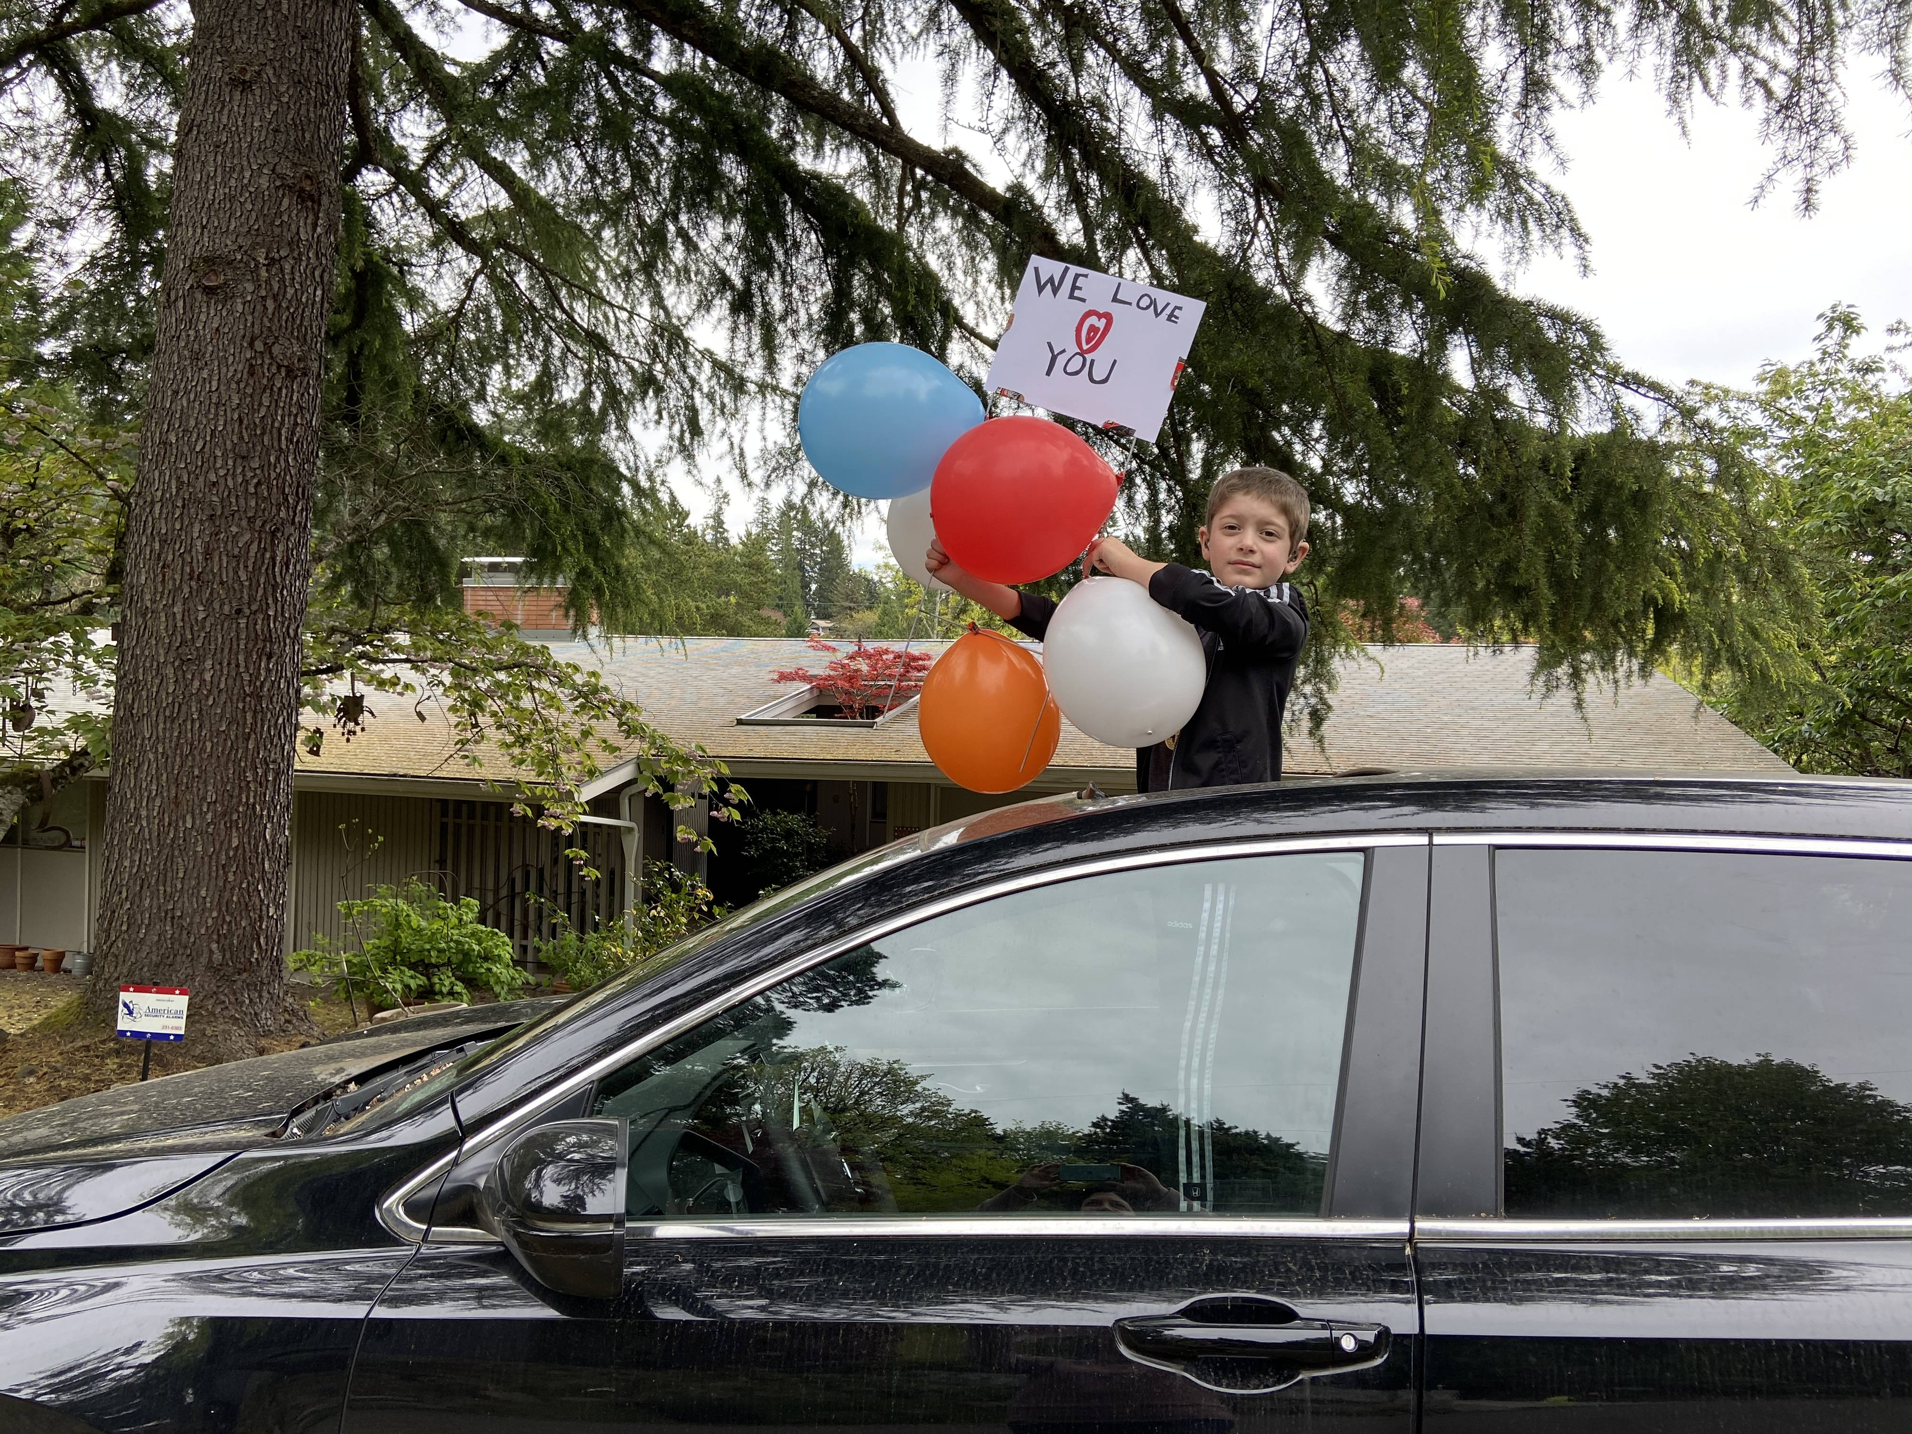
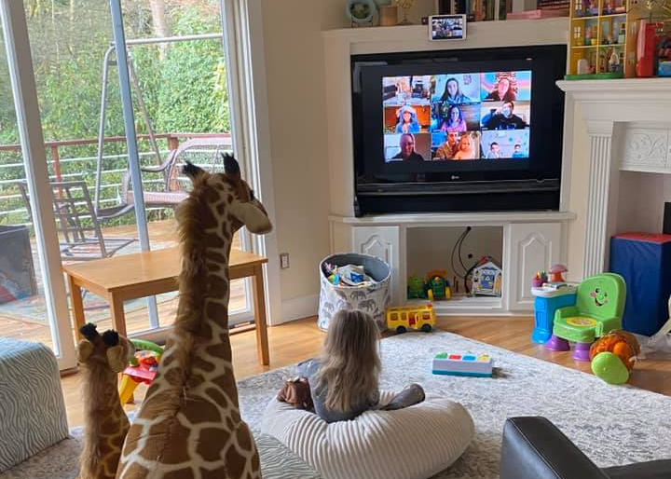
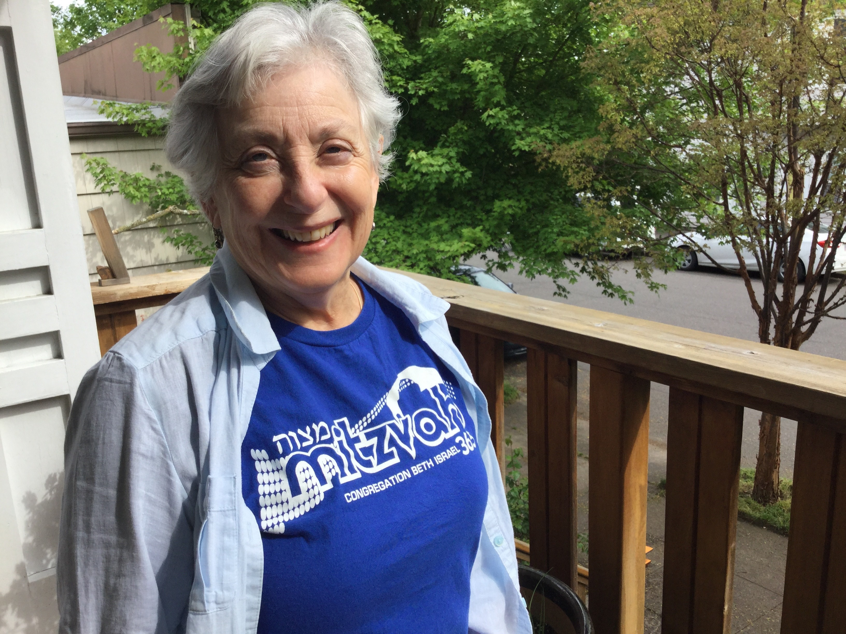
Physically Distant & Emotionally Close
Our weekly programs expanded to include Talmud Tuesday, Havdalah, clergy office hours, and virtual religious school.
An average of 255 families attend virtual Shabbat Services through the website.
New programmatic offerings have included cooking with Cantor, a community Seder, and Taste of Tradition classes.
Life-cycle events have shifted online to include virtual B’nei Mitzvah and funerals.
More than 3/4 of the congregation received wellness check-ins.
Torah Study has had an average of 15-20 attendees each week.

Slide 19
Honoring Retiring Trustees
Kathleen Doctor
Stacy Friedman
Robin McCoy
David Sarasohn

Slide 20
Election of 2020-2021 Trustees
New Nominees for 2 Year Term 2020 – 2022
Sarah Pitman, Meryl Haber, Sandy Lewis, and Shoshanna Lansberg
Trustees Nominated for Re-election for a 2 Year Term 2020 – 2022
Bonnie Davis, Naomi Derner, David Goldwyn, and Bill June
Trustees Continuing Their 2 Year Terms
Jeff Capen, Eric Flamm, Janet Hoffman, Dan Hurwitz, Glen Levy,
Christie Moore, Sally Rosenfeld, Libby Schwartz, and Tony Urdes

Slide 21
President Elect
Tony Urdes

Slide 22
Past Presidents of CBI
Glen Levy: 2018-2020
Theodore Nelson: 2016-2018
Ned Duhnkrack: 2014-2016
Stuart Chestler: 2012-2014
Jill Rubinstein: 2010-2012
Michael Simon: 2008-2010
Roger Cone: 2006-2008
Craig Hartzman: 2004-2006
Rhonda Kennedy: 2002-2004
John Rosenthal: 2000-2002
Jim Richman: 1998-2000
Jeff Wolfstone: 1996-1998
Rose Rustin: 1994-1996
Ken Lewis: 1992-1994
David Lipman: 1990-1992
Jerry Sadis: 1988-1990
Irvin Layton: 1987-1988
Dick Maizels: 1985-1987
Bob Mesher: 1983-1985
Bernadine Brenner: 1981-1983
Lloyd Rosenfeld: 1979-1981
Philip Feldman: 1977-1979
Stanley Loeb: 1975-1977
Thomas George: 1973-1975
Henry Blauer: 1971-1973
Philip Reiter: 1969-1971
Abe Vidgoff: 1967-1969
Stuart Durkheimer: 1964-1966
Norman Savinar: 1962-1964
Leland Lowenson: 1960-1962
Harry Gevurtz: 1958-1960
George Friede: 1956-1958
David Robinson: 1954-1955
Monte Bettman: 1951-1953
Frank Fink: 1949-1950
Mason Ehrman: 1944-1948
Samuel Weinstein: 1941-1944
Sylvan Durkheimer: 1938-1941
Milton Markewitz: 1937-1938
Otto Kraemer: 1935-1937
Julius Meier: 1933-1935
Joseph Shemanski: 1931-1933
Chase Berg: 1929-1930
Henry Ottenheimer: 1926-1928
Max Hirsch: 1924-1926
Adolph Wolfe: 1917-1923 (1902-1907)
Sigmund Sichel: 1907-1917
Solomon Hirsch: 1900-1901
Simon Blumauer: 1881-1899 (1868-1872)
Phillip Selling: 1869-1870
CH Friendly: 1864
Jacob Mayer: 1863
Hery Bloch: 1860
Leopold Mayer: 1858-1860

Slide 23
Looking to the Future
Rabbi Michael Z. Cahana, Senior Rabbi

Slide 24
Questions
Please leave questions to be answered by the Synagogue Leadership in the Zoom chat box.

Slide 25
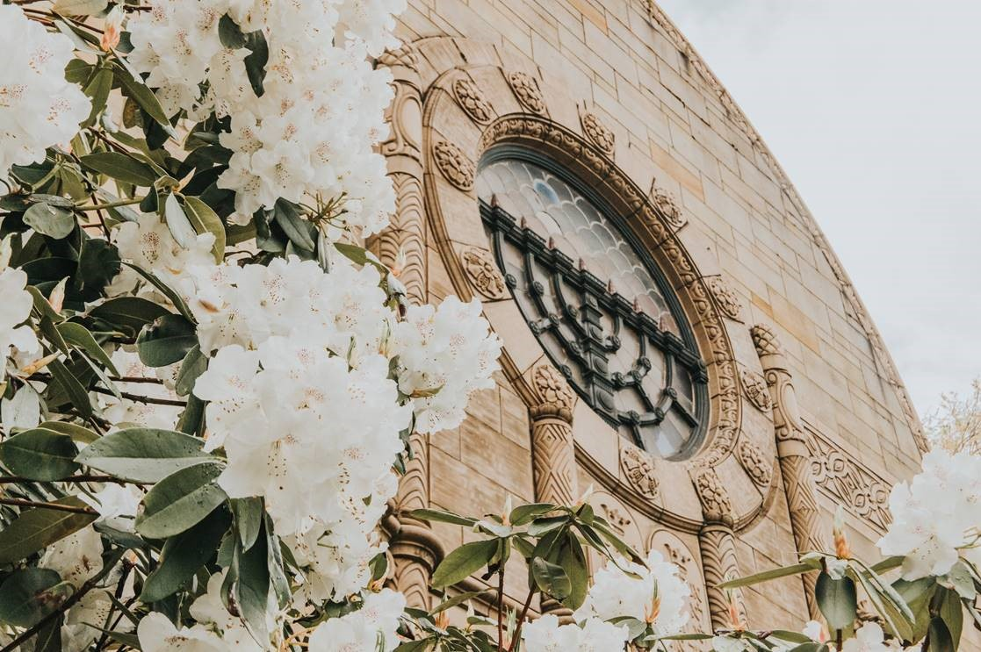
Thank you
Please direct follow-up questions to Shoshanna@bethisrael-pdx.org

