Slide 1
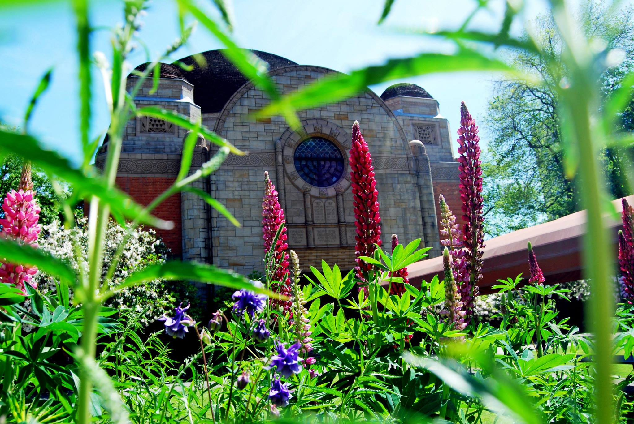
Congregation Beth Israel
162nd Annual Meeting Slideshow

Slide 2
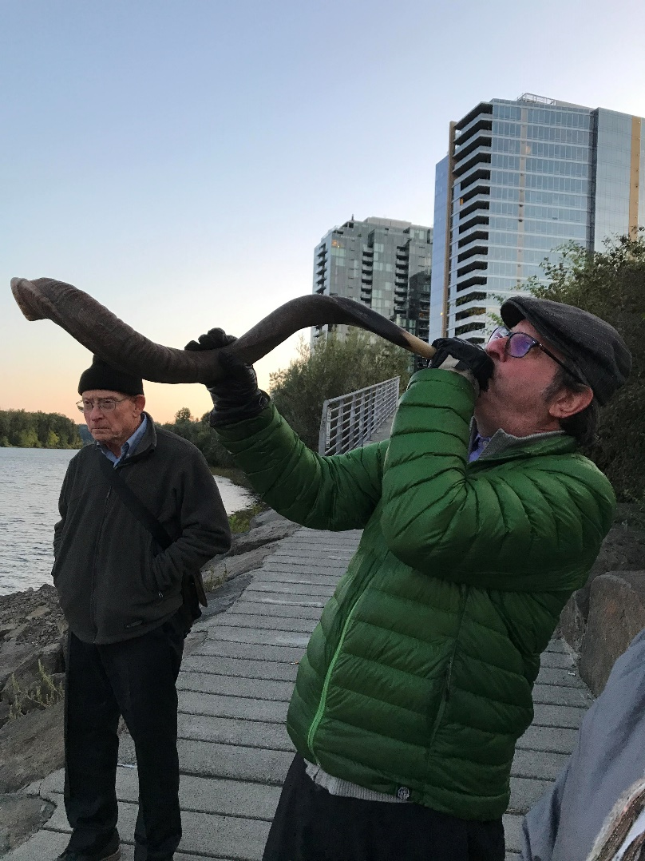
High Holidays
Blowing the Shofar at Tashlich

Slide 3
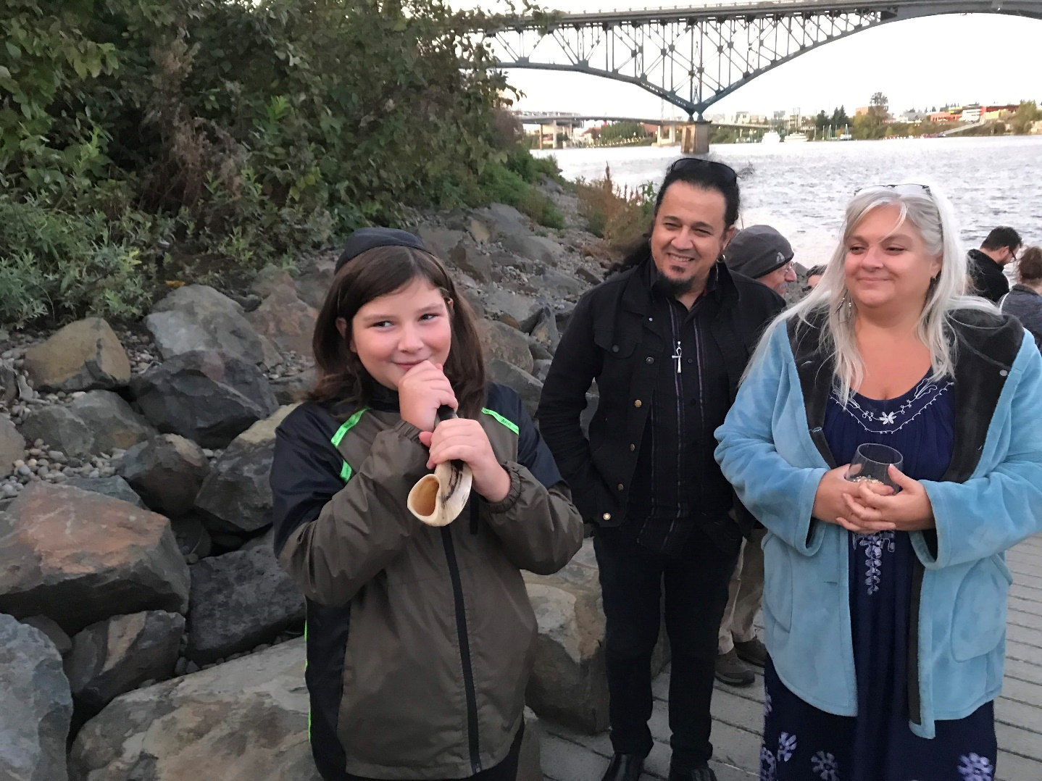
High Holidays
Blowing the Shofar at Tashlich

Slide 4
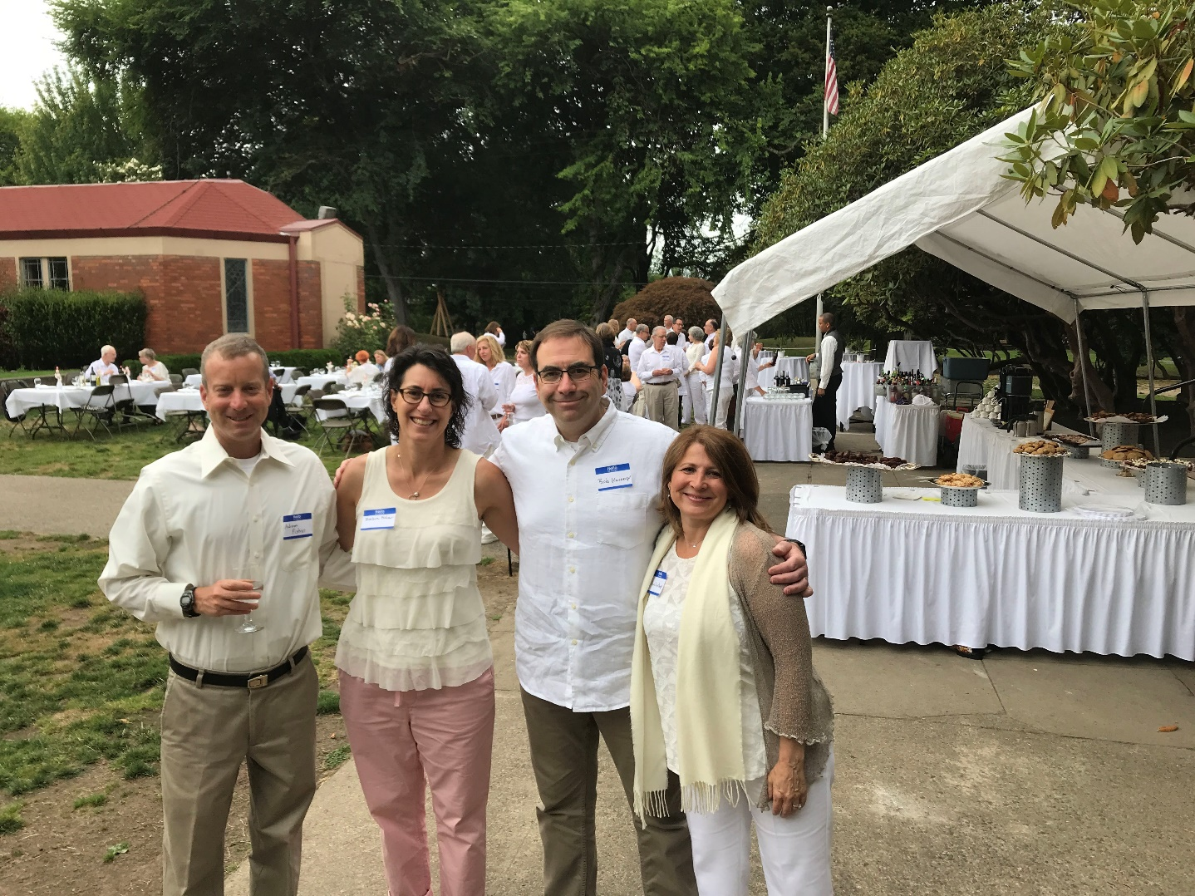
Sisterhood Shabbat
Lilah Lavan

Slide 5
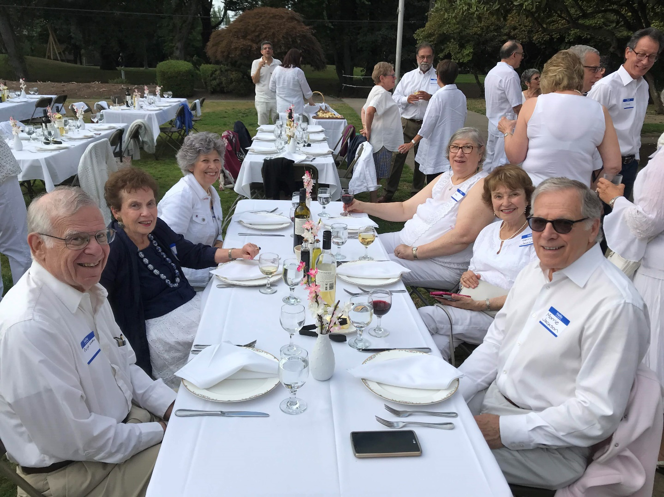
Sisterhood Shabbat
Lilah Lavan

Slide 6
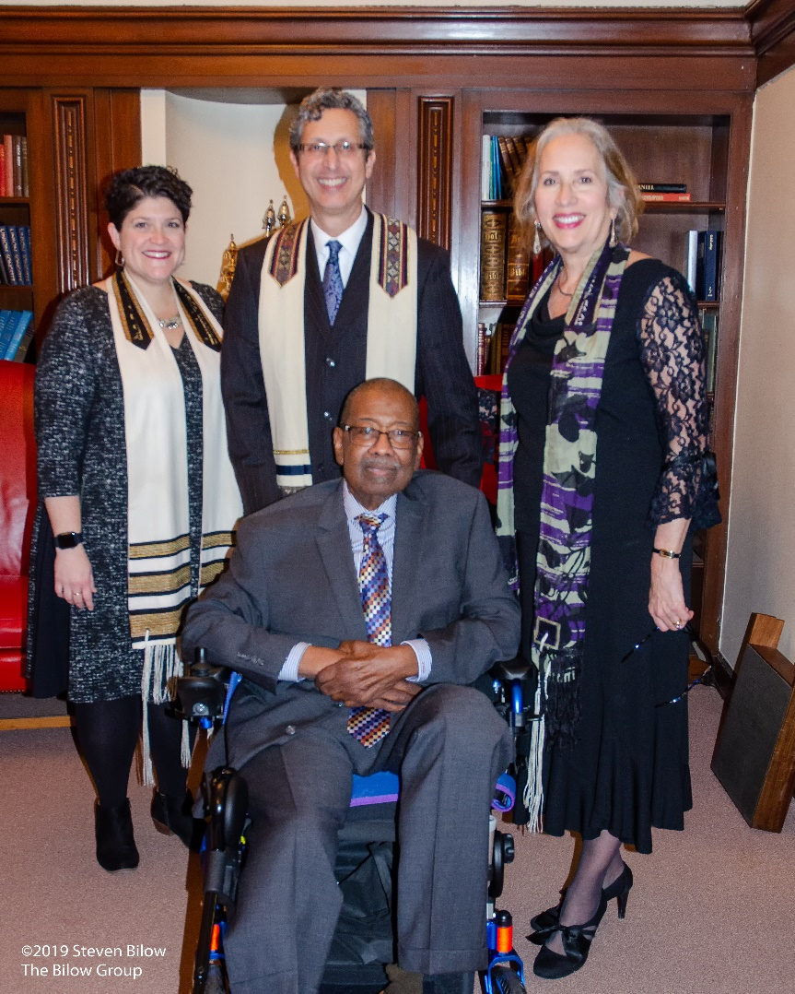
MLK Shabbat with Guest Speaker Rev. Dr. T. Allen Bethel

Slide 7
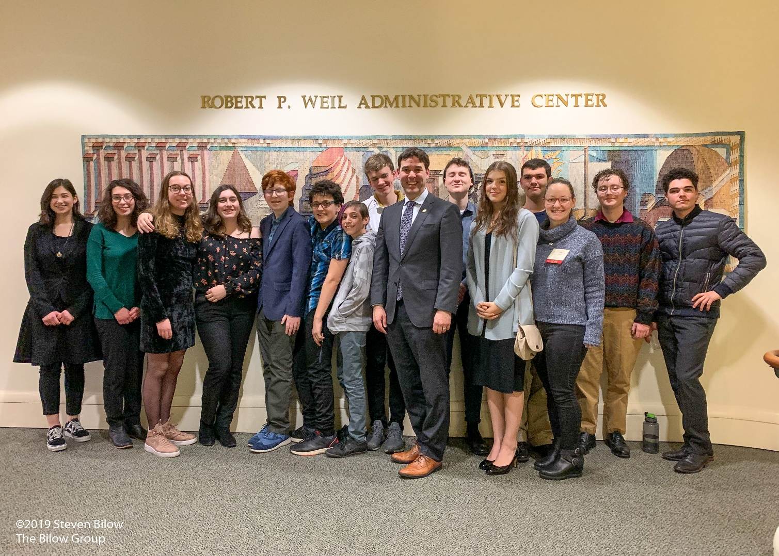
MLK Shabbat
Teen Dinner with State Senator Rob Wagner

Slide 8
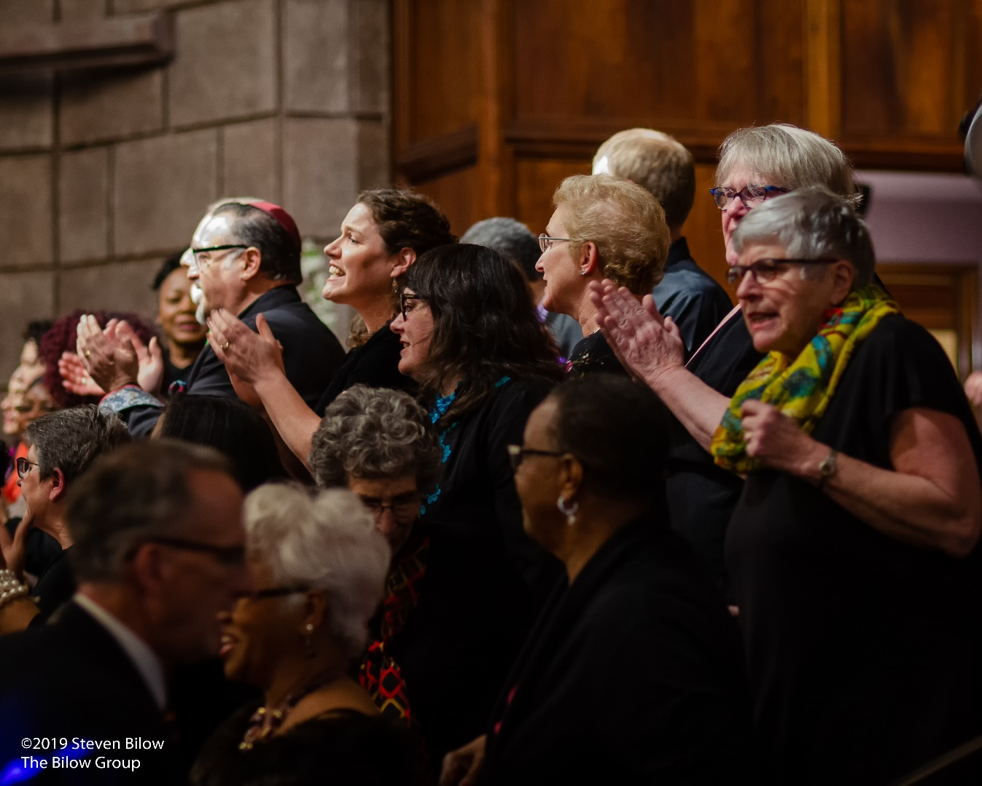
MLK Shabbat with Guest Speaker Rev. Dr. T. Allen Bethel

Slide 9
CBI Legacy Circle
Congregation Beth Israel is a participant in the Life and Legacy Program, which is a partnership of the Oregon Jewish Community Foundation and the Harold Grinspoon Foundation.
Congregation Beth Israel is proud to recognize every person/family who decides to create a Jewish legacy. A legacy gift includes any donation that lives on in perpetuity ensuring that CBI will be here to serve the generations to come. Different reasons have motivated each of our Legacy Circle donors to choose CBI as a beneficiary of their life’s work. We are fortunate that many of our members embraced the benefit that becoming a legacy donor brought to their lives and their memory. We continue to be honored by those who are now committing gifts through endowments, trusts, wills, and estate plans. We hope you will consider joining this esteemed and appreciated group and let us know of your intention so that we may include you in this growing list. Executive Director Josh Kashinsky welcomes the opportunity to discuss creating a Jewish legacy with you: (503) 222-1069 or josh@bethisrael-pdx.org.
Joy Alkalay*
Anonymous
William and Sydney Baer
Carole Barkley
Monte and Frances Bettman*
Philip and Fay Blank*
Henry* and Gerel Blauer
George and Harriet* Bodner
Lynn Bonner
Howard and Raquel Byer
Rabbi Michael and
Cantor Ida Rae Cahana
Lance and Deborah Caldwell
Bernard Carr*
Mandi and Stuart Chestler
Daniel J. and Elizabeth O. Cohn*
Edward* and Margery Cohn
Marcia Colton
Roger and Midge Cone
James and Ilene Davidson
Sylvia Davidson
Barry and Bonnie Davis
Berta M. Delman*
Susan Diamond
Nettie Director*
Simon and Helen Director*
Ned Duhnkrack
Barbara Durkheimer
Stuart and Leah Durkheimer*
Lester Eisendorf*
Judith Ann Epstein*
Marie Louise Feldenheimer*
Jen and Howard Feldman
Martin Fishel*
Eric and Robin Flamm
Lynn and Charlie Gelber
Thomas Georges III* and Linda Georges
Thomas and May Georges*
William and Shirley Gittelsohn*
Richard and Beth Glassman
Maurice* and Ilene Goldberg
Arthur and Martha Goldsmith*
David and Tiffany Goldwyn
Douglas and Lila Goodman*
Michelle and Steve Gradow
Rachel Halupowski
Craig Hartzman and James John
Margaret Hasson
Celia Heims*
Irwin and Renee Holzman and family
Benjamin* and Janice Isenberg
Rabbi Rachel L. Joseph
James and Rhonda Kennedy
Steve and Marilyn Kerman
Morris Klein*
Charles and Lois Koteen
Henry Kunowski and Kerstin Schulz
Theodore D. Lachman*
Robert and Sally Landauer
Gerald and Evelyn Leshgold
Glen and Lisa Levy
Joan Lindholm*
David and Beverly Lipman*
Lee Lowenson
Rita Lubliner*
Arnold Maizels*
Richard and Harriet Maizels
Howard B and Robin L Marcus
Lynn L. Marks
Barry and Susan Menashe
Joanne Van Ness Menashe and Joe Menashe
Ruben and Elizabeth Menashe
Robert and Robin Mesher
Alan and Lana Miller
Edith O. Miller*

Slide 10
CBI Legacy Circle
Congregation Beth Israel is a participant in the Life and Legacy Program, which is a partnership of the Oregon Jewish Community Foundation and the Harold Grinspoon Foundation.
Congregation Beth Israel is proud to recognize every person/family who decides to create a Jewish legacy. A legacy gift includes any donation that lives on in perpetuity ensuring that CBI will be here to serve the generations to come. Different reasons have motivated each of our Legacy Circle donors to choose CBI as a beneficiary of their life’s work. We are fortunate that many of our members embraced the benefit that becoming a legacy donor brought to their lives and their memory. We continue to be honored by those who are now committing gifts through endowments, trusts, wills, and estate plans. We hope you will consider joining this esteemed and appreciated group and let us know of your intention so that we may include you in this growing list. Executive Director Josh Kashinsky welcomes the opportunity to discuss creating a Jewish legacy with you: (503) 222-1069 or josh@bethisrael-pdx.org.
Lloyd and Beverly Miller*
Ted Nelson and Curt Shaffstall
Robert Neuberger*
Jeanne Newmark
John and Hulda Neustadter*
Kenneth and Debra Novack
Jackie and Burton* Nudelman
Victor Nudelman*
Henry* and Nancy Oseran
Raymond and Dorothy Packouz*
Mark and Judy Peterman
Randie and Mark Peterson
Robert and Rita Philip
Harold and Jane Pollin
Gerald and Lois Poplack*
Anita Reinhorn*
Philip and Dorothy Reiter
Laurie and Bert Rogoway
Gayle Romain
Millard and Carolyn Rosenblatt*
Alan and Eve Rosenfeld
Lloyd B. Rosenfeld*
Sally Rosenfeld and Andrew Frank
Tiffany and Eric Rosenfeld
John and Marti Rosenthal
Lawrence Rosenthal*
Franklin Rosumny
Richard and Deanne Rubinstein
Arnold* and Rose Rustin
Hal Ruthizer*
Bunny and Jerry Sadis
Ken and Loree Sakai
Benjamin Sandler and Laura Jamerson
Jeaneatta “Rusty” Sautter*
Norman* and Elaine Savinar
Ralph and Bernice Schlesinger*
Gilbert* and Thelma Schnitzer
Harold* and Arlene Schnitzer
Harold and Arlene Schnitzer: CARE Foundation
Leonard* and Lois Schnitzer
Manuel and Edith Schnitzer*
Sandra Schnitzer
Herbert and Shirley Semler
Ruth* and Larry Semler
Joel Seres and Sandra Lamer Seres
Christopher Setzer
Douglas and Dorothy* Sherman
Estelle Director Sholkoff*
Michael Simon and Suzanne Bonamici
Milton and Marilyn Singer*
Jill Newman Slansky
Mortimer and Alice Mary Solomon*
Richard Solomon and Alyce Flitcraft
Ladislao and Martha Soltesz
Ruth Spear*
Bruce Spiegel*
Donald Spiegel and Deborah Davis-Spiegel
Arthur Steinhorn
Frances Stern*
Marvin* and Gloria Swire
Ron* and Marcy Tonkin
Bianca and Tony Urdes
Robert P. Weil*
Joella Werlin and Robert *Autrey
Isam and Rose White*
Jeff and Lynn Wolfstone
Jennifer and Kenneth Zeidman
Jerome and Zelda Zeidman*
Alan* and Janet Zell
*Of blessed memory

Slide 11
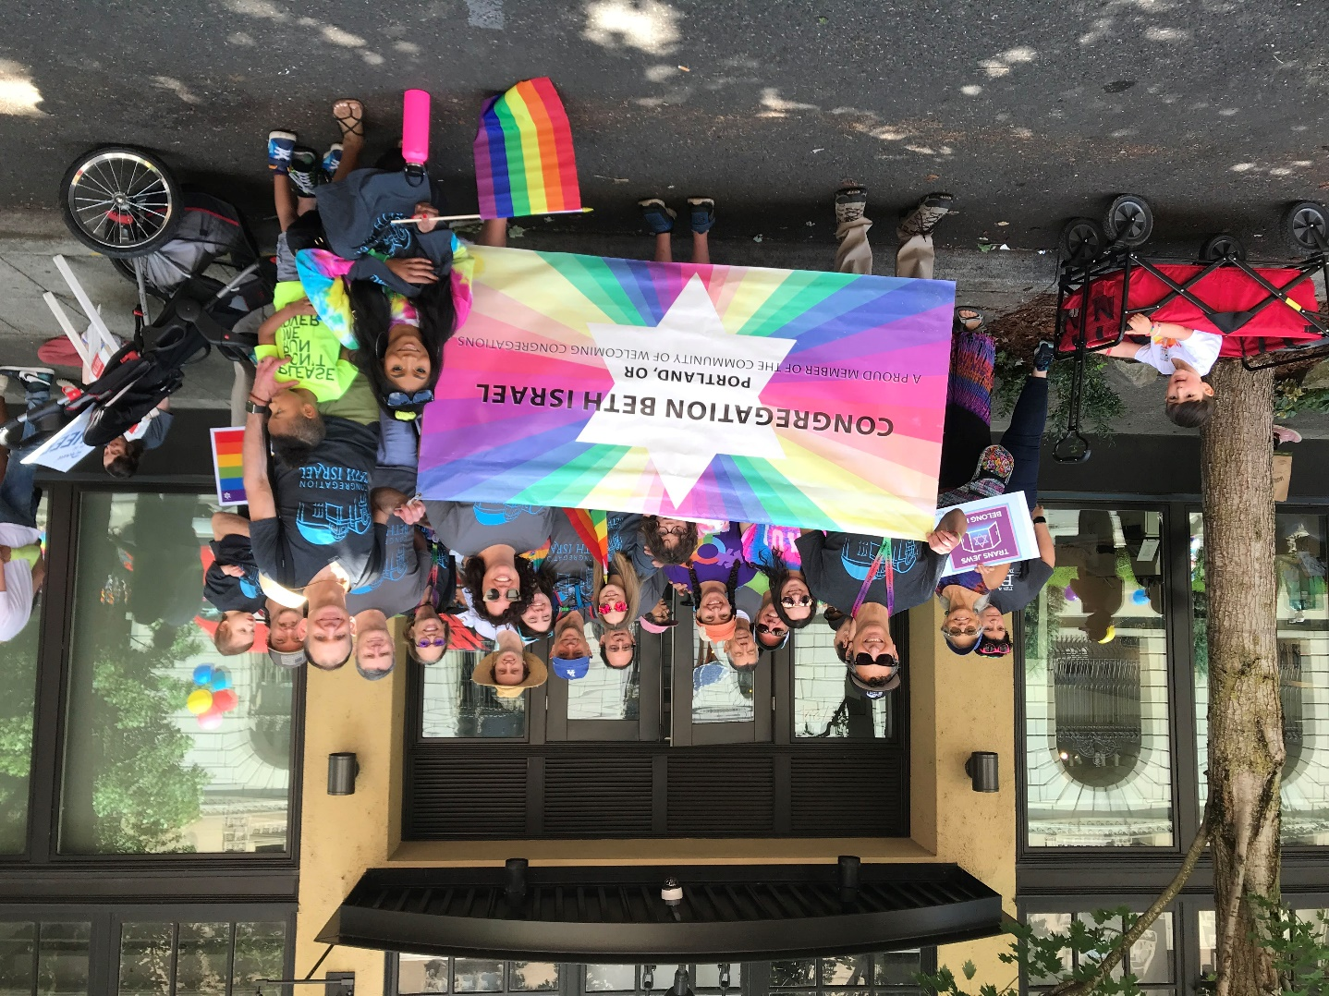
Portland Pride Parade
CBI Shows Their Support

Slide 12
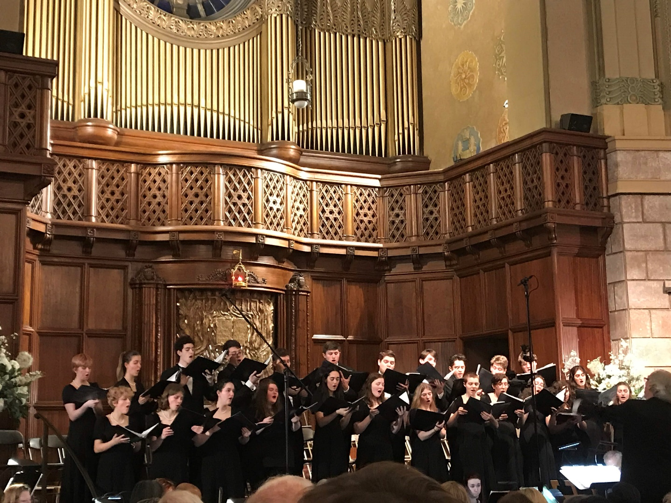
Portland Youth Philharmonic
Sharing Our Love of Music

Slide 13
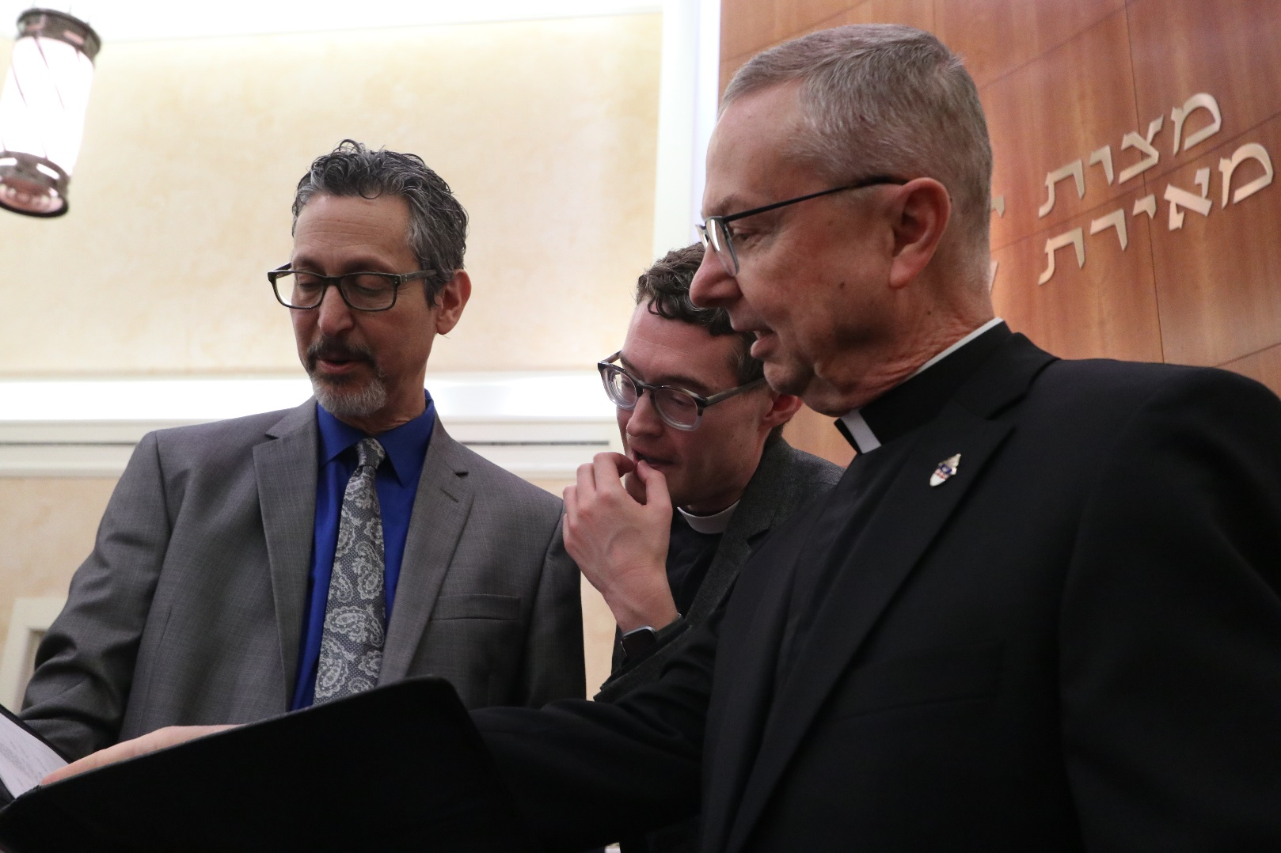
Adult Education
Three Clergy Present

Slide 14
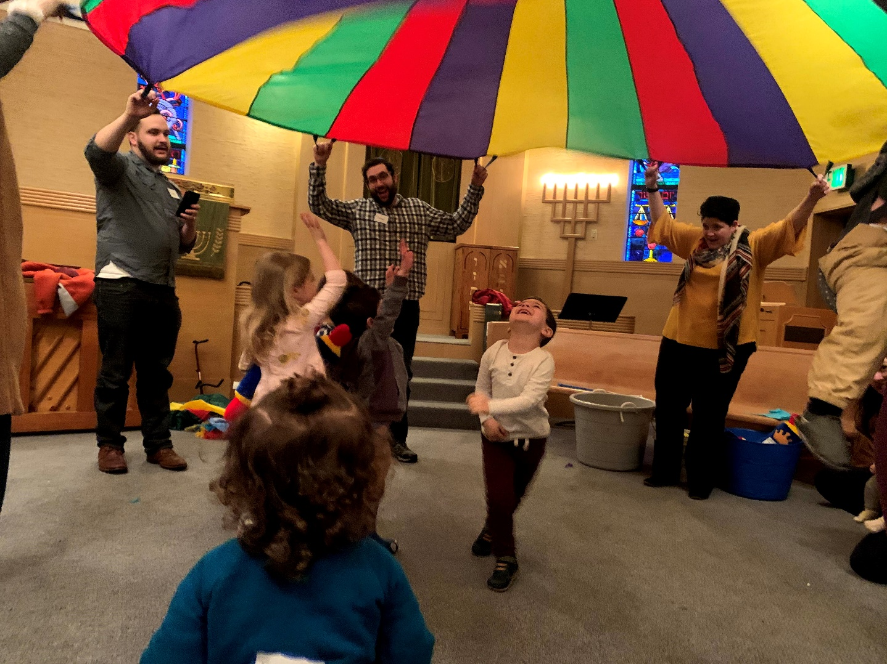
Mini Mensches
TOT Shabbat with Our Youngest Friends

Slide 15
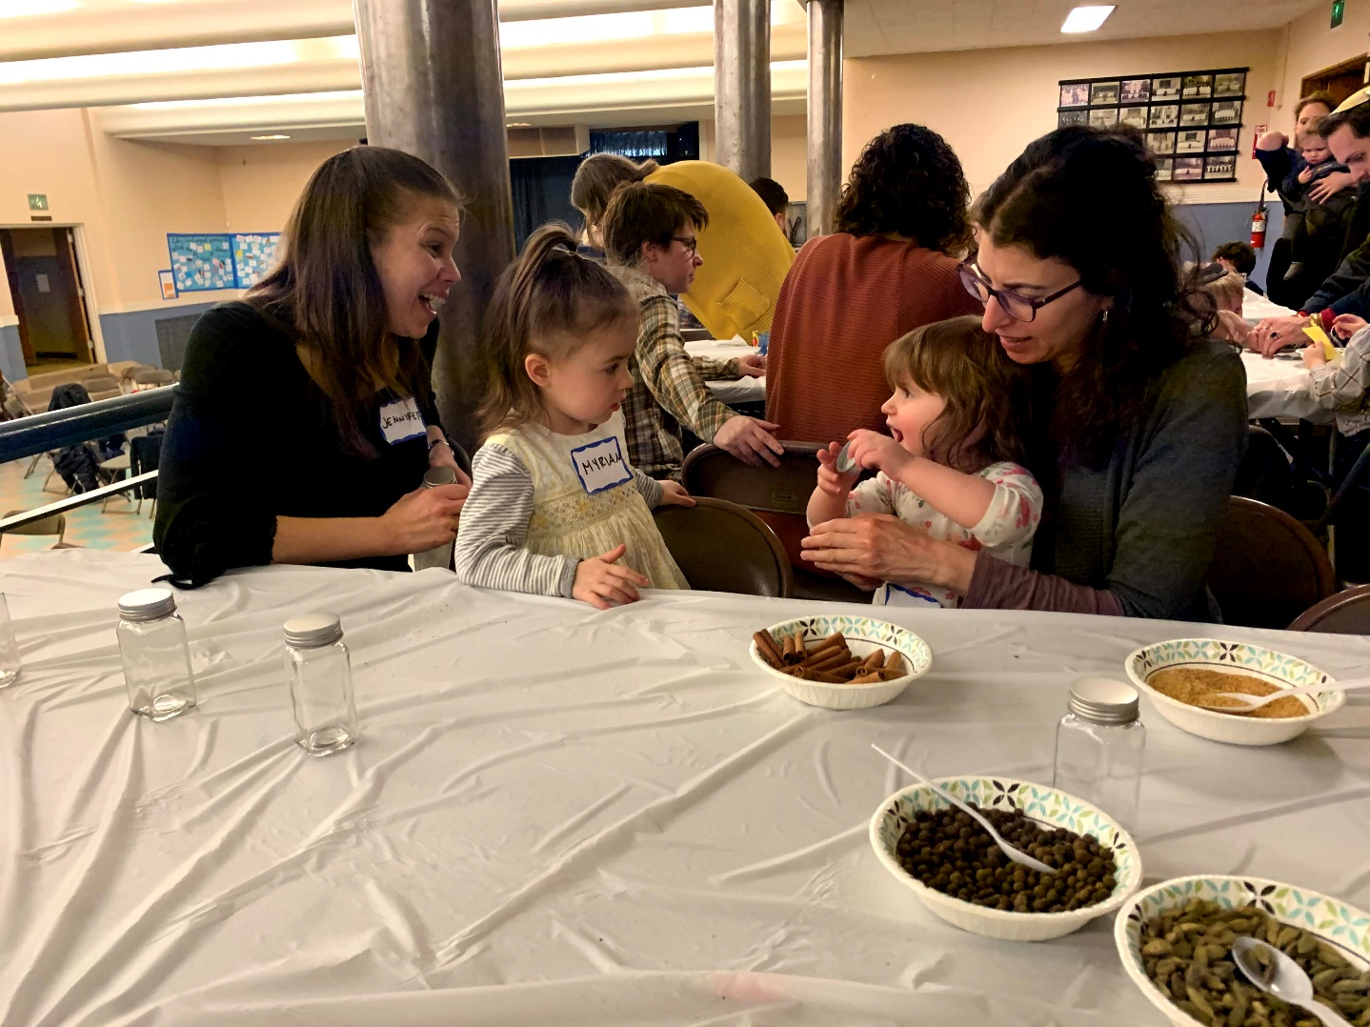
Mini Mensches
TOT Shabbat with Our Youngest Friends

Slide 16
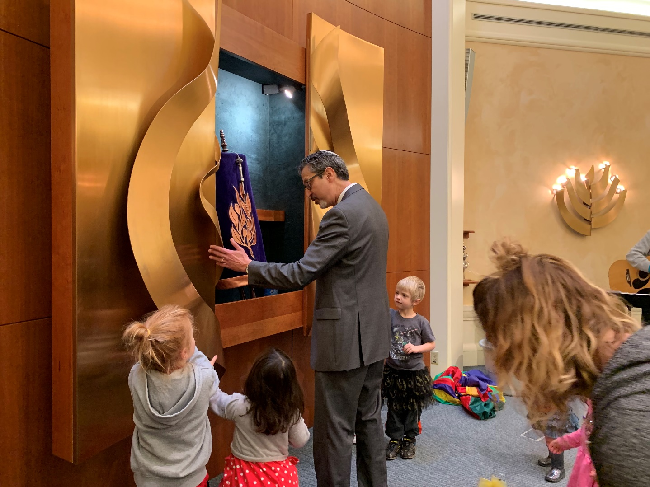
Mini Mensches
TOT Shabbat with Our Youngest Friends

Slide 17
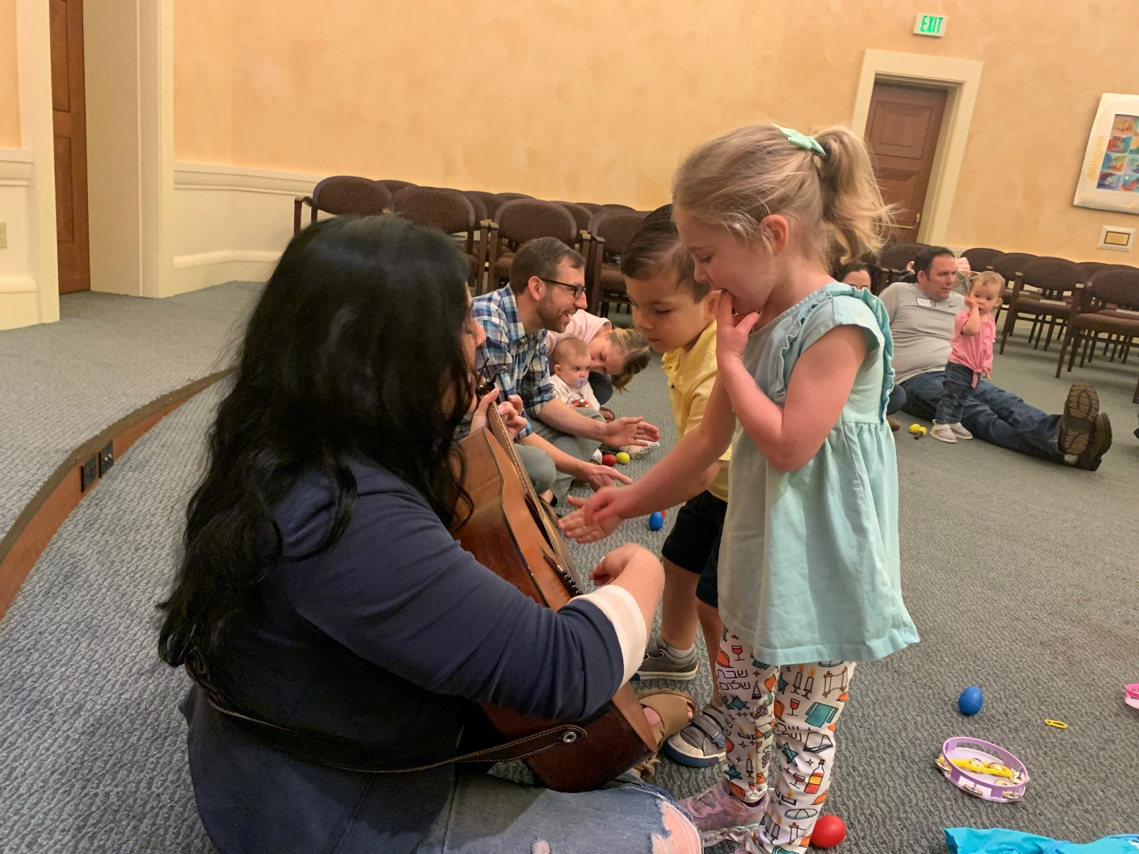
Mini Mensches
TOT Shabbat with Our Youngest Friends

Slide 18
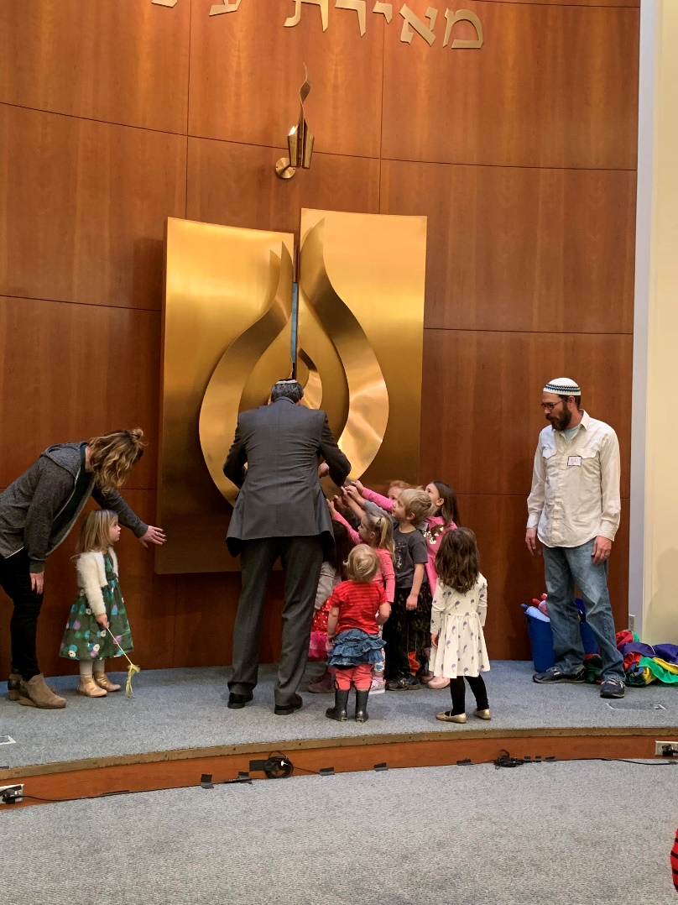
Mini Mensches
TOT Shabbat with Our Youngest Friends

Slide 19
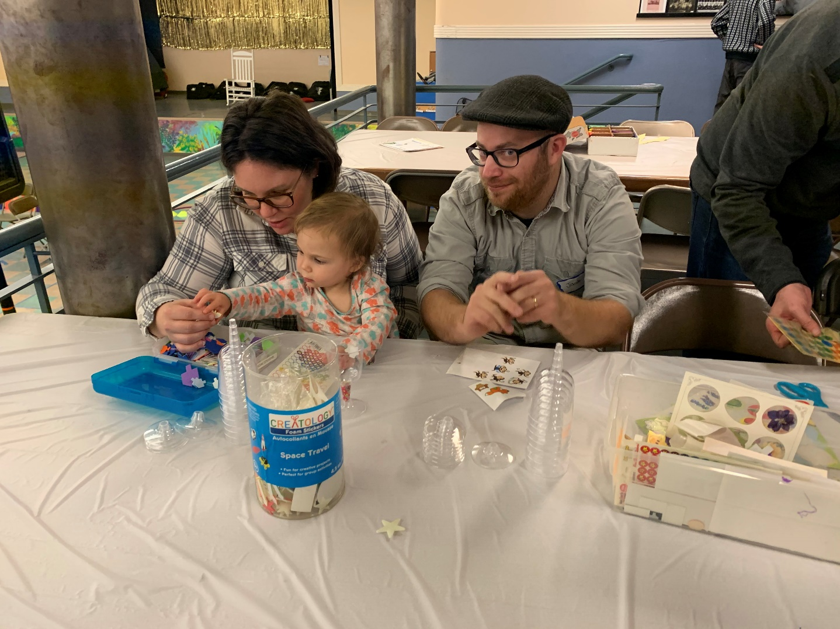
Mini Mensches
TOT Shabbat with Our Youngest Friends

Slide 20
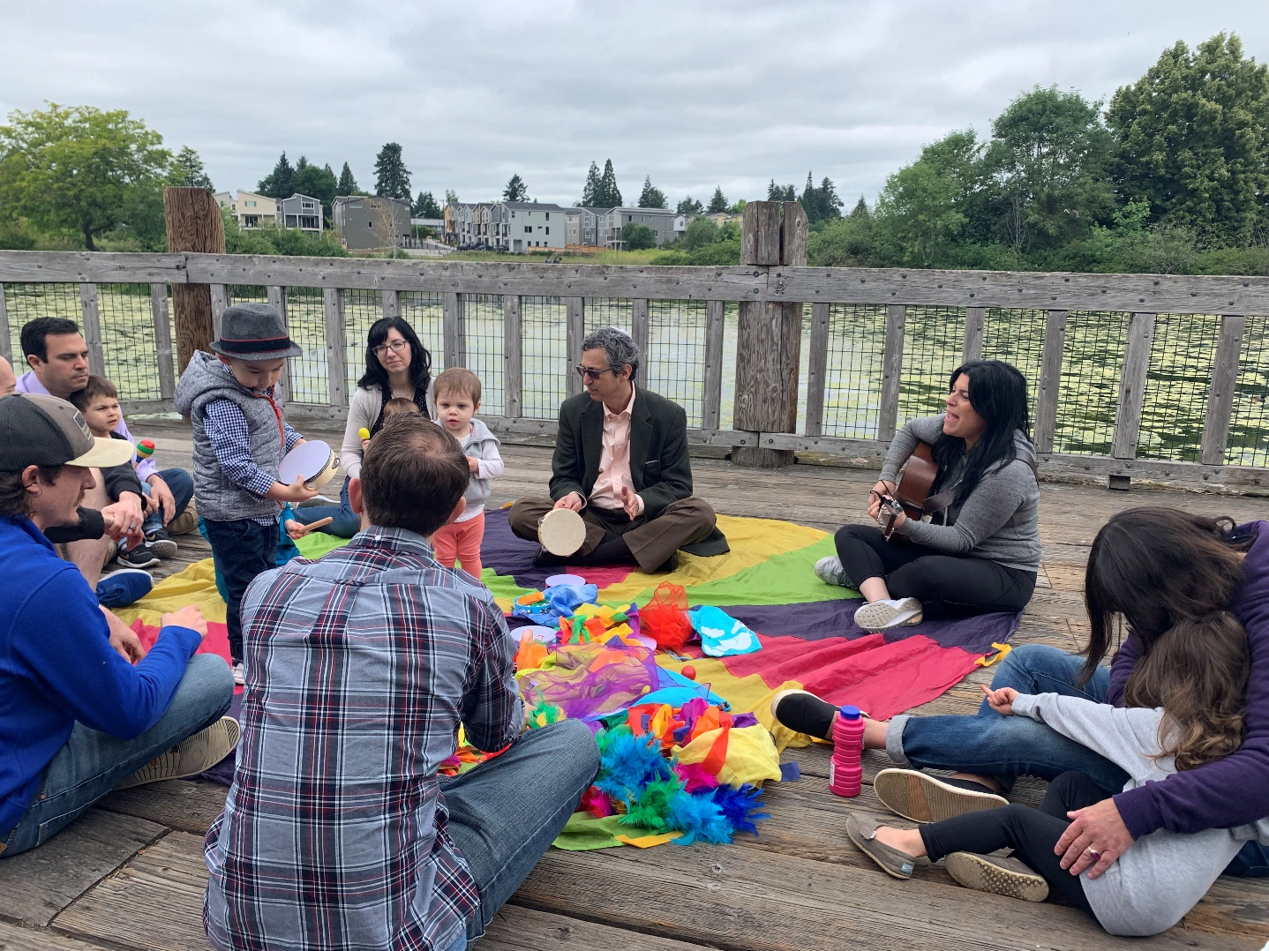
Mini Mensches
TOT Shabbat with Our Youngest Friends

Slide 21
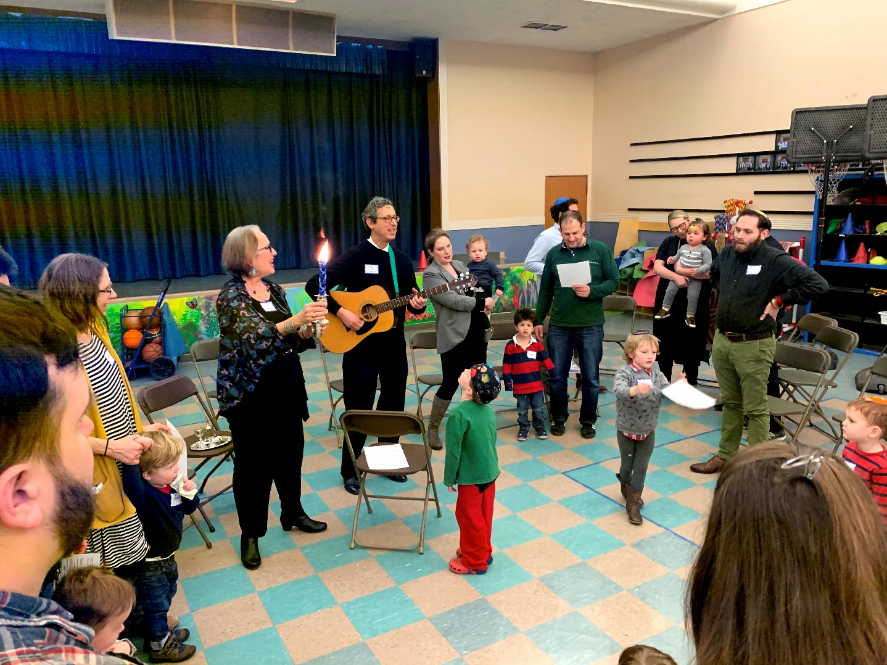
Mini Mensches
Havdalah with Our Youngest Friends

Slide 22
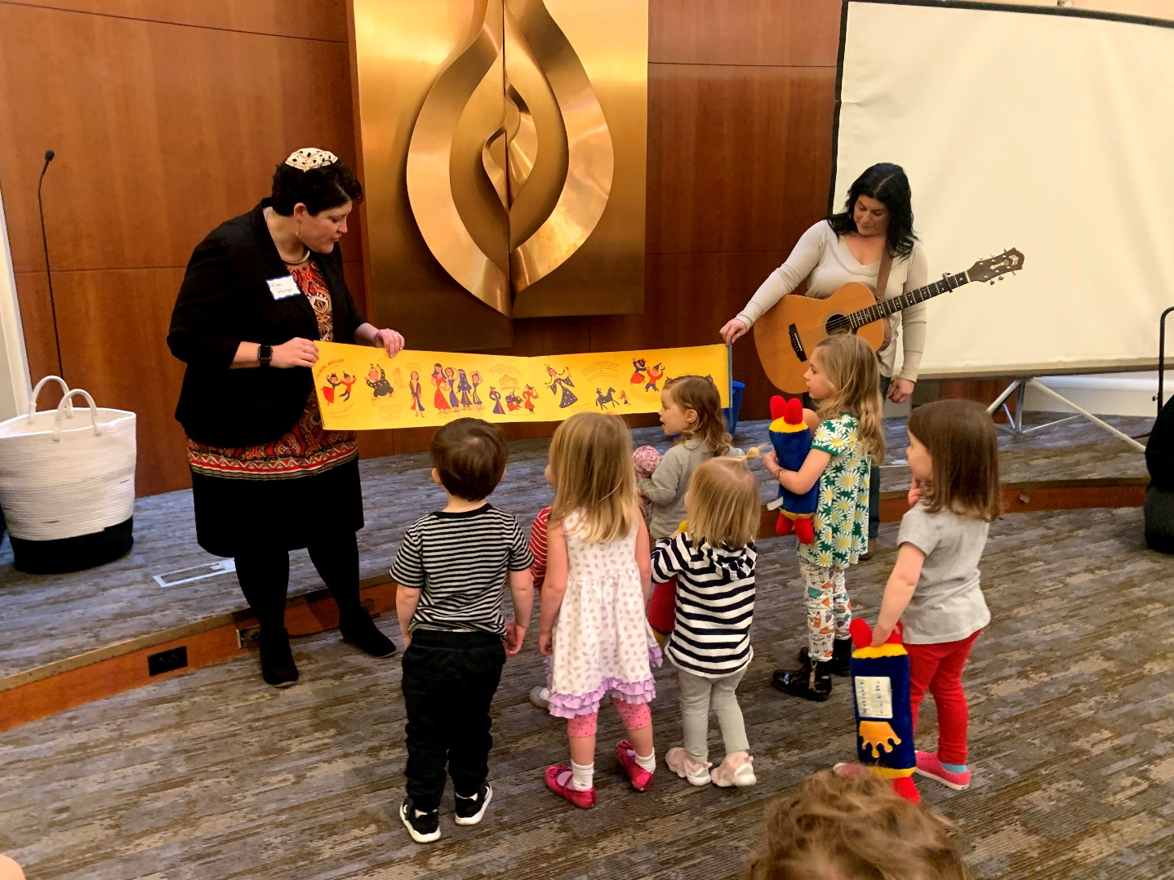
Mini Mensches
Purim with Our Youngest Friends

Slide 23
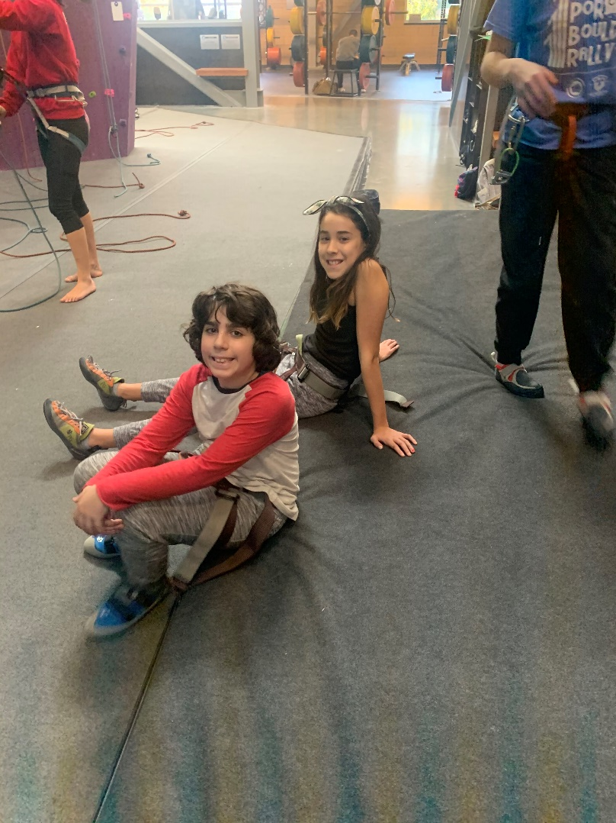
Date Night
Monthly Weekend Fun

Slide 24
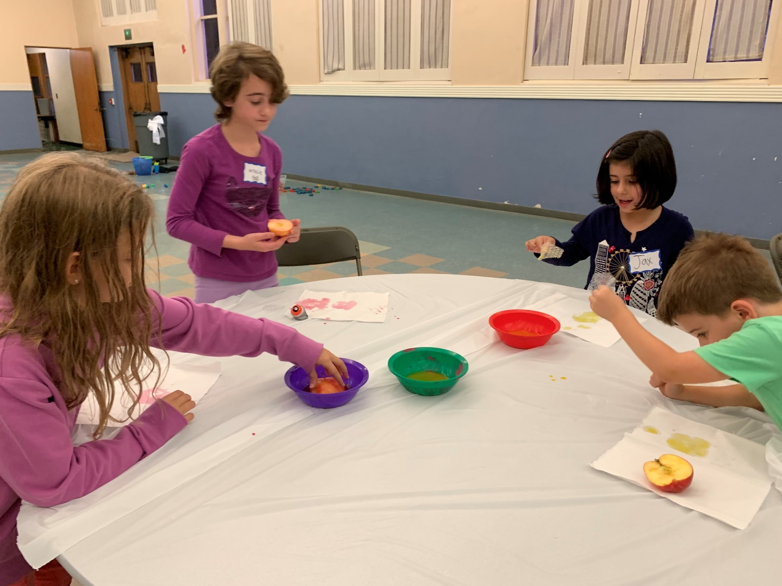
Date Night
Monthly Weekend Fun

Slide 25
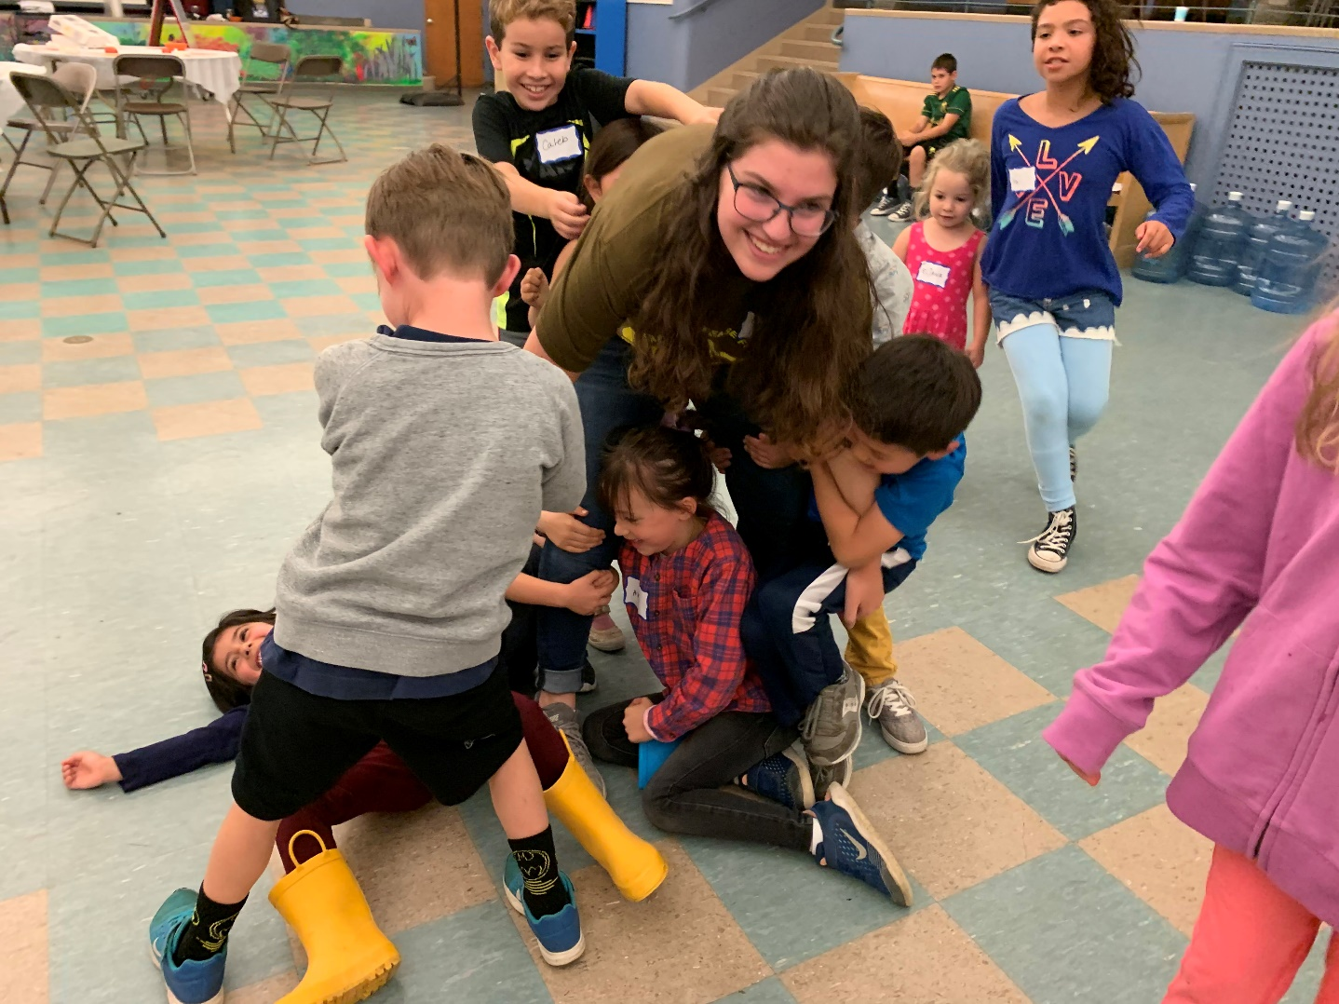
Date Night
Monthly Weekend Fun

Slide 26
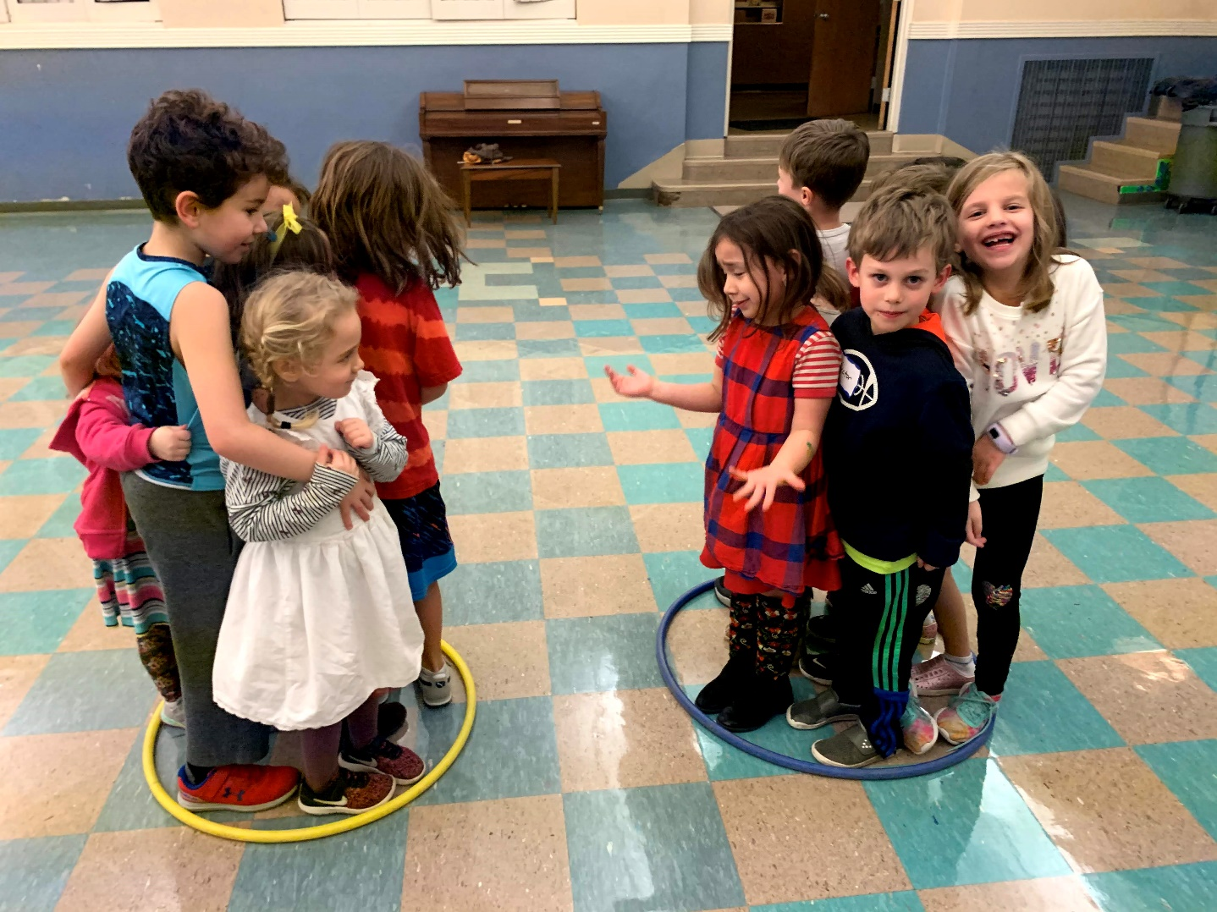
Date Night
Monthly Weekend Fun

Slide 27
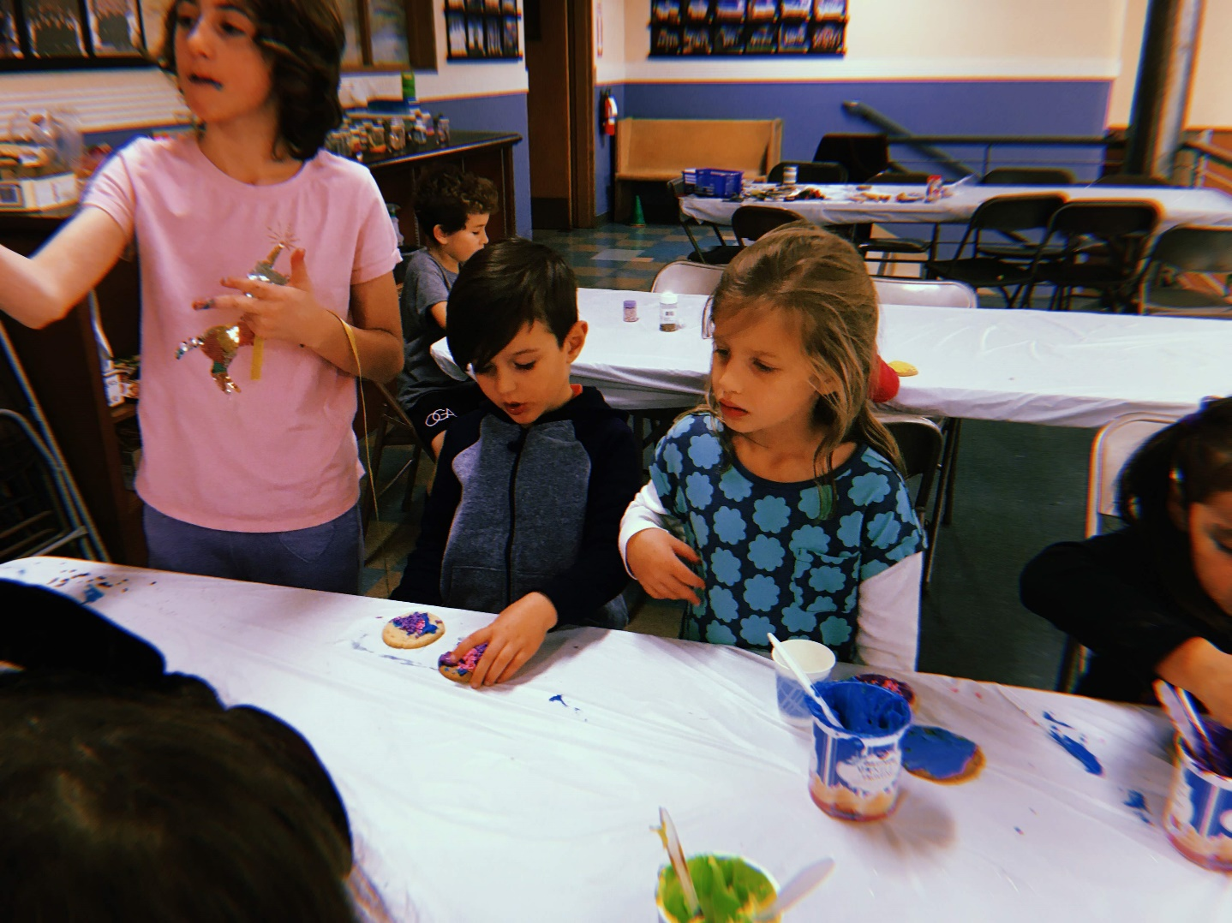
Date Night
Monthly Weekend Fun

Slide 28
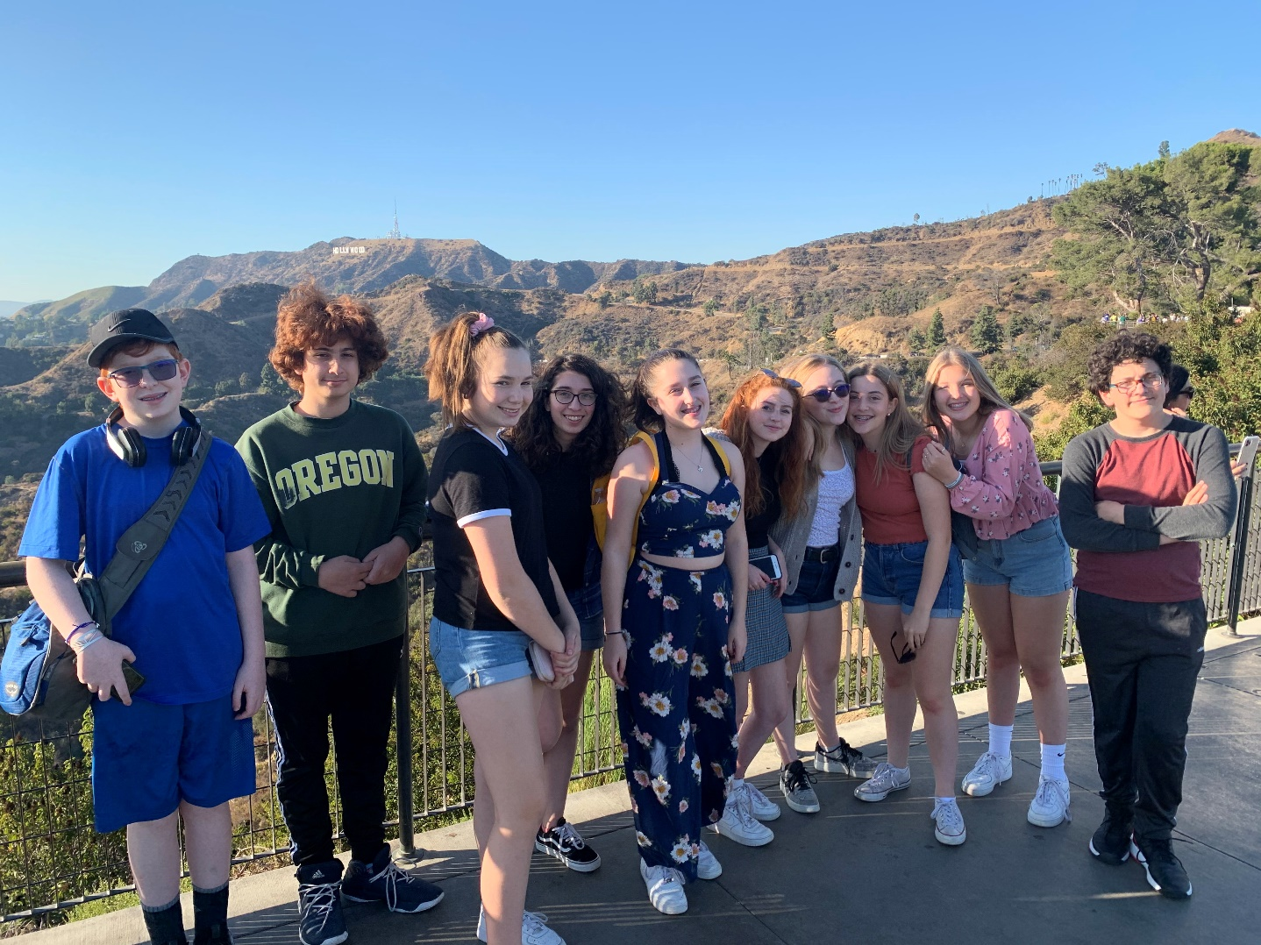
Religious School
Teen L.A. Social Action Trip

Slide 29
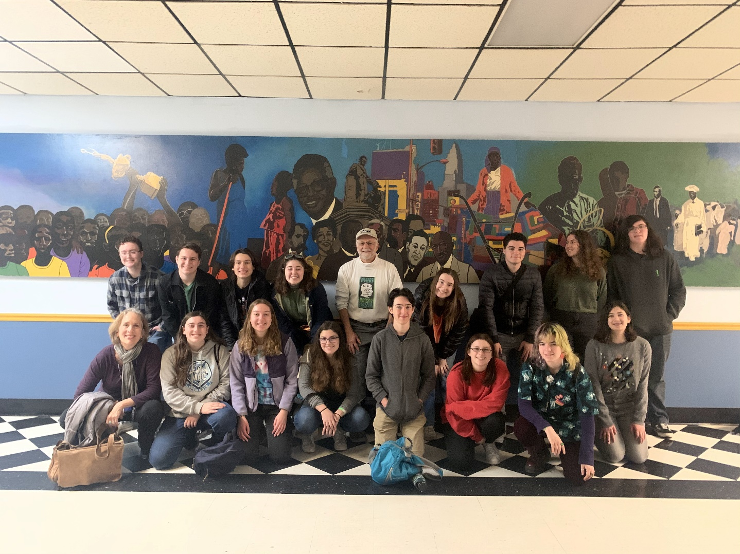
Religious School
Teen L.A. Social Action Trip

Slide 30
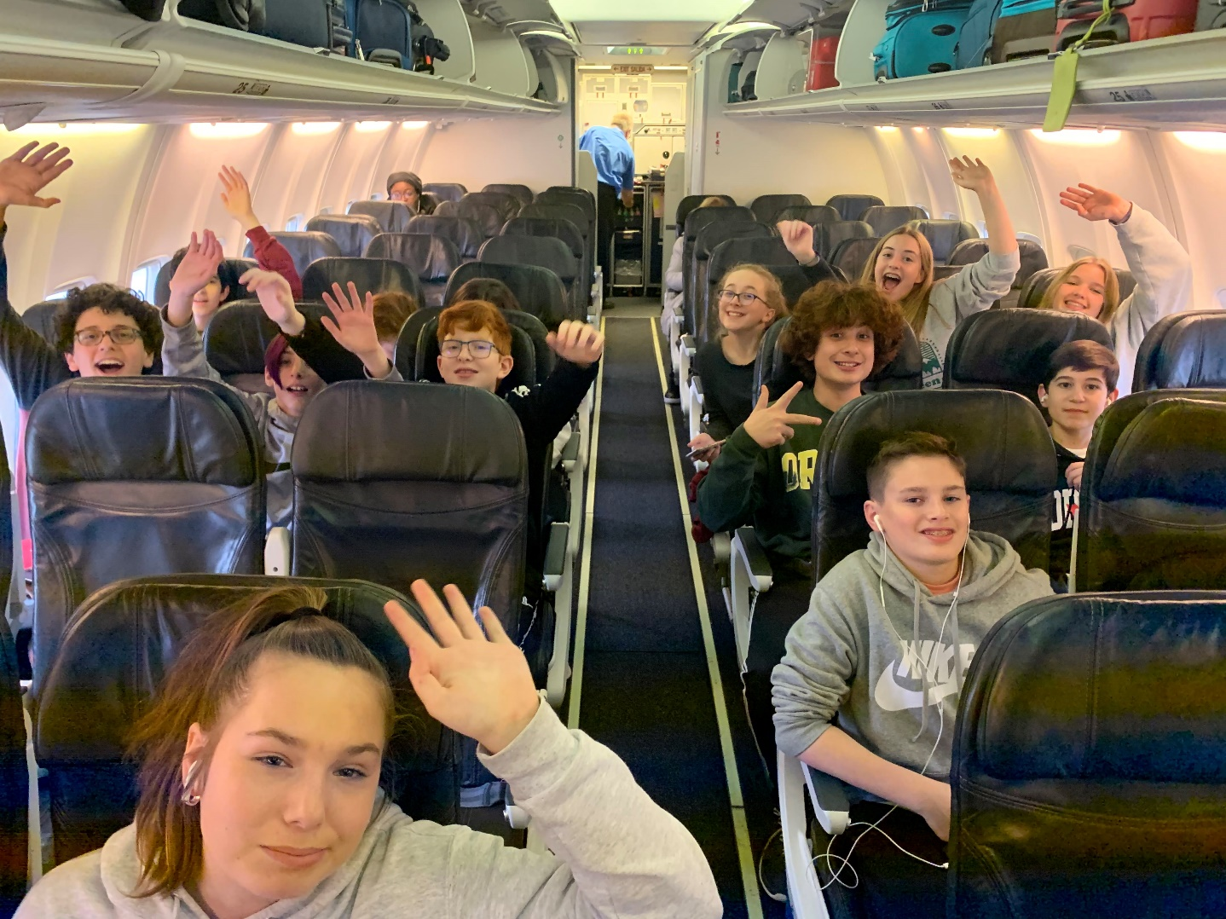
Religious School
Teen L.A. Social Action Trip

Slide 31
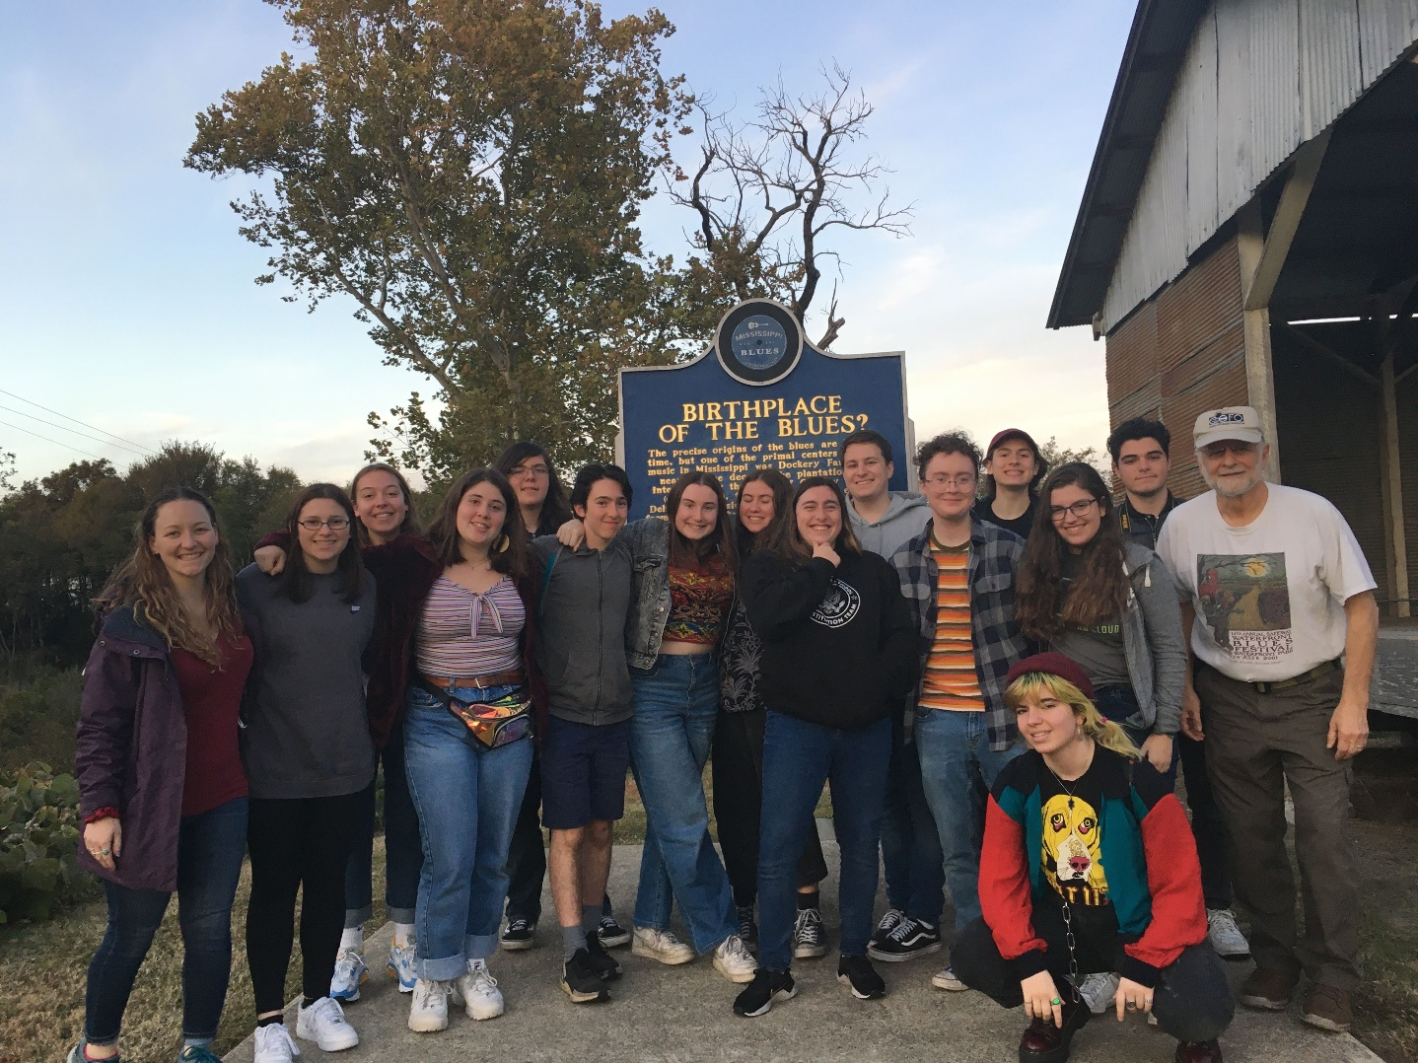
Religious School
Teen Civil Rights Trip
With thanks to the Roscoe and Debra Nelson Youth Fund

Slide 32
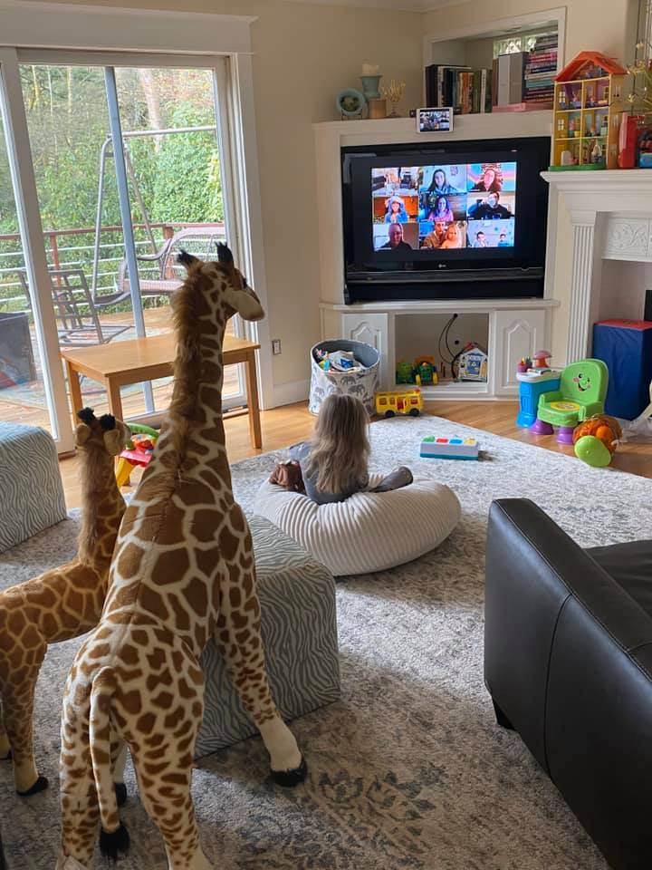
Religious School
Learning from Home

Slide 33
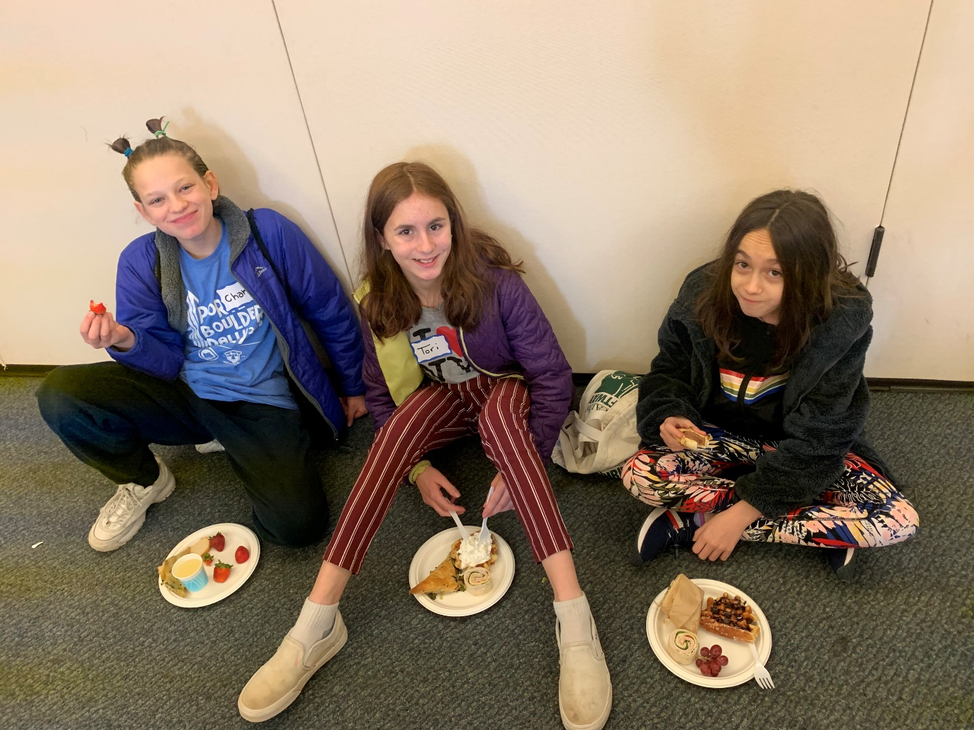
Youth Programming
Laser Tag with Dor Chadash

Slide 34
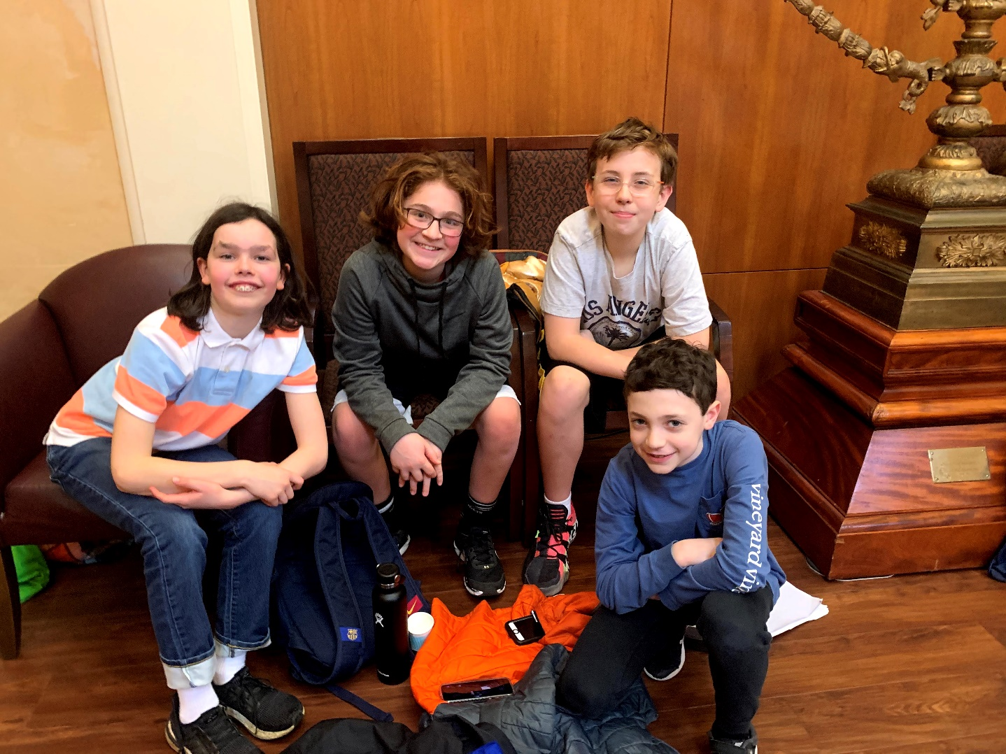
Youth Programming
Laser Tag with Dor Chadash

Slide 35
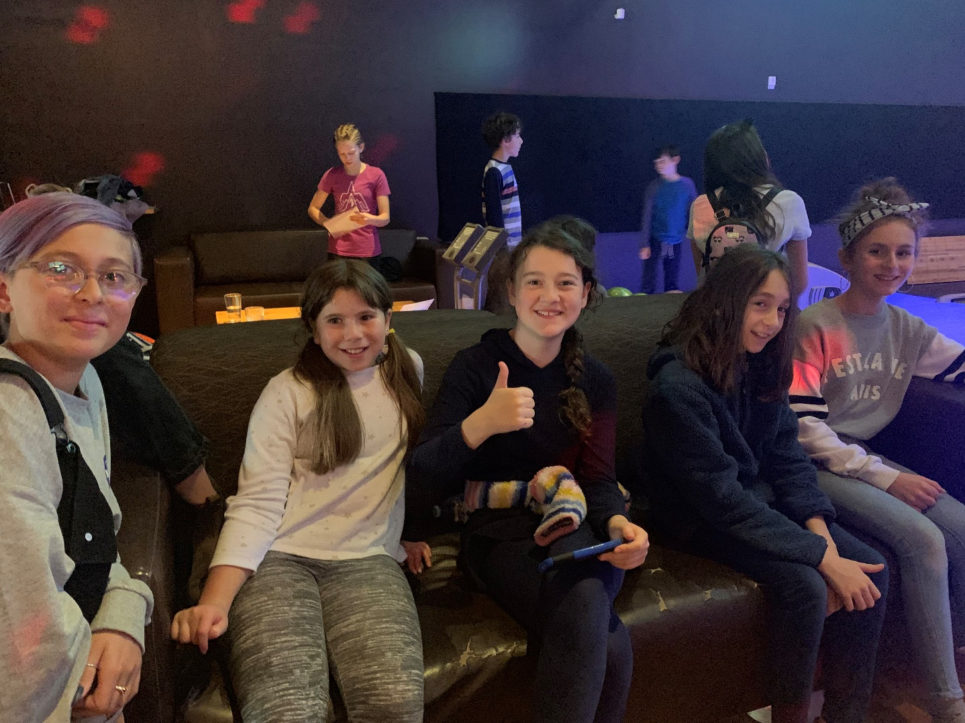
Youth Programming
Laser Tag with Dor Chadash

Slide 36
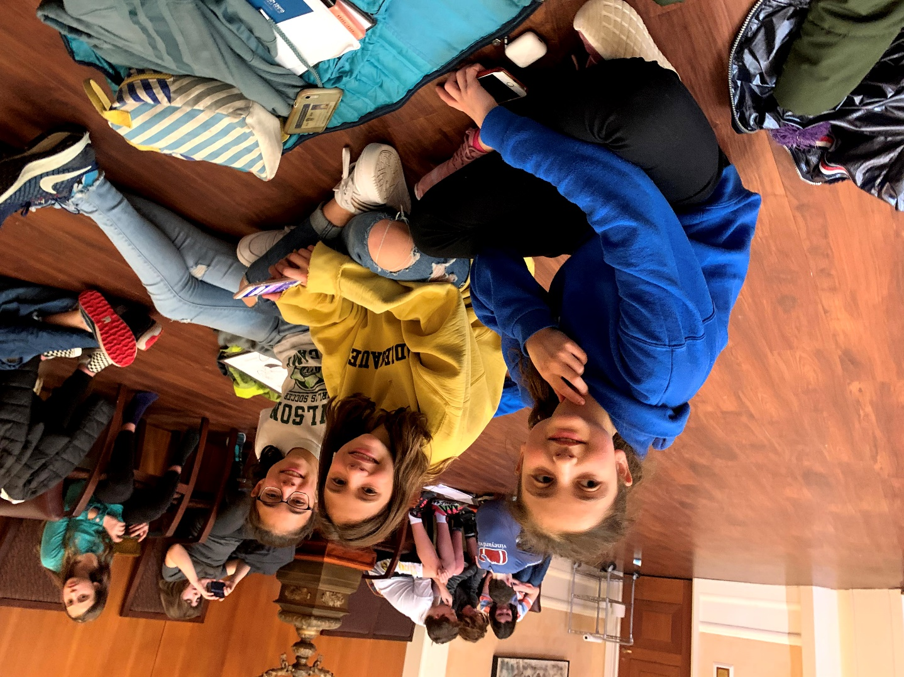
Youth Programming
Laser Tag with Dor Chadash

Slide 37
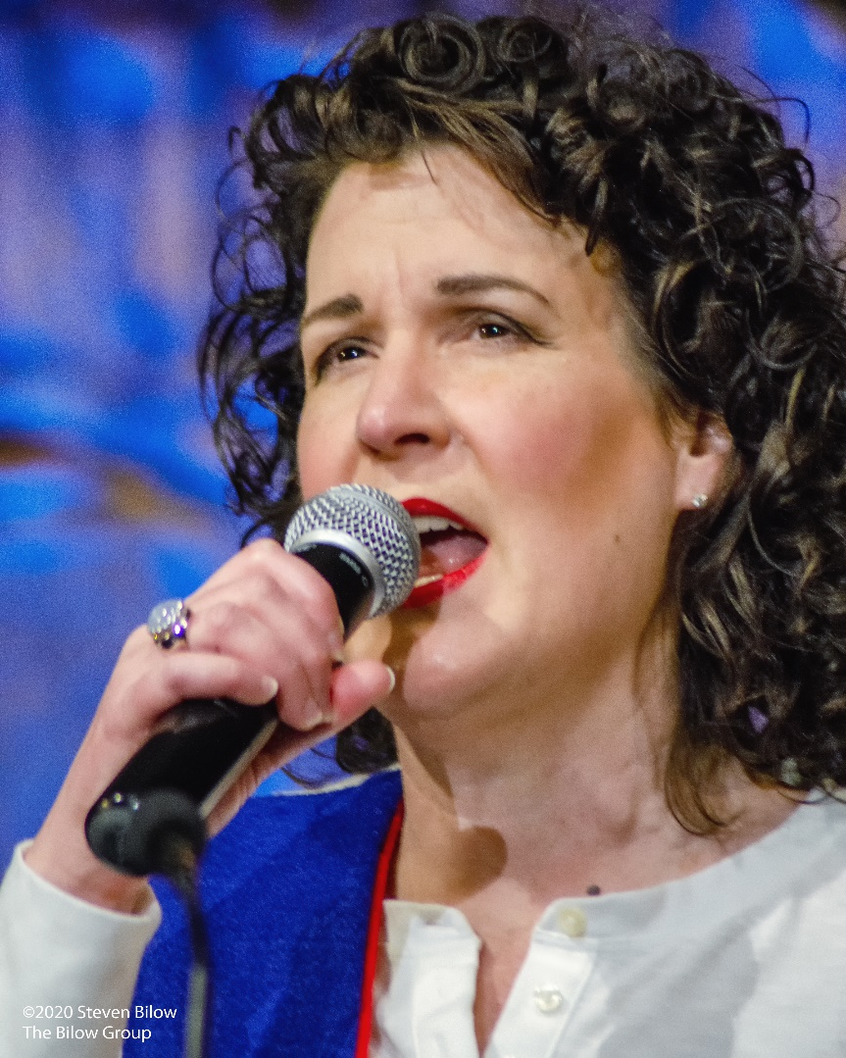
Oy-Klahoma!
The Purim Shpiel

Slide 38
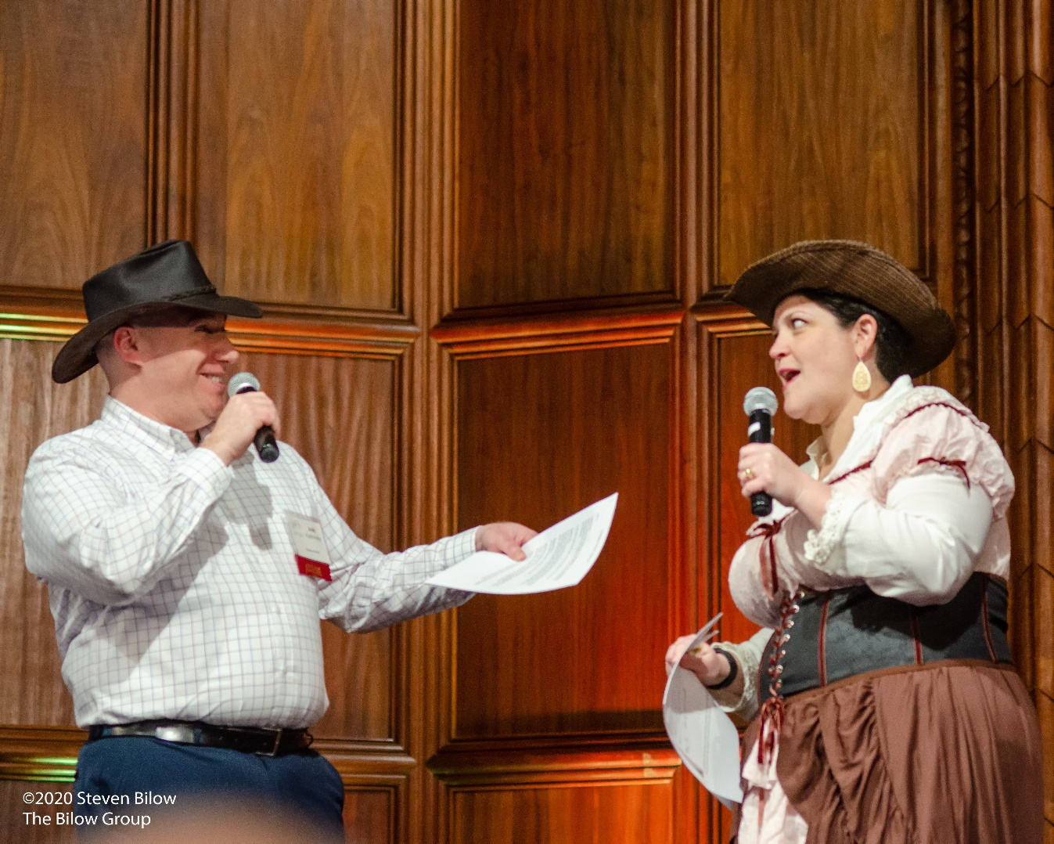
Oy-Klahoma!
The Purim Shpiel

Slide 39
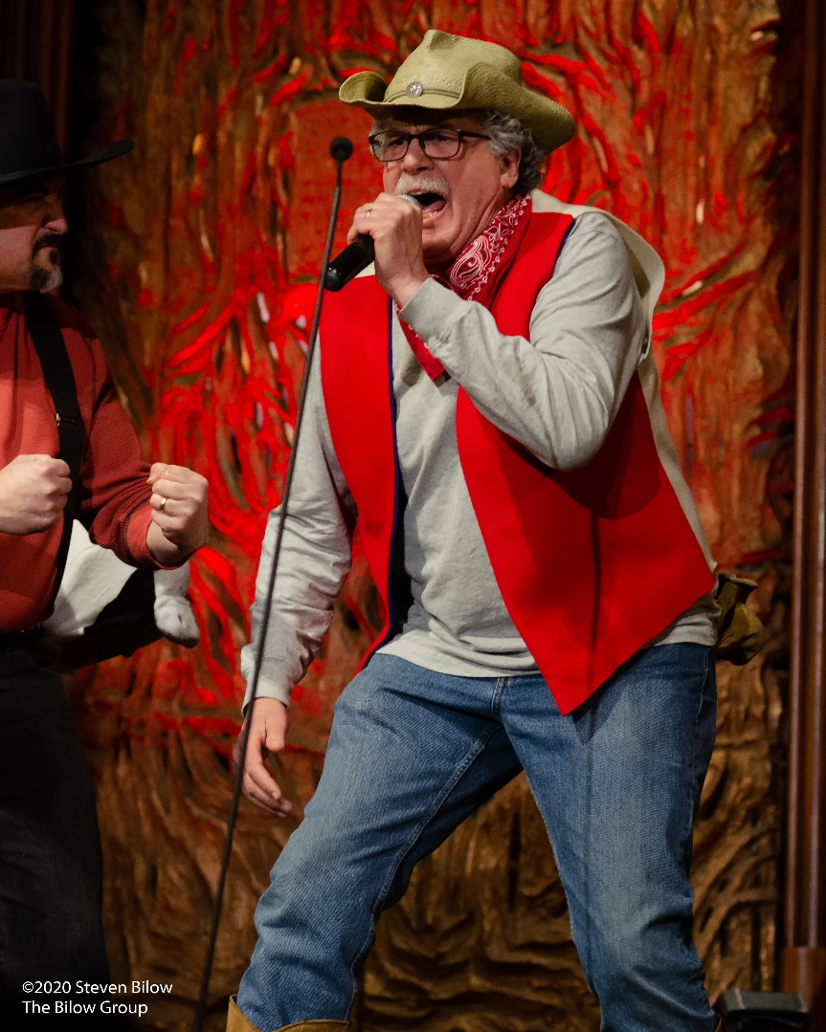
Oy-Klahoma!
The Purim Shpiel

Slide 40
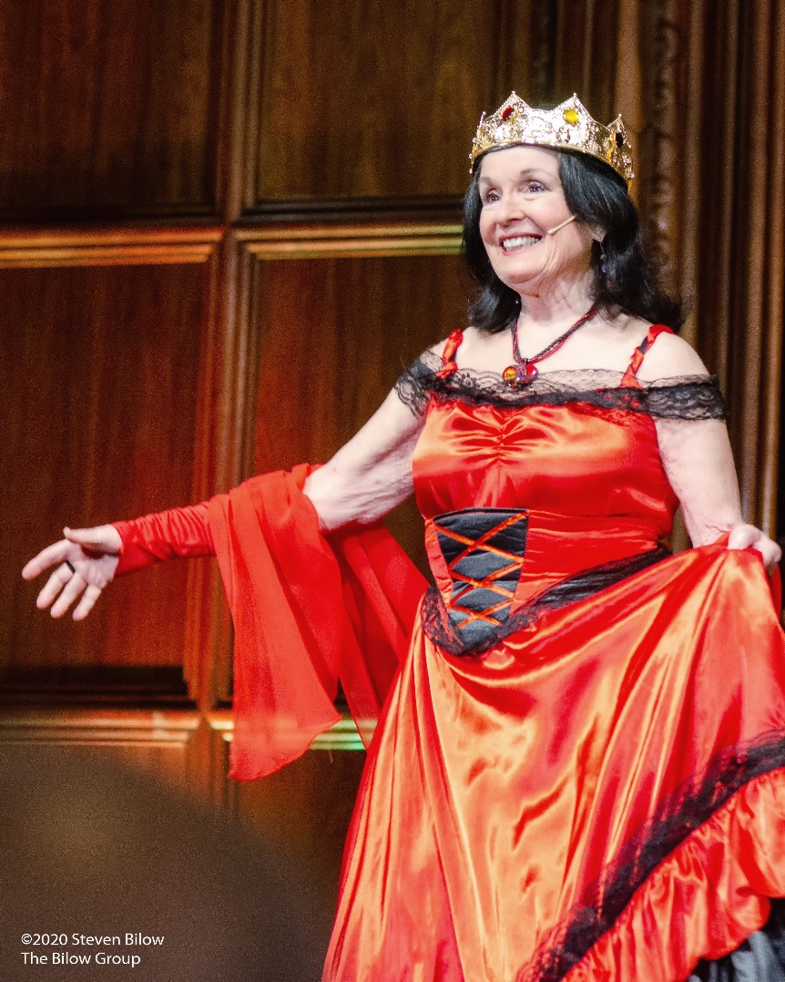
Oy-Klahoma!
The Purim Shpiel

Slide 41
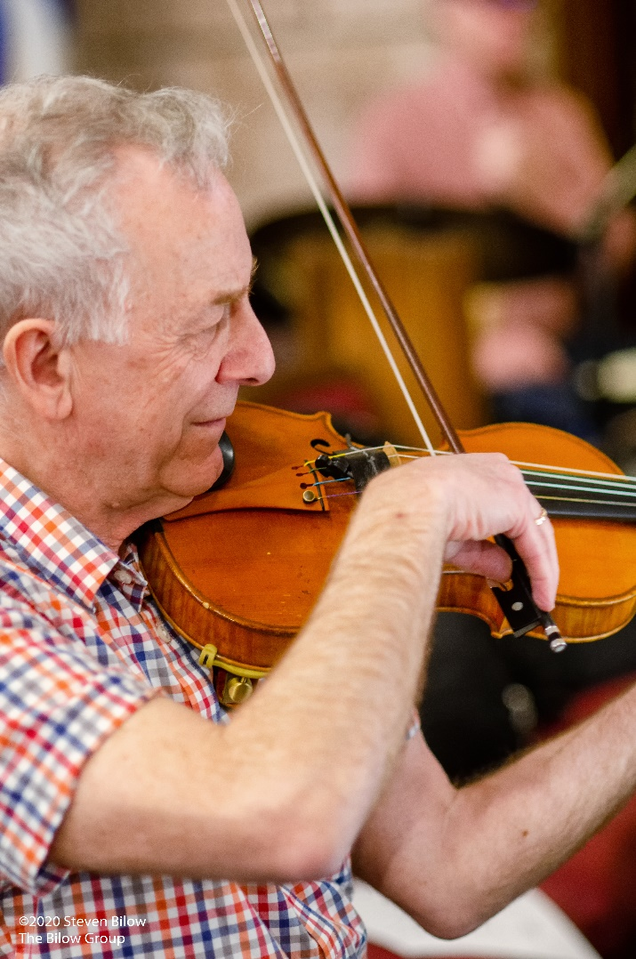
Oy-Klahoma!
The Purim Shpiel

Slide 42
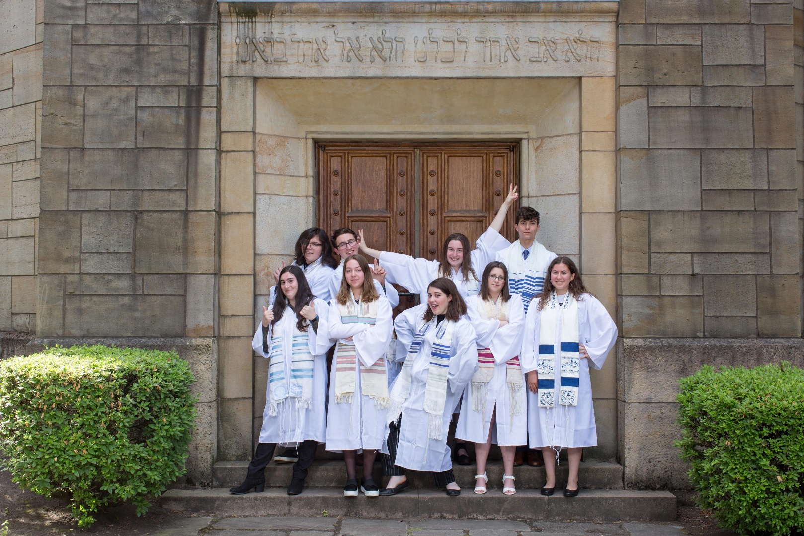
Confirmation 2019
Last Year’s 10th Grade Class

Slide 43
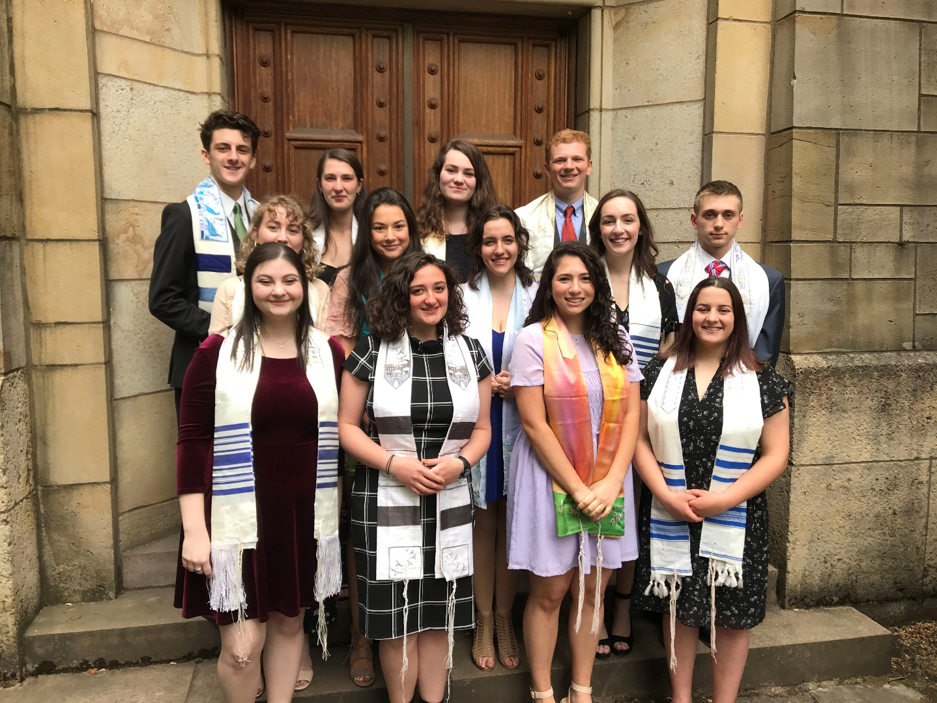
Graduation 2019
Last Year’s Seniors

Slide 44
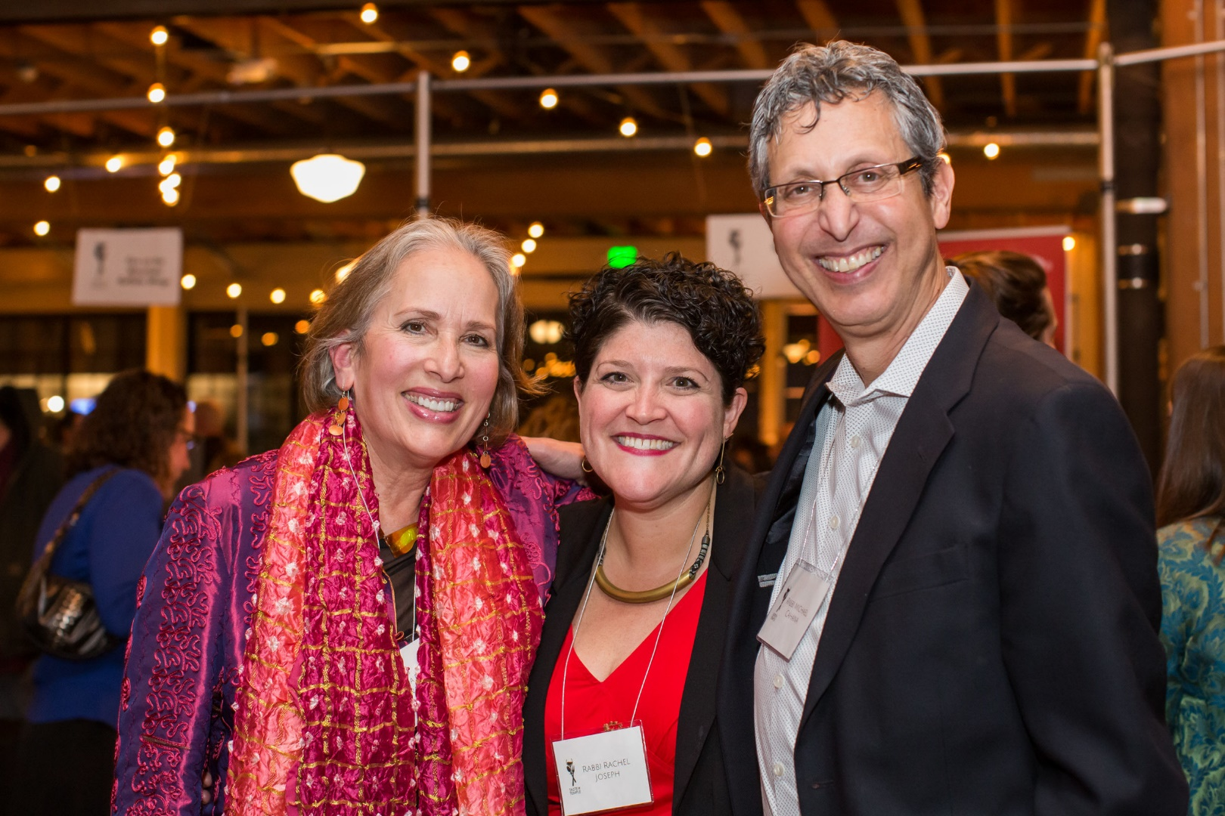
Taste of Temple
Our Tastiest Fundraiser Returned

Slide 45
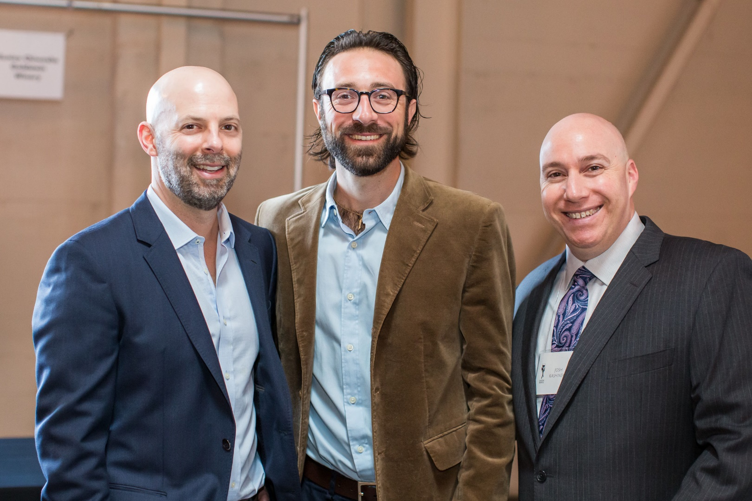
Taste of Temple
Our Tastiest Fundraiser Returned

Slide 46
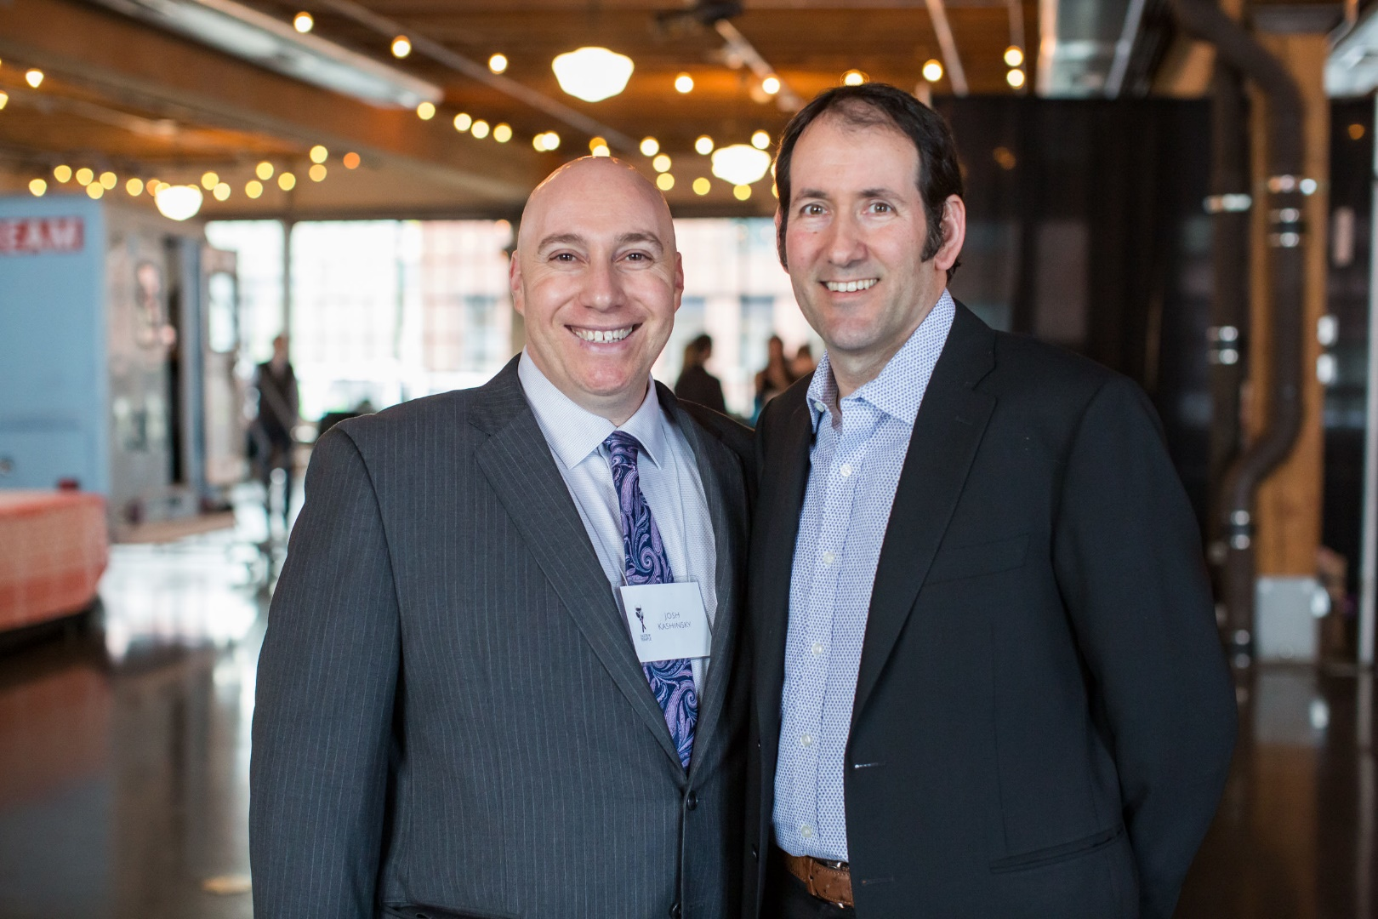
Taste of Temple
Our Tastiest Fundraiser Returned

Slide 47
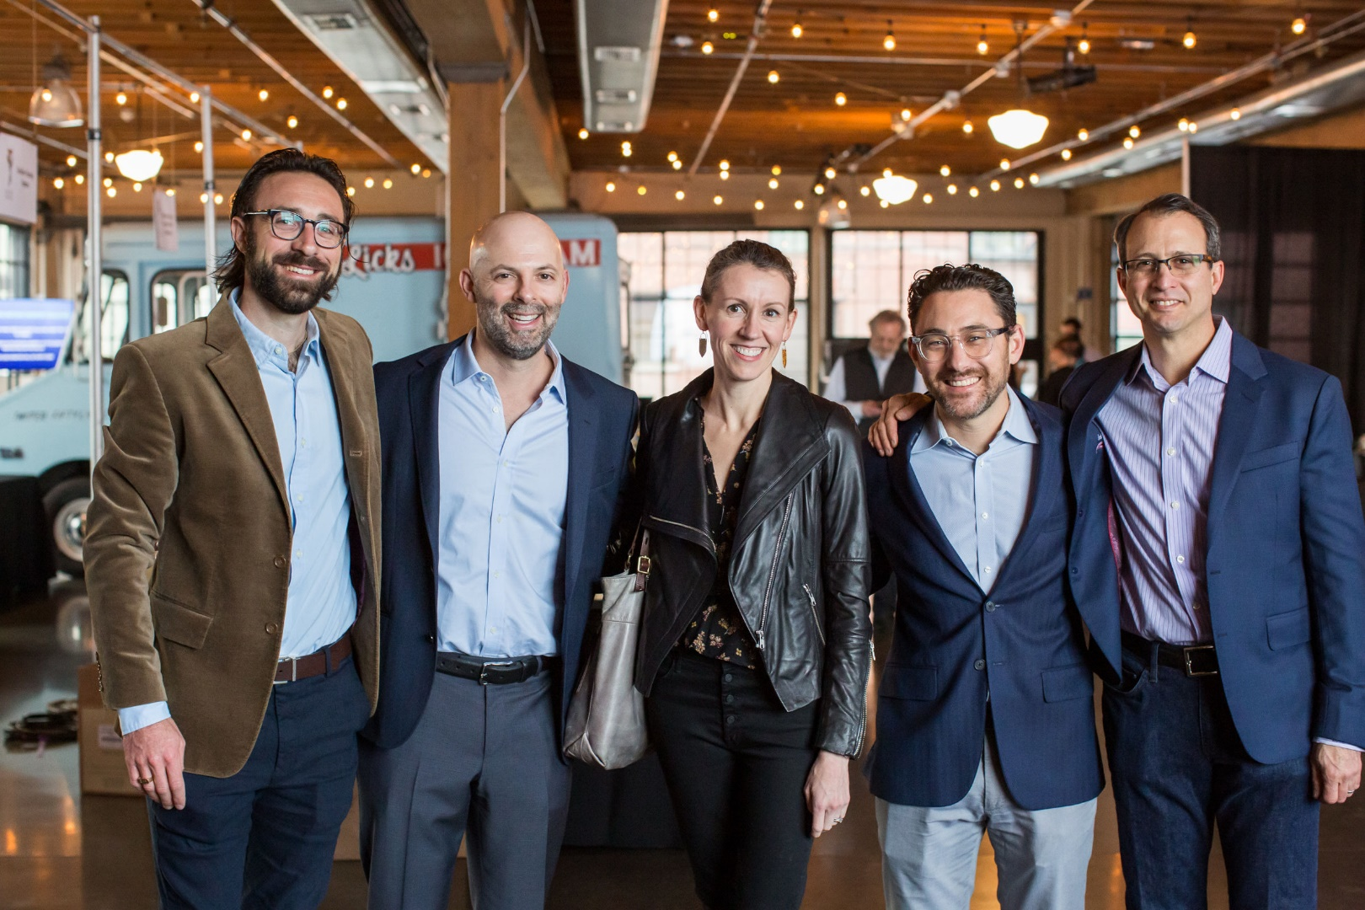
Taste of Temple
Our Tastiest Fundraiser Returned

Slide 48
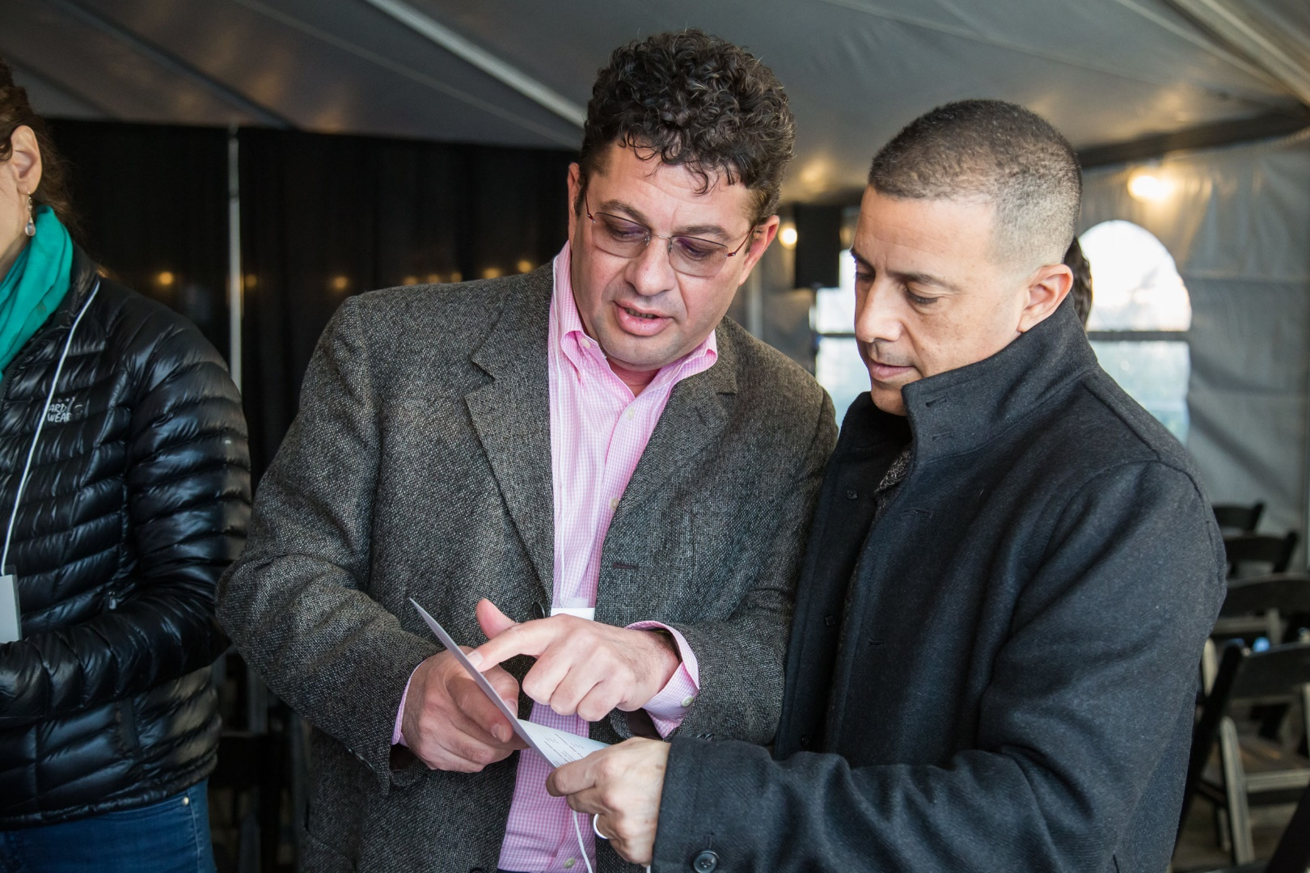
Taste of Temple
Our Tastiest Fundraiser Returned

Slide 49
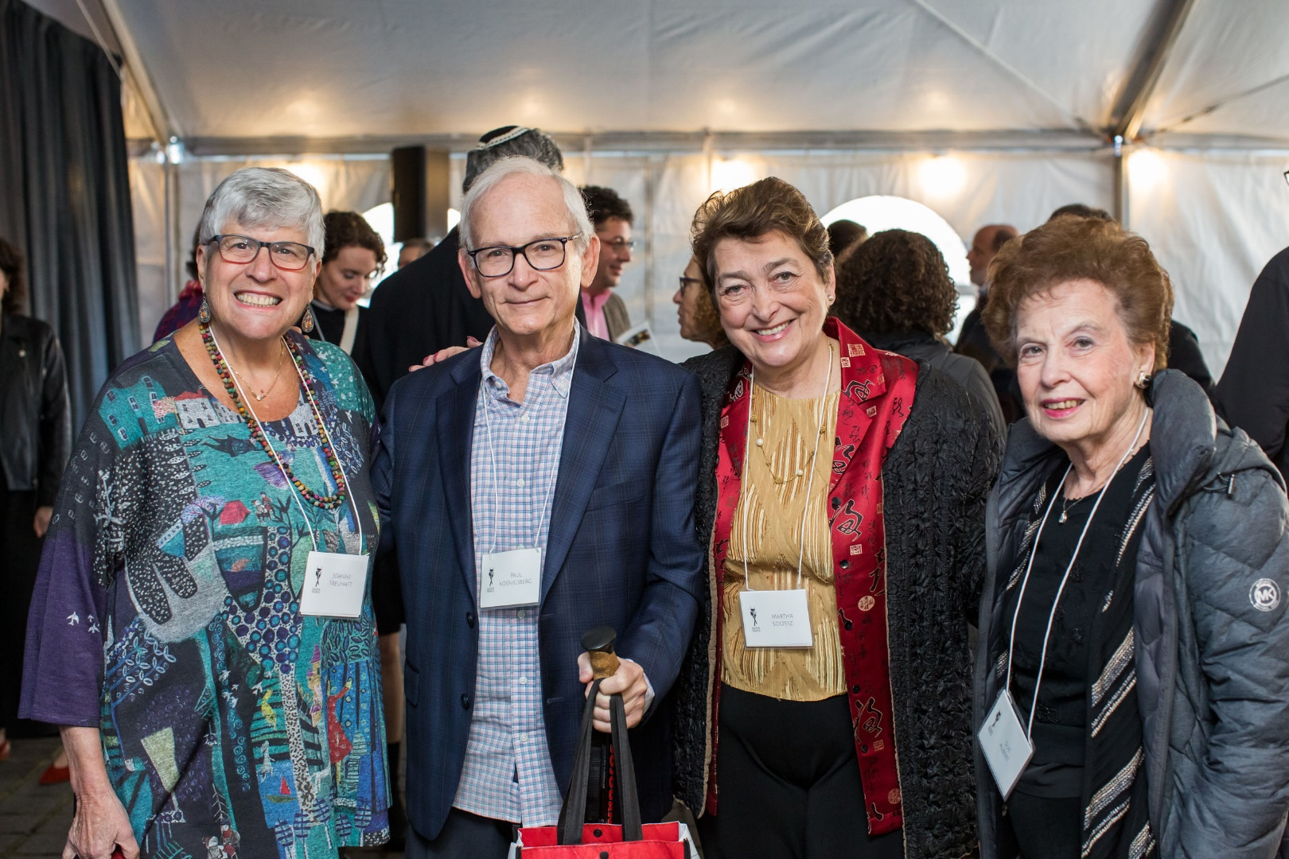
Taste of Temple
Our Tastiest Fundraiser Returned

Slide 50
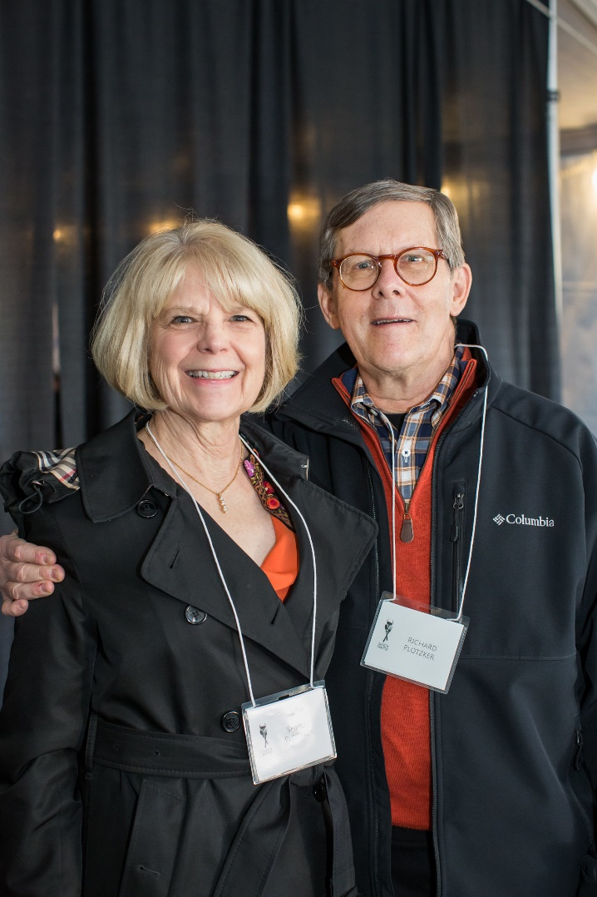
Taste of Temple
Our Tastiest Fundraiser Returned

Slide 51
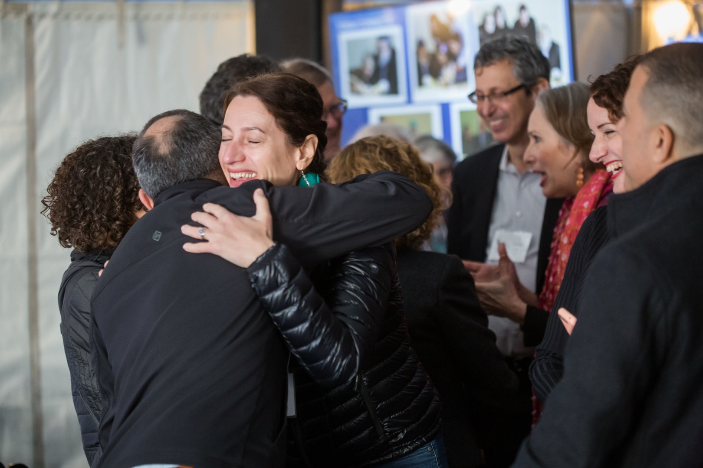
Taste of Temple
Our Tastiest Fundraiser Returned

Slide 52
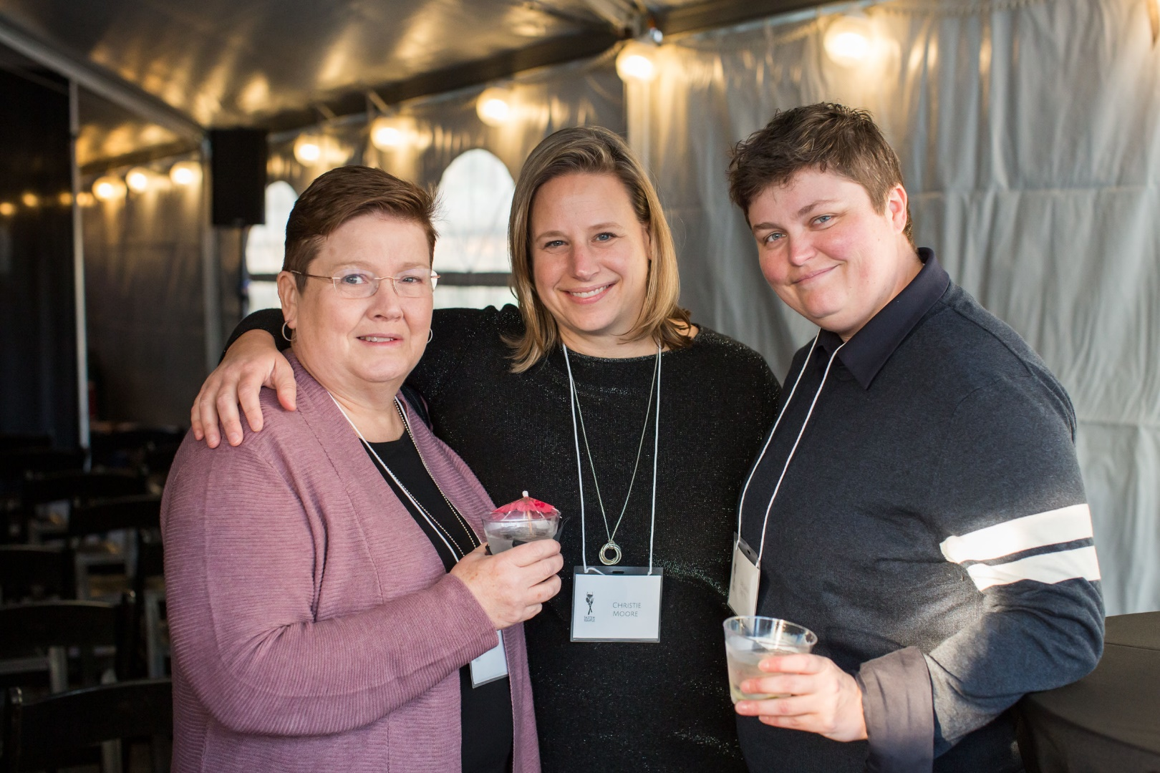
Taste of Temple
Our Tastiest Fundraiser Returned

Slide 53

Taste of Temple
Our Tastiest Fundraiser Returned

Slide 54

Taste of Temple
Our Tastiest Fundraiser Returned

Slide 55

Taste of Temple
Our Tastiest Fundraiser Returned

Slide 56

Taste of Temple
Our Tastiest Fundraiser Returned

Slide 57

Taste of Temple
Our Tastiest Fundraiser Returned

Slide 58

Taste of Temple
Our Tastiest Fundraiser Returned

Slide 59

Taste of Temple
Our Tastiest Fundraiser Returned

Slide 60

Taste of Temple
Our Tastiest Fundraiser Returned

Slide 61

Taste of Temple
Our Tastiest Fundraiser Returned

Slide 62

Taste of Temple
Our Tastiest Fundraiser Returned

Slide 63

Taste of Temple
Our Tastiest Fundraiser Returned

Slide 64

Taste of Temple
Our Tastiest Fundraiser Returned

Slide 65

Taste of Temple
Our Tastiest Fundraiser Returned

Slide 66

Taste of Temple
Our Tastiest Fundraiser Returned

Slide 67

Taste of Temple
Our Tastiest Fundraiser Returned

Slide 68

Taste of Temple
Our Tastiest Fundraiser Returned

Slide 69

Taste of Temple
Our Tastiest Fundraiser Returned

Slide 70

Taste of Temple
Our Tastiest Fundraiser Returned

Slide 71

Taste of Temple
Our Tastiest Fundraiser Returned

Slide 72

Taste of Temple
Our Tastiest Fundraiser Returned

Slide 73

Social Action
Every Day is Mitzvah Day

Slide 74

Social Action
Every Day is Mitzvah Day

Slide 75

Social Action
Every Day is Mitzvah Day

Slide 76

Social Action
Every Day is Mitzvah Day

Slide 77

Social Action
Every Day is Mitzvah Day

Slide 78

Social Action
Every Day is Mitzvah Day

Slide 79
Thank you to our Donors
Michael Adler and Molly Newcomer
George and Sharon Alexander
Michael and Margie Anton
Jonathan and Bonnie Barg
Kevin and Rachelle Barrett
Lester and Heather Baskin
Brad and Janice Berman
Gerel Blauer
Janet Bronitsky and Mark Suprenand
Dan Hurwitz and Debra Brooks
Connie Cambreleng
William and Judy Cappleman
Stuart and Mandi Chestler
David Cohen and Lee Anna Jones
Fred Cohen and Randy Zasloff
Marcia Colton
Will and Melanie Dann
Barry and Bonnie Davis
Dick and Cameron Davis
Dr. Pike Dentistry for Children
Thomas and Susie Desmond
Lou and Kathleen Doctor
James Monteith and Ned Duhnkrack
Richard and Jill Edelson
John and Sarah Epstein
Howard and Jen Feldman
Paul and Sherry Fishman
Eric and Robin Flamm
Andrew Frank and Sally Rosenfeld
Josh and Amy Frankel
Eric and Rebecca Friedenwald-Fishman
Stacy and Sharon Friedman
Morrie Galen
Bill and Bev Galen
Zanley and Claire Galton
Judah and Ali Garfinkle
Linda Georges
Ted and Connie Gilbert
Leonard and Yvonne Gionet
Barbara Glazer
David and Tiffany Goldwyn
Doug Goodman
Greg Goodman and Susan Schnitzer
Mark and Christi Goodman
Bill June and Susan Graber
Steve and Michelle Gradow
Jonathan and Lisa Greenleaf
Craig Hartzman and James John
Dan Henig and Jamie Rice
Andrew Herman and Tina Szczesniak
Gary and Joyce Hoffman
John Harland and Janet Hoffman
Janice Isenberg
Ken and Karen Janoff
Howard Jarvis, DMD, LLC and Tiffany Goldwyn, DMD
Rabbi Sam and Dori Joseph
Josh and Michelle Kashinsky
Leslie Kelinson
Jim and Rhonda Kennedy
Paul and Arlene Koenigsberg
Donald and Judith Kramer
Mrs. Jean Krosner
Irv Levin and Stephanie Fowler
Glen and Lisa Levy
Carol Lewis
Kathleen Lewis
Ken Lewis
Keith Linn and Lisa Ludwig Linn
Dick and Harriet Maizels
Howard and Robin Marcus
Phillip Margolin

Slide 80
Thank you to our Donors
Lynn Marks
Gary and Sheryl Martel
Steve and Robin McCoy
Ruben and Liz Menashe
Page and Lynn Mesher
Barney and Susan Milstein
Christie Moore and Stacy Lewis
Corey Morris-Singer and Andrew Morris-Singer
Doug Muir and Shelley Adams-Muir
Roscoe Nelson III and Debra Nelson
Ted Nelson
Rosalyn Neuberger
Dan and Tracy Oseran
Nancy Oseran
Pete Hammerschmidt and Judith Pakosinski
Bob and Rachel Papkin
Leslie Peltz
Bob and Rita Philip
Allan and Marney Pike
Steven Pike and Allison Sneider Pike
Ryan and Sarah Pitman
Richard and Shirley Plotzker
Harold and Jane Pollin
Joshua and Amy Remick
Jim and Michael Richman
Stephen and Leslie Robinson
Paul and Gayle Romain
Alan and Eve Rosenfeld
James Rosenbaum and Sandra Lewis
John and Marti Rosenthal
Rosemarie Rosenfeld
Warren Rosenfeld and Sheryl Langerman
Eleanore Rubinstein
Rick Rubinstein, Jr. and Jill Rubinstein
Jerry and Bunny Sadis
Michael and Linda Salinsky
Arlene Schnitzer
Dori Schnitzer
Thelma Schnitzer
Lois Schnitzer
Dave Smith and Libby Schwartz
Richard Schwartz
Joel and Sandra Seres
Michael Freeman and Lynda Shapiro
Tom and Megan Shipley
Ron and Sheila Silver
Michael Simon and Suzanne Bonamici
Jonathan Singer
Rodger Sleven and Marcella Flores
Nate Smith and Anna Epstein
Paul Snyder and Amy Malkin Snyder
Martha Soltesz
Bruce Spiegel
Mardi Spitzer
Harley and Robyn Spring
Chester Edwards and Lynn Tobias
Brad and Michelle Tonkin
Cheryl Tonkin
Rena Tonkin
Marcy Tonkin
Bill and Joanne Treuhaft
Tony and Bianca Urdes
Jason Waxman
Sharon Weil
Michael Weiner and Kathy Davis-Weiner
Jeff and Lynn Wolfstone
Ron and Nancy Wyden
Phil Zald and Heh Shin Kwak
Bob Zelinka

