Slide 1

Passover 2020
Connecting to Jews around the world
from the safety of our homes
Slides for a Zoom seder
by Sarah Bunin Benor, sbenor@huc.edu

Slide 2
Preface
This PowerPoint presentation is intended for use during a Zoom seder or to be projected at a home seder. For Zoom, you can use the screensharing function to share the slides and videos with your guests. It’s a good idea to start with gallery view so guests can see each other’s faces and have conversations. You might want to begin screensharing around slide 5 and turn it off periodically for discussion.
This presentation includes most of the traditional Ashkenazi Haggadah in Hebrew and English, as well as videos, texts, and traditions from around the world, including multiple Jewish languages. You can tailor the slides to your own seder. At the end you will find the omitted sections, and you can insert them in their appropriate locations, using sefaria.org as a guide.
At the end you will find an afikoman escape room that can be tailored to your home (this requires some advance preparation).

Slide 3
Zoom tips (to send out in advance with the Zoom link and password)
Best to use a laptop or tablet if possible, but phones work too
Download Zoom app or program in advance
Keep your screen horizontal
Keep yourself muted until you want to talk (especially during singing)
Keep it on Gallery view so you can see more people. If you’re on a phone, you can find that by swiping left.
I’ll be sharing images so you won’t need a haggadah

Slide 4
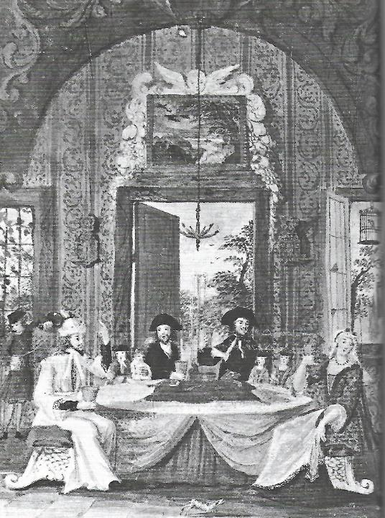
Welcome
Introductions: Leader calls on each guest individually:
  Name
  Location
  Coronavirus check-in
  One thought about how the Exodus story relates to the current situation

Slide 5
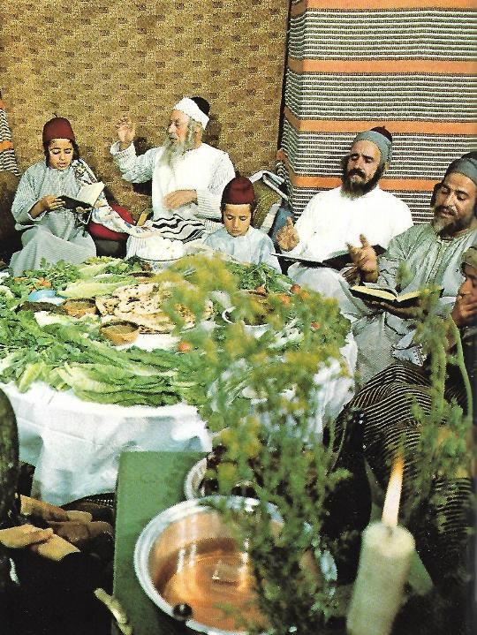
Welcome
Why is this an international seder?
  As we are stuck in the “narrow place” of our homes, we can connect symbolically with Jewish communities around the world

Slide 6
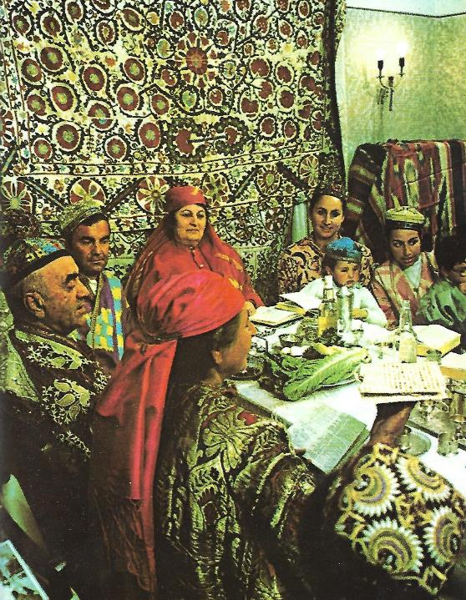
Welcome
How is this an international seder?
  Songs
  Images
  Phrases
  Traditions
  Foods

Slide 7
Shehecheyanu - שֶׁהֶחֱיָנוּ
בָּרוּךְ אַתָּה ה', אֱלֹהֵינוּ מֶלֶךְ הַעוֹלָם שֶׁהֶחֱיָנוּ וְקִיְּמָנוּ וְהִגִּיעָנוּ לַזְּמַן הַזֶּה
Baruch ata adonai elohenu melech haolam shehecheyanu vekiyemanu vehigianu lazman hazeh.
Blessed are You, Lord our God, King of the Universe, who has granted us life, sustained us and enabled us to reach this occasion.

Slide 8
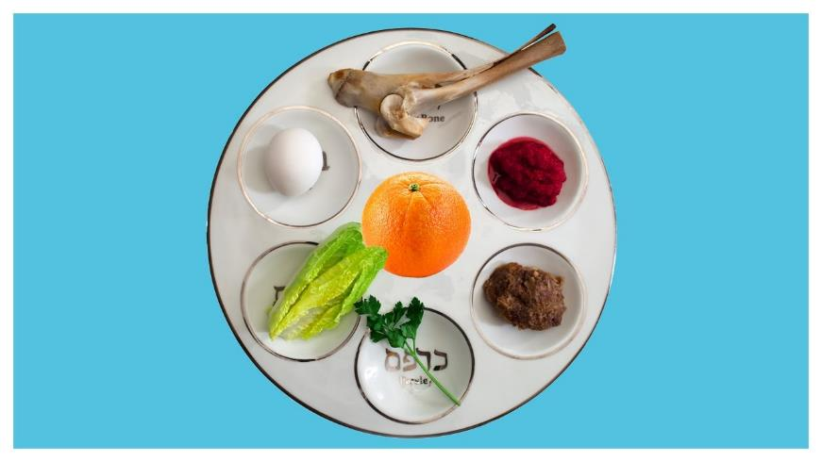
Seder plate

Slide 9
Seder plate
Zroa – shank bone - Paschal lamb replaced by paschal yam
Beitzah: Egg
Maror: Bitter herb
Orange: American innovation
Chazeret: Romaine lettuce
Charoset: Fruit and nut mixture
Karpas: Parsley

Slide 10
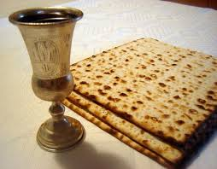
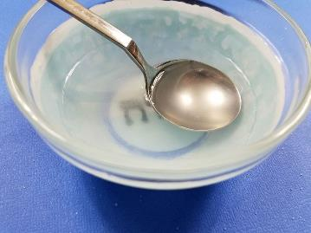
Seder plate
Matzah, wine, Elijah’s cup
Salt water

Slide 11
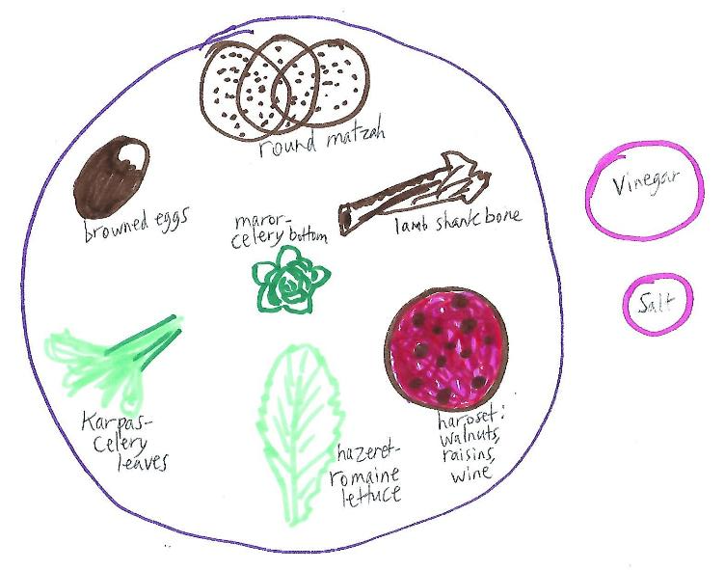
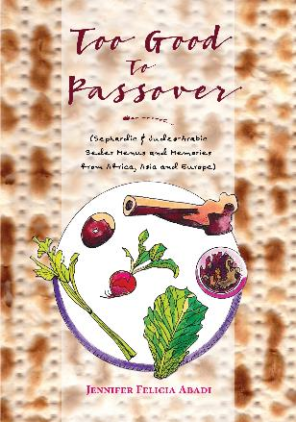
Seder “plates” around the world
Greece:
Plate

Slide 12
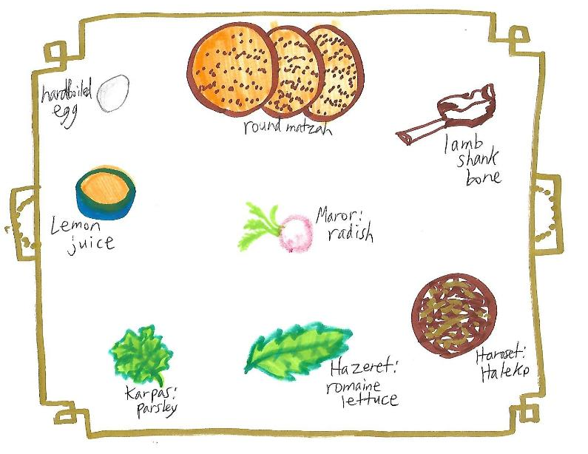
Seder “plates” around the world
Uzbekistan:
Tray

Slide 13
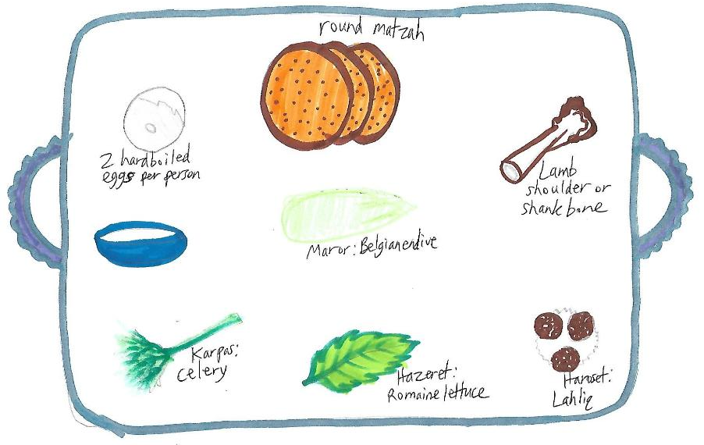
Seder “plates” around the world
Libya:
Basket tray

Slide 14
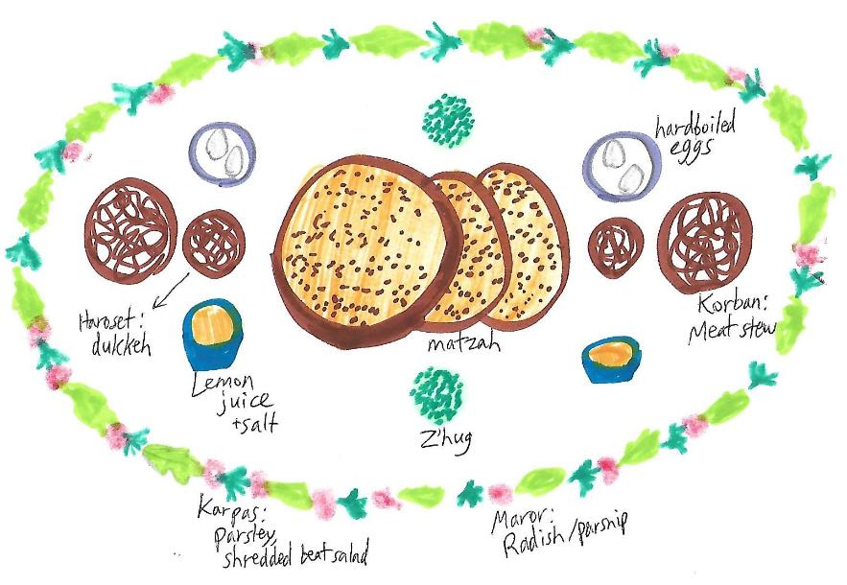
Seder “plates” around the world
Yemen:
Whole table

Slide 15
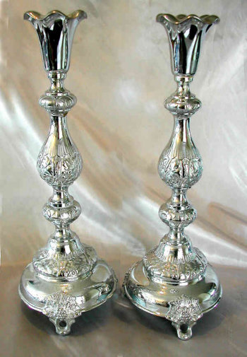
Candle lighting
בָּרוּךְ אַתָּה ה', אֱלֹהֵינוּ מֶלֶךְ הָעוֹלָם אֲשֶׁר קִדְּשָׁנוּ בְּמִצְוֹתָיו וְצִוָּנוּ לְהַדְלִיק נֵר שֶׁל (שַבָּת וְ)יוֹם־טוֹב
Baruch ata adonai elohenu melech haolam asher kidishanu b'mitzvotav v'tzivanu l'hadlik ner shel (shabbat v')yom-tov.

Slide 16
Table of contents – order of the seder
1. Kadesh 2. Urchatz 3. Karpas 4. Yachatz 5. Magid 6. Rochtza 7. Motzi, Matza 8. Maror 9. Korech 10. Shulchan Orech 11. Tzafun 12. Barech 13. Hallel 14. Nirtza | קַדֵש וּרְחַץ כַּרְפַּס יחץ מגיד רָחְצָה מוֹצִיא, מַצָּה מָרוֹר כּוֹרֵךְ שֻׁלְחָן עוֹרֵךְ צָפוּן בָּרֵךְ הלל נרצה | 1. Recite the Kiddush (Sanctifi​cation - blessing over wine)​ 2. Wash hands without a blessing 3. Parsley dipped in salt water 4. Break the middle matzah, and hide part to be Afikomen 5. Tell the Exodus story 6. Wash hands with a blessing 7. Recite the blessings for bread and matzah 8. Eat a bitter herb (maror) 9. Each matzah, maror, and charoset together in a sandwich​ 10. Festive meal 11. Afikoman​​ 12. Say Grace after the meal 13. Remainder​ of Hallel 14. Prayer for acceptanc​e of the service, fun songs

Slide 17
Kadesh - קַדֵּשׁ
On Shabbat, begin here: And there was evening and there was morning, the sixth day. And the heaven and the earth were finished, and all their host. And on the seventh day God finished His work which He had done; and He rested on the seventh day from all His work which He had done. And God blessed the seventh day, and sanctified it; because He rested on it from all of His work which God created in doing (Genesis 1:31-2:3). | וַיְהִי עֶרֶב וַיְהִי בֹקֶר יוֹם הַשִּׁשִּׁי. וַיְכֻלּוּ הַשָּׁמַיִם וְהָאָרֶץ וְכָל-צְבָאָם. וַיְכַל אֱלֹהִים בַּיּוֹם הַשְּׁבִיעִי מְלַאכְתּוֹ אֲשֶׁר עָשָׂה וַיִּשְׁבֹּת בַּיּוֹם הַשְּׁבִיעִי מִכָּל מְלַאכְתּוֹ אֲשֶׁר עָשָׂה. וַיְבָרֵךְ אֱלֹהִים אֶת יוֹם הַשְּׁבִיעִי וַיְקַדֵּשׁ אוֹתוֹ כִּי בוֹ שָׁבַת מִכָּל-מְלַאכְתּוֹ אֲשֶׁר בָּרָא אֱלֹהִים לַעֲשׂוֹת.

Slide 18
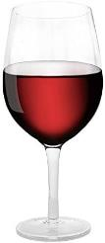
Kadesh - קַדֵּשׁ - first cup
On weekdays, begin here: Baruch ata adonai elohenu melech haolam borey pri hagafen. Blessed are You, Lord our God, King of the universe, who creates the fruit of the vine. Blessed are You, Lord our God, King of the universe, who has chosen us from all peoples and has raised us above all tongues and has sanctified us with His commandments... Drink while reclining to the left | בָּרוּךְ אַתָּה ה', אֱלֹהֵינוּ מֶלֶךְ הָעוֹלָם בּוֹרֵא פְּרִי הַגָּפֶן. בָּרוּךְ אַתָּה ה', אֱלהֵינוּ מֶלֶךְ הָעוֹלָם אֲשֶׁר בָּחַר בָּנוּ מִכָּל-עָם וְרוֹמְמָנוּ מִכָּל-לָשׁוֹן וְקִדְּשָׁנוּ בְּמִצְוֹתָיו. וַתִּתֶּן לָנוּ ה' אֱלֹהֵינוּ בְּאַהֲבָה (לשבת: שַׁבָּתוֹת לִמְנוּחָה וּ) מוֹעֲדִים לְשִׂמְחָה, חַגִּים וּזְמַנִּים לְשָׂשוֹן, (לשבת: אֶת יוֹם הַשַׁבָּת הַזֶּה וְ) אֶת יוֹם חַג הַמַּצּוֹת הַזֶּה זְמַן חֵרוּתֵנוּ, (לשבת: בְּאַהֲבָה) מִקְרָא קֹדֶשׁ זֵכֶר לִיצִיאַת מִצְרָיִם. כִּי בָנוּ בָחַרְתָּ וְאוֹתָנוּ קִדַּשְׁתָּ מִכָּל הָעַמִּים, (לשבת: וְשַׁבָּת) וּמוֹעֲדֵי קָדְשֶׁךָ (לשבת: בְּאַהֲבָה וּבְרָצוֹן) בְּשִׂמְחָה וּבְשָׂשוֹן הִנְחַלְתָּנוּ. בָּרוּךְ אַתָּה ה', מְקַדֵּשׁ (לשבת: הַשַׁבָּת וְ) יִשְׂרָאֵל וְהַזְּמַנִּים.

Slide 19
Kadesh - קַדֵּשׁ
On Saturday night add: Blessed are You, Lord our God, King of the universe, who creates the light of the fire. Blessed are You, Lord our God, King of the universe, who distinguishes between the holy and the profane, between light and darkness, between Israel and the nations, between the 7th day and the six working days... | בָּרוּךְ אַתָּה ה', אֱלֹהֵינוּ מֶלֶךְ הָעוֹלָם, בּוֹרֵא מְאוֹרֵי הָאֵשׁ. בָּרוּךְ אַתָּה ה', אֱלֹהֵינוּ מֶלֶךְ הָעוֹלָם הַמַּבְדִיל בֵּין קֹדֶשׁ לְחֹל, בֵּין אוֹר לְחשֶׁךְ, בֵּין יִשְׂרָאֵל לָעַמִּים, בֵּין יוֹם הַשְּׁבִיעִי לְשֵׁשֶׁת יְמֵי הַמַּעֲשֶׂה. בֵּין קְדֻשַּׁת שַׁבָּת לִקְדֻשַּׁת יוֹם טוֹב הִבְדַּלְתָּ, וְאֶת-יוֹם הַשְּׁבִיעִי מִשֵּׁשֶׁת יְמֵי הַמַּעֲשֶׂה קִדַּשְׁתָּ. הִבְדַּלְתָּ וְקִדַּשְׁתָּ אֶת-עַמְּךָ יִשְׂרָאֵל בִּקְדֻשָּׁתֶךָ. בָּרוּךְ אַתָּה ה', הַמַּבְדִיל בֵּין קֹדֶשׁ לְקֹדֶשׁ.

Slide 20
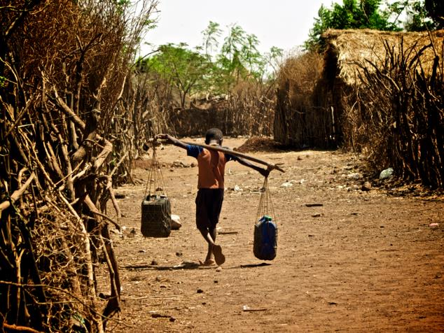
Urchatz - ורחץ
Wash your hands without a blessing.
In contrast to many people in our country and around the world, especially refugees, we're fortunate to have easy access to water.

Slide 21
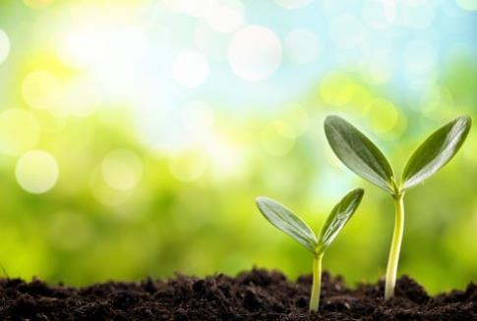
Karpas - כרפס
בָּרוּךְ אַתָּה ה', אֱלֹהֵינוּ מֶלֶךְ הָעוֹלָם, בּוֹרֵא פְּרִי הָאֲדָמָה.
Baruch ata adonai elohenu melech haolam borey pri ha'adamah.
Blessed are you, Lord our God, King of the universe, who creates the fruit of the earth.
Eat parsley or other green vegetable
Despite the crisis, spring is sprouting up around us

Slide 22
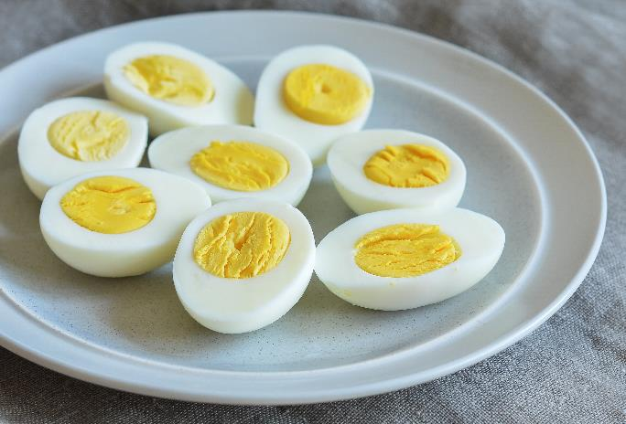
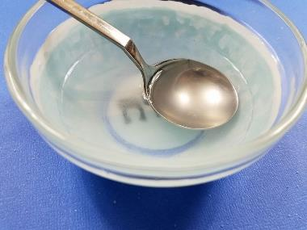
Appetizers!

Slide 23
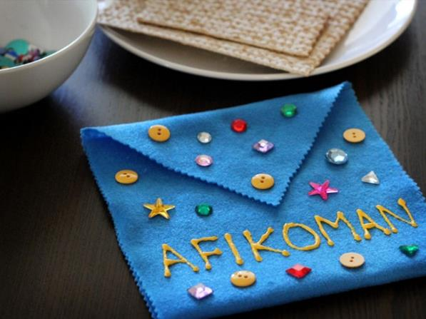
Yachatz - יחץ
Split the middle matzah in two, and hide the larger piece to use for the afikoman.

Slide 24
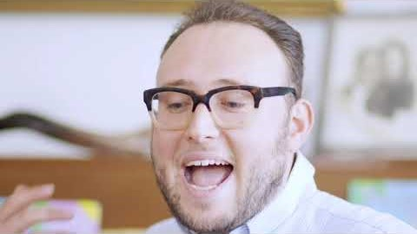
Yachatz - יחץ - Syrian Jews
Asher Shasho Levy with Chloe Pourmorady

Slide 25
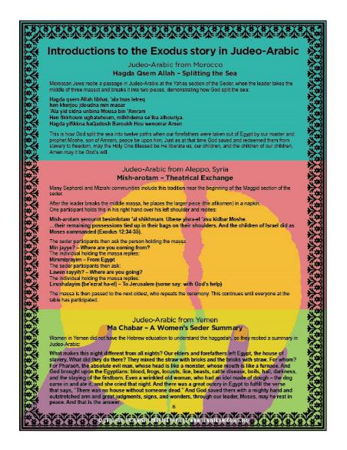
Magid - מגיד - Syrian Jews
One participant holds the afikoman in his right hand over his left shoulder and recites:
Mish-arotam ṣerourot besimlotam ‘al shikhmam. Ubene yisra-el ‘asu kidbar Moshe.
…their remaining possessions tied up in their bags on their shoulders. And the children of Israel did as Moses commanded (Exodus 12:34-35).
The seder participants then ask the person holding the matzah‫:‬‬‬‬‬‬‬‬‬‬‬‬‬‬‬‬
- Min jayye? – Where are you coming from?
The individual replies:
- Mimmiṣrayim – From Egypt
- Lawen rayyiḥ? – Where are you going?
- Lirushalayim – To Jerusalem

Slide 26
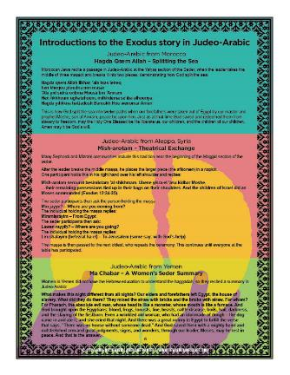
Magid - מגיד - Yemenite women
Women in Yemen did not have the Hebrew education to understand the haggadah, so they recited a summary in Judeo-Arabic:
What makes this night different from all nights? Our elders and forefathers left Egypt, the house of slavery. What did they do there? They mixed the straw with bricks and the bricks with straw. For whom? For Pharaoh, the absolute evil man, whose head is like a monster, whose mouth is like a furnace. And God brought upon the Egyptians: blood, frogs, locusts, lice, beasts, cattle disease, boils, hail, darkness, and the slaying of the firstborn. Even a wrinkled old woman, who had an idol made of dough – the dog came in and ate it, and she cried that night. And there was a great outcry in Egypt to fulfill the verse that says, “There was no house without someone dead.” And God saved them with a mighty hand and outstretched arm and great judgments, signs, and wonders, through our leader, Moses, may he rest in peace. And that is the answer.

Slide 27
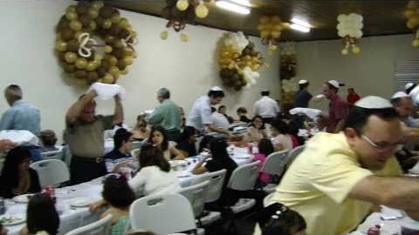
Magid - מגיד – Moroccan Jews
Jews in Brazil doing the Moroccan tradition of reciting the "Bibhilu" piyyut while waving the seder plate over guests’ heads before Ha Lahma.

Slide 28
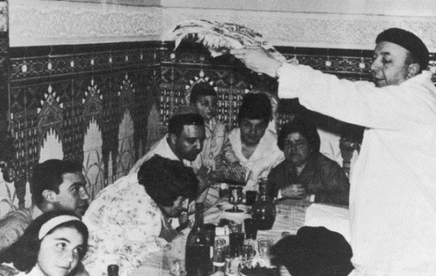
Ha Lachma Anya - הָא לַחְמָא עַנְיָא
Uncover the matzahs, raise them, and recite:
Ha lachma, ha lachma anya di achalu, achalu avhatana b'ar'a b'ar'a d'mitzrayim, b'ar'a b'ar'a d'mitzrayim. Kol dichfin yetey v'yechol, kol ditzrich yetey v'yifsach. Hashata hacha, l'shana habaa b'ar'a d'yisrael. Hashata avdei, l'shana habaa bnei chorin.
This is the bread of destitution that our ancestors ate in the land of Egypt. Anyone who is famished should come and eat, anyone who is in need should come and partake of the Pesach sacrifice. Now we are here, next year we will be in the land of Israel; this year we are slaves, next year we will be free people.
הָא לַחְמָא עַנְיָא דִּי אֲכָלוּ אַבְהָתָנָא בְאַרְעָא דְמִצְרָיִם. כָּל דִכְפִין יֵיתֵי וְיֵיכֹל, כָּל דִצְרִיךְ יֵיתֵי וְיִפְסַח. הָשַּׁתָּא הָכָא, לְשָׁנָה הַבָּאָה בְּאַרְעָא דְיִשְׂרָאֵל. הָשַּׁתָּא עַבְדֵי, לְשָׁנָה הַבָּאָה בְּנֵי חוֹרִין.

Slide 29
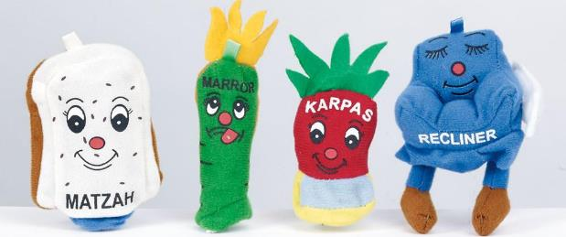
Four Questions
Ma nishtana halayla hazeh mikol halelot?
How different this night is from all [other] nights! On all [other] nights we eat leavened products and matzah; this night, only matzah. On all [other] nights we eat other vegetables; tonight bitter herbs. On all [other] nights, we don't dip [our food] even one time; tonight [we dip it] twice. On [all] other nights, we eat either sitting or reclining; tonight we all recline.
מַה נִּשְׁתַּנָּה הַלַּיְלָה הַזֶּה מִכָּל הַלֵּילוֹת? שֶׁבְּכָל הַלֵּילוֹת אָנוּ אוֹכְלִין חָמֵץ וּמַצָּה, הַלַּיְלָה הַזֶּה - כֻּלּוֹ מַצָּה.שֶׁבְּכָל הַלֵּילוֹת אָנוּ אוֹכְלִין שְׁאָר יְרָקוֹת - הַלַּיְלָה הַזֶּה (כֻּלּוֹ) מָרוֹר. שֶׁבְּכָל הַלֵּילוֹת אֵין אָנוּ מַטְבִּילִין אֲפִילוּ פַּעַם אֶחָת - הַלַּיְלָה הַזֶּה שְׁתֵּי פְעָמִים. שֶׁבְּכָל הַלֵּילוֹת אָנוּ אוֹכְלִין בֵּין יוֹשְׁבִין וּבֵין מְסֻבִּין - הַלַּיְלָה הַזֶּה כֻּלָּנוּ מְסֻבִּין.

Slide 30
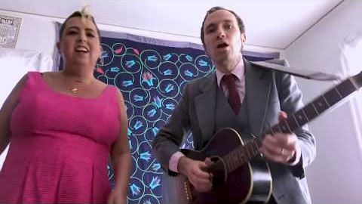
Four Questions - Yiddish
Book of J: Jewlia Eisenberg and Jeremiah Lockwood

Slide 31
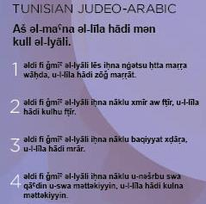
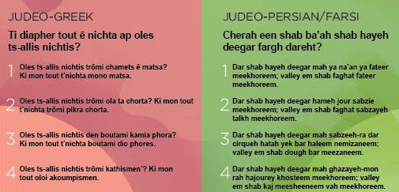
Four Questions - Other Languages

Slide 32
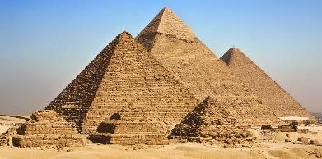
We Were Slaves in Egypt - עֲבָדִים הָיִינו
We were slaves to Pharaoh in the land of Egypt. And the Lord, our God, took us out from there with a strong hand and an outstretched forearm. And if the Holy One, blessed be He, had not taken our ancestors from Egypt, behold we and our children and our children's children would [all] be enslaved to Pharaoh in Egypt. And even if we were all sages, all discerning, all elders, all knowledgeable about the Torah, it is a commandment upon us to tell the story of the exodus from Egypt. And anyone who adds [and spends extra time] in telling the story of the exodus from Egypt, behold he is praiseworthy.
עֲבָדִים הָיִינוּ לְפַרְעֹה בְּמִצְרָיִם, וַיּוֹצִיאֵנוּ ה' אֱלֹהֵינוּ מִשָּׁם בְּיָד חֲזָקָה וּבִזְרֹעַ נְטוּיָה. וְאִלּוּ לֹא הוֹצִיא הַקָּדוֹשׁ בָּרוּךְ הוּא אֶת אֲבוֹתֵינוּ מִמִּצְרָיִם, הֲרֵי אָנוּ וּבָנֵינוּ וּבְנֵי בָנֵינוּ מְשֻׁעְבָּדִים הָיִינוּ לְפַרְעֹה בְּמִצְרָיִם. וַאֲפִילוּ כֻּלָּנוּ חֲכָמִים כֻּלָּנוּ נְבוֹנִים כֻּלָּנוּ זְקֵנִים כֻּלָּנוּ יוֹדְעִים אֶת הַתּוֹרָה מִצְוָה עָלֵינוּ לְסַפֵּר בִּיצִיאַת מִצְרָיִם. וְכָל הַמַּרְבֶּה לְסַפֵּר בִּיצִיאַת מִצְרַיִם הֲרֵי זֶה מְשֻׁבָּח.
    Avadim hayinu, hayinu, l'faro b'mitzrayim, b’mitzrayim.
    Avadim hayinu. Ata, ata, bnei chorin. Avadim hayinu. Ata, ata, bnei chorin, bnei chorin.

Slide 33
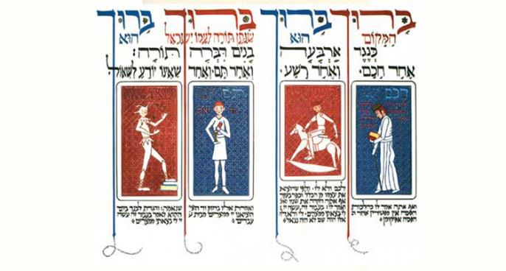
Four Sons
Blessed is the Place [of all], Blessed is He; Blessed is the One who gave the Torah to His people Israel, Blessed is He. Corresponding to four sons the Torah spoke; one [who is] wise, one [who is] evil, one who is innocent and one who doesn't know to ask.
בָּרוּךְ הַמָּקוֹם, בָּרוּךְ הוּא, בָּרוּךְ שֶׁנָּתַן תּוֹרָה לְעַמּוֹ יִשְׂרָאֵל, בָּרוּךְ הוּא.
כְּנֶגֶד אַרְבָּעָה בָנִים דִּבְּרָה תוֹרָה: אֶחָד חָכָם, וְאֶחָד רָשָׁע, וְאֶחָד תָּם, וְאֶחָד שֶׁאֵינוֹ יוֹדֵעַ לִשְׁאוֹל.

Slide 34
Four Sons
What does the wise [son] say? "What are these testimonies, statutes and judgments that the Lord our God commanded you?" And accordingly you will say to him, as per the laws of the Pesach sacrifice, "We may not eat an afikoman [a dessert or other foods eaten after the meal] after [we are finished eating] the Pesach sacrifice. (Mishnah Pesachim 10:8)"
What does the evil/wicked [son] say? "What is this worship to you?" 'To you' and not 'to him.' And since he excluded himself from the collective, he denied a principle [of the Jewish faith]. And accordingly, you will blunt [the bite of his words] and say to him, "'For the sake of this, did the Lord do [this] for me in my going out of Egypt' (Exodus 13:8)." 'For me' and not 'for him.' If he had been there, he would not have been saved.
חָכָם מָה הוּא אוֹמֵר? מָה הָעֵדוֹת וְהַחֻקִּים וְהַמִּשְׁפָּטִים אֲשֶׁר צִוָּה ה' אֱלֹהֵינוּ אֶתְכֶם. וְאַף אַתָּה אֱמוֹר לוֹ כְּהִלְכוֹת הַפֶּסַח: אֵין מַפְטִירִין אַחַר הַפֶּסַח אֲפִיקוֹמָן:
רָשָׁע מָה הוּא אוֹמֵר? מָה הָעֲבוֹדָה הַזּאֹת לָכֶם. לָכֶם - וְלֹא לוֹ. וּלְפִי שֶׁהוֹצִיא אֶת עַצְמוֹ מִן הַכְּלָל כָּפַר בְּעִקָּר. וְאַף אַתָּה הַקְהֵה אֶת שִׁנָּיו וֶאֱמוֹר לוֹ: "בַּעֲבוּר זֶה עָשָׂה ה' לִי בְּצֵאתִי מִמִּצְרָיִם". לִי וְלֹא-לוֹ. אִלּוּ הָיָה שָׁם, לֹא הָיָה נִגְאָל:

Slide 35
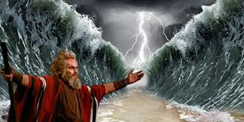
Four Sons
What does the innocent [son] say? "What is this?" And you will say to him, "'With the strength of [His] hand did the Lord take us out from Egypt, from the house of slaves (Exodus 13:14).'"
And [regarding] the one who doesn't know to ask, you will open [the conversation] for him. As it is stated (Exodus 13:8), "And you will speak to your son on that day, saying, for the sake of this, did the Lord do [this] for me in my going out of Egypt."
תָּם מָה הוּא אוֹמֵר? מַה זּאֹת? וְאָמַרְתָּ אֵלָיו "בְּחוֹזֶק יָד הוֹצִיאָנוּ ה' מִמִּצְרַיִם מִבֵּית עֲבָדִים".
וְשֶׁאֵינוֹ יוֹדֵעַ לִשְׁאוֹל - אַתְּ פְּתַח לוֹ, שֶׁנֶּאֱמַר, וְהִגַּדְתָּ לְבִנְךָ בַּיּוֹם הַהוּא לֵאמֹר, .בַּעֲבוּר זֶה עָשָׂה ה' לִי בְּצֵאתִי מִמִּצְרָיִם

Slide 36
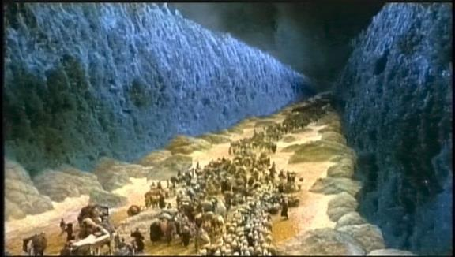
V’hi she’amda - וְהִיא שֶׁעָמְדָה
Lift the cup and say:
And it is this that has stood for our ancestors and for us, since it is not [only] one [person or nation] that has stood [against] us to destroy us, but rather in each generation, they stand [against] us to destroy us, but the Holy One, blessed be He, rescues us from their hand.
V'hi she'amda, v'hi sheamda, lavotenu v'lanu. x2
Shelo echad bilvad amad alenu l'chalotenu,
Ela sheb'chol dor vador omdim alenu l'chalotenu v'hakadosh baruch hu matzilenu miyadam.
וְהִיא שֶׁעָמְדָה לַאֲבוֹתֵינוּ וְלָנוּ. שֶׁלֹּא אֶחָד בִּלְבָד עָמַד עָלֵינוּ לְכַלּוֹתֵנוּ, אֶלָּא שֶׁבְּכָל דּוֹר וָדוֹר עוֹמְדִים עָלֵינוּ לְכַלוֹתֵנוּ, וְהַקָּדוֹשׁ בָּרוּךְ הוּא מַצִּילֵנוּ מִיָּדָם.

Slide 37
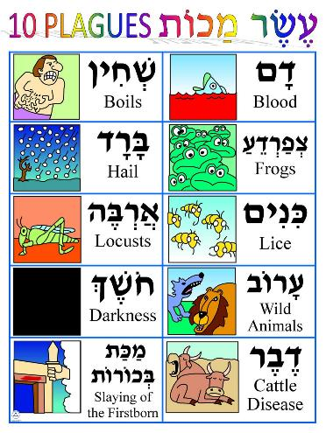
The Ten Plagues
אֵלּוּ עֶשֶׂר מַכּוֹת שֶׁהֵבִיא הַקָּדוֹשׁ בָּרוּךְ הוּא עַל-הַמִּצְרִים בְּמִצְרַיִם, וְאֵלוּ הֵן:
-----
דָּם
צְפַרְדֵּעַ
כִּנִּים
עָרוֹב
דֶּבֶר
שְׁחִין
בָּרָד
אַרְבֶּה
חשֶׁךְ
מַכַּת בְּכוֹרוֹת
רַבִּי יְהוּדָה הָיָה נוֹתֵן בָּהֶם סִמָּנִים: דְּצַ"ךְ עַדַ"שׁ בְּאַחַ"ב.
These are [the] ten plagues that the Holy One, blessed be He, brought on the Egyptians in Egypt, and they are:
Dam - Blood
Tzfarde'a - Frogs
Kinim - Lice
Arov - Wild animals
Dever - cattle disease
Shchin - Boils
Barad - Hail
Arbeh - Locusts
Choshech - Darkness
Makat Bechorot - Slaying of the firstborn

Slide 38
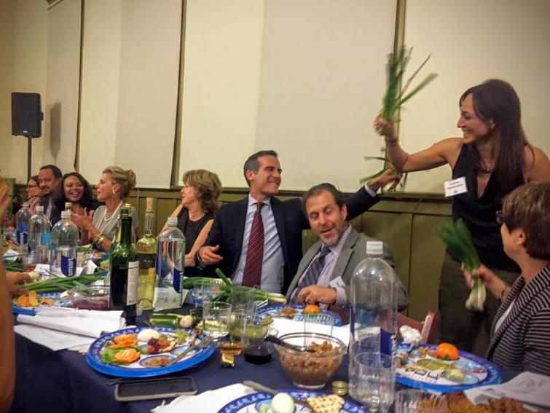
Dayenu! - Enough!
אִלּוּ הוֹצִיאָנוּ מִמִצְרַיִם, דַּיֵּנוּ.
אִלּוּ נָתַן לָנוּ אֶת-הַשַׁבָּת, דַּיֵּנוּ.
אִלּוּ נַתַן לָנוּ אֶת-הַתּוֹרָה, דַּיֵּנוּ.
Ilu hotsi- hotsianu, hotsianu mimitzrayim, hotsianu mimitzrayim, dayenu.
Day- dayenu, day- dayenu, day- dayenu, dayenu dayenu dayenu (x2)
Ilu natan natan lanu, natan lanu et hashabat, natan lanu et hashabat, dayenu.
Day- dayenu, day- dayenu, day- dayenu, dayenu dayenu dayenu (x2)
Ilu natan natan lanu, natan lanu et hatorah, natan lanu et hatorah, dayenu.
Day- dayenu, day- dayenu, day- dayenu, dayenu dayenu dayenu (x2)

Slide 39
Dayenu! - Enough!
כַּמָה מַעֲלוֹת טוֹבוֹת לַמָּקוֹם עָלֵינוּ!
אִלּוּ הוֹצִיאָנוּ מִמִצְרַיִם וְלֹא עָשָׂה בָהֶם שְׁפָטִים, דַּיֵּנוּ.
אִלּוּ עָשָׂה בָהֶם שְׁפָטִים, וְלֹא עָשָׂה בֵאלֹהֵיהֶם, דַּיֵּנוּ.
אִלּוּ עָשָׂה בֵאלֹהֵיהֶם, וְלֹא הָרַג אֶת-בְּכוֹרֵיהֶם, דַּיֵּנוּ.
אִלּוּ הָרַג אֶת-בְּכוֹרֵיהֶם וְלֹא נָתַן לָנוּ אֶת-מָמוֹנָם, דַּיֵּנוּ.
אִלּוּ נָתַן לָנוּ אֶת-מָמוֹנָם וְלֹא קָרַע לָנוּ אֶת-הַיָּם, דַּיֵּנוּ.
אִלּוּ קָרַע לָנוּ אֶת-הַיָּם וְלֹא הֶעֱבִירָנוּ בְּתוֹכוֹ בֶּחָרָבָה, דַּיֵּנוּ.
אִלּוּ הֶעֱבִירָנוּ בְּתוֹכוֹ בֶּחָרָבָה וְלֹא שִׁקַּע צָרֵנוּ בְּתוֹכוֹ דַּיֵּנוּ.
אִלּוּ שִׁקַּע צָרֵנוּ בְּתוֹכוֹ וְלֹא סִפֵּק צָרְכֵּנוּ בַּמִדְבָּר אַרְבָּעִים שָׁנָה דַּיֵּנוּ.
אִלּוּ סִפֵּק צָרְכֵּנוּ בְּמִדְבָּר אַרְבָּעִים שָׁנָה וְלֹא הֶאֱכִילָנוּ אֶת-הַמָּן דַּיֵּנוּ.
How many degrees of good did the Place [of all] bestow upon us! If He had taken us out of Egypt and not made judgements on them; [it would have been] enough for us. If He had made judgments on them and had not made [them] on their gods; [it would have been] enough for us. If He had made [them] on their gods and had not killed their firstborn; [it would have been] enough for us. If He had killed their firstborn and had not given us their money; [it would have been] enough for us. If He had given us their money and had not split the Sea for us; [it would have been] enough for us. If He had split the Sea for us and had not taken us through it on dry land; [it would have been] enough for us. If He had taken us through it on dry land and had not pushed down our enemies in [the Sea]; [it would have been] enough for us. If He had pushed down our enemies in [the Sea] and had not supplied our needs in the wilderness for forty years; [it would have been] enough for us. If He had supplied our needs in the wilderness for forty years and had not fed us the manna; [it would have been] enough for us.

Slide 40
Dayenu! - Enough!
אִלּוּ הֶאֱכִילָנוּ אֶת-הַמָּן וְלֹא נָתַן לָנוּ אֶת-הַשַׁבָּת, דַּיֵּנוּ.
אִלּוּ נָתַן לָנוּ אֶת-הַשַׁבָּת, וְלֹא קֵרְבָנוּ לִפְנֵי הַר סִינַי, דַּיֵּנוּ.
אִלּוּ קֵרְבָנוּ לִפְנֵי הַר סִינַי, וְלא נַתַן לָנוּ אֶת-הַתּוֹרָה. דַּיֵּנוּ.
אִלּוּ נַתַן לָנוּ אֶת-הַתּוֹרָה וְלֹא הִכְנִיסָנוּ לְאֶרֶץ יִשְׂרָאֵל, דַּיֵּנוּ.
אִלּוּ הִכְנִיסָנוּ לְאֶרֶץ יִשְׂרָאֵל וְלֹא בָנָה לָנוּ אֶת-בֵּית הַבְּחִירָה דַּיֵּנוּ.
עַל אַחַת, כַּמָה וְכַּמָה, טוֹבָה כְפוּלָה וּמְכֻפֶּלֶת לַמָּקוֹם עָלֵינוּ: שֶׁהוֹצִיאָנוּ מִמִּצְרַיִם, וְעָשָׂה בָהֶם שְׁפָטִים, וְעָשָׂה בֵאלֹהֵיהֶם, וְהָרַג אֶת-בְּכוֹרֵיהֶם, וְנָתַן לָנוּ אֶת-מָמוֹנָם, וְקָרַע לָנוּ אֶת-הַיָּם, וְהֶעֱבִירָנוּ בְּתוֹכוֹ בֶּחָרָבָה, וְשִׁקַּע צָרֵנוּ בְּתוֹכוֹ, וְסִפֵּק צָרְכֵּנוּ בַּמִדְבָּר אַרְבָּעִים שָׁנָה, וְהֶאֱכִילָנוּ אֶת-הַמָּן, וְנָתַן לָנוּ אֶת-הַשַּׁבָּת, וְקֵרְבָנוּ לִפְנֵי הַר סִינַי, וְנַתָן לָנוּ אֶת-הַתּוֹרָה, וְהִכְנִיסָנוּ לְאֶרֶץ יִשְׂרָאֵל, וּבָנָה לָנוּ אֶת-בֵּית הַבְּחִירָה לְכַפֵּר עַל-כָּל-עֲוֹנוֹתֵינוּ.
If He had fed us the manna and had not given us the Shabbat; [it would have been] enough for us. If He had given us the Shabbat and had not brought us close to Mount Sinai; [it would have been] enough for us. If He had brought us close to Mount Sinai and had not given us the Torah; [it would have been] enough for us. If He had given us the Torah and had not brought us into the land of Israel; [it would have been] enough for us. If He had brought us into the land of Israel and had not built us the 'Chosen House' [the Temple; it would have been] enough for us. How much more so is the good that is doubled and quadrupled that the Place [of all bestowed] upon us [enough for us]; since he took us out of Egypt, and made judgments with them, and made [them] with their gods, and killed their firstborn, and gave us their money, and split the Sea for us, and brought us through it on dry land, and pushed down our enemies in [the Sea], and supplied our needs in the wilderness for forty years, and fed us the manna, and gave us the Shabbat, and brought us close to Mount Sinai, and gave us the Torah, and brought us into the land of Israel and built us the 'Chosen House' [the Temple] to atone upon all of our sins.

Slide 41
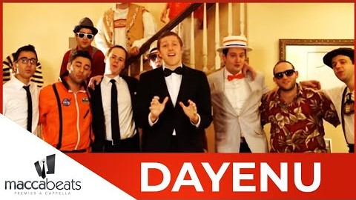
Dayenu! - Enough!

Slide 42
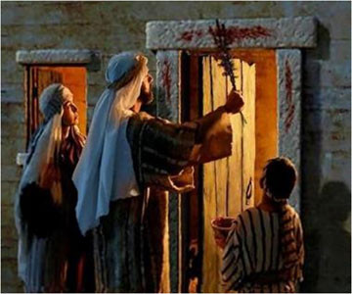
Rabban Gamliel’s Three Things
Rabban Gamliel was accustomed to saying, Anyone who has not said these three things on Pesach has not fulfilled his obligation, and here they are: the Pesach sacrifice, matzah and maror.
The Pesach [Passover] sacrifice that our ancestors were accustomed to eating when the Temple existed, for the sake of what [was it]? For the sake [to commemorate] that the Holy One, blessed be He, passed over the homes of our ancestors in Egypt, as it is stated (Exodus 12:27); "And you shall say: 'It is the Passover sacrifice to the Lord, for that He passed over the homes of the Children of Israel in Egypt, when He smote the Egyptians, and our homes he saved.’ And the people bowed the head and prostrated themselves."
רַבָּן גַּמְלִיאֵל הָיָה אוֹמֵר: כָּל שֶׁלֹּא אָמַר שְׁלשָׁה דְּבָרִים אֵלּוּ בַּפֶּסַח, לא יָצָא יְדֵי חוֹבָתוֹ, וְאֵלּוּ הֵן: פֶּסַח, מַצָּה, וּמָרוֹר.
פֶּסַח שֶׁהָיוּ אֲבוֹתֵינוּ אוֹכְלִים בִּזְמַן שֶׁבֵּית הַמִּקְדָּשׁ הָיָה קַיָּם, עַל שׁוּם מָה? עַל שׁוּם שֶׁפָּסַח הַקָּדוֹשׁ בָּרוּךְ הוּא עַל בָּתֵּי אֲבוֹתֵינוּ בְּמִצְרַיִם, שֶׁנֶּאֱמַר: וַאֲמַרְתֶּם זֶבַח פֶּסַח הוּא לַה', אֲשֶׁר פָּסַח עַל בָּתֵּי בְנֵי יִשְׂרָאֵל בְּמִצְרַיִם בְּנָגְפּוֹ אֶת-מִצְרַיִם, וְאֶת-בָּתֵּינוּ הִצִּיל? וַיִּקֹּד הָעָם וַיִּשְׁתַּחווּ.

Slide 43
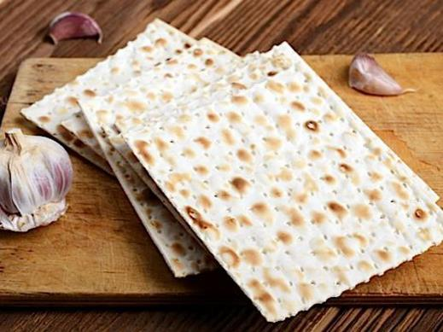
Rabban Gamliel’s Three Things
Point to the matzah.
This matzah that we are eating, for the sake of what [is it]? For the sake [to commemorate] that our ancestors' dough was not yet able to rise, before the King of the kings of kings, the Holy One, blessed be He, revealed [Himself] to them and redeemed them, as it is stated (Exodus 12:39): "And they baked the dough which they brought out of Egypt into matzah cakes, since it did not rise; because they were expelled from Egypt, and could not tarry, neither had they made for themselves provisions."
מַצָּה זוֹ שֶׁאָנוֹ אוֹכְלִים, עַל שׁוּם מַה? עַל שׁוּם שֶׁלֹּא הִסְפִּיק בְּצֵקָם שֶׁל אֲבוֹתֵינוּ לְהַחֲמִיץ עַד שֶׁנִּגְלָה עֲלֵיהֶם מֶלֶךְ מַלְכֵי הַמְּלָכִים, הַקָּדוֹשׁ בָּרוּךְ הוּא, וּגְאָלָם, שֶׁנֶּאֱמַר: וַיֹּאפוּ אֶת-הַבָּצֵק אֲשֶׁר הוֹצִיאוּ מִמִּצְרַיִם עֻגֹת מַצּוֹּת, כִּי לֹא חָמֵץ, כִּי גֹרְשׁוּ מִמִּצְרַיִם וְלֹא יָכְלוּ לְהִתְמַהְמֵהַּ, וְגַם צֵדָה לֹא עָשׂוּ לָהֶם.
Garlic pun:
al shum- ma?

Slide 44
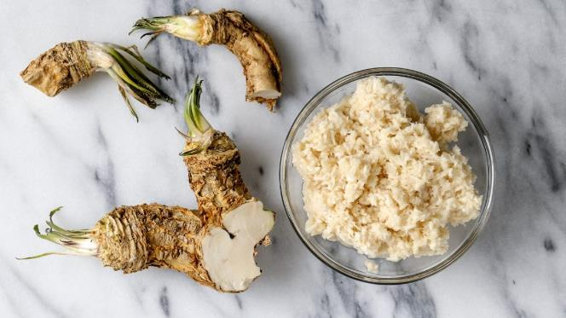
Rabban Gamliel’s Three Things
Point to the maror.
This maror [bitter herbs] that we are eating, for the sake of what [is it]? For the sake [to commemorate] that the Egyptians embittered the lives of our ancestors in Egypt, as it is stated (Exodus 1:14); "And they made their lives bitter with hard service, in mortar and in brick, and in all manner of service in the field; in all their service, wherein they made them serve with rigor."
מָרוֹר זֶה שֶׁאָנוּ אוֹכְלִים, עַל שׁוּם מַה? עַל שׁוּם שֶׁמֵּרְרוּ הַמִּצְרִים אֶת-חַיֵּי אֲבוֹתֵינוּ בְּמִצְרַיִם, שֶׁנֶּאֱמַר: וַיְמָרְרוּ אֶת חַיֵּיהֶם בַּעֲבֹדָה קָשָה, בְּחֹמֶר וּבִלְבֵנִים וּבְכָל-עֲבֹדָה בַּשָּׂדֶה אֶת כָּל עֲבֹדָתָם אֲשֶׁר עָבְדוּ בָהֶם בְּפָרֶךְ.

Slide 45
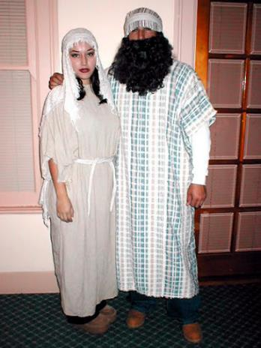
Rabban Gamliel’s Three Things
In each and every generation, a person is obligated to see himself as if he left Egypt, as it is stated (Exodus 13:8); "For the sake of this, did the Lord do [this] for me in my going out of Egypt." Not only our ancestors did the Holy One, blessed be He, redeem, but rather also us [together] with them did he redeem, as it is stated (Deuteronomy 6:23); "And He took us out from there, in order to bring us in, to give us the land which He swore unto our fathers."
בְּכָל-דּוֹר וָדוֹר חַיָּב אָדָם לִרְאוֹת אֶת-עַצְמוֹ כְּאִלּוּ הוּא יָצָא מִמִּצְרַיִם, שֶׁנֶּאֱמַר: וְהִגַּדְתָּ לְבִנְךָ בַּיּוֹם הַהוּא לֵאמֹר, בַּעֲבוּר זֶה עָשָׂה ה' לִי בְּצֵאתִי מִמִּצְרַיִם. לֹא אֶת-אֲבוֹתֵינוּ בִּלְבָד גָּאַל הַקָּדוֹשׁ בָּרוּךְ הוּא, אֶלָּא אַף אוֹתָנוּ גָּאַל עִמָּהֶם, שֶׁנֶּאֱמַר: וְאוֹתָנוּ הוֹצִיא מִשָּׁם, לְמַעַן הָבִיא אוֹתָנוּ, לָתֶת לָנוּ אֶת-הָאָרֶץ אֲשֶׁר נִשָׁבַּע לַאֲבֹתֵינוּ.

Slide 46
Hallel - הלל - first part
In Israel's going out from Egypt, the house of Ya'akov from a people of foreign speech, the Sea saw and fled, the Jordan turned to the rear. The mountains danced like rams, the hills like young sheep. What is happening to you, O Sea, that you are fleeing, O Jordan that you turn to the rear; O mountains that you dance like rams, O hills like young sheep? From before the Master, tremble O earth, from before the Lord of Ya'akov. He who turns the boulder into a pond of water, the flint into a spring of water. (Psalms 114)
בְּצֵאת יִשְׂרָאֵל מִמִצְרַיִם, בֵּית יַעֲקֹב מֵעַם לֹעֵז, הָיְתָה יְהוּדָה לְקָדְשׁוֹ, יִשְׂרָאֵל מַמְשְׁלוֹתָיו. הַיָּם רָאָה וַיַּנֹס, הַיַּרְדֵּן יִסֹּב לְאָחוֹר. הֶהָרִים רָקְדוּ כְאֵילִים, גְּבַעוֹת כִּבְנֵי צֹאן. מַה לְּךָ הַיָּם כִּי תָנוּס, הַיַּרְדֵּן - תִּסֹּב לְאָחוֹר, הֶהָרִים - תִּרְקְדוּ כְאֵילִים, גְּבַעוֹת כִּבְנֵי-צֹאן. מִלְּפְנֵי אָדוֹן חוּלִי אָרֶץ, מִלְּפְנֵי אֱלוֹהַ יַעֲקֹב. הַהֹפְכִי הַצּוּר אֲגַם-מָיִם, חַלָּמִיש לְמַעְיְנוֹ-מָיִם.
B'tset yisrael mimitzrayim, bet yaakov me'am loez, hayta yehuda l'kodsho, yisrael mamshelotav.

Slide 47
Second cup
We say the blessing and drink while reclining to the left:
Baruch ata adonai elohenu melech haolam borey pri hagafen.
Blessed are You, Lord our God, who creates the fruit of the vine.
בָּרוּךְ אַתָּה ה', אֱלֹהֵינוּ מֶלֶךְ הָעוֹלָם בּוֹרֵא פְּרִי הַגָּפֶן.

Slide 48
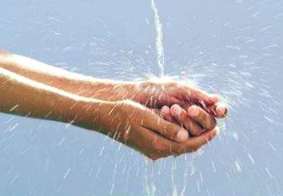
Rochtzah - רָחְצָה
We wash our hands and say the blessing.
Baruch ata adonay elohenu melech haolam asher kidshanu b’mitzvotav v’tzivanu al nitilat yadayim.
Blessed are You, Lord our God, King of the Universe, who has sanctified us with His commandments and has commanded us on the washing of the hands.
בָּרוּךְ אַתָּה ה', אֱלֹהֵינוּ מֶלֶךְ הָעוֹלָם, אֲשֶׁר קִדְּשָׁנוּ בְּמִצְוֹתָיו וְצִוָּנוּ עַל נְטִילַת יָדַיִם.

Slide 49
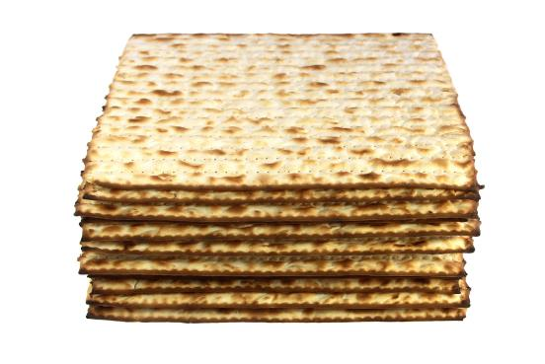
Motzi Matzah - מוֹצִיא מַצָּה
Baruch ata adonai elohenu melech haolam hamotsi lechem min haaretz.
Blessed are You, Lord our God, King of the Universe, who brings forth bread from the earth.
Baruch ata adonai elohenu melech haolam asher kidishanu b'mitzvotav v'tzivanu al achilat matzah.
Blessed are You, Lord our God, King of the Universe, who has sanctified us with His commandments and has commanded us on the eating of matzah.
We eat some matzah.
בָּרוּךְ אַתָּה ה', אֱלֹהֵינוּ מֶלֶךְ הָעוֹלָם הַמּוֹצִיא לֶחֶם מִן הָאָרֶץ.
בָּרוּךְ אַתָּה ה', אֱלֹהֵינוּ מֶלֶךְ הָעוֹלָם, אֲשֶׁר קִדְּשָׁנוּ בְּמִצְוֹתָיו וְצִוָּנוּ עַל אֲכִילַת מַצָּה.

Slide 50
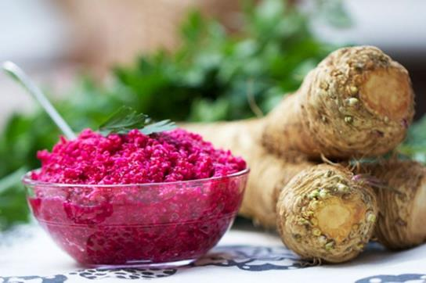
Maror - מרור
Baruch ata adonai elohenu melech haolam asher kidishanu b'mitzvotav v'tzivanu al achilat maror.
Blessed are You, Lord our God, King of the Universe, who has sanctified us with His commandments and has commanded us on the eating of maror.
We eat some bitter herb.
בָּרוּךְ אַתָּה ה', אֱלֹהֵינוּ מֶלֶךְ הָעוֹלָם, אֲשֶׁר קִדְּשָנוּ בְּמִצְוֹתָיו וְצִוָּנוּ עַל אֲכִילַת מָרוֹר.

Slide 51
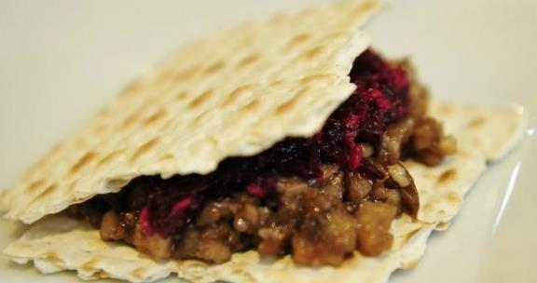
Korech - כורך
Maror/charoset sandwich with matzah:
In memory of the Temple according to Hillel. This is what Hillel would do when the Temple existed:
He would wrap the matzah and maror and eat them together, in order to fulfill what is stated, (Exodus 12:15): "You should eat it upon matzot and merorim."
זֵכֶר לְמִקְדָּשׁ כְּהִלֵּל. כֵּן עָשָׂה הִלֵּל בִּזְמַן שֶׁבֵּית הַמִּקְדָּשׁ הָיָה קַיָּם:
הָיָה כּוֹרֵךְ מַצָּה וּמָרוֹר וְאוֹכֵל בְּיַחַד, לְקַיֵּם מַה שֶּׁנֶּאֱמַר: עַל מַצּוֹת וּמְרוֹרִים יֹאכְלֻהוּ.

Slide 52
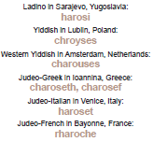
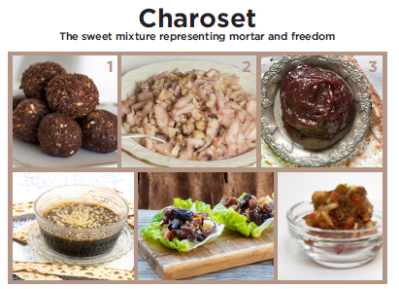
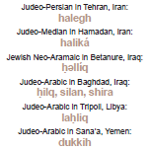


Slide 53
Shulchan orech - שֻׁלְחָן עוֹרֵךְ
Some images of foods and Passover tables from around the world to entertain you while you eat

Slide 54
Some international Passover foods
See more at www.jewishlanguages.org/passover-recipes
Morocco (Haketía/Judeo-Arabic/Judeo-Berber): Laḥliq – date-walnut ginger charoset
Azerbaijan (Judeo-Tat/Juhuri): Bodimjon Khoyagusht – eggplant onion frittata
Romania (Yiddish): Kharoyses – apple walnut charoset
Iraq (Judeo-Arabic): Hajji Badam – flourless almond cookies with rosewater and cardamom
Iran (Judeo-Persian/Median): Kuku Sabzi – baked herb omelette
Georgia (Judeo-Georgian): Espanakhi Pkhali – ground walnut spread with spinach, garlic, coriander, and onion

Slide 55
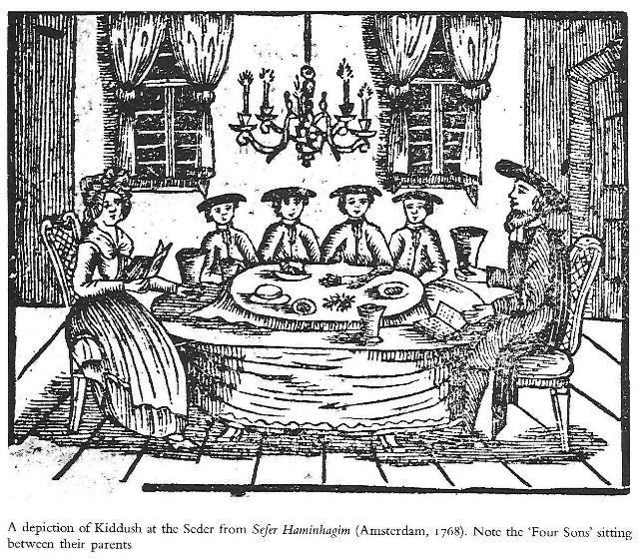
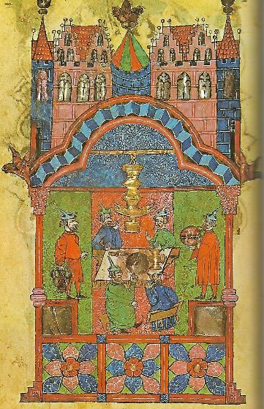
Shulchan orech - שֻׁלְחָן עוֹרֵךְ

Slide 56
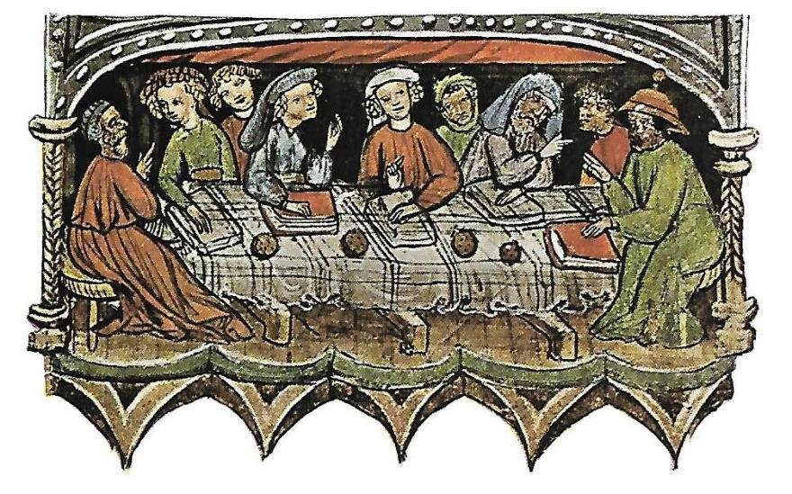
Shulchan orech - שֻׁלְחָן עוֹרֵךְ

Slide 57
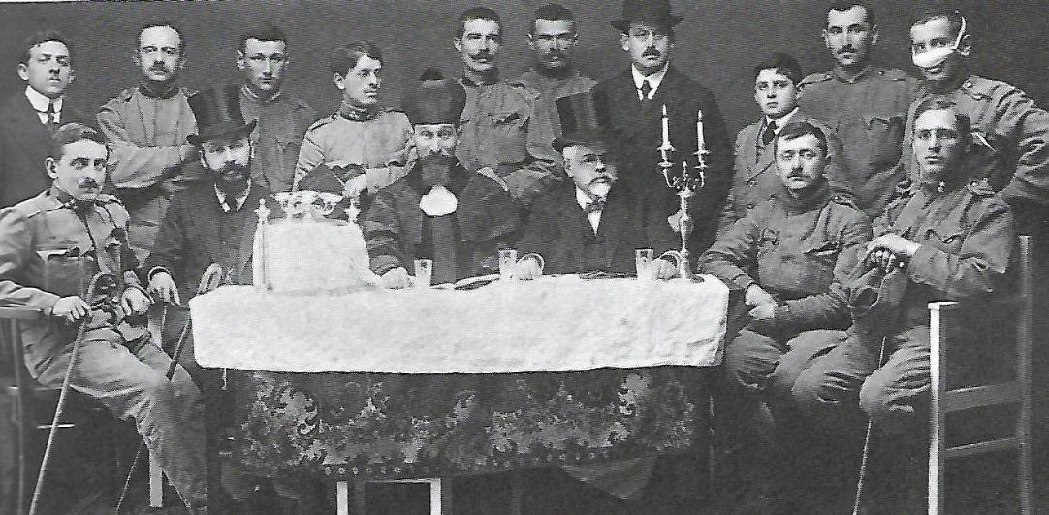
Shulchan orech - שֻׁלְחָן עוֹרֵךְ

Slide 58
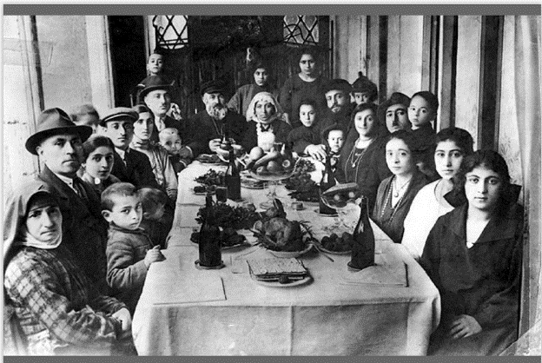

Shulchan orech - שֻׁלְחָן עוֹרֵךְ

Slide 59


Shulchan orech

Slide 60


Shulchan orech - שֻׁלְחָן עוֹרֵךְ

Slide 61


Shulchan orech - שֻׁלְחָן עוֹרֵךְ

Slide 62
Shulchan orech - שֻׁלְחָן עוֹרֵךְ
Proverbs:
Jewish Neo-Aramaic in Zakho, Iraq: ‘ez moshe, qazele mnoshe (Holiday of Moses, He provides Himself [God helps needy people celebrate Passover])
Yiddish in Vilna, Lithuania: Matses un vayn muz zayn, shmalts un eyer – nit zeyer (matzah and wine are a must, chicken fat and eggs – not so much)
Fun fact:
Some Jews in Arabic-speaking lands avoid eating chickpeas on Passover, even though they eat other kitniyot. One explanation is that hummus (chickpea) and hametz (leavened products forbidden on Passover) sound very similar in Arabic.

Slide 63

Shulchan orech - שֻׁלְחָן עוֹרֵךְ
Kosher-for-Passover food and utensils:
Western Yiddish in Amrichshausen, Germany: yontefdig
Yiddish in Warsaw, Poland: paysechdik
Judeo-Georgian in Tbilisi, Georgia: kasheria pesaxistvin
Jewish Malayalam in Chennamangalam, India: pesaholle sadhangle
Judeo-Arabic in Sana‘a, Yemen: altavaqa almufatra (kashered room for preparing/storing Passover grains)

Slide 64


Shulchan orech - שֻׁלְחָן עוֹרֵךְ
Matzah:
Jews in most communities use variants ofמצה , but here are some additional names for Passover unleavened bread:
Judeo-Tat/Juhuri in Derbent, Dagestan: qoqol
Judeo-Provençal in Comtat Venaissin, France: coudolo
Ladino in Salonika, Greece: sensenya
Judeo-Arabic in Baghdad, Iraq: jərduqayi
Judeo-Arabic in Cairo, Egypt: faṭīr
Judeo-Arabic in Ḥugariyyah, Yemen: mašummōr

Slide 65
Shulchan orech - שֻׁלְחָן עוֹרֵךְ
Passover seder:
Judeo-Greek in Ioannina, Greece: chova (duty)
Judeo-Arabic in Mossul, Iraq: fassaḥ (verb- conduct the seder)
Yiddish in Lvov/Lemburg, Ukraine: praven/uprichtn dem sayder, saydern (verb- conduct the seder)
(The evening of) searching for and getting rid of chametz:
Yiddish in Bialystok, Poland: di nacht tsi chumets batlen (the night to void chametz); boydek chumets zaan (search for chametz [to be])
Haketía in Tetuan, Morocco: dechamezzar (de-chametz - infinitive verb)
Ladino in Salonica, Greece: des·hamesar (de-chametz), badkamiento (search [badkar]-ing), día de kal hamirá (day of kal chamira - formula renouncing possession of chametz)
Judeo-Arabic in Bengazi, Libya: lilet qto‘ el-ḥamiṣ (night of stopping the chametz)
Judeo-Arabic in Ksar Es-Souk, Morocco: bdikt ḥamiṣ (searching for chametz – also used by women as a curse, meaning ‘may [the person being cursed] become extinct’)

Slide 66
Tzafun - צפון - Afikoman
After the meal, hunt for the afikomen and eat it in commemoration of the Passover sacrifice.
The word afikoman comes from Greek, which exerted strong cultural influence in the Middle East when the seder was codified.

Slide 67

Barech - ברך
We pour the third cup and recite Grace:
A Song of Ascents; When the Lord will bring back the captivity of Zion, we will be like dreamers. Then our mouth will be full of mirth and our tongue joyful melody; then they will say among the nations; "The Lord has done greatly with these." The Lord has done great things with us; we are happy. Lord, return our captivity like streams in the desert. Those that sow with tears will reap with joyful song. He who surely goes and cries, he carries the measure of seed, he will surely come in joyful song and carry his sheaves. (Psalms 126)
שִׁיר הַמַּעֲלוֹת, בְּשוּב ה' אֶת שִׁיבַת צִיּוֹן הָיִינוּ כְּחֹלְמִים. אָז יִמָּלֵא שְׂחוֹק פִּינוּ וּלְשׁוֹנֵנוּ רִנָּה. אָז יֹאמְרוּ בַגּוֹיִם: הִגְדִּיל ה' לַעֲשׂוֹת עִם אֵלֶּה. הִגְדִּיל ה' לַעֲשׂוֹת עִמָּנוּ, הָיִינוּ שְׂמֵחִים. שׁוּבָה ה' אֶת שְׁבִיתֵנוּ כַּאֲפִיקִים בַּנֶּגֶב. הַזֹּרְעִים בְּדִמְעָה, בְּרִנָּה יִקְצֹרוּ. הָלוֹךְ יֵלֵךְ וּבָכֹה נֹשֵׂא מֶשֶךְ הַזָּרַע, בֹּא יָבֹא בְרִנָּה נֹשֵׂא אֲלֻמֹּתָיו.

Slide 68
Barech - ברך
My friends, let us bless:
May the Name of the Lord be blessed from now and forever. (Psalms 113:2) With the permission of our friends, let us bless [our God] from whom we have eaten. Blessed is [our God] from whom we have eaten and from whose goodness we live. Blessed are You, Lord our God, King of the Universe, who nourishes the entire world in His goodness, in grace, in kindness and in mercy; He gives bread to all flesh since His kindness is forever. And in His great goodness, we always have not lacked, and may we not lack nourishment forever and always, because of His great name. Since He is a Power that feeds and provides for all and does good to all and prepares nourishment for all of his creatures that he created. Blessed are You, Lord, who sustains all.
חברי נְבָרֵךְ:
יְהִי שֵׁם ה' מְבֹרָךְ מֵעַתָּה וְעַד עוֹלָם.
בִּרְשׁוּת חברי, נְבָרֵךְ [אֱלֹהֵינוּ] שֶׁאָכַלְנוּ מִשֶּׁלוֹ.
בָּרוּךְ [אֱלֹהֵינוּ] שֶׁאָכַלְנוּ מִשֶּׁלוֹ וּבְטוּבוֹ חָיִינוּ
בָּרוּךְ [אֱלֹהֵינוּ] שֶׁאָכַלְנוּ מִשֶּׁלוֹ וּבְטוּבוֹ חָיִינוּ
בָּרוך הוּא ובָרוּך שְׁמוֹ
בָּרוּךְ אַתָּה ה', אֱלֹהֵינוּ מֶלֶךְ הָעוֹלָם, הַזָּן אֶת הָעוֹלָם כֻּלּוֹ בְּטוּבוֹ בְּחֵן בְּחֶסֶד וּבְרַחֲמִים, הוּא נוֹתֵן לֶחֶם לְכָל בָּשָׂר כִּי לְעוֹלָם חַסְדוֹ. וּבְטוּבוֹ הַגָּדוֹל תָּמִיד לֹא חָסַר לָנוּ, וְאַל יֶחְסַר לָנוּ מָזוֹן לְעוֹלָם וָעֶד. בַּעֲבוּר שְׁמוֹ הַגָּדוֹל, כִּי הוּא אֵל זָן וּמְפַרְנֵס לַכֹּל וּמֵטִיב לַכֹּל, וּמֵכִין מָזוֹן לְכָל בְּרִיּוֹתָיו אֲשֶׁר בָּרָא. בָּרוּךְ אַתָּה ה', הַזָּן אֶת הַכֹּל.

Slide 69
Barech - ברך
נוֹדֶה לְךָ ה' אֱלֹהֵינוּ עַל שֶׁהִנְחַלְתָּ לַאֲבוֹתֵינוּ אֶרֶץ חֶמְדָה טוֹבָה וּרְחָבָה, וְעַל שֶׁהוֹצֵאתָנוּ ה' אֱלֹהֵינוּ מֵאֶרֶץ מִצְרַיִם, וּפְדִיתָנוּ מִבֵּית עֲבָדִים, וְעַל בְּרִיתְךָ שֶׁחָתַמְתָּ בְּבְשָׂרֵנוּ, וְעַל תּוֹרָתְךָ שֶׁלִּמַּדְתָּנוּ, וְעַל חֻקֶּיךָ שֶׁהוֹדַעְתָּנוּ, וְעַל חַיִּים חֵן וָחֶסֶד שֶׁחוֹנַנְתָּנוּ, וְעַל אֲכִילַת מָזוֹן שָׁאַתָּה זָן וּמְפַרְנֵס אוֹתָנוּ תָּמִיד, בְּכָל יוֹם וּבְכָל עֵת וּבְכָל שָׁעָה:
וְעַל הַכּל ה' אֱלֹהֵינוּ, אֲנַחְנוּ מוֹדִים לָךְ וּמְבָרְכִים אוֹתָךְ, יִתְבָּרַךְ שִׁמְךָ בְּפִי כָּל חַי תָּמִיד לְעוֹלָם וָעֶד. כַּכָּתוּב: וְאָכַלְתָּ וְשָׂבַעְתָּ וּבֵרַכְתָּ אֶת ה' אֱלֹהֵיךָ עַל הָאָרֶץ הַטּוֹבָה אֲשֶּׁר נָתַן לָךְ. בָּרוּךְ אַתָּה ה', עַל הָאָרֶץ וְעַל הַמָּזוֹן:
We thank you, Lord our God, that you have given as an inheritance to our ancestors a lovely, good and broad land, and that You took us out, Lord our God, from the land of Egypt and that You redeemed us from a house of slaves, and for Your covenant which You have sealed in our flesh, and for Your Torah that You have taught us, and for Your statutes which You have made known to us, and for life, grace and kindness that You have granted us and for the eating of nourishment that You feed and provide for us always, on all days, and at all times and in every hour. And for everything, Lord our God, we thank You and bless You; may Your name be blessed by the mouth of all life, constantly forever and always, as it is written (Deuteronomy 8:10); "And you shall eat and you shall be satiated and you shall bless the Lord your God for the good land that He has given you." Blessed are You, Lord, for the land and for the nourishment.

Slide 70
Barech - ברך
רַחֵם נָא ה' אֱלֹהֵינוּ עַל יִשְׂרָאַל עַמֶּךָ וְעַל יְרוּשָׁלַיִם עִירֶךָ וְעַל צִיּוֹן מִשְׁכַּן כְּבוֹדֶךָ וְעַל מַלְכוּת בֵּית דָּוִד מְשִׁיחֶךָ וְעַל הַבַּיִת הַגָּדוֹל וְהַקָּדוֹשׁ שֶׁנִּקְרָא שִׁמְךָ עָלָיו: אֱלֹהֵינוּ אָבִינוּ, רְעֵנוּ זוּנֵנוּ פַרְנְסֵנוּ וְכַלְכְּלֵנוּ וְהַרְוִיחֵנוּ, וְהַרְוַח לָנוּ ה' אֱלֹהֵינוּ מְהֵרָה מִכָּל צָרוֹתֵינוּ. וְנָא אַל תַּצְרִיכֵנוּ ה' אֱלֹהֵינוּ, לֹא לִידֵי מַתְּנַת בָּשָׂר וָדָם וְלֹא לִידֵי הַלְוָאתָם, כִּי אִם לְיָדְךָ הַמְּלֵאָה הַפְּתוּחָה הַקְּדוֹשָׁה וְהָרְחָבָה, שֶׁלֹא נֵבוֹשׁ וְלֹא נִכָּלֵם לְעוֹלָם וָעֶד.
Please have mercy, Lord our God, upon Israel, Your people; and upon Jerusalem, Your city; and upon Zion, the dwelling place of Your Glory; and upon the monarchy of the House of David, Your appointed one; and upon the great and holy house that Your name is called upon. Our God, our Father, tend us, sustain us, provide for us, relieve us and give us quick relief, Lord our God, from all of our troubles. And please do not make us needy, Lord our God, not for the gifts of flesh and blood, and not for their loans, but rather from Your full, open, holy and broad hand, so that we not be embarrassed and we not be ashamed forever and always.

Slide 71
Barech - ברך
רְצֵה וְהַחֲלִיצֵנוּ ה' אֱלֹהֵינוּ בְּמִצְוֹתֶיךָ וּבְמִצְוַת יוֹם הַשְּׁבִיעִי הַשַּׁבָּת הַגָּדול וְהַקָּדוֹשׂ הַזֶּה. כִּי יוֹם זֶה גָּדוֹל וְקָדוֹשׁ הוּא לְפָנֶיךָ לִשְׁבָּת בּוֹ וְלָנוּחַ בּוֹ בְּאַהֲבָה כְּמִצְוַת רְצוֹנֶךָ.וּבִרְצוֹנְךָ הָנִיחַ לָנוּ ה' אֱלֹהֵינוּ שֶׁלֹּא תְהֵא צָרָה וְיָגוֹן וַאֲנָחָה בְּיוֹם מְנוּחָתֵנוּ. וְהַרְאֵנוּ ה' אֱלֹהֵינוּ בְּנֶחָמַת צִיּוֹן עִירֶךָ וּבְבִנְיַן יְרוּשָׁלַיִם עִיר קָדְשֶׁךָ כִּי אַתָּה הוּא בַּעַל הַיְשׁוּעוֹת וּבַעַל הַנֶּחָמוֹת.
On Shabbat:

Slide 72
Barech - ברך
אֱלֹהֵינוּ וֵאלֹהֵי אֲבוֹתֵינוּ, יַעֲלֶה וְיָבֹא וְיַגִּיעַ וְיֵרָאֶה וְיֵרָצֶה וְיִשָּׁמַע וְיִפָּקֵד וְיִזָּכֵר זִכְרוֹנֵנוּ וּפִקְדּוֹנֵנוּ, וְזִכְרוֹן אֲבוֹתֵינוּ, וְזִכְרוֹן מָשִׁיחַ בֶּן דָּוִד עַבְדֶּךָ, וְזִכְרוֹן יְרוּשָׁלַיִם עִיר קָדְשֶׁךָ, וְזִכְרוֹן כָּל עַמְּךָ בֵּית יִשְׂרָאַל לְפָנֶיךָ, לִפְלֵיטָה לְטוֹבָה לְחֵן וּלְחֶסֶד וּלְרַחֲמִים, לְחַיִּים וּלְשָׁלוֹם בְּיוֹם חַג הַמַּצּוֹת הַזֶּה זָכְרֵנוּ ה' אֱלֹהֵינוּ בּוֹ לְטוֹבָה וּפָקְדֵנוּ בוֹ לִבְרָכָה וְהושִׁיעֵנוּ בוֹ לְחַיִּים. וּבִדְבַר יְשׁוּעָה וְרַחֲמִים חוּס וְחָנֵּנוּ וְרַחֵם עָלֵינוּ וְהוֹשִׁיעֵנוּ, כִּי אֵלֶיךָ עֵינֵינוּ, כִּי אֵל מֶלֶךְ חַנּוּן וְרַחוּם אָתָּה. וּבְנֵה יְרוּשָׁלַיִם עִיר הַקֹּדֶשׁ בִּמְהֵרָה בְיָמֵינוּ. בָּרוּךְ אַתָּה ה', בּוֹנֶה בְרַחֲמָיו יְרוּשָׁלַיִם. אָמֵן.
בָּרוּךְ אַתָּה ה', אֱלֹהֵינוּ מֶלֶךְ הָעוֹלָם, הָאֵל אָבִינוּ מַלְכֵּנוּ אַדִירֵנוּ בּוֹרְאֵנוּ גּוֹאֲלֵנוּ יוֹצְרֵנוּ קְדוֹשֵׁנוּ קְדוֹשׁ יַעֲקֹב רוֹעֵנוּ רוֹעֵה יִשְׂרָאַל הַמֶּלֶךְ הַטּוֹב וְהַמֵּטִיב לַכּל שֶׁבְּכָל יוֹם וָיוֹם הוּא הֵטִיב, הוּא מֵטִיב, הוּא יֵיטִיב לָנוּ. הוּא גְמָלָנוּ הוּא גוֹמְלֵנוּ הוּא יִגְמְלֵנוּ לָעַד, לְחֵן וּלְחֶסֶד וּלְרַחֲמִים וּלְרֶוַח הַצָּלָה וְהַצְלָחָה, בְּרָכָה וִישׁוּעָה נֶחָמָה פַּרְנָסָה וְכַלְכָּלָה וְרַחֲמִים וְחַיִּים וְשָׁלוֹם וְכָל טוֹב, וּמִכָּל טוּב לְעוֹלָם עַל יְחַסְּרֵנוּ.

Slide 73
Barech - ברך
הָרַחֲמָן הוּא יִמְלוֹךְ עָלֵינוּ לְעוֹלָם וָעֶד. הָרַחֲמָן הוּא יִתְבָּרַךְ בַּשָּׁמַיִם וּבָאָרֶץ. הָרַחֲמָן הוּא יִשְׁתַּבַּח לְדוֹר דּוֹרִים, וְיִתְפָּאַר בָּנוּ לָעַד וּלְנֵצַח נְצָחִים, וְיִתְהַדַּר בָּנוּ לָעַד וּלְעוֹלְמֵי עוֹלָמִים. הָרַחֲמָן הוּא יְפַרְנְסֵנוּ בְּכָבוֹד. הָרַחֲמָן הוּא יִשְׁבּוֹר עֻלֵּנוּ מֵעַל צַּוָּארֵנוּ, וְהוּא יוֹלִיכֵנוּ קוֹמְמִיּוּת לְאַרְצֵנוּ. הָרַחֲמָן הוּא יִשְׁלַח לָנוּ בְּרָכָה מְרֻבָּה בַּבַּיִת הַזֶּה, וְעַל שֻׁלְחָן זֶה שֶׁאָכַלְנוּ עָלָיו. הָרַחֲמָן הוּא יִשְׁלַח לָנוּ אֶת אֵלִיָּהוּ הַנָּבִיא זָכוּר לַטּוֹב, וִיבַשֶּׂר לָנוּ בְּשׂוֹרוֹת טוֹבוֹת יְשׁוּעוֹת וְנֶחָמוֹת. הָרַחֲמָן הוּא יְבָרֵךְ אֶת בַּעֲלִי / אִשְתִּי. הָרַחֲמָן הוּא יְבָרֵךְ אֶת [אָבִי מוֹרִי] בַּעַל הַבַּיִת הַזֶּה. וְאֶת [אִמִּי מוֹרָתִי] בַּעֲלַת הַבַּיִת הַזֶּה, אוֹתָם וְאֶת בֵּיתָם וְאֶת זַרְעָם וְאֶת כָּל אֲשֶׁר לָהֶם. אוֹתָנוּ וְאֶת כָּל אֲשֶׁר לָנוּ, כְּמוֹ שֶׁנִּתְבָּרְכוּ אֲבוֹתֵינוּ אַבְרָהָם יִצְחָק וְיַעֲקֹב בַּכֹּל מִכֹּל כֹּל, כֵּן יְבָרֵךְ אוֹתָנוּ כֻּלָּנוּ יַחַד בִּבְרָכָה שְׁלֵמָה, וְנֹאמַר, אָמֵן. בַּמָּרוֹם יְלַמְּדוּ עֲלֵיהֶם וְעָלֵינוּ זְכוּת שֶׁתְּהֵא לְמִשְׁמֶרֶת שָׁלוֹם. וְנִשָּׂא בְרָכָה מֵאֵת ה', וּצְדָקָה מֵאלֹהֵי יִשְׁעֵנוּ, וְנִמְצָא חֵן וְשֵׂכֶל טוֹב בְּעֵינֵי אֱלֹהִים וְאָדָם. בשבת: הָרַחֲמָן הוּא יַנְחִילֵנוּ יוֹם שֶׁכֻּלּוֹ שַׁבָּת וּמְנוּחָה לְחַיֵּי הָעוֹלָמִים. הָרַחֲמָן הוּא יַנְחִילֵנוּ יוֹם שֶׁכֻּלוֹ טוֹב. הָרַחֲמָן הוּא יְזַכֵּנוּ לִימוֹת הַמָּשִׁיחַ וּלְחַיֵּי הָעוֹלָם הַבָּא. מִגְדּוֹל יְשׁוּעוֹת מַלְכּוֹ וְעֹשֶׂה חֶסֶד לִמְשִׁיחוֹ לְדָוִד וּלְזַרְעוֹ עַד עוֹלָם. עשֶׂה שָׁלוֹם בִּמְרוֹמָיו, הוּא יַעֲשֶׂה שָׁלוֹם עָלֵינוּ וְעַל כָּל יִשְׂרָאַל וְאִמְרוּ, אָמֵן. יִרְאוּ אֶת ה' קְדֹשָׁיו, כִּי אֵין מַחְסוֹר לִירֵאָיו. כְּפִירִים רָשׁוּ וְרָעֵבוּ, וְדֹרְשֵׁי ה' לֹא יַחְסְרוּ כָל טוֹב. הוֹדוּ לַה' כִּי טוֹב כִּי לְעוֹלָם חַסְדּוֹ. פּוֹתֵחַ אֶת יָדֶךָ, וּמַשְׂבִּיעַ לְכָל חַי רָצוֹן. בָּרוּךְ הַגֶּבֶר אֲשֶׁר יִבְטַח בַּה', וְהָיָה ה' מִבְטַחוֹ. נַעַר הָיִיתִי גַם זָקַנְתִּי, וְלֹא רָאִיתִי צַדִּיק נֶעֱזָב, וְזַרְעוֹ מְבַקֶּשׁ לָחֶם.ה' עֹז לְעַמּוֹ יִתֵּן, ה' יְבָרֵךְ אֶת עַמּוֹ בַשָּׁלוֹם.

Slide 74
Third cup
We say the blessing and drink while reclining to the left:
Baruch ata adonai elohenu melech haolam borey pri hagafen.
Blessed are You, Lord our God, who creates the fruit of the vine.
בָּרוּךְ אַתָּה ה', אֱלֹהֵינוּ מֶלֶךְ הָעוֹלָם בּוֹרֵא פְּרִי הַגָּפֶן.

Slide 75


Eliyahu Hanavi
We open the door to welcome Eliyahu Hanavi - Elijah the Prophet.
Eliyahu hanavi,
Eliyahu hatishbi,
Eliyahu, Eliyahu, Eliyahu hagiladi.
Bimheirah b'yameinu,
yavo eileinu,
im Mashiach ben David,
im Mashiach ben David.
אֵלִיָהוּ הַנָבִיא, אֵלִיָהוּ הַתִּשְׁבִּי, אֵלִיָהוּ הַגִלְעָדִי בִּמְהֵרָה בְּיָמֵנוּ יָבוֹא אֵלֵינוּ עִם מָשִׁיחַ בֶּן דָוִד
Did he drink from his cup? Did he sit in his chair? (a Moroccan tradition)

Slide 76
Pour out your wrath
Pour out your wrath upon the nations that have not recognized You and upon the kingdoms that have not called upon Your Name! Because they have devoured Ya'akov and laid waste his habitation (Psalms 79:6-7). Pour out Your fury upon them and the fierceness of Your anger shall reach them (Psalms 69:25)! You shall pursue them with anger and eradicate them from under the skies of the Lord (Lamentations 3:66).
We can skip this one or discuss why it was important to Jews at various points during history.
שְׁפֹךְ חֲמָתְךָ אֶל-הַגּוֹיִם אֲשֶׁר לֹא יְדָעוּךָ וְעַל-מַמְלָכוֹת אֲשֶׁר בְּשִׁמְךָ לֹא קָרָאוּ. כִּי אָכַל אֶת-יַעֲקֹב וְאֶת-נָוֵהוּ הֵשַׁמּוּ. שְׁפָךְ-עֲלֵיהֶם זַעֲמֶךָ וַחֲרוֹן אַפְּךָ יַשִּׂיגֵם. תִּרְדֹף בְּאַף וְתַשְׁמִידֵם מִתַּחַת שְׁמֵי ה’.
Fun fact: In Judeo-Italian, shefok can mean “to vomit,” based on this text.

Slide 77

Hallel - הלל
...ה' זְכָרָנוּ יְבָרֵךְ. יְבָרֵךְ אֶת בֵּית יִשְׂרָאֵל, יְבָרֵךְ אֶת בֵּית אַהֲרֹן, יְבָרֵךְ יִרְאֵי ה', הַקְּטַנִים עִם הַגְּדֹלִים. יֹסֵף ה' עֲלֵיכֶם, עֲלֵיכֶם וְעַל בְּנֵיכֶם. בְּרוּכִים אַתֶּם לַה', עֹשֵׂה שָׁמַיִם וָאָרֶץ. הַשָּׁמַיִם שָׁמַיִם לַה' וְהָאָרֶץ נָתַן לִבְנֵי אָדָם. לֹא הַמֵּתִים יְהַלְלוּ יָהּ וְלֹא כָּל יֹרְדֵי דוּמָה. וַאֲנַחְנוּ נְבָרֵךְ יָהּ מֵעַתָּה וְעַד עוֹלָם. הַלְלוּיָהּ.
הַלְלוּ אֶת ה' כָּל גּוֹיִם, שַׁבְּחוּהוּ כָּל הָאֻמִּים. כִּי גָבַר עָלֵינוּ חַסְדּוֹ, וֶאֱמֶת ה' לְעוֹלָם. הַלְלוּיָהּ. הוֹדוּ לַה' כִּי טוֹב כִּי לְעוֹלָם חַסְדּוֹ. יֹאמַר נָא יִשְׂרָאֵל כִּי לְעוֹלָם חַסְדּוֹ. יֹאמְרוּ נָא בֵית אַהֲרֹן כִּי לְעוֹלָם חַסְדּוֹ. יֹאמְרוּ נָא יִרְאֵי ה' כִּי לְעוֹלָם חַסְדּוֹ.
The Lord who remembers us, will bless; He will bless the House of Israel; He will bless the House of Aaron... Halleluyah! (Psalms 115)
Praise the name of the Lord, all nations; extol Him all peoples… Let those that fear the Lord now say, "Thank the Lord, since He is good, since His kindness is forever." (Psalms 117-118:4)

Slide 78
Hallel - הלל
מִן הַמֵּצַר קָרָאתִי יָּהּ, עָנָנִי בַמֶּרְחַב יָהּ.
פִּתְחוּ לִי שַׁעֲרֵי צֶדֶק, אָבֹא בָם, אוֹדֶה יָהּ. זֶה הַשַּׁעַר לַה', צַדִּיקִים יָבֹאוּ בוֹ.
אוֹדְךָ כִּי עֲנִיתָנִי וַתְּהִי לִי לִישׁוּעָה. אוֹדְךָ כִּי עֲנִיתָנִי וַתְּהִי לִי לִישׁוּעָה. אֶבֶן מָאֲסוּ הַבּוֹנִים הָיְתָה לְראשׁ פִּנָּה. אֶבֶן מָאֲסוּ הַבּוֹנִים הָיְתָה לְראשׁ פִּנָּה. מֵאֵת ה' הָיְתָה זֹּאת הִיא נִפְלָאת בְּעֵינֵינוּ. מֵאֵת ה' הָיְתָה זֹּאת הִיא נִפְלָאת בְּעֵינֵינוּ.
אָנָּא ה', הוֹשִיעָה נָּא. אָנָּא ה', הוֹשִיעָה נָּא. אָנָּא ה', הַצְלִיחָה נָא. אָנָּא ה', הַצְלִיחָה נָא.
Min hametzar karati ya
Anani bamerchav ya
From the narrow space I have called, Lord; He answered me from the wide space, the Lord.
Pitchu li shaarei tzedek, avo vam, odeh yah.
Ze hashaar ladonay, tzadikim yavou vam. x2
Open up for me the gates of righteousness; I will enter them and thank the Lord. This is the gate of the Lord, the righteous will enter it. (Psalms 118:5-20)...

Slide 79

Hallel - הלל
מִן הַמֵּצַר קָרָאתִי יָּהּ, עָנָנִי בַמֶּרְחַב יָהּ. ה' לִי, לֹא אִירָא – מַה יַּעֲשֶׂה לִי אָדָם, ה' לִי בְּעֹזְרָי וַאֲנִי אֶרְאֶה בְּשׂנְאָי. טוֹב לַחֲסוֹת בַּיי מִבְּטֹחַ בָּאָדָם. טוֹב לַחֲסוֹת בַּיי מִבְּטֹחַ בִּנְדִיבִים.
From the narrow space I have called, God; He answered me from the wide space, God. The Lord is for me, I will not fear, what will man do to me? The Lord is for me with my helpers, and I shall glare at those that hate me. It is better to take refuge with the Lord than to trust in man. It is better to take refuge with the Lord than to trust in nobles.
Chloe Pourmorady and Asher Shasho Levy: Min Hamessar – Syrian, Iraqi, and Sephardic melodies. If short on time, start at 5:43 – you won’t want to miss this beautiful duet.

Slide 80
Fourth cup
We say the blessing and drink while reclining to the left:
Baruch ata adonai elohenu melech haolam borey pri hagafen.
Blessed are You, Lord our God, who creates the fruit of the vine.
בָּרוּךְ אַתָּה ה', אֱלֹהֵינוּ מֶלֶךְ הָעוֹלָם בּוֹרֵא פְּרִי הַגָּפֶן.

Slide 81

Nirtzah - נרצה
Completed is the Seder of Pesach according to its law, according to all its judgement and statute. Just as we have merited to arrange it, so too, may we merit to do [its sacrifice]. Pure One who dwells in the habitation, raise up the congregation of the community, which whom can count. Bring close, lead the plantings of the sapling, redeemed, to Zion in joy.
L'shana haba'a b'yerushalayim x3
L'shana haba'a b'yerushalayim habnuya
Next year, let us be in the built Jerusalem.
חֲסַל סִדּוּר פֶּסַח כְּהִלְכָתוֹ, כְּכָל מִשְׁפָּטוֹ וְחֻקָּתוֹ. כַּאֲשֶׁר זָכִינוּ לְסַדֵּר אוֹתוֹ כֵּן נִזְכֶּה לַעֲשׂוֹתוֹ. זָךְ שׁוֹכֵן מְעוֹנָה, קוֹמֵם קְהַל עֲדַת מִי מָנָה. בְּקָרוֹב נַהֵל נִטְעֵי כַנָּה פְּדוּיִם לְצִיּוֹן בְּרִנָּה.
לְשָׁנָה הַבָּאָה בִּירוּשָלָיִם הַבְּנוּיָה.

Slide 82
Ki Lo Na’eh - כִּי לוֹ נָאֶה
Since for Him it is pleasant, for Him it is suited.
Mighty in rulership, properly chosen, his troops shall say to Him, "Yours and Yours, Yours since it is Yours, Yours and even Yours, Yours, Lord is the kingdom; since for Him it is pleasant, for Him it is suited."
Noted in rulership, properly splendid, His distinguished ones will say to him, "Yours and Yours, Yours since it is Yours, Yours and even Yours, Yours, Lord is the kingdom; since for Him it is pleasant, for Him it is suited."
Meritorious in rulership, properly robust, His scribes shall say to him, "Yours and Yours, Yours since it is Yours, Yours and even Yours, Yours, Lord is the kingdom; since for Him it is pleasant, for Him it is suited."
כִּי לוֹ נָאֶה, כִּי לוֹ יָאֶה.
אַדִּיר בִּמְלוּכָה, בָּחוּר כַּהֲלָכָה, גְּדוּדָיו יֹאמְרוּ לוֹ: לְךָ וּלְךָ, לְךָ כִּי לְךָ, לְךָ אַף לְךָ, לְךָ ה' הַמַּמְלָכָה, כִּי לוֹ נָאֵה, כִּי לוֹ יָאֶה.
דָּגוּל בִּמְלוּכָה, הָדוּר כַּהֲלָכָה, וָתִיקָיו יֹאמְרוּ לוֹ: לְךָ וּלְךָ, לְךָ כִּי לְךָ, לְךָ אַף לְךָ, לְךָ ה' הַמַּמְלָכָה, כִּי לוֹ נָאֵה, כִּי לוֹ יָאֶה.
זַכַּאי בִּמְלוּכָה, חָסִין כַּהֲלָכָה טַפְסְרָיו יֹאמְרוּ לוֹ: לְךָ וּלְךָ, לְךָ כִּי לְךָ, לְךָ אַף לְךָ, לְךָ ה' הַמַּמְלָכָה, כִּי לוֹ נָאֵה, כִּי לוֹ יָאֶה.

Slide 83
Ki Lo Na’eh - כִּי לוֹ נָאֶה
Unique in rulership, properly powerful, His wise ones say to Him, "Yours and Yours, Yours since it is Yours, Yours and even Yours, Yours, Lord is the kingdom; since for Him it is pleasant, for Him it is suited."
Reigning in rulership, properly awesome, those around Him say to Him, "Yours and Yours, Yours since it is Yours, Yours and even Yours, Yours, Lord is the kingdom; since for Him it is pleasant, for Him it is suited."...
יָחִיד בִּמְלוּכָה, כַּבִּיר כַּהֲלָכָה לִמּוּדָיו יֹאמְרוּ לוֹ: לְךָ וּלְךָ, לְךָ כִּי לְךָ, לְךָ אַף לְךָ, לְךָ ה' הַמַּמְלָכָה, כִּי לוֹ נָאֶה, כִּי לוֹ יָאֶה.
מוֹשֵׁל בִּמְלוּכָה, נוֹרָא כַּהֲלָכָה סְבִיבָיו יֹאמְרוּ לוֹ: לְךָ וּלְךָ, לְךָ כִּי לְךָ, לְךָ אַף לְךָ, לְךָ ה' הַמַּמְלָכָה, כִּי לוֹ נָאֵה, כִּי לוֹ יָאֶה.
עָנָיו בִּמְלוּכָה, פּוֹדֶה כַּהֲלָכָה, צַדִּיקָיו יֹאמְרוּ לוֹ: לְךָ וּלְךָ, לְךָ כִּי לְךָ, לְךָ אַף לְךָ, לְךָ ה' הַמַּמְלָכָה, כִּי לוֹ נָאֵה, כִּי לוֹ יָאֶה.
קָּדּוֹשׁ בִּמְלוּכָה, רַחוּם כַּהֲלָכָה שִׁנְאַנָּיו יֹאמְרוּ לוֹ: לְךָ וּלְךָ, לְךָ כִּי לְךָ, לְךָ אַף לְךָ, לְךָ ה' הַמַּמְלָכָה, כִּי לוֹ נָאֵה, כִּי לוֹ יָאֶה.
תַּקִיף בִּמְלוּכָה, תּוֹמֵךְ כַּהֲלָכָה תְּמִימָיו יֹאמְרוּ לוֹ: לְךָ וּלְךָ, לְךָ כִּי לְךָ, לְךָ אַף לְךָ, לְךָ ה' הַמַּמְלָכָה, כִּי לוֹ נָאֵה, כִּי לוֹ יָאֶה.

Slide 84
Adir Hu - אדיר הוא
Mighty is He, may He build His house soon. Quickly, quickly, in our days, soon. God build, God build, build Your house soon.
Chosen is He, great is He, noted is He. Quickly, quickly, in our days, soon. God build, God build, build Your house soon.
Splendid is He, distinguished is He, meritorious is He. Quickly, quickly, in our days, soon. God build, God build, build Your house soon.
Pious is He, pure is He, unique is He. Quickly, quickly, in our days, soon. God build, God build, build Your house soon.
Powerful is He, wise is He, A king is He. Quickly, quickly, in our days, soon. God build, God build, build Your house soon.
אַדִּיר הוּא יִבְנֶה בֵּיתוֹ בְּקָרוֹב. בִּמְהֵרָה, בִּמְהֵרָה, בְּיָמֵינוּ בְּקָרוֹב. אֵל בְּנֵה, אֵל בְּנֵה, בְּנֵה בֵּיתְךָ בְּקָרוֹב.
בָּחוּר הוּא, גָּדוֹל הוּא, דָּגוּל הוּא יִבְנֶה בֵּיתוֹ בְּקָרוֹב. בִּמְהֵרָה, בִּמְהֵרָה, בְּיָמֵינוּ בְּקָרוֹב. אֵל בְּנֵה, אֵל בְּנֵה, בְּנֵה בֵּיתְךָ בְּקָרוֹב.
הָדוּר הוּא, וָתִיק הוּא, זַכַּאי הוּא יִבְנֶה בֵּיתוֹ בְּקָרוֹב. בִּמְהֵרָה, בִּמְהֵרָה, בְּיָמֵינוּ בְּקָרוֹב. אֵל בְּנֵה, אֵל בְּנֵה, בְּנֵה בֵּיתְךָ בְּקָרוֹב.
חָסִיד הוּא, טָהוֹר הוּא, יָחִיד הוּא יִבְנֶה בֵּיתוֹ בְּקָרוֹב. בִּמְהֵרָה, בִּמְהֵרָה, בְּיָמֵינוּ בְּקָרוֹב. אֵל בְּנֵה, אֵל בְּנֵה, בְּנֵה בֵּיתְךָ בְּקָרוֹב.
כַּבִּיר הוּא, לָמוּד הוּא, מֶלֶךְ הוּא יִבְנֶה בֵּיתוֹ בְּקָרוֹב. בִּמְהֵרָה, בִּמְהֵרָה, בְּיָמֵינוּ בְּקָרוֹב. אֵל בְּנֵה, אֵל בְּנֵה, בְּנֵה בֵּיתְךָ בְּקָרוֹב.

Slide 85

Adir Hu - אדיר הוא
Awesome is He, exalted is He, heroic is He. Quickly, quickly, in our days, soon. God build, God build, build Your house soon...
נוֹרָא הוּא, סַגִּיב הוּא, עִזּוּז הוּא יִבְנֶה בֵּיתוֹ בְּקָרוֹב. בִּמְהֵרָה, בִּמְהֵרָה, בְּיָמֵינוּ בְּקָרוֹב. אֵל בְּנֵה, אֵל בְּנֵה, בְּנֵה בֵּיתְךָ בְּקָרוֹב.
פּוֹדֶה הוּא, צַדִּיק הוּא, קָּדוֹשׁ הוּא יִבְנֶה בֵּיתוֹ בְּקָרוֹב. בִּמְהֵרָה, בִּמְהֵרָה, בְּיָמֵינוּ בְּקָרוֹב. אֵל בְּנֵה, אֵל בְּנֵה, בְּנֵה בֵּיתְךָ בְּקָרוֹב.
רַחוּם הוּא, שַׁדַּי הוּא, תַּקִּיף הוּא יִבְנֶה בֵּיתוֹ בְּקָרוֹב. בִּמְהֵרָה, בִּמְהֵרָה, בְּיָמֵינוּ בְּקָרוֹב. אֵל בְּנֵה, אֵל בְּנֵה, בְּנֵה בֵּיתְךָ בְּקָרוֹב.
Fun fact:
A Passover greeting in Western Yiddish (Germany, Alsace-Lorraine, Switzerland) is bauet gut (build well), likely a reference to the rebuilding of the Temple mentioned in this song.

Slide 86

Counting of the Omer - ספירת העומר
On the second night of Pesach:
Blessed are You, Lord our God, King of the Universe, who has sanctified us with His commandments and has commanded us on the counting of the omer. Today is the first day of the omer.
בָּרוּךְ אַתָּה ה', אֱלֹהֵינוּ מֶלֶךְ הָעוֹלָם, אֲשֶׁר קִדְּשָׁנוּ בְּמִצְוֹּתָיו וְצִוָּנוּ עַל סְפִירַת הָעֹמֶר. הַיּוֹם יוֹם אֶחָד בָּעֹמֶר.
Subscribe to Hillel Smith’s GIF omer counting email notifications:
https://bestomerever.tumblr.com/

Slide 87


Echad Mi Yodea - Who Knows One?
Who knows one? I know one: One is Hashem in the heavens and the earth. Ooh-ah-ooh-ah-ah.
Who knows two? I know two: two are the tablets that Moshe brought, and one is Hashem... in the heavens and the earth.
Who knows three? I know three: three are the papas...
Who knows four? I know four: four are the mamas...
Who knows five? I know five: five are the books of the Torah...
אֶחָד מִי יוֹדֵעַ? אֶחָד אֲנִי יוֹדֵעַ: אֶחָד אֱלֹהֵינוּ שֶׁבַּשָּׁמַיִם וּבָאָרֶץ.
שְׁנַיִם מִי יוֹדֵעַ? שְׁנַיִם אֲנִי יוֹדֵעַ: שְׁנֵי לֻחוֹת הַבְּרִית. אֶחָד אֱלֹהֵינוּ שֶׁבַּשָּׁמַיִם וּבָאָרֶץ.
שְׁלֹשָׁה מִי יוֹדֵעַ? שְׁלֹשָׁה אֲנִי יוֹדֵעַ: שְׁלֹשָׁה אָבוֹת, שְׁנֵי לֻחוֹת הַבְּרִית, אֶחָד אֱלֹהֵינוּ שֶׁבַּשָּׁמַיִם וּבָאָרֶץ.
אַרְבַּע מִי יוֹדֵעַ? אַרְבַּע אֲנִי יוֹדֵעַ: אַרְבַּע אִמָּהוֹת, שְׁלשָׁה אָבוֹת, שְׁנֵי לֻחוֹת הַבְּרִית, אֶחָד אֱלֹהֵינוּ שֶׁבַּשָּׁמַיִם וּבָאָרֶץ.
חֲמִשָּׁה מִי יוֹדֵעַ? חֲמִשָּׁה אֲנִי יוֹדֵעַ: חֲמִשָּׁה חוּמְשֵׁי תוֹרָה, אַרְבַּע אִמָּהוֹת, שְׁלשָׁה אָבוֹת, שְׁנֵי לֻחוֹת הַבְּרִית, אֶחָד אֱלֹהֵינוּ שֶׁבַּשָּׁמַיִם וּבָאָרֶץ.

Slide 88

Echad Mi Yodea - Who Knows One?
Who knows six? I know six: six are the books of the Mishnah...
Who knows seven? I know seven: seven are the days of the week...
Who knows eight? I know eight: eight are the days before a baby boy's bris...
שִׁשָּׂה מִי יוֹדֵעַ? שִׁשָּׂה אֲנִי יוֹדֵעַ: שִׁשָּׁה סִדְרֵי מִשְׁנָה, חֲמִשָּׁה חוּמְשֵׁי תוֹרָה, אַרְבַּע אִמָּהוֹת, שְׁלֹשָׁה אָבוֹת, שְׁנֵי לֻחוֹת הַבְּרִית, אֶחָד אֱלֹהֵינוּ שֶׁבַּשָּׁמַיִם וּבָאָרֶץ.
שִׁבְעָה מִי יוֹדֵעַ? שִׁבְעָה אֲנִי יוֹדֵעַ: שִׁבְעָה יְמֵי שַׁבָּתָא, שִׁשָּׁה סִדְרֵי מִשְׁנָה, חֲמִשָּׁה חוּמְשֵׁי תוֹרָה, אַרְבַּע אִמָּהוֹת, שְׁלשָׁה אָבוֹת, שְׁנֵי לֻחוֹת הַבְּרִית, אֶחָד אֱלֹהֵינוּ שֶׁבַּשָּׁמַיִם וּבָאָרֶץ.
שְׁמוֹנָה מִי יוֹדֵעַ? שְׁמוֹנָה אֲנִי יוֹדֵעַ: שְׁמוֹנָה יְמֵי מִילָה, שִׁבְעָה יְמֵי שַׁבָּתָא, שִׁשָּׁה סִדְרֵי מִשְׁנָה, חֲמִשָּׁה חוּמְשֵׁי תוֹרָה, אַרְבַּע אִמָּהוֹת, שְׁלשָׁה אָבוֹת, שְׁנֵי לֻחוֹת הַבְּרִית, אֶחָד אֱלֹהֵינוּ שֶׁבַּשָּׁמַיִם וּבָאָרֶץ.

Slide 89

Echad Mi Yodea - Who Knows One?
Who knows nine? I know nine: nine are the months before a baby's born...
Who knows ten? I know ten: ten are THE commandments...
Who knows eleven? I know eleven: eleven are the stars in Joseph's dream...
תִּשְׁעָה מִי יוֹדֵעַ? תִּשְׁעָה אֲנִי יוֹדֵעַ: תִּשְׁעָה יַרְחֵי לֵדָה, שְׁמוֹנָה יְמֵי מִילָה, שִׁבְעָה יְמֵי שַׁבָּתָא, שִׁשָּׁה סִדְרֵי מִשְׁנָה, חֲמִשָּׁה חוּמְשֵׁי תוֹרָה, אַרְבַּע אִמָּהוֹת, שְׁלֹשָׁה אָבוֹת, שְׁנֵי לֻחוֹת הַבְּרִית, אֶחָד אֱלֹהֵינוּ שֶׁבַּשָּׁמַיִם וּבָאָרֶץ.
עֲשָֹרָה מִי יוֹדֵעַ? עֲשָֹרָה אֲנִי יוֹדֵעַ: עֲשָׂרָה דִבְּרַיָא, תִּשְׁעָה יַרְחֵי לֵדָה, שְׁמוֹנָה יְמֵי מִילָה, שִׁבְעָה יְמֵי שַׁבָּתָא, שִׁשָּׁה סִדְרֵי מִשְׁנָה, חֲמִשָּׁה חוּמְשֵׁי תוֹרָה, אַרְבַּע אִמָּהוֹת, שְׁלשָׁה אָבוֹת, שְׁנֵי לֻחוֹת הַבְּרִית, אֶחָד אֱלֹהֵינוּ שֶׁבַּשָּׁמַיִם וּבָאָרֶץ.
אַחַד עָשָׂר מִי יוֹדֵעַ? אַחַד עָשָׂר אֲנִי יוֹדֵעַ: אַחַד עָשָׂר כּוֹכְבַיָּא, עֲשָׂרָה דִבְּרַיָא, תִּשְׁעָה יַרְחֵי לֵדָה, שְׁמוֹנָה יְמֵי מִילָה, שִׁבְעָה יְמֵי שַׁבָּתָא, שִׁשָּׁה סִדְרֵי מִשְׁנָה, חֲמִשָּׁה חוּמְשֵׁי תוֹרָה, אַרְבַּע אִמָּהוֹת, שְׁלשָׁה אָבוֹת, שְׁנֵי לֻחוֹת הַבְּרִית, אֶחָד אֱלֹהֵינוּ שֶׁבַּשָּׁמַיִם וּבָאָרֶץ.

Slide 90
Echad Mi Yodea - Who Knows One?
Who knows twelve? I know twelve: twelve are the tribes of Yisrael...
Who knows thirteen? I know thirteen:
Thirteen are the attributes of God. Twelve are the tribes of Yisrael. Eleven are the stars in Joseph's dream. Ten are THE commandments. Nine are the months before a baby's born. Eight are the days before a baby boy's bris. Seven are the days of the week. Six are the books of the Mishnah. Five are the books of the Torah. Four are the mamas, and three are the papas, and two are tablets that Moshe brought. One is Hashem, one is Hashem, one is Hashem! In the heavens and the earth.
שְׁנֵים עָשָׂר מִי יוֹדֵעַ? שְׁנֵים עָשָׂר אֲנִי יוֹדֵעַ: שְׁנֵים עָשָׂר שִׁבְטַיָּא, אַחַד עָשָׂר כּוֹכְבַיָּא, עֲשָׂרָה דִבְּרַיָא, תִּשְׁעָה יַרְחֵי לֵדָה, שְׁמוֹנָה יְמֵי מִילָה, שִׁבְעָה יְמֵי שַׁבָּתָא, שִׁשָּׁה סִדְרֵי מִשְׁנָה, חֲמִשָּׁה חוּמְשֵׁי תוֹרָה, אַרְבַּע אִמָּהוֹת, שְׁלשָׁה אָבוֹת, שְׁנֵי לֻחוֹת הַבְּרִית, אֶחָד אֱלֹהֵינוּ שֶׁבַּשָּׁמַיִם וּבָאָרֶץ.
שְׁלשָׁה עֶשָׂר מִי יוֹדֵעַ? שְׁלשָׁה עָשָׂר אֲנִי יוֹדֵעַ: שְׁלשָׁה עָשָׂר מִדַּיָּא. שְׁנֵים עָשָׂר שִׁבְטַיָּא, אַחַד עָשָׂר כּוֹכְבַיָּא, עֲשָׂרָה דִבְּרַיָא, תִּשְׁעָה יַרְחֵי לֵדָה, שְׁמוֹנָה יְמֵי מִילָה, שִׁבְעָה יְמֵי שַׁבָּתָא, שִׁשָּׁה סִדְרֵי מִשְׁנָה, חֲמִשָּׁה חוּמְשֵׁי תוֹרָה, אַרְבַּע אִמָּהוֹת, שְׁלשָׁה אָבוֹת, שְׁנֵי לֻחוֹת הַבְּרִית, אֶחָד אֱלֹהֵינוּ שֶׁבַּשָּׁמַיִם וּבָאָרֶץ.

Slide 91

Who Knows One? – Bukharian / Judeo-Tajik
Sezdakhum kie medonad? [Who knows the thirteenth?]
Sezdakhum man’ medonam! [I know the thirteenth.]
Sezdakhum: sezdah khislatcho. [Thirteenth are the 13 Attributes (of God).]
Duvozdakhum: duvozdah shivtocho. [Twelfth are the 12 Tribes.]
Yozdakhum: yozdah sitoracho. [Eleventh are the 11 Stars (in Joseph's dream).]
Dakhumin: dakh sukhanon. [Tenth are the 10 Utterances (Commandments).]
Nokhumin: noch mochie zanon. [Ninth are the nine months of pregnancy.]
Khashtumin: khasht rouzi millo. [Eighth are the eight days of circumcision.]
Khaftumin: khaft rouzi khafta. [Seventh are the seven days of the week.]
Shishtumin: shash sidrey mishno. [Sixth are the six Orders of the Mishnah.]
Panjumin: panj sifrey Toro. [Fifth are the five books of Torah.]
Chorumin: chor’ modaron. [Fourth are the four Matriarchs.]
Seyumin: se’e padaron. [Third are the three Patriarchs.]
Duyumin: du’u lavchie gavkhar. [Second are the two Tablets of the Covenant.]
Yakumin: Khudoyi pabun olamin. [First is God, Lord of Heaven and Earth.]

Slide 92

Who Knows One? - Syrian Judeo-Arabic
Min ya‪'elam wumin yidri‪
Allah rab el mijalli‪
heda hinen il tleta'ash
tleta'ash il bar-misvah
tna'ash shibte Yisrael
hda'ash kokab bisama
‪'asher qilmat itorah‪
tisa'at ishhor il hible
tmint-iyyam il mila
sab'at-iyyam il hupa
site sdadir il Mishna‪
khamse msahaf itorah‪.
Arba'a imatna
wutlate abatna
wutnen Musa waAharon
wahid yali khalana‪,
Allahu Allahu la ilahh illa hu
Who knows, and who understands?
God is the master of the revealed universe
God is the one and the only Creator.
God, God, there is no God but God.
Thirteen is bar misvah
twelve tribes of Israel
eleven stars in the sky
ten commandments
nine months of pregnancy
eight days for circumcision
seven days for huppa
six orders of the Mishna
five books of the Torah
four mothers
three fathers
two are Moses and Aaron
God is the one and the only Creator.
God, God, there is no God but God.
​
Asher Shasho Levy and Chloe Pourmorady

Slide 93

Who Knows One? - Ladino
Kien supiense i entendiense? Alavar al dyo kreyense. [Who knows and understands? Praise God the Creator.]
Kwalo son los TREDJE? [What are THIRTEEN?]
TREDJE anyos de bar mitzva. [THIRTEEN years for bar mitzvah.]
DODJE tribus de Israel. [TWELVE tribes of Israel.]
ONZE hermanos sin Yosef. [ELEVEN brothers without Joseph.]
DYEZ los mandamiento de la ley. [TEN commandments.]
MUEVE meses de la prenyada. [NINE months of pregnancy.]
OCHO dias de la milá [EIGHT days for circumcision.]
SIETE dias kon shabat. [SEVEN days with Shabbat.]
SEISH dias de la semana. [SIX days of the week.]
SINKO livros de la ley. [FIVE books of the law.]
KWATRO madres de israel. [FOUR mothers of Israel.]
TRES muestros padres son. [THREE are our fathers.]
DOS Moshe y Aron. [TWO Moses and Aaron.]
UNO es el kriador, baruh hu u'varuh shemo. [ONE is the Creator, Blessed Be He and his name.]
Ya'akov Tsur Ben Ovadiah

Slide 94

Who Knows One? - Yiddish
Mu asapru, mu adabru, ay day, ay day, yam da day day day.
​Ver ken zogn ver ken redn vos di DRAYTSN batayt? [Who can say what THIRTEEN means?]
DRAYTSN iz men bar mitsve. [THIRTEEN is a bar mitzvah.]
TSVELF zenen di shvotim. [TWELVE are the tribes.]
ELF ZENEN di shtern. [ELEVEN are the stars.]
TSEN zenen di gebot. [TEN are the Commandments.]
NAYN zenen khedoshim trogt men. [NINE months you're carried.]
AKHT teg iz der bris. [EIGHT days till the bris.]
​ZIBN zenen di vokh-teg. [SEVEN are the weekdays.]
ZEKS zenen mishnayes. [SIX are the books of the Mishnah.]
FINF zenen khamushim. [FIVE are the books of the Torah.]
FIR zenen di imoes (mames). [FOUR are the mothers.]
DRAY zenen di oves (tates). [THREE are the fathers.]
TSVEY zenen di lukhes. [TWO are the tablets.]
Un EYNER iz dokh got. [And ONE is of course God.]
Un got iz eyner, un vayter keyner. [And God is One, and there is no other.]
Book of J: Jewlia Eisenberg and Jeremiah Lockwood
See other languages at jewishlanguages.org

Slide 95

Chad Gadya - - חד גדיאOne Little Goat
Chad gadya, chad gadya (one little goat, one little goat).
My father bought for two zuzim, chad gadya, chad gadya.
Then came a cat and ate the goat...
Then came a dog and bit the cat that ate the goat...
Then came a stick and beat the dog...
Then came fire and burned the stick...
Then came water and quenched the fire...
Then came an ox and drank the water...
Then came a shochet and slaughtered the ox...
Then came the angel of death and slaughtered the shochet...
Then came the Holy One, blessed be He and slaughtered the angel of death, that slaughtered the shochet, that slaughtered the ox, that drank the water, that quenched the fire, that burned the stick, that beat the dog, that bit the cat, that ate the goat, my father bought for two zuzim.
Chad gadya, chad gadya.
Guests can participate by making the sound of each animal/object after its name is said.
חַד גַּדְיָא, חַד גַּדְיָא דְּזַבִּין אַבָּא בִּתְרֵי זוּזֵי, חַד גַּדְיָא, חַד גַּדְיָא…
וְאָתָא הַקָּדוֹשׁ בָּרוּךְ הוּא וְשָׁחַט לְמַלְאַךְ הַמָּוֶת, דְּשָׁחַט לְשׁוֹחֵט, דְּשָׁחַט לְתוֹרָא, דְשָׁתָה לְמַיָּא, דְּכָבָה לְנוּרָא, דְשָׂרַף לְחוּטְרָא, דְהִכָּה לְכַלְבָּא, דְנָשַׁךְ לְשׁוּנְרָא, דְאָכְלָה לְגַדְיָא, דְזַבִּין אַבָּא בִּתְרֵי זוּזֵי. חַד גַּדְיָא, חַד גַּדְיָא.

Slide 96



Slide 97

Chad Gadya - Syrian Judeo-Arabic
Wa-ija ilmuqadas mubarak hu‫, wa-akhad malak ilmot, illaḍi akhad rouḥ i-dabaḥ, illaḍi dabaḥ i-tor, illaḍi shireb il maye, illaḍi ṭafet i-nar, illaḍi ḥaret il 'aṣaye, illaḍi darbet il kaleb, illaḍi 'ad il iṭa, illaḍi aklet il jidi, illaḍi shtara li abi bimaṣariten, waḥad jidi waḥad jidi.
Asher Shasho Levy and Chloe Pourmorady

Slide 98

Chad Gadya - Yiddish
A mayse mit a tsigele, hert oys ovois-uvonim
Der foter hot batsolt far ir tsvey gildn mezumonim.
Di umshildike tsigele zi shpringt arum in hoyz.
Plutsem kumt a beyze kats, un khapt un frest es oyf.
Di tsigele, di tsigele, hert oys ovis-uvonim.
Der foter hot batsolt far it tsvey gildn mezumonim.
Khad-gad-yo, khad-gad-yo.
Der hunt hot faynt gehat di kats dos treft zikh al-pi-rov.
Er klert nit lang un khapt ir on un makht fun ir a sof.
Der hunt iz dokh dem shtekn vert, er iz dokh beyz un shlekht.
Der shtekn git im klep vi bob un meynt er iz gerekht.
Di tsigele, di tsigele, hert oys ovois-uvonim
Der foter hot batsolt far ir tsvey gildn mezumonim.
Khad-gad-yo, khad-gad-yo.
Book of J: Jewlia Eisenberg and Jeremiah Lockwood

Slide 99

Chad Gadya - Bukharian / Judeo-Tajik
Ve biyomad ha-Qodösh Borukh Hu ve bikhusht be malakh ha-movet, onchi bikhusht be shöhet, onchi zobeh khord be on gov, onchi binöshid be ob, onchi khomösh khard be otash, onchi bisözond be aso, onchi bizad be on sag, onchi bigozid be pishok, onchi bikhörd be buzghola, onchi bikharid padar be du tanga. Jon buzghola, jon buzghola.
Asher Shasho Levy and Chloe Pourmorady

Slide 100

Chad Gadya - Ladino
I vino el Santo Bendicho, i mato al malah amavet, ke se yevo al shohet, ke mato al buey, ke se bevyo al agua, ke amato al fuego, ke kemo al palo, ke aharvo al perro, ke modryo al gato, ke kome al kavritiko, ke lo merko mi padre, por dos levanim.
Asher Shasho Levy and Chloe Pourmorady

Slide 101


Slide 102

Sources:
https://www.sefaria.org/
https://www.jewishlanguages.org/passover
Images from various sites.
Abadi, Jennifer Felicia. 2018. Too Good to Passover: Sephardic & Judeo-Arabic Seder Menus and Memories from Africa, Asia and Europe. Jennifer Abadi.
Kurshan, Ilana. 2008. Why Is This Night Different from All Other Nights?: “The Four Questions” Around the World. Schocken.
Lowenstein, Steven. 2000. The Jewish Cultural Tapestry: International Jewish Folk Traditions. Oxford University Press.
Ochs, Vanessa. 2020. The Passover Haggadah: A Biography. Princeton University Press.
Raphael, Chaim. 1993. A Feast of History: The Drama of Passover through the Ages. Reprint edition. Bnai Brith International.
Spiegel, Murray, and Rickey Stein. 2013. 300 Ways to Ask the Four Questions. Second edition. Spiegel-Stein Publishing.

Slide 103
Omitted sections
If you want to include the entire Haggadah text, you can paste these sections where they belong above, and you can find English translations at Sefaria.org.

Slide 104
Omitted sections
מַעֲשֶׂה בְּרַבִּי אֱלִיעֶזֶר וְרַבִּי יְהוֹשֻׁעַ וְרַבִּי אֶלְעָזָר בֶּן־עֲזַרְיָה וְרַבִּי עֲקִיבָא וְרַבִּי טַרְפוֹן שֶׁהָיוּ מְסֻבִּין בִּבְנֵי־בְרַק וְהָיוּ מְסַפְּרִים בִּיצִיאַת מִצְרַיִם כָּל־אוֹתוֹ הַלַּיְלָה, עַד שֶׁבָּאוּ תַלְמִידֵיהֶם וְאָמְרוּ לָהֶם רַבּוֹתֵינוּ הִגִּיעַ זְמַן קְרִיאַת שְׁמַע שֶׁל שַׁחֲרִית.
אָמַר רַבִּי אֶלְעָזָר בֶּן־עֲזַרְיָה הֲרֵי אֲנִי כְּבֶן שִׁבְעִים שָׁנָה וְלֹא זָכִיתִי שֶׁתֵּאָמֵר יְצִיאַת מִצְרַיִם בַּלֵּילוֹת עַד שֶׁדְּרָשָׁהּ בֶּן זוֹמָא, שֶׁנֶּאֱמַר, לְמַעַן תִּזְכֹּר אֶת יוֹם צֵאתְךָ מֵאֶרֶץ מִצְרַיִם כֹּל יְמֵי חַיֶּיךָ. יְמֵי חַיֶּיךָ הַיָּמִים. כֹּל יְמֵי חַיֶּיךָ הַלֵּילוֹת. וַחֲכָמִים אוֹמְרִים יְמֵי חַיֶּיךָ הָעוֹלָם הַזֶּה. כֹּל
יְמֵי חַיֶּיךָ לְהָבִיא לִימוֹת הַמָּשִׁיחַ:
יָכוֹל מֵראשׁ חֹדֶשׁ? תַּלְמוּד לוֹמַר בַּיּוֹם הַהוּא. אִי בַּיּוֹם הַהוּא יָכוֹל מִבְּעוֹד יוֹם? תַּלְמוּד לוֹמַר בַּעֲבוּר זֶה – בַּעֲבוּר זֶה לֹא אָמַרְתִּי, אֶלָּא בְּשָׁעָה שֶׁיֵּשׁ מַצָּה וּמָרוֹר מֻנָּחִים לְפָנֶיךָ.
מִתְּחִלָּה עוֹבְדֵי עֲבוֹדָה זָרָה הָיוּ אֲבוֹתֵינוּ, וְעַכְשָׁיו קֵרְבָנוּ הַמָּקוֹם לַעֲבדָתוֹ, שֶׁנֶּאֱמַר: וַיֹאמֶר יְהוֹשֻעַ אֶל־כָּל־הָעָם, כֹּה אָמַר ה' אֱלֹהֵי יִשְׂרָאֵל: בְּעֵבֶר הַנָּהָר יָשְׁבוּ אֲבוֹתֵיכֶם מֵעוֹלָם, תֶּרַח אֲבִי אַבְרָהָם וַאֲבִי נָחוֹר, וַיַּעַבְדוּ אֱלֹהִים אֲחֵרִים.
וָאֶקַּח אֶת־אֲבִיכֶם אֶת־אַבְרָהָם מֵעֵבֶר הַנָּהָר וָאוֹלֵךְ אוֹתוֹ בְּכָל־אֶרֶץ כְּנָעַן, וָאַרְבֶּה אֶת־זַרְעוֹ וָאֶתֵּן לוֹ אֶת־יִצְחָק, וָאֶתֵּן לְיִצְחָק אֶת־יַעֲקֹב וְאֶת־עֵשָׂו. וָאֶתֵּן לְעֵשָׂו אֶת־הַר שֵּׂעִיר לָרֶשֶׁת אתוֹ, וְיַעֲקֹב וּבָנָיו יָרְדוּ מִצְרָיִם.
בָּרוּךְ שׁוֹמֵר הַבְטָחָתוֹ לְיִשְׂרָאֵל, בָּרוּךְ הוּא. שֶׁהַקָּדוֹשׁ בָּרוּךְ הוּא חִשַּׁב אֶת־הַקֵּץ, לַעֲשׂוֹת כְּמוֹ שֶּׁאָמַר לְאַבְרָהָם אָבִינוּ בִּבְרִית בֵּין הַבְּתָרִים, שֶׁנֶּאֱמַר: וַיֹּאמֶר לְאַבְרָם, יָדֹעַ תֵּדַע כִּי־גֵר יִהְיֶה זַרְעֲךָ בְּאֶרֶץ לֹא לָהֶם, וַעֲבָדוּם וְעִנּוּ אֹתָם אַרְבַּע מֵאוֹת שָׁנָה. וְגַם אֶת־הַגּוֹי אֲשֶׁר יַעֲבֹדוּ דָּן אָנֹכִי וְאַחֲרֵי־כֵן יֵצְאוּ בִּרְכֻשׁ גָּדוֹל.

Slide 105
Omitted sections
צֵא וּלְמַד מַה בִּקֵּשׁ לָבָן הָאֲרַמִּי לַעֲשׂוֹת לְיַעֲקֹב אָבִינוּ: שֶׁפַּרְעֹה לֹא גָזַר אֶלָּא עַל הַזְּכָרִים, וְלָבָן בִּקֵּשׁ לַעֲקֹר אֶת־הַכֹּל. שֶׁנֶּאֱמַר: אֲרַמִּי אֹבֵד אָבִי, וַיֵּרֶד מִצְרַיְמָה וַיָּגָר שָׁם בִּמְתֵי מְעָט, וַיְהִי שָׁם לְגוֹי גָּדוֹל, עָצוּם וָרָב.
וַיֵּרֶד מִצְרַיְמָה – אָנוּס עַל פִּי הַדִּבּוּר. וַיָּגָר שָׁם. מְלַמֵּד שֶׁלֹא יָרַד יַעֲקֹב אָבִינוּ לְהִשְׁתַּקֵּעַ בְּמִצְרַיִם אֶלָּא לָגוּר שָׁם, שֶׁנֶּאֱמַר: וַיֹּאמְרוּ אֶל־פַּרְעֹה, לָגוּר בָּאָרֶץ בָּאנוּ, כִּי אֵין מִרְעֶה לַצֹּאן אֲשֶׁר לַעֲבָדֶיךָ, כִּי כָבֵד הָרָעָב בְּאֶרֶץ כְּנָעַן. וְעַתָּה יֵשְׁבוּ־נָא עֲבָדֶיךָ בְּאֶרֶץ גֹּשֶן.
בִּמְתֵי מְעָט. כְּמָה שֶּׁנֶּאֱמַר: בְּשִׁבְעִים נֶפֶשׁ יָרְדוּ אֲבוֹתֶיךָ מִצְרָיְמָה, וְעַתָּה שָׂמְךָ ה' אֱלֹהֶיךָ כְּכוֹכְבֵי הַשָּׁמַיִם לָרֹב.
וַיְהִי שָׁם לְגוֹי. מְלַמֵד שֶׁהָיוּ יִשְׂרָאֵל מְצֻיָּנִים שָׁם. גָּדוֹל עָצוּם – כְּמָה שֶּׁנֶּאֱמַר: וּבְנֵי יִשְׂרָאֵל פָּרוּ וַיִּשְׁרְצוּ וַיִּרְבּוּ וַיַּעַצְמוּ בִּמְאֹד מְאֹד, וַתִּמָּלֵא הָאָרֶץ אֹתָם.
וָרָב. כְּמָה שֶּׁנֶּאֱמַר: רְבָבָה כְּצֶמַח הַשָּׂדֶה נְתַתִּיךְ, וַתִּרְבִּי וַתִּגְדְּלִי וַתָּבֹאִי בַּעֲדִי עֲדָיִים, שָׁדַיִם נָכֹנוּ וּשְׂעָרֵךְ צִמֵּחַ, וְאַתְּ עֵרֹם וְעֶרְיָה. וָאֶעֱבֹר עָלַיִךְ וָאֶרְאֵךְ מִתְבּוֹסֶסֶת בְּדָמָיִךְ, וָאֹמַר לָךְ בְּדָמַיִךְ חֲיִי, וָאֹמַר לָךְ בְּדָמַיִךְ חֲיִי.
וַיָּרֵעוּ אֹתָנוּ הַמִּצְרִים וַיְעַנּוּנוּ, וַיִתְּנוּ עָלֵינוּ עֲבֹדָה קָשָׁה. וַיָּרֵעוּ אֹתָנוּ הַמִּצְרִים – כְּמָה שֶּׁנֶּאֱמַר: הָבָה נִתְחַכְּמָה לוֹ פֶּן יִרְבֶּה, וְהָיָה כִּי תִקְרֶאנָה מִלְחָמָה וְנוֹסַף גַּם הוּא עַל שֹׂנְאֵינוּ וְנִלְחַם־בָּנוּ, וְעָלָה מִן־הָאָרֶץ.
וַיְעַנּוּנוּ. כְּמָה שֶּׁנֶּאֱמַר: וַיָּשִׂימוּ עָלָיו שָׂרֵי מִסִּים לְמַעַן עַנֹּתוֹ בְּסִבְלֹתָם. וַיִּבֶן עָרֵי מִסְכְּנוֹת לְפַרְעֹה. אֶת־פִּתֹם וְאֶת־רַעַמְסֵס.
וַיִתְּנוּ עָלֵינוּ עֲבֹדָה קָשָׁה. כְּמָה שֶֹׁנֶּאֱמַר: וַיַּעֲבִדוּ מִצְרַיִם אֶת־בְּנֵי יִשְׂרָאֵל בְּפָרֶךְ.
וַנִּצְעַק אֶל־ה' אֱלֹהֵי אֲבֹתֵינוּ, וַיִּשְׁמַע ה' אֶת־קֹלֵנוּ, וַיַּרְא אֶת־עָנְיֵנוּ וְאֶת עֲמָלֵנוּ וְאֶת לַחֲצֵנוּ.
וַנִּצְעַק אֶל־ה' אֱלֹהֵי אֲבֹתֵינוּ – כְּמָה שֶּׁנֶּאֱמַר: וַיְהִי בַיָּמִים הָרַבִּים הָהֵם וַיָּמָת מֶלֶךְ מִצְרַיִם, וַיֵּאָנְחוּ בְנֵי־יִשְׂרָאֵל מִ־הָעֲבוֹדָה וַיִּזְעָקוּ, וַתַּעַל שַׁוְעָתָם אֶל־הָאֱלֹהִים מִן הָעֲבֹדָה.

Slide 106
Omitted sections
וַיִּשְׁמַע ה' אֶת קלֵנוּ. כְּמָה שֶּׁנֶּאֱמַר: וַיִּשְׁמַע אֱלֹהִים אֶת־נַאֲקָתָם, וַיִּזְכֹּר אֱלֹהִים אֶת־בְּרִיתוֹ אֶת־אַבְרָהָם, אֶת־יִצְחָק וְאֶת־יַעֲקֹב.
וַיַּרְא אֶת־עָנְיֵנוּ. זוֹ פְּרִישׁוּת דֶּרֶךְ אֶרֶץ, כְּמָה שֶּׁנֶּאֱמַר: וַיַּרְא אֱלֹהִים אֶת בְּנֵי־יִשְׂרָאֵל וַיֵּדַע אֱלֹהִים.
וְאֶת־עֲמָלֵנוּ. אֵלּוּ הַבָּנִים. כְּמָה שֶּׁנֶּאֱמַר: כָּל־הַבֵּן הַיִּלּוֹד הַיְאֹרָה תַּשְׁלִיכֻהוּ וְכָל־הַבַּת תְּחַיּוּן.וְאֶת לַחָצֵנוּ. זֶו הַדְּחַק, כְּמָה שֶּׁנֶּאֱמַר: וְגַם־רָאִיתִי אֶת־הַלַּחַץ אֲשֶׁר מִצְרַיִם לֹחֲצִים אֹתָם.וַיּוֹצִאֵנוּ ה' מִמִצְרַיִם בְּיָד חֲזָקָה, וּבִזְרֹעַ נְטוּיָה, וּבְמֹרָא גָּדֹל, וּבְאֹתוֹת וּבְמֹפְתִים.וַיּוֹצִאֵנוּ ה' מִמִּצְרַיִם. לֹא עַל־יְדֵי מַלְאָךְ, וְלֹא עַל־יְדֵי שָׂרָף, וְלֹא עַל־יְדֵי שָׁלִיחַ, אֶלָּא הַקָּדוֹשׁ בָּרוּךְ הוּא בִּכְבוֹדוֹ וּבְעַצְמוֹ. שֶׁנֶּאֱמַר: וְעָבַרְתִּי בְאֶרֶץ מִצְרַיִם בַּלַּיְלָה הַזֶּה, וְהִכֵּיתִי כָּל־בְּכוֹר בְּאֶרֶץ מִצְרַיִם מֵאָדָם וְעַד בְּהֵמָה, וּבְכָל אֱלֹהֵי מִצְרַיִם אֶעֱשֶׂה שְׁפָטִים. אֲנִי ה'.וְעָבַרְתִּי בְאֶרֶץ מִצְרַיִם בַּלַּיְלָה הַזֶּה – אֲנִי וְלֹא מַלְאָךְ; וְהִכֵּיתִי כָל בְּכוֹר בְּאֶרֶץ־מִצְרַים. אֲנִי וְלֹא שָׂרָף; וּבְכָל־אֱלֹהֵי מִצְרַיִם אֶעֱשֶׂה שְׁפָטִים. אֲנִי וְלֹא הַשָּׁלִיחַ; אֲנִי ה'. אֲנִי הוּא וְלֹא אַחֵר.בְּיָד חֲזָקָה. זוֹ הַדֶּבֶר, כְּמָה שֶּׁנֶּאֱמַר: הִנֵּה יַד־ה' הוֹיָה בְּמִקְנְךָ אֲשֶׁר בַּשָּׂדֶה, בַּסּוּסִים, בַּחֲמֹרִים, בַּגְּמַלִים, בַּבָּקָר וּבַצֹּאן, דֶּבֶר כָּבֵד מְאֹד.וּבִזְרֹעַ נְטוּיָה. זוֹ הַחֶרֶב, כְּמָה שֶּׁנֶּאֱמַר: וְחַרְבּוֹ שְׁלוּפָה בְּיָדוֹ, נְטוּיָה עַל־יְרוּשָלָיִם.וּבְמוֹרָא גָּדֹל. זוֹ גִּלּוּי שְׁכִינָה. כְּמָה שֶּׁנֶּאֱמַר, אוֹ הֲנִסָּה אֱלֹהִים לָבוֹא לָקַחַת לוֹ גּוֹי מִקֶּרֶב גּוֹי בְּמַסֹּת בְּאֹתֹת וּבְמוֹפְתִים וּבְמִלְחָמָה וּבְיָד חֲזָקָה וּבִזְרוֹעַ נְטוּיָה וּבְמוֹרָאִים גְּדוֹלִים כְּכֹל אֲשֶׁר־עָשָׂה לָכֶם ה' אֱלֹהֵיכֶם בְּמִצְרַיִם לְעֵינֶיךָ.וּבְאֹתוֹת. זֶה הַמַּטֶּה, כְּמָה שֶּׁנֶּאֱמַר: וְאֶת הַמַּטֶּה הַזֶּה תִּקַּח בְּיָדְךָ, אֲשֶׁר תַּעֲשֶׂה־בּוֹ אֶת הָאֹתוֹת. וּבְמֹפְתִים. זֶה הַדָּם, כְּמָה שֶּׁנֶּאֱמַר: וְנָתַתִּי מוֹפְתִים בַּשָּׁמַיִם וּבָאָרֶץ.
דָּם וָאֵשׁ וְתִימְרוֹת עָשָׁן.דָבָר אַחֵר: בְּיָד חֲזָקָה שְׁתַּיִם, וּבִזְרֹעַ נְטוּיָה שְׁתַּיִם, וּבְמֹרָא גָּדֹל – שְׁתַּיִם, וּבְאֹתוֹת – שְׁתַּיִם, וּבְמֹפְתִים – שְׁתַּיִם.

Slide 107
Omitted sections
רַבִּי יוֹסֵי הַגְּלִילִי אוֹמֵר: מִנַּיִן אַתָּה אוֹמֵר שֶׁלָּקוּ הַמִּצְרִים בְּמִצְרַיִם עֶשֶׂר מַכּוֹת וְעַל הַיָּם לָקוּ חֲמִשִּׁים מַכּוֹת? בְּמִצְרַיִם מַה הוּא אוֹמֵר? וַיֹּאמְרוּ הַחַרְטֻמִּם אֶל פַּרְעֹה: אֶצְבַּע אֱלֹהִים הִוא, וְעַל הַיָּם מָה הוּא אוֹמֵר? וַיַּרְא יִשְׂרָאֵל אֶת־הַיָּד הַגְּדֹלָה אֲשֶׁר עָשָׂה ה' בְּמִצְרַיִם, וַיִּירְאוּ הָעָם אֶת־ה', וַיַּאֲמִינוּ בַּיי וּבְמשֶׁה עַבְדוֹ. כַּמָה לָקוּ בְאֶצְבַּע? עֶשֶׂר מַכּוֹת. אֱמוֹר מֵעַתָּה: בְּמִצְרַים לָקוּ עֶשֶׂר מַכּוֹת וְעַל הַיָּם לָקוּ חֲמִשִּׁים מַכּוֹת.רַבִּי אֱלִיעֶזֲר אוֹמֵר: מִנַּיִן שֶׁכָּל־מַכָּה וּמַכָּה שֶׁהֵבִיא הַקָּדוֹשׁ בָּרוּךְ הוּא עַל הַמִּצְרִים בְּמִצְרַיִם הָיְתָה שֶׁל אַרְבַּע מַכּוֹת? שֶׁנֶּאֱמַר: יְשַׁלַּח־בָּם חֲרוֹן אַפּוֹ, עֶבְרָה וָזַעַם וְצָרָה, מִשְׁלַחַת מַלְאֲכֵי רָעִים. עֶבְרָה – אַחַת, וָזַעַם – שְׁתַּיִם, וְצָרָה – שָׁלשׁ, מִשְׁלַחַת מַלְאֲכֵי רָעִים – אַרְבַּע. אֱמוֹר מֵעַתָּה: בְּמִצְרַיִם לָקוּ אַרְבָּעִים מַכּוֹת וְעַל הַיָּם לָקוּ מָאתַיִם מַכּוֹת.
רַבִּי עֲקִיבָא אוֹמֵר: מִנַּיִן שֶׁכָּל־מַכָּה וּמַכָּה שֶהֵבִיא הַקָּדוֹשׁ בָּרוּךְ הוּא עַל הַמִּצְרִים בְּמִצְרַיִם הָיְתָה שֶׁל חָמֵשׁ מַכּוֹת? שֶׁנֶּאֱמַר: יְִשַׁלַּח־בָּם חֲרוֹן אַפּוֹ, עֶבְרָה וָזַעַם וְצַרָה, מִשְׁלַחַת מַלְאֲכֵי רָעִים. חֲרוֹן אַפּוֹ – אַחַת, עֶבְרָה – שְׁתָּיִם, וָזַעַם – שָׁלוֹשׁ, וְצָרָה – אַרְבַּע, מִשְׁלַחַת מַלְאֲכֵי רָעִים – חָמֵשׁ. אֱמוֹר מֵעַתָּה: בְּמִצְרַיִם לָקוּ חֲמִשִּׁים מַכּות וְעַל הַיָּם לָקוּ חֲמִשִּׁים וּמָאתַיִם מַכּוֹת.

Slide 108
Omitted sections
עַל אַחַת, כַּמָה וְכַּמָה, טוֹבָה כְפוּלָה וּמְכֻפֶּלֶת לַמָּקוֹם עָלֵינוּ: שֶׁהוֹצִיאָנוּ מִמִּצְרַיִם, וְעָשָׂה בָהֶם שְׁפָטִים, וְעָשָׂה בֵאלֹהֵיהֶם, וְהָרַג אֶת־בְּכוֹרֵיהֶם, וְנָתַן לָנוּ אֶת־מָמוֹנָם, וְקָרַע לָנוּ אֶת־הַיָּם, וְהֶעֱבִירָנוּ בְּתוֹכוֹ בֶּחָרָבָה, וְשִׁקַּע צָרֵנוּ בְּתוֹכוֹ, וְסִפֵּק צָרְכֵּנוּ בַּמִדְבָּר אַרְבָּעִים שָׁנָה, וְהֶאֱכִילָנוּ אֶת־הַמָּן, וְנָתַן לָנוּ אֶת־הַשַּׁבָּת, וְקֵרְבָנוּ לִפְנֵי הַר סִינַי, וְנַתָן לָנוּ אֶת־הַתּוֹרָה, וְהִכְנִיסָנוּ לְאֶרֶץ יִשְׂרָאֵל, וּבָנָה לָנוּ אֶת־בֵּית הַבְּחִירָה לְכַפֵּר עַל־כָּל־עֲוֹנוֹתֵינוּ.

Slide 109
Omitted sections
לְפִיכָךְ אֲנַחְנוּ חַיָּבִים לְהוֹדוֹת, לְהַלֵּל, לְשַׁבֵּחַ, לְפָאֵר, לְרוֹמֵם, לְהַדֵּר, לְבָרֵךְ, לְעַלֵּה וּלְקַלֵּס לְמִי שֶׁעָשָׂה לַאֲבוֹתֵינוּ וְלָנוּ אֶת־כָּל־הַנִסִּים הָאֵלּוּ: הוֹצִיאָנוּ מֵעַבְדוּת לְחֵרוּת מִיָּגוֹן לְשִׂמְחָה, וּמֵאֵבֶל לְיוֹם טוֹב, וּמֵאֲפֵלָה לְאוֹר גָּדוֹל, וּמִשִּׁעְבּוּד לִגְאֻלָּה. וְנֹאמַר לְפָנָיו שִׁירָה חֲדָשָׁה: הַלְלוּיָהּ.הַלְלוּיָהּ הַלְלוּ עַבְדֵי ה', הַלְלוּ אֶת־שֵׁם ה'. יְהִי שֵׁם ה' מְבֹרָךְ מֵעַתָּה וְעַד עוֹלָם. מִמִּזְרַח שֶׁמֶשׁ עַד מְבוֹאוֹ מְהֻלָּל שֵׁם ה'. רָם עַל־כָּל־גּוֹיִם ה', עַל הַשָּׁמַיִם כְּבוֹדוֹ. מִי כַּיי אֱלֹהֵינוּ הַמַּגְבִּיהִי לָשָׁבֶת, הַמַּשְׁפִּילִי לִרְאוֹת בַּשָּׁמַיִם וּבָאָרֶץ? מְקִימִי מֵעָפָר דָּל, מֵאַשְׁפֹּת יָרִים אֶבְיוֹן, לְהוֹשִׁיבִי עִם־נְדִיבִים, עִם נְדִיבֵי עַמּוֹ. מוֹשִׁיבִי עֲקֶרֶת הַבַּיִת, אֵם הַבָּנִים שְׂמֵחָה. הַלְלוּיָהּ.

Slide 110
Omitted sections
בָּרוּךְ אַתָּה ה' אֱלֹהֵינוּ מֶלֶךְ הָעוֹלָם, אֲשֶׁר גְּאָלָנוּ וְגָאַל אֶת־אֲבוֹתֵינוּ מִמִּצְרַיִם, וְהִגִּיעָנוּ הַלַּיְלָה הַזֶּה לֶאֱכָל־בּוֹ מַצָּה וּמָרוֹר. כֵּן ה' אֱלֹהֵינוּ וֵאלֹהֵי אֲבוֹתֵינוּ יַגִּיעֵנוּ לְמוֹעֲדִים וְלִרְגָלִים אֲחֵרִים הַבָּאִים לִקְרָאתֵנוּ לְשָׁלוֹם, שְׂמֵחִים בְּבִנְיַן עִירֶךְ וְשָׂשִׂים בַּעֲבוֹדָתֶךָ. וְנֹאכַל שָׁם מִן הַזְּבָחִים וּמִן הַפְּסָחִים אֲשֶׁר יַגִּיעַ דָּמָם עַל קִיר מִזְבַּחֲךָ לְרָצון, וְנוֹדֶה לְךָ שִׁיר חָדָש עַל גְּאֻלָּתֵנוּ וְעַל פְּדוּת נַפְשֵׁנוּ. בָּרוּךְ אַתָּה ה', גָּאַל יִשְׂרָאֵל.

Slide 111
Omitted sections
זֵכֶר לְקָרְבָּן פֶּסַח הָנֶאֱכַל עַל הָשוֹׁבַע.

Slide 112
Omitted sections
לֹא לָנוּ, ה', לֹא לָנוּ, כִּי לְשִׁמְךָ תֵּן כָּבוֹד, עַל חַסְדְּךָ עַל אֲמִתֶּךָ. לָמָּה יֹאמְרוּ הַגּוֹיִם אַיֵּה נָא אֱלֹהֵיהֶם. וְאֱלֹהֵינוּ בַּשָּׁמַיִם, כֹּל אֲשֶׁר חָפֵץ עָשָׂה. עֲצַבֵּיהֶם כֶּסֶף וְזָהָב מַעֲשֵׂה יְדֵי אָדָם. פֶּה לָהֶם וְלֹא יְדַבֵּרוּ, עֵינַיִם לָהֶם וְלֹא יִרְאוּ. אָזְנָיִם לָהֶם וְלֹא יִשְׁמָעוּ, אַף לָהֶם וְלֹא יְרִיחוּן. יְדֵיהֶם וְלֹא יְמִישׁוּן, רַגְלֵיהֶם וְלֹא יְהַלֵּכוּ, לׁא יֶהְגּוּ בִּגְרוֹנָם. כְּמוֹהֶם יִהְיוּ עֹשֵׂיהֶם, כֹּל אֲשֶׁר בֹּטֵחַ בָּהֶם. יִשְׂרָאֵל בְּטַח בַּיי, עֶזְרָם וּמָגִנָּם הוּא. בֵּית אַהֲרֹן בִּטְחוּ בַיי, עֶזְרָם וּמָגִנָּם הוּא. יִרְאֵי ה' בִּטְחוּ בַיי, עֶזְרָם וּמָגִנָּם הוּא.
אָהַבְתִּי כִּי יִשְׁמַע ה' אֶת קוֹלִי תַּחֲנוּנָי. כִּי הִטָּה אָזְנוֹ לִי וּבְיָמַי אֶקְרָא. אֲפָפוּנִי חֶבְלֵי מָוֶת וּמְצָרֵי שְׁאוֹל מְצָאוּנִי, צָרָה וְיָגוֹן אֶמְצָא. וּבְשֵׁם ה' אֶקְרָא: אָנָּא ה' מַלְּטָה נַפְשִׁי. חַנוּן ה' וְצַדִּיק, וֵאֱלֹהֵינוּ מְרַחֵם. שֹׁמֵר פְּתָאִים ה', דַּלוֹתִי וְלִי יְהושִׁיעַ. שׁוּבִי נַפְשִׁי לִמְנוּחָיְכִי, כִּי ה' גָּמַל עָלָיְכִי. כִּי חִלַּצְתָּ נַפְשִׁי מִמָּוֶת, אֶת עֵינִי מִן דִּמְעָה, אֶת רַגְלִי מִדֶּחִי. אֶתְהַלֵךְ לִפְנֵי ה' בְּאַרְצוֹת הַחַיִּים. הֶאֱמַנְתִּי כִּי אֲדַבֵּר, אֲנִי עָנִיתִי מְאֹד. אֲנִי אָמַרְתִּי בְחָפְזִי כָּל הָאָדָם כּזֵֹב.
מָה אָשִׁיב לַיי כֹּל תַּגְמוּלוֹהִי עָלָי. כּוֹס יְשׁוּעוֹת אֶשָּׂא וּבְשֵׁם ה' אֶקְרָא. נְדָרַי לַיי אֲשַׁלֵּם נֶגְדָה נָּא לְכָל עַמּוֹ. יָקָר בְּעֵינֵי ה' הַמָּוְתָה לַחֲסִידָיו. אָנָּה ה' כִּי אֲנִי עַבְדֶּךָ, אֲנִי עַבְדְּךָ בֶּן אֲמָתֶךָ, פִּתַּחְתָּ לְמוֹסֵרָי. לְךָ אֶזְבַּח זֶבַח תּוֹדָה וּבְשֵׁם ה' אֶקְרָא. נְדָרַי לַיי אֲשַׁלֵּם נֶגְדָה נָּא לְכָל עַמּוֹ. בְּחַצְרוֹת בֵּית ה', בְּתוֹכֵכִי יְרוּשָלַיִם. הַלְלוּיָהּ.

Slide 113
Omitted sections
מִן הַמֵּצַר קָרָאתִי יָּהּ, עָנָנִי בַמֶּרְחַב יָהּ. ה' לִי, לֹא אִירָא – מַה יַּעֲשֶׂה לִי אָדָם, ה' לִי בְּעֹזְרָי וַאֲנִי אֶרְאֶה בְּשׂנְאָי. טוֹב לַחֲסוֹת בַּיי מִבְּטֹחַ בָּאָדָם. טוֹב לַחֲסוֹת בַּיי מִבְּטֹחַ בִּנְדִיבִים. כָּל גּוֹיִם סְבָבוּנִי, בְּשֵׁם ה' כִּי אֲמִילַם. סַבּוּנִי גַם סְבָבוּנִי, בְּשֵׁם ה' כִּי אֲמִילַם. סַבּוּנִי כִדְּבֹרִים, דֹּעֲכוּ כְּאֵשׁ קוֹצִים, בְּשֵׁם ה' כִּי אֲמִילַם. דָּחֹה דְּחִיתַנִי לִנְפֹּל, וַיי עֲזָרָנִי. עָזִּי וְזִמְרָת יָהּ וַיְהִי לִי לִישׁוּעָה. קוֹל רִנָּה וִישׁוּעָה בְּאָהֳלֵי צַדִּיקִים: יְמִין ה' עֹשָׂה חָיִל, יְמִין ה' רוֹמֵמָה, יְמִין ה' עֹשָׂה חָיִל. לֹא אָמוּת כִּי אֶחְיֶה, וַאֲסַפֵּר מַעֲשֵׂי יָהּ. יַסֹּר יִסְּרַנִי יָּהּ, וְלַמָּוֶת לֹא נְתָנָנִי. פִּתְחוּ לִי שַׁעֲרֵי צֶדֶק, אָבֹא בָם, אוֹדֶה יָהּ. זֶה הַשַּׁעַר לַיי, צַדִּיקִים יָבֹאוּ בוֹ.
…
בָּרוּךְ הַבָּא בְּשֵׁם ה', בֵּרַכְנוּכֶם מִבֵּית ה'. בָּרוּךְ הַבָּא בְּשֵׁם ה', בֵּרַכְנוּכֶם מִבֵּית ה'. אֵל ה' וַיָּאֶר לָנוּ. אִסְרוּ חַג בַּעֲבֹתִים עַד קַרְנוֹת הַמִּזְבֵּחַ. אֵל ה' וַיָּאֶר לָנוּ. אִסְרוּ חַג בַּעֲבֹתִים עַד קַרְנוֹת הַמִּזְבֵּחַ. אֵלִי אַתָּה וְאוֹדֶךָּ, אֱלֹהַי – אֲרוֹמְמֶךָּ. אֵלִי אַתָּה וְאוֹדֶךָּ, אֱלֹהַי – אֲרוֹמְמֶךָּ. הוֹדוּ לַיי כִּי טוֹב, כִּי לְעוֹלָם חַסְדּוֹ. הוֹדוּ לַיי כִּי טוֹב, כִּי לְעוֹלָם חַסְדּוֹ.יְהַלְלוּךָ ה' אֱלֹהֵינוּ כָּל מַעֲשֶׂיךָ, וַחֲסִידֶיךָ צַדִּיקִים עוֹשֵׂי רְצוֹנֶךָ, וְכָל עַמְּךָ בֵּית יִשְׂרָאֵל בְּרִנָה יוֹדוּ וִיבָרְכוּ, וִישַׁבְּחוּ וִיפָאֲרוּ, וִירוֹמְמוּ וְיַעֲרִיצוּ, וְיַקְדִּישׁוּ וְיַמְלִיכוּ אֶת שִׁמְךָ, מַלְכֵּנוּ. כִּי לְךָ טוֹב לְהוֹדותֹ וּלְשִׁמְךָ נָאֶה לְזַמֵּר, כִּי מֵעוֹלָם וְעַד עוֹלָם אַתָּה אֵל.

Slide 114
Afikoman escape room
In case you want to do an escape room to find the afikoman, you can prepare it in advance using the following slides. Here’s an introduction, which could be done during Magid.
Moshe (dressed like an Egyptian): Welcome, Israelites. My name is Moshe, and I may look Egyptian, but I’m one of you. I know it’s been a tough time for you slaves. You built all of those pyramids, but it’s just never enough for Pharaoh. The taskmasters are getting harsher. Just recently I saw one beating a slave, and I couldn’t stand it any more so I killed him. It’s time for us to do something. We need to escape from Egypt.
Guest: But Pharaoh will never let us go!
Moshe: That’s a valid concern. But we have God on our side. It might take a while, but I think he’ll eventually work his miracles. But you need to do your part by paying attention at all times. There will be times when you need to crack codes to help us with this great escape. Some day our descendants and their friends will celebrate this great escape with something called a Pesach seder. This celebration has lots of rituals – some will eventually become part of Israelite life more generally and some will be specific to the holiday celebrating our great escape. Some rituals will be common to your descendants around the world (yes, we Israelites will spread to many lands, and we’ll be renamed “the Jews”). But each community will have their own traditions, influenced by the philosophy and culture of the people around them. In fact, here’s a flash forward to that celebration about 3000 years from now in a place called California.

Slide 115
Afikoman escape room
Do the seder. During Kadesh Urchatz, point to paper posted on the wall and tell them that’s a clue. During four questions and four sons, tell them those are clues.
After dessert:
Moshe: Welcome back, Israelites. I hope you enjoyed your feast – much better than the measly unleavened bread and manna we ate after we crossed the Red Sea, right? Now we come to the fun part of the seder. Soon we’ll sing some songs, but first, we’ll commemorate our great escape from slavery with a grand hunt for the afikomen that was broken off before. The hunt is framed as an escape room, a game your descendants will play where they get locked in a room and have to find their way out using puzzles and clues. Don’t worry – I won’t actually lock you in – I know you’re still traumatized from all those plagues, especially darkness. The team that wins will get a prize: we will donate in your honor to the charity of your choice. The team captains will be ** and **, and I will assign each of you to one of their teams. If you don’t want to participate, just put a little lamb’s blood on your doorpost (hold up your glass of wine) and I’ll skip over you. (Assign teams.)
Here are the instructions: In each location, there are two codes or notes. If your team gets there first, leave the second one for the other team. The hunt begins with those pyramids you built.

Slide 116



Afikoman escape room
In advance: Post these on the wall:

Slide 117
Afikoman escape room
Make papers with four codes – 2 each for the 2 teams:
Hieroglyphics note: “Man Woman BED” (parents’ bedroom)
Order of seder first letters: “FRONTPORCHLOCK” (lock box on the front porch)
Sons and questions: “5472”
Lock box: “Under seder plate”
Place the hieroglyphics notes under a model pyramid (or somewhere). That leads to pillows on the parents’ bed. Place the order codes under a pillow in the parents’ bed. That leads to the front porch lock box. Place the lock box on the front porch. Tape the sons and questions codes on the lock box. That provides the lock code. Set the code to 5472. In the lock box, place a note that says “Under seder plate.”
During the hunt, place the afikomen under the seder plate.

Slide 118

Afikoman escape room

Slide 119
Afikoman escape room
Unscramble the letters – the first letter of each word of the order song (Kadesh, Urchatz…) – and you get a code indicating the location of the next clue (front porch lock):
K | נ
L | צָ
C | כּוֹ
F | קַ
H | שֻׁ
N | י
O | כַּ
O | ממַ
O | בָּ
P | רָ
R | וּ
R | מָ
T | מ
C | ה

Slide 120


Afikoman escape room
Unscramble the 4 sons and 4 questions, and you get the lock box code (they’re the same):

