Slide 1
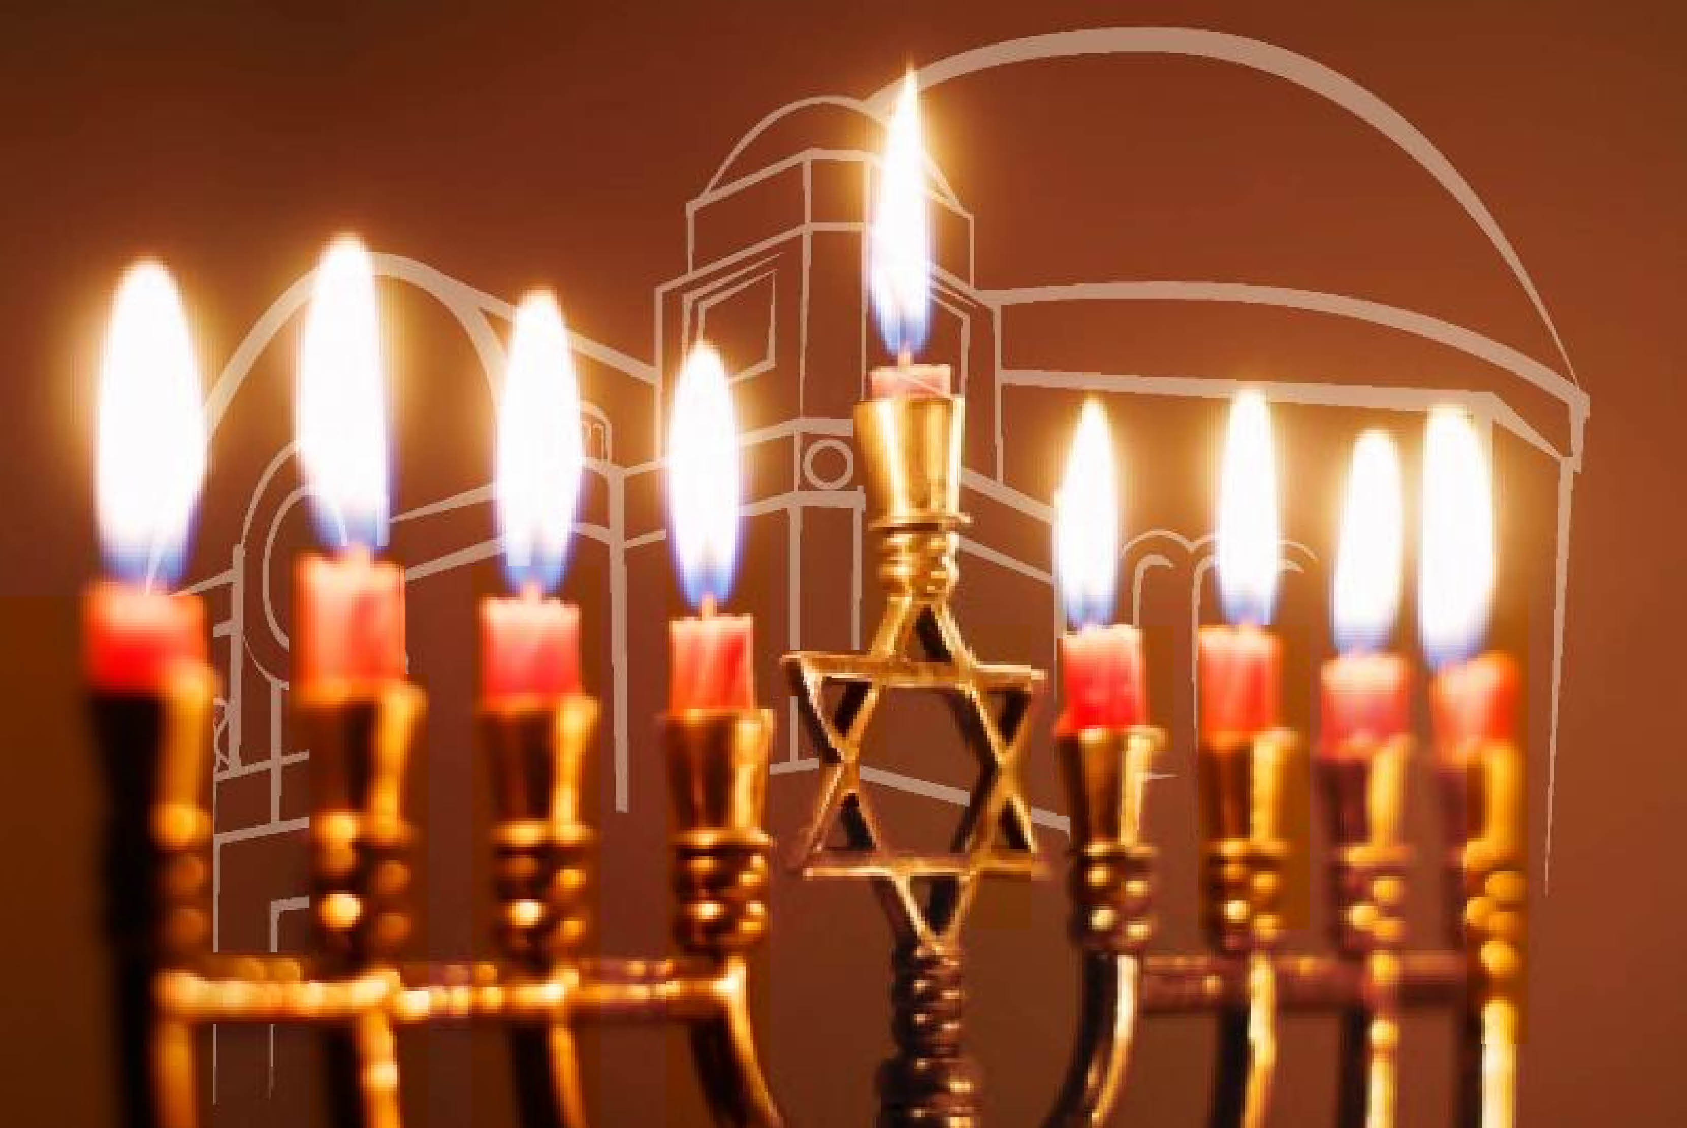
Happy Hannukah

Slide 2

Or Zarua
Music by Jeff Klepper
אוֹר זָרֻעַ לַצַּדּיק וּלְיִשְׁרֵי לֵב שִׂמְחָה:
Or Zarua
Latzadik
Ul’yishrei Lev Simcha
Light is sown for the righteous
Joy for the upright
(Psalm 97:11)
page 343

Slide 3
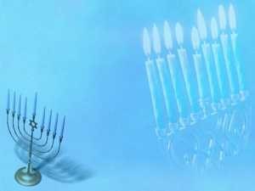
Not By Might, Not By Power
Lyrics by Debbie Friedman
Adapted from Zachariah IV:6
Not by might
and not by power
But by spirit alone
shall we all live in peace
1 of 3

Slide 4
Not By Might, Not By Power
Lyrics by Debbie Friedman
Adapted from Zachariah IV:6
The children sing,
the children dream
And their tears may fall,
but we'll hear them call
And another song will rise
Another song will rise,
Another will rise
2 of 3

Slide 5
Not By Might, Not By Power
Lyrics by Debbie Friedman
Adapted from Zachariah IV:6
Not by might
and not by power
But by spirit alone
shall we all live in peace
Not by might,
not by power, shalom
3 of 3

Slide 6
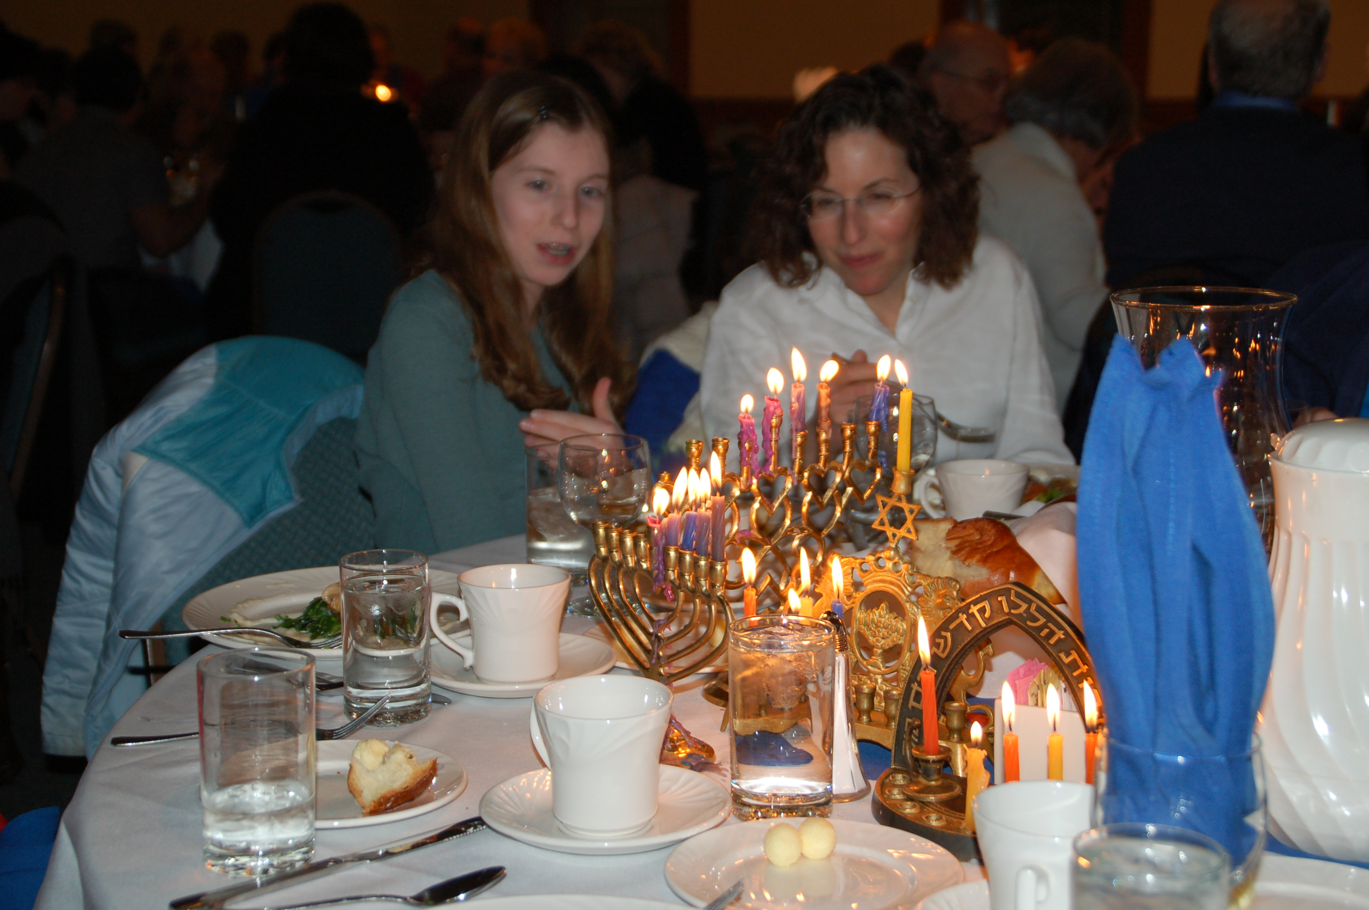
WELCOME
WELCOME

Slide 7
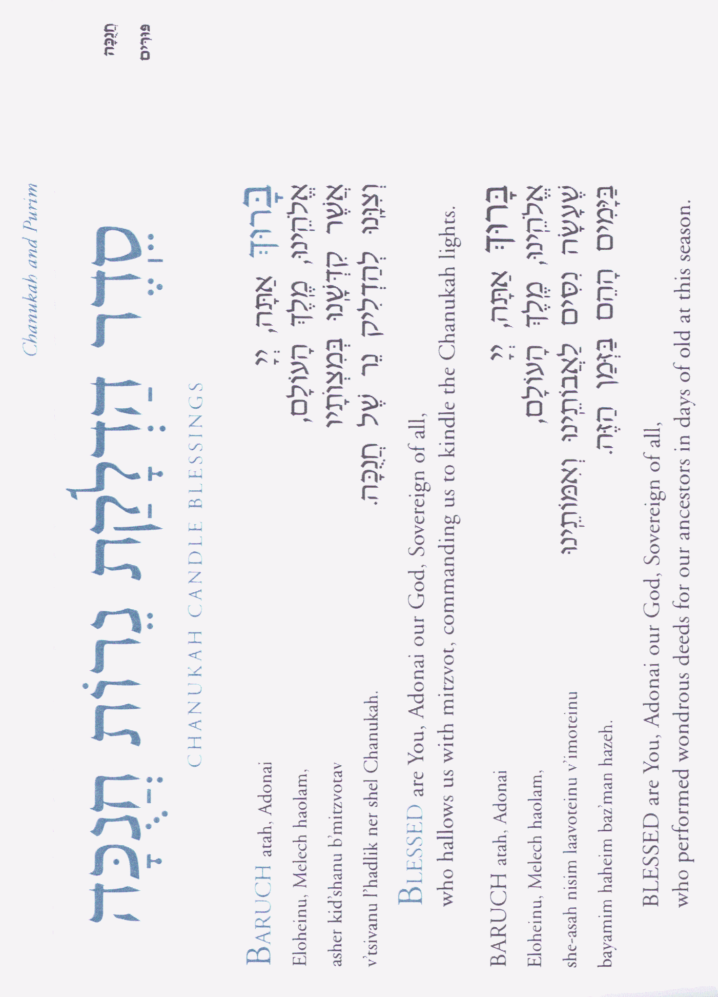
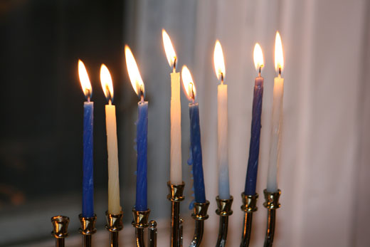

Slide 9
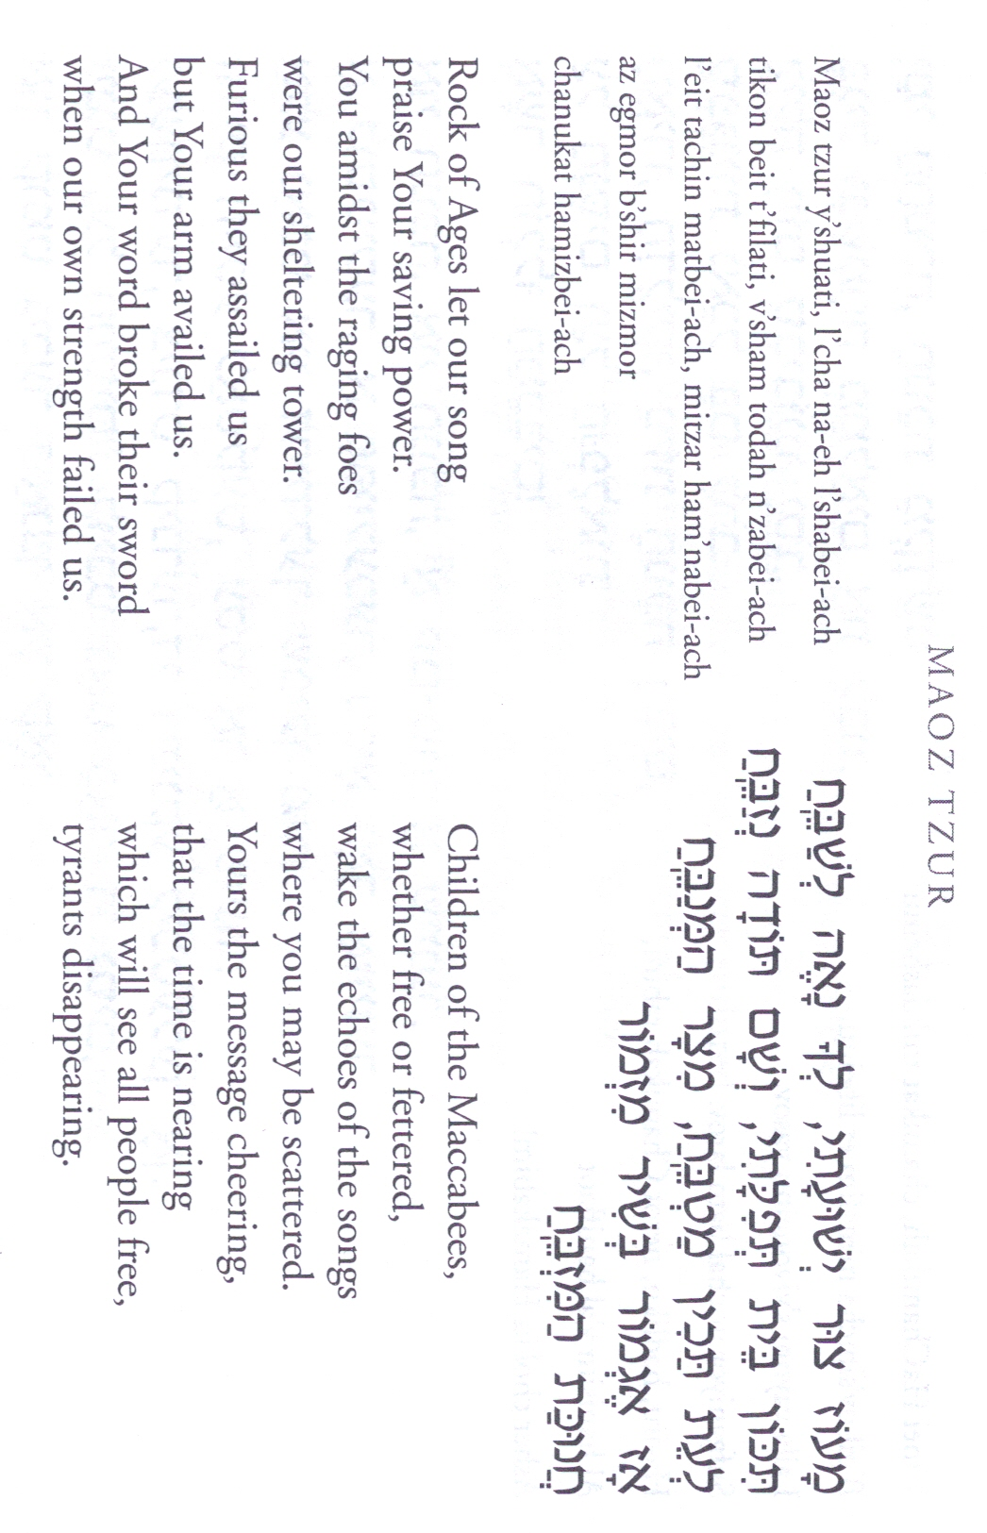

Slide 10

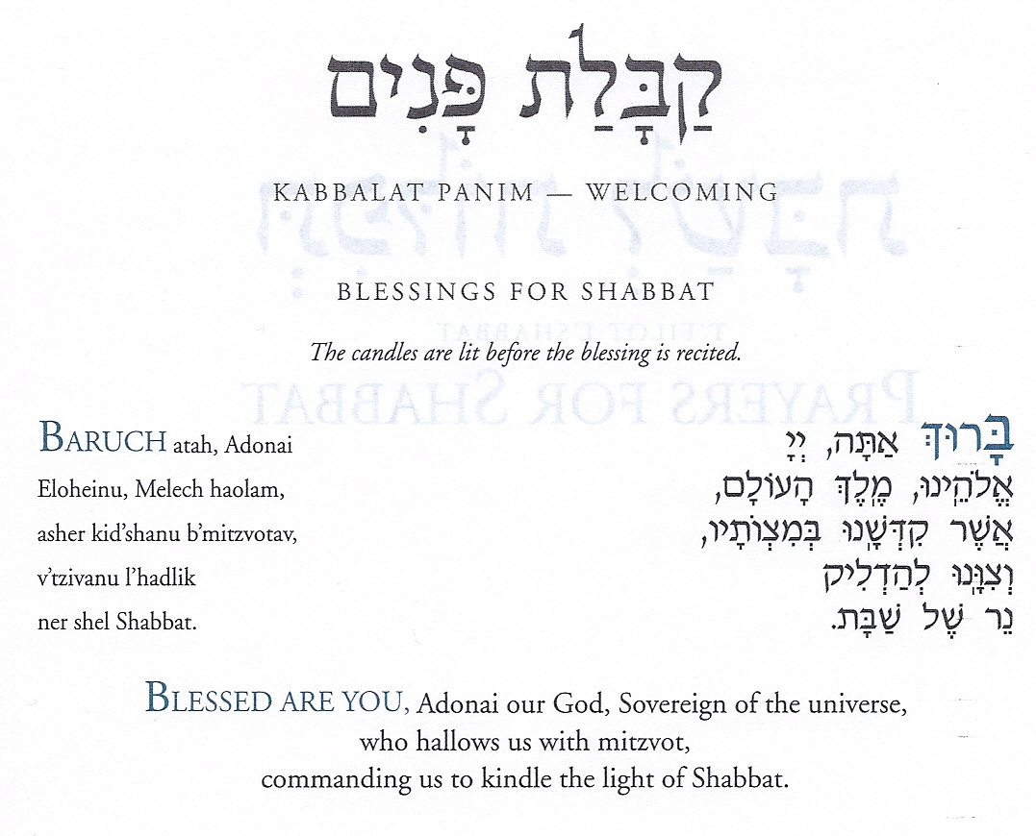

Slide 11
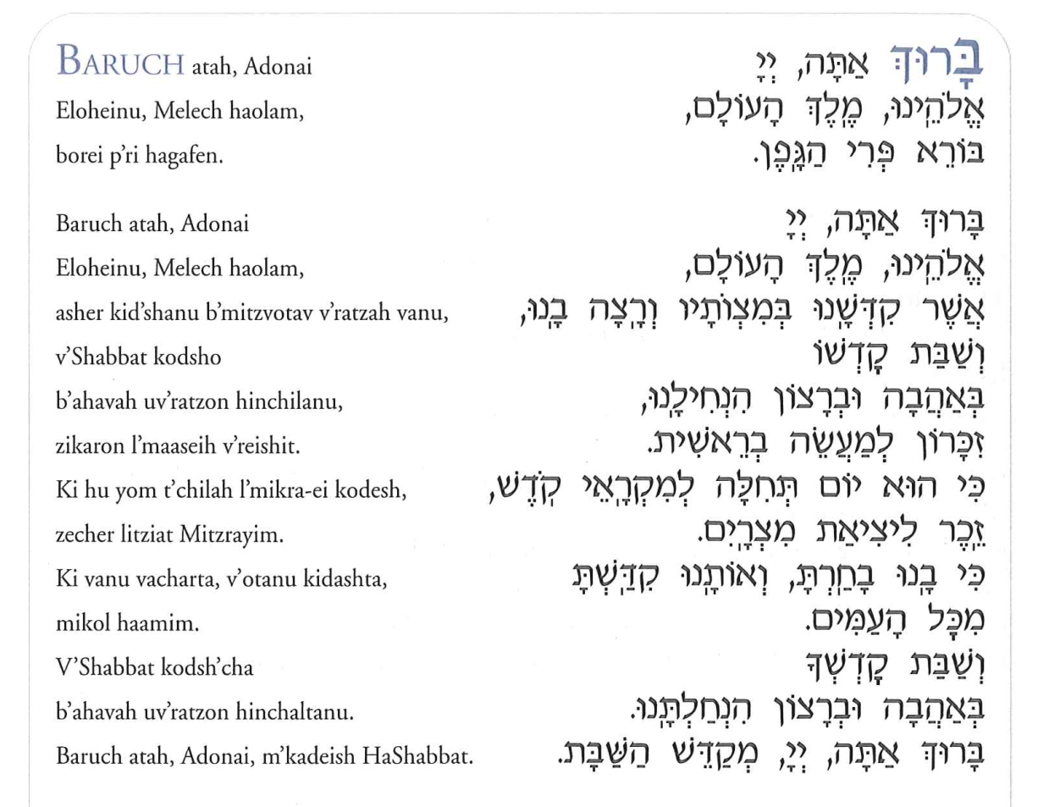
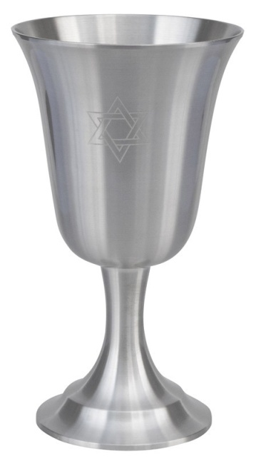

Slide 12
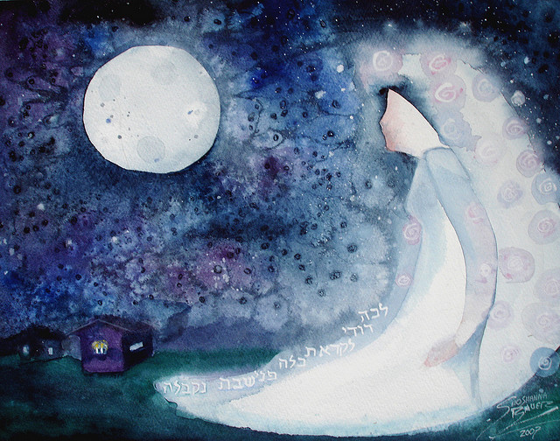
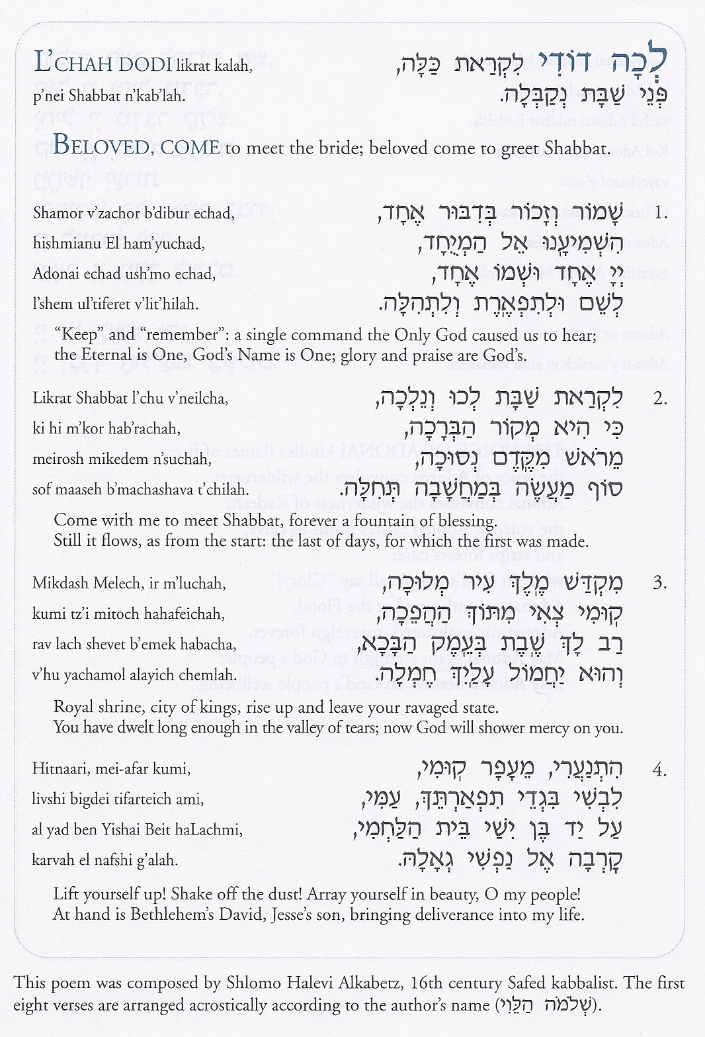
138b – Lecha Dodi 2 – Likrat Shabbat
1 of 3

Slide 13
138b – Lecha Dodi 2 – Likrat Shabbat
2 of 3

Slide 14
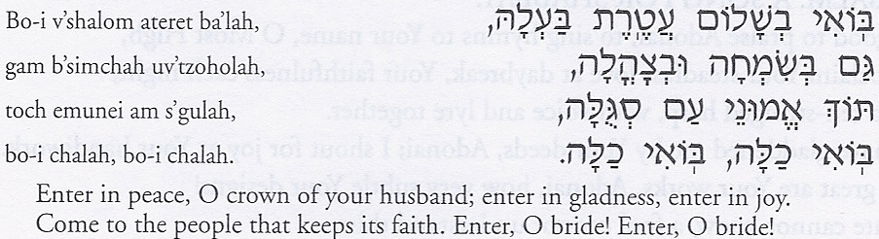
138b – Lecha Dodi 2 – Likrat Shabbat
3 of 3

Slide 15
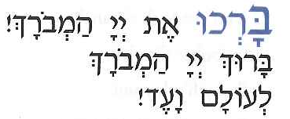


Bar’chu
BAR’CHU et Adonai ham’vorah!
Baruch Adonai ham’vorah
L’olam va-ed!
PRAISE ADONAI to whom praise is due forever!
Praised be Adonai to whom praise is due,
now and forever!

Slide 16
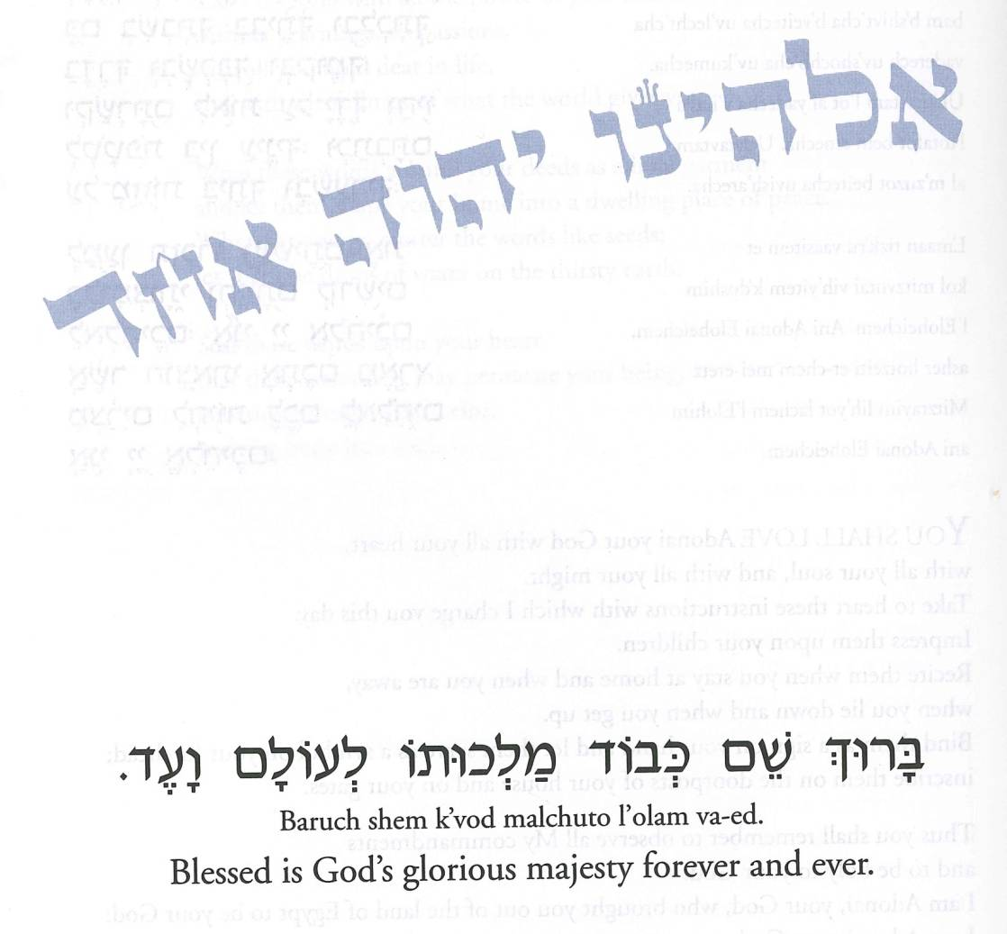
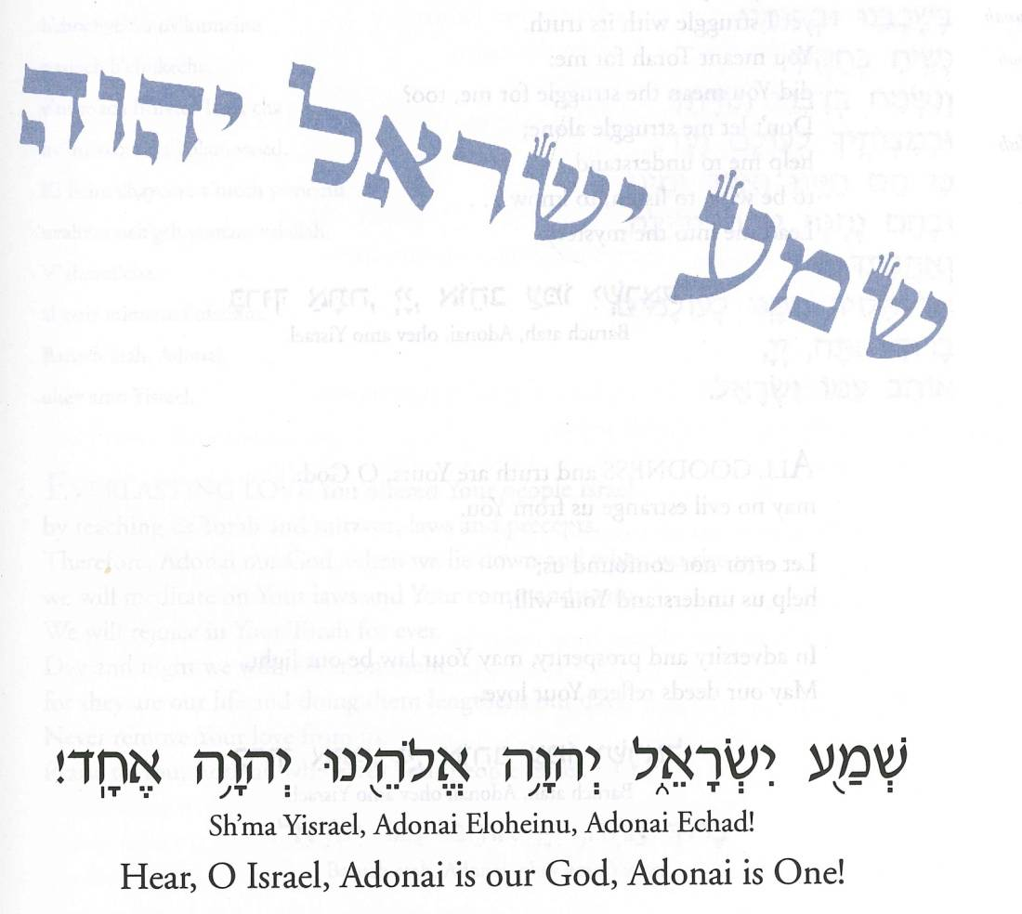


Slide 17
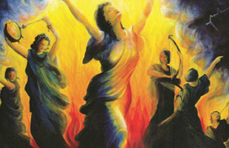
Love Adonai by Sababa (based on V’ahavata)
Love – Adonai you God (6x)
With all your heart (clap, clap)
With all your soul (clap, clap)
With all you might [repeat]
Take these words
that I command this day
And keep them in your heart [repeat]
Write them on the
doorposts of your house
And on your gates
[repeat]

Slide 18
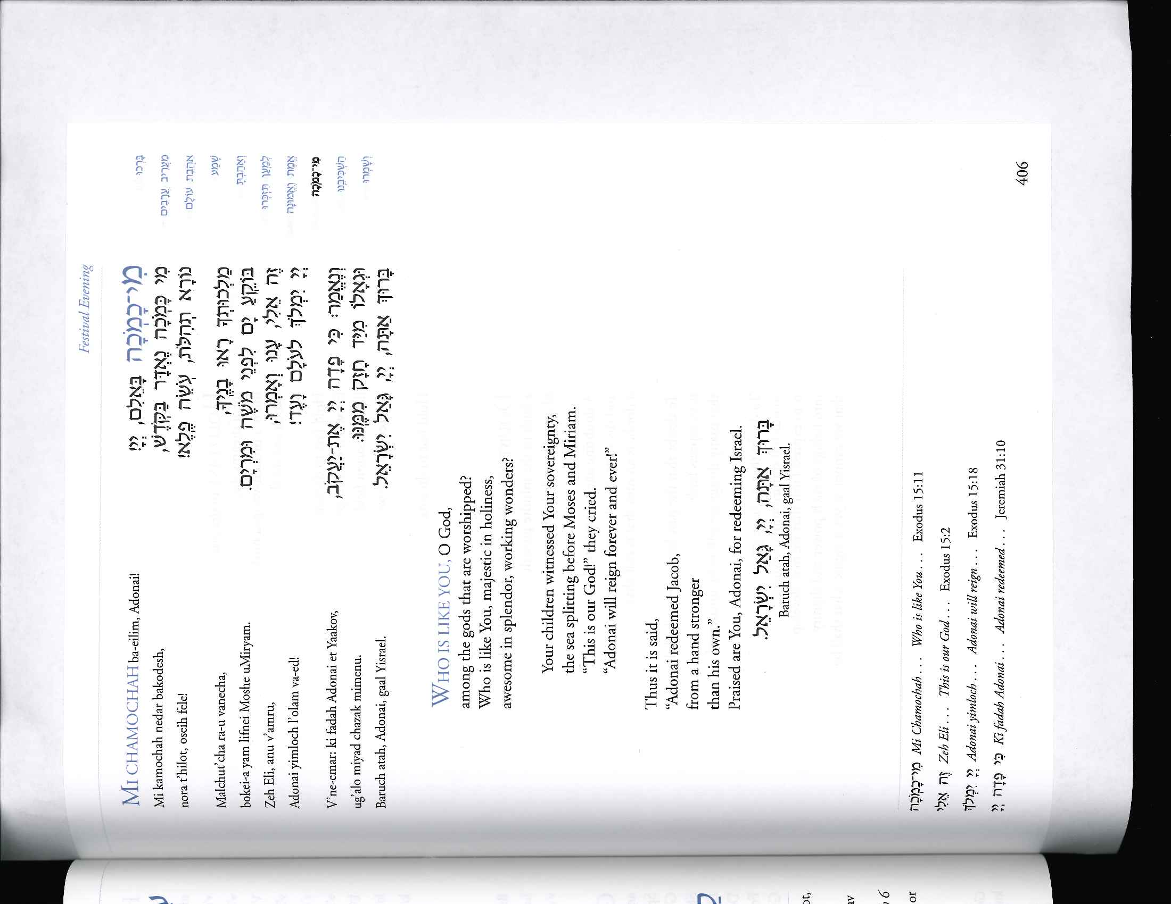
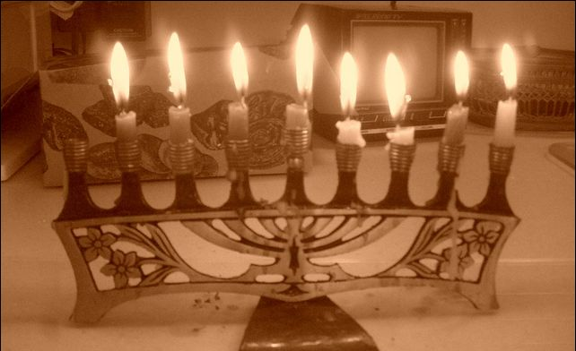
158 - Michamocha

Slide 19
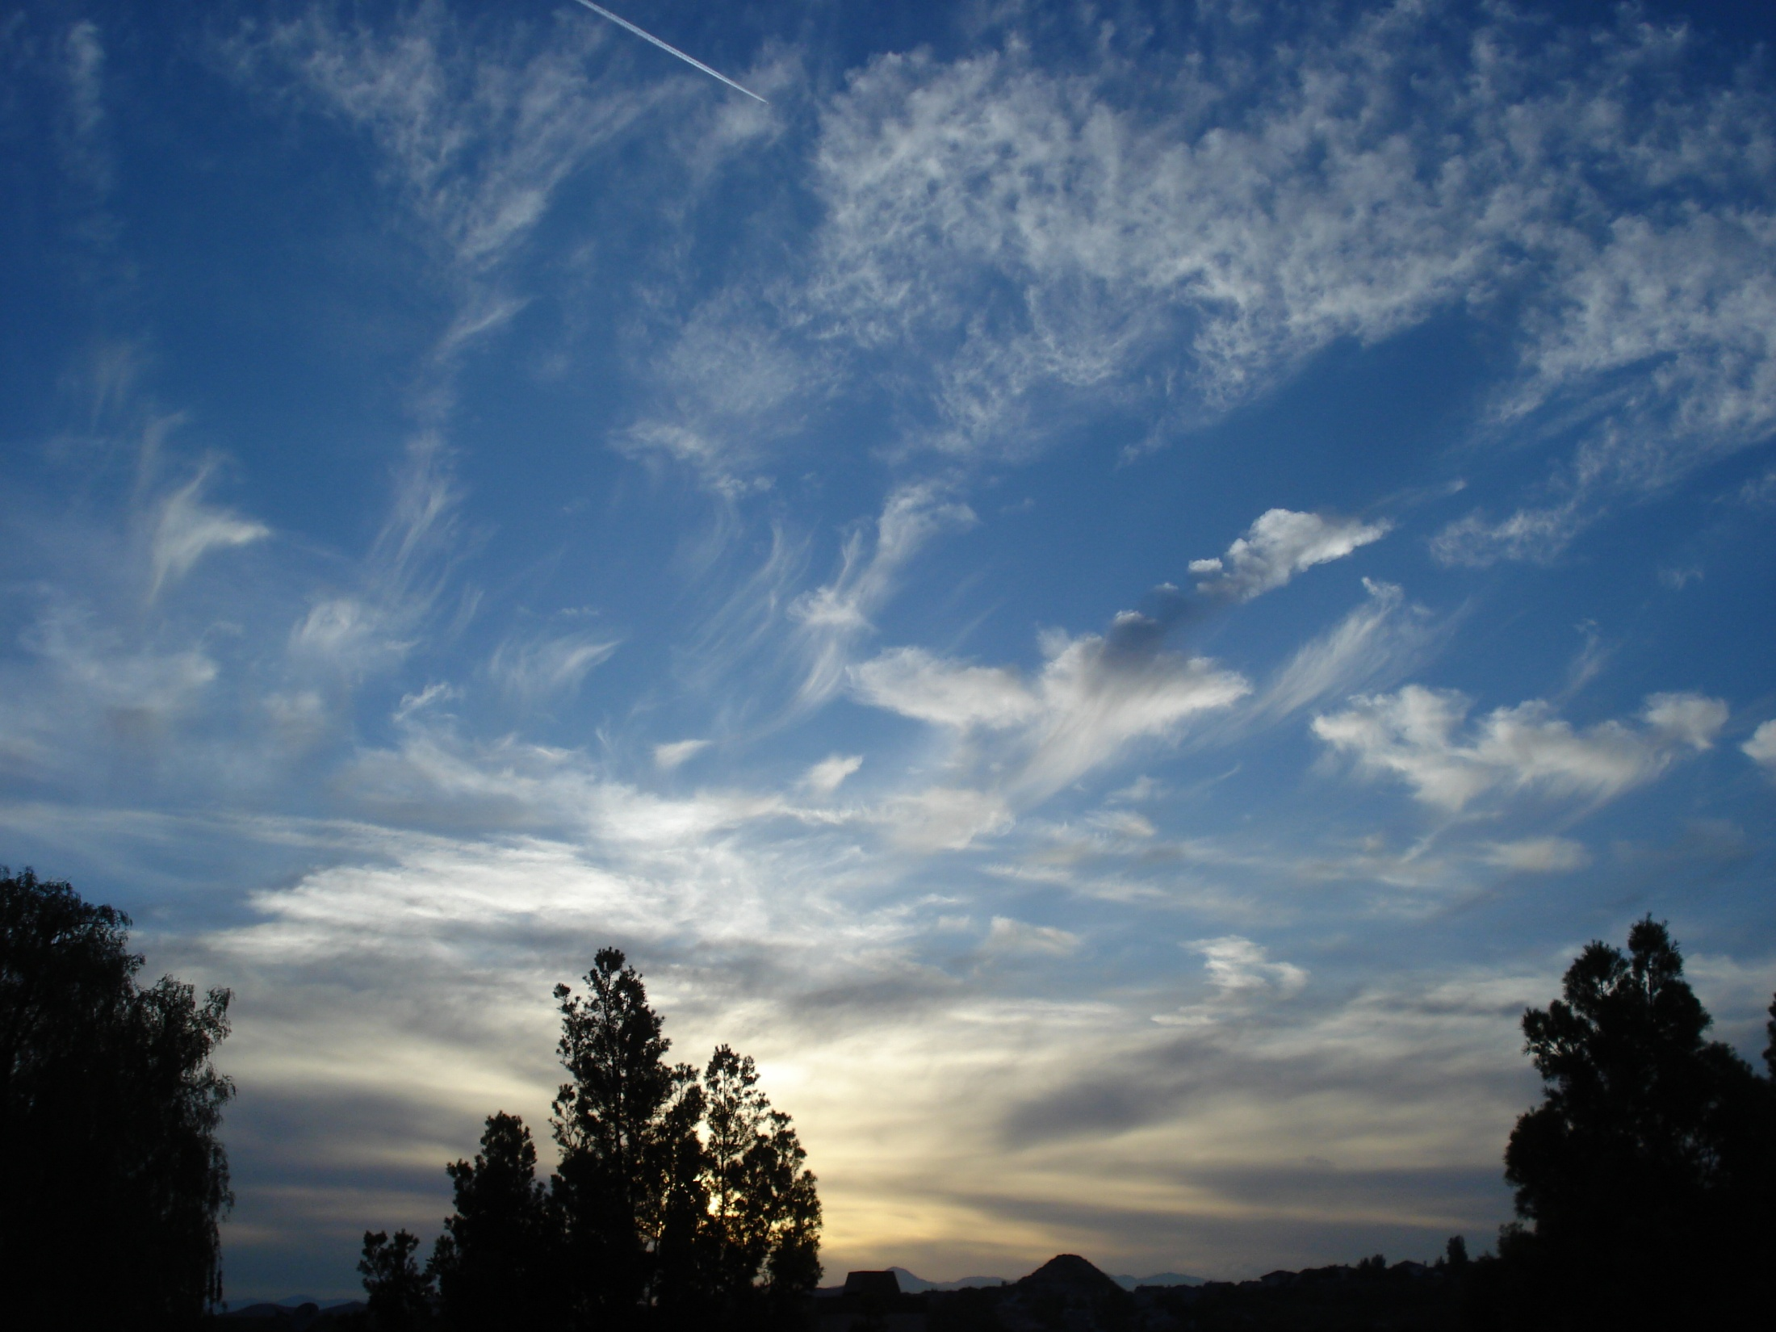
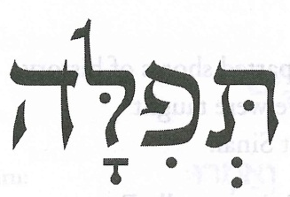

ADONAI, s’fatai tiftach,
Ufi yagid t’hilatcecha.
ADONAI, open up my lips,
That my mouth may declare Your praise.
page 46

Slide 20
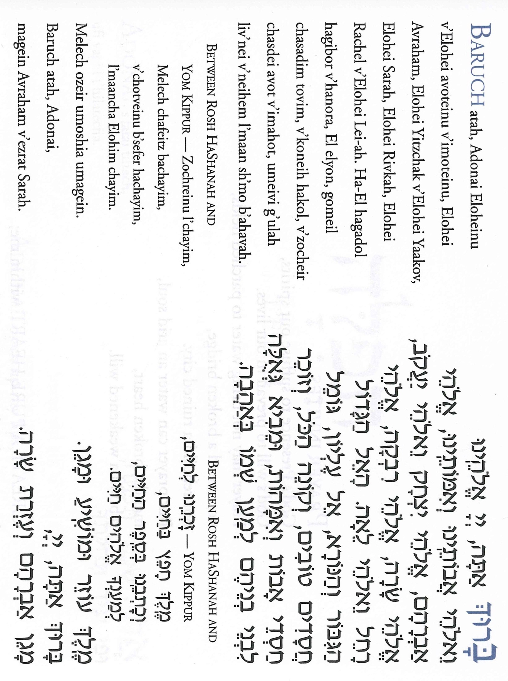


Slide 21


Slide 22
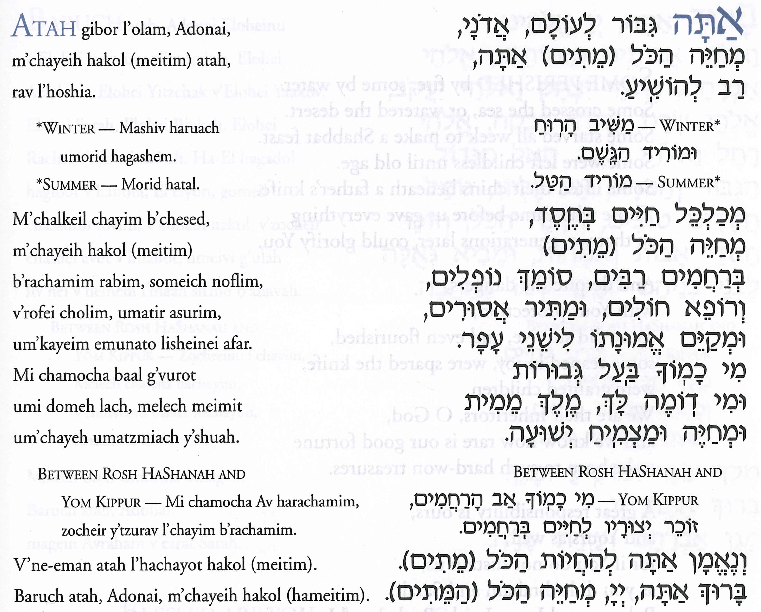

Slide 25
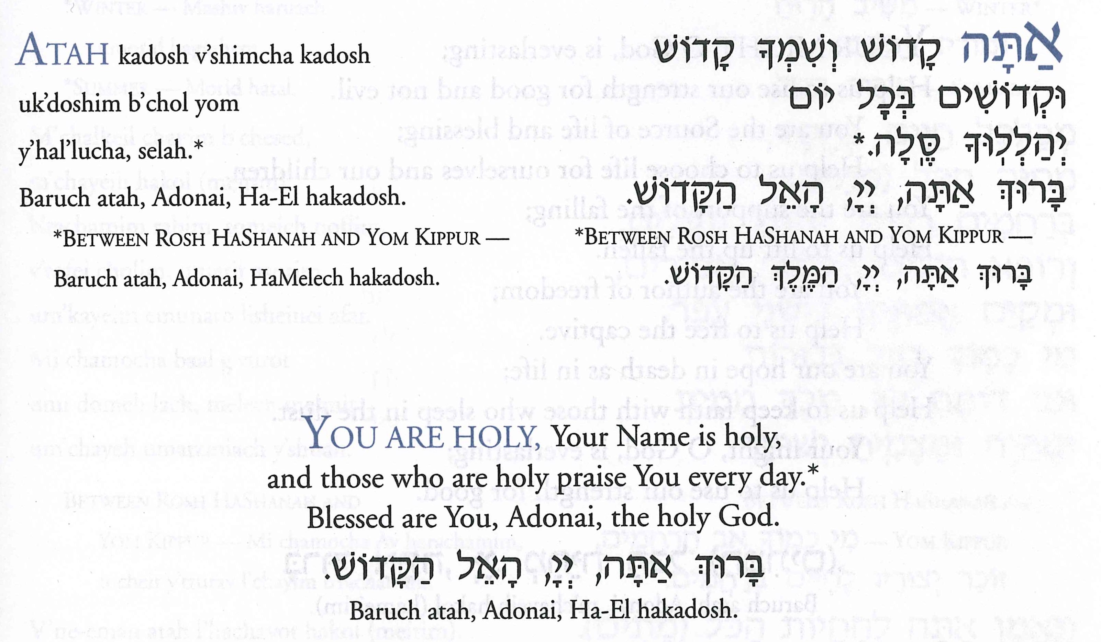

Slide 26

HAPPY BIRTHDAY!
Notes:
Photo by Michael Z. Cahana – 11/20/2021

Slide 27
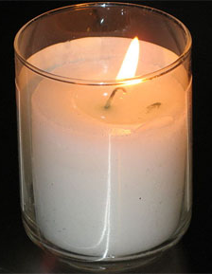

Slide 28
Recent Deaths
Marian Jaffe
Steve Kantor
Gilda Oster
Josephine Shevach

Slide 29
Valerie Alia
Harry Lewis Baron
Ida Bergman*
Sally Bilow
Robert Blank
James D. Bromberg
Alice Lok Cahana
Samuel Chaimov
Regina Cohen
William Cohen
Adrienne Darnell
Theodore B. Davidson*
Arnold Dayan
E. Frieda Dobrow*
Alan Robert Duhnkrack
David Finkelstein*
David Frisch
Betty V. Goldman
Ann Granger
Nancy F. Green
Matthew Henkin
Beth Israel
Edward Jaffie
Samuel Joseph

Slide 30
Solomon Katz
Edith Kessler
Daniel Kivel
Artur Koenig
Robert (Bob) Kreifels
Ruth Liebenstein
Max Malkin
Susan Marcus
Nettie Margolis
Rose M. Radding Marks*
Leonard Meeker
Robert J. Neuberger*
Samuel Oldstein
Barney Papkin
Rita Kantor
Pearlmutter*
Barbara Prebish
Rita P Roseby
Oscar Asher Rosen
Jane Rosenbaum
Miriam F. Rosenfeld*
Lewis A. Sadick
Anna Saltzman
Thelma Schnitzer

Slide 31
Nathan Shapiro
Rachel Shaw
Joan Sitwell
Polly Spero
Minnie Spivak*
Lillian Sugarman
Cohn
  Keats K. Vining
  Dorothy Warner
  Yvette G. Weil*
  Stella Weiss
  Margie Winkler
  Albert A. Woolach
  Arthur Zacks
  Elynor Zusman

Slide 32
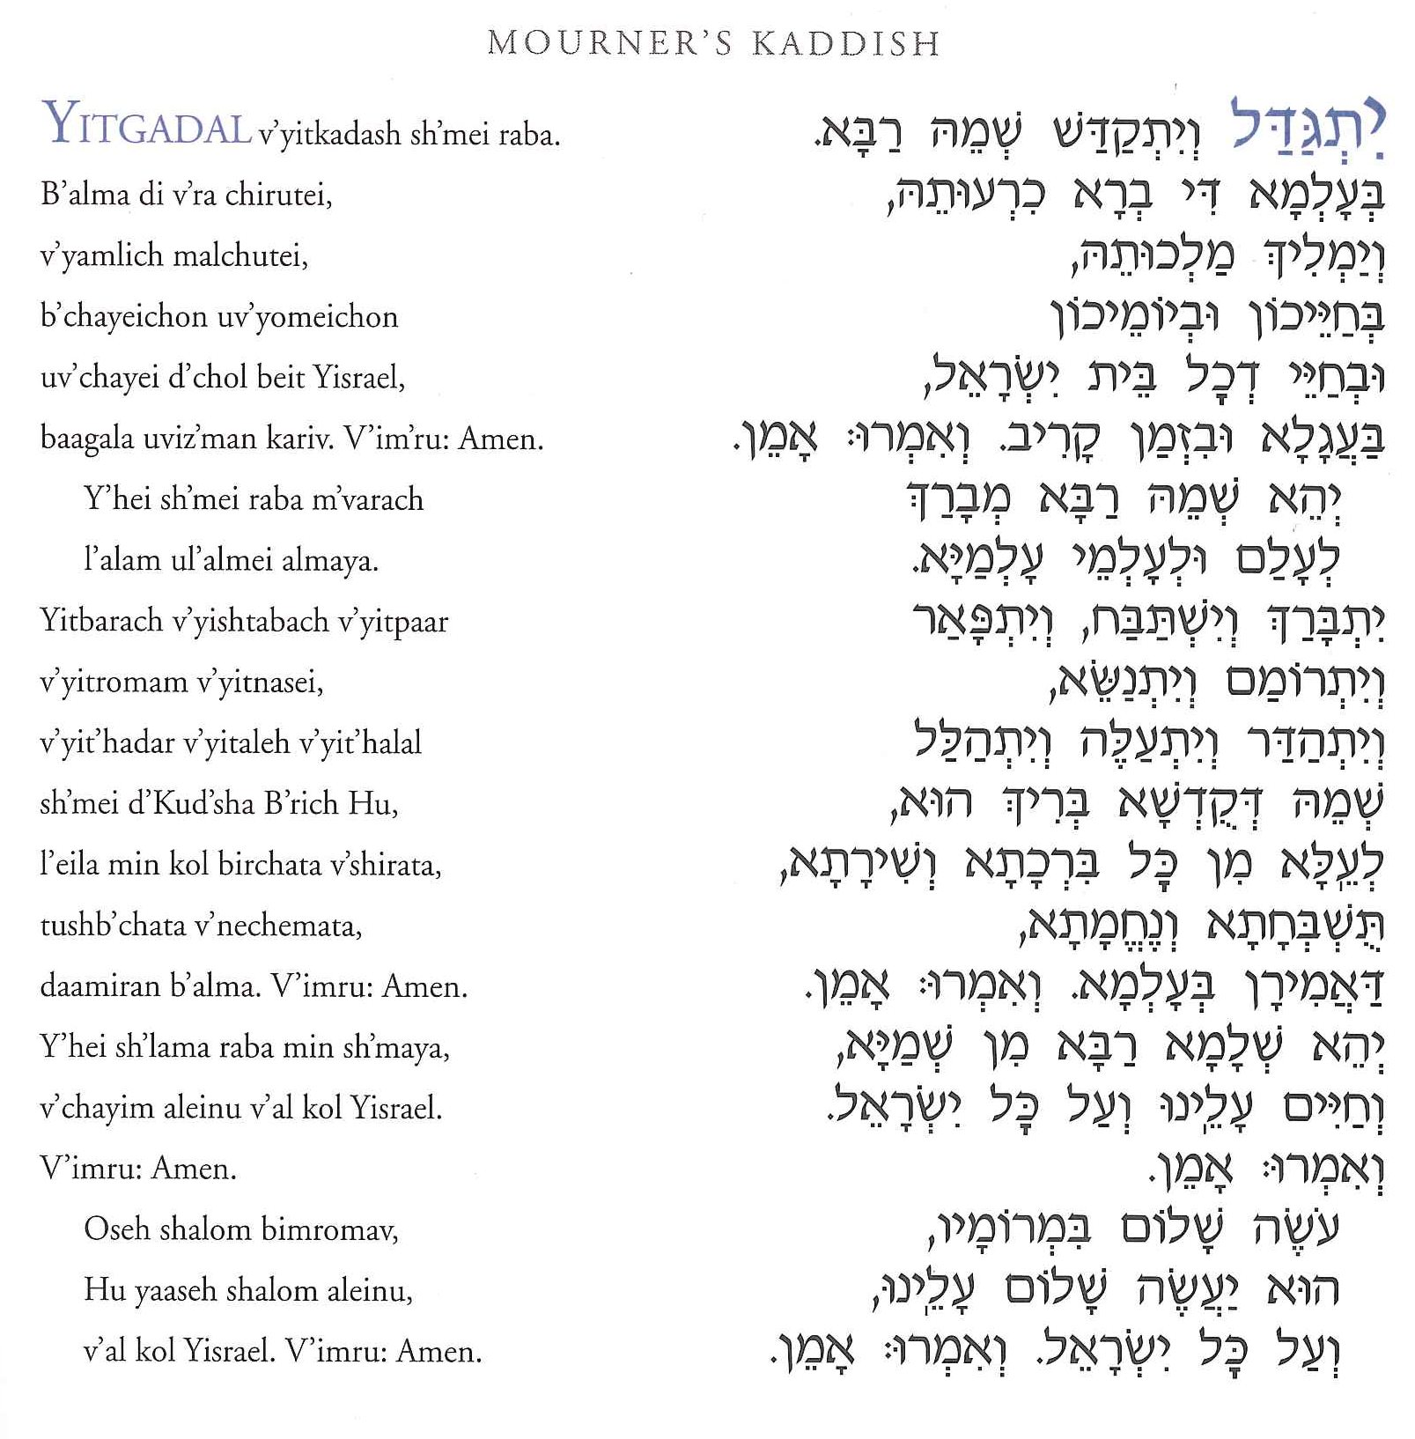
598 – Kaddish

Slide 35
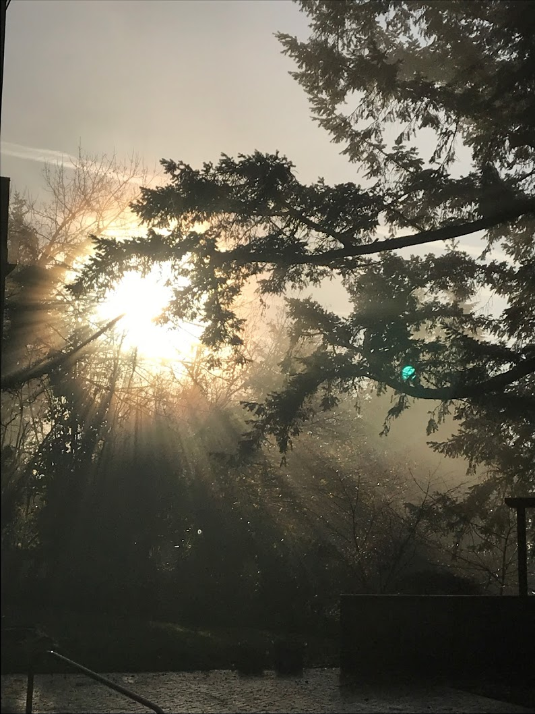
Silent Meditation
Notes:
Photo by Michael Z. Cahana

Slide 36

OR ELOHIM BANU
Words and Music by Kim Schneiderman
Or Elohim Banu
Or Elohim Banu
The Light, the Light is Within

Slide 37
OR ELOHIM BANU
Words and Music by Kim Schneiderman
When we are lost,
when fear surrounds
The weight of darkness dims our brilliance
As we struggle with uncertainty and doubt
When we forgett or fail to recognize
There’s holiness inside our every brokenness
As we reveal the light

Slide 38
OR ELOHIM BANU
Words and Music by Kim Schneiderman
Or Elohim Banu
Or Elohim Banu
The Light, the Light is Within

Slide 39
OR ELOHIM BANU
Words and Music by Kim Schneiderman
The narrow place,
the hardened heart
The story of the suffering melts
from the flame of hope
With just one spark
It’s who we are, it’s possibility
To notice that the very light within you
Also lies within me

Slide 40
OR ELOHIM BANU
Words and Music by Kim Schneiderman
Or Elohim Banu
Or Elohim Banu
The Light, the Light is Within

Slide 41
OR ELOHIM BANU
Words and Music by Kim Schneiderman
Illuminate the Mystery from the past
to what’s not yet begun
Who guides us through the in between
Who is everywhere and Who is One

Slide 42
OR ELOHIM BANU
Words and Music by Kim Schneiderman
Or Elohim Banu
Or Elohim Banu
The Light, the Light is Within

Slide 43
OR ELOHIM BANU
Words and Music by Kim Schneiderman
Light one candle for the Maccabee children
With thanks that their light didn’t die
Light one candle for the pain they endured
When their right to exist was denied
Ma’oz tsur yeshu’ati lecha na’eh leshabeakh
Tikon beit tefilati vesham todah nezaveakh
Do you believe in miracles
Am I hearing you? Am I seeing you?
Eight nights, eight lights
And these rites keep me right
Bless me to the highest heights with your miracle

Slide 44
OR ELOHIM BANU
Words and Music by Kim Schneiderman
Or Elohim Banu
Or Elohim Banu
The Light, the Light is Within

Slide 46


Slide 47


Slide 48
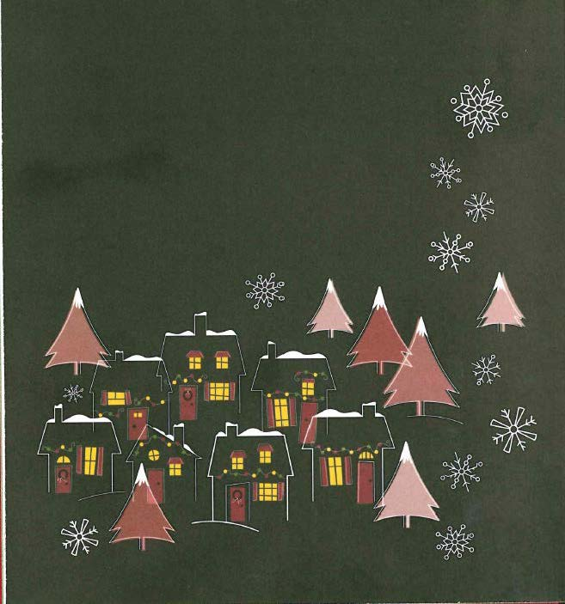

Slide 49
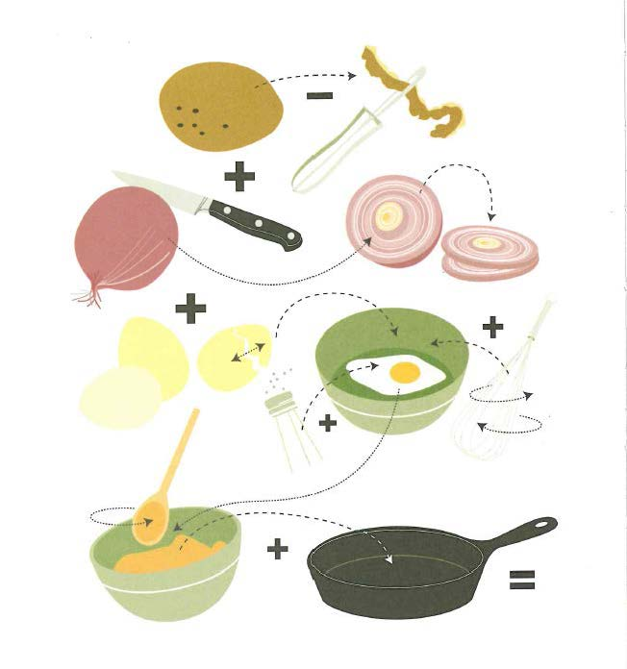

Slide 50
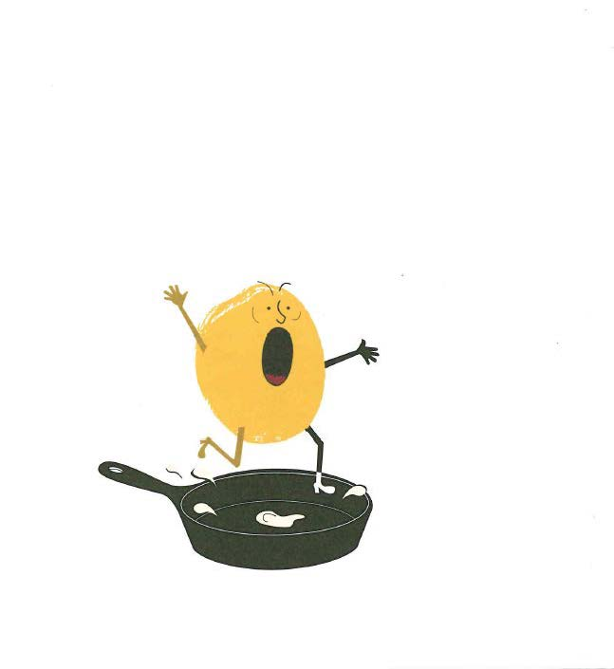

Slide 52


Slide 53
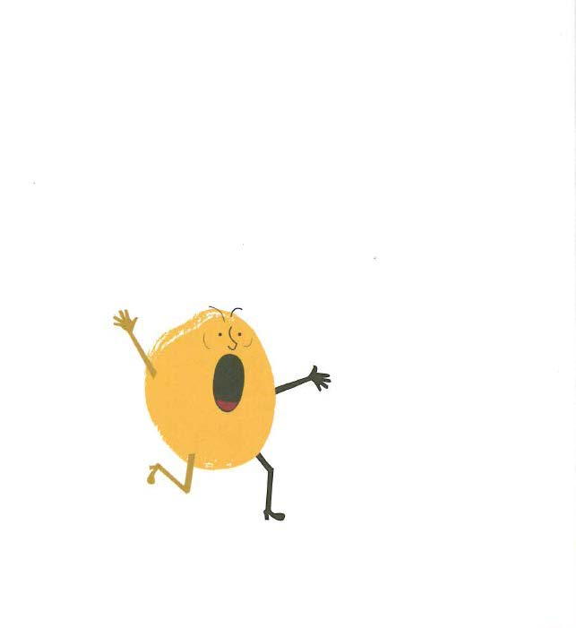

Slide 54
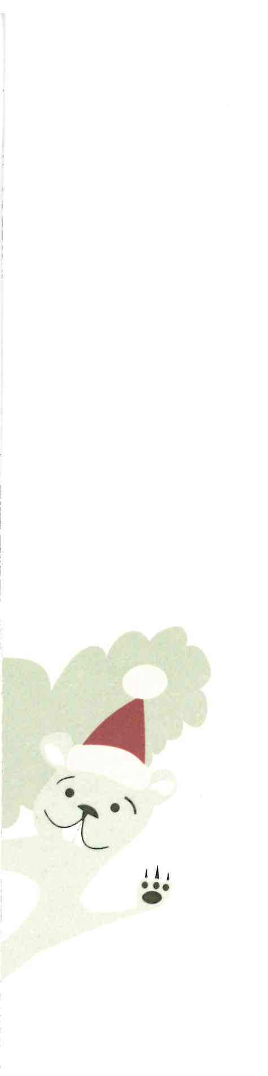

Slide 55



Slide 58
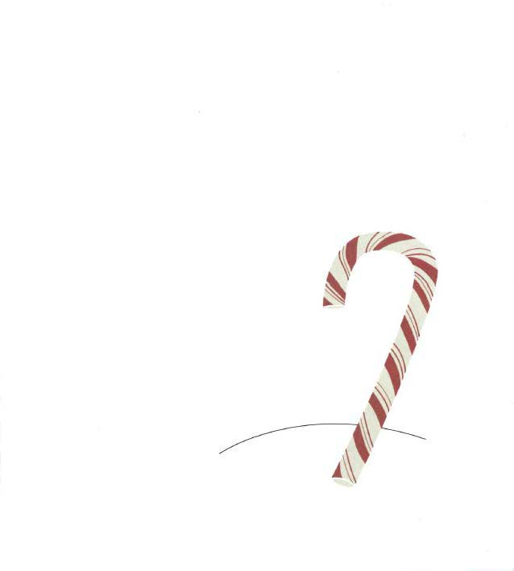

Slide 61
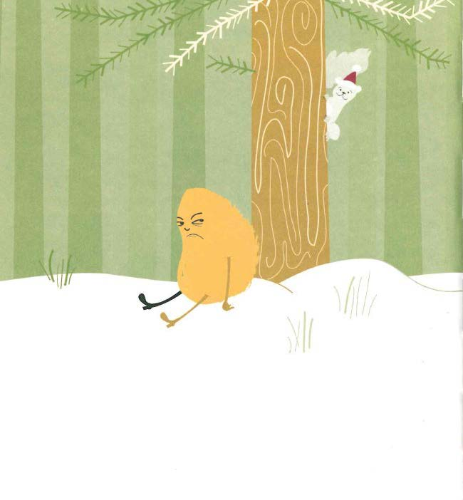

Slide 62


Slide 63


Slide 64


Slide 65
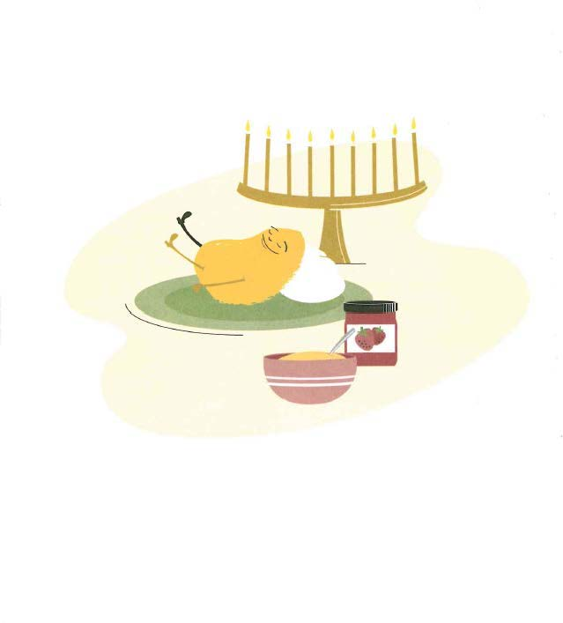

Slide 67
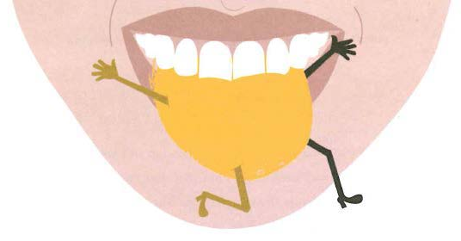

Slide 68


Slide 69
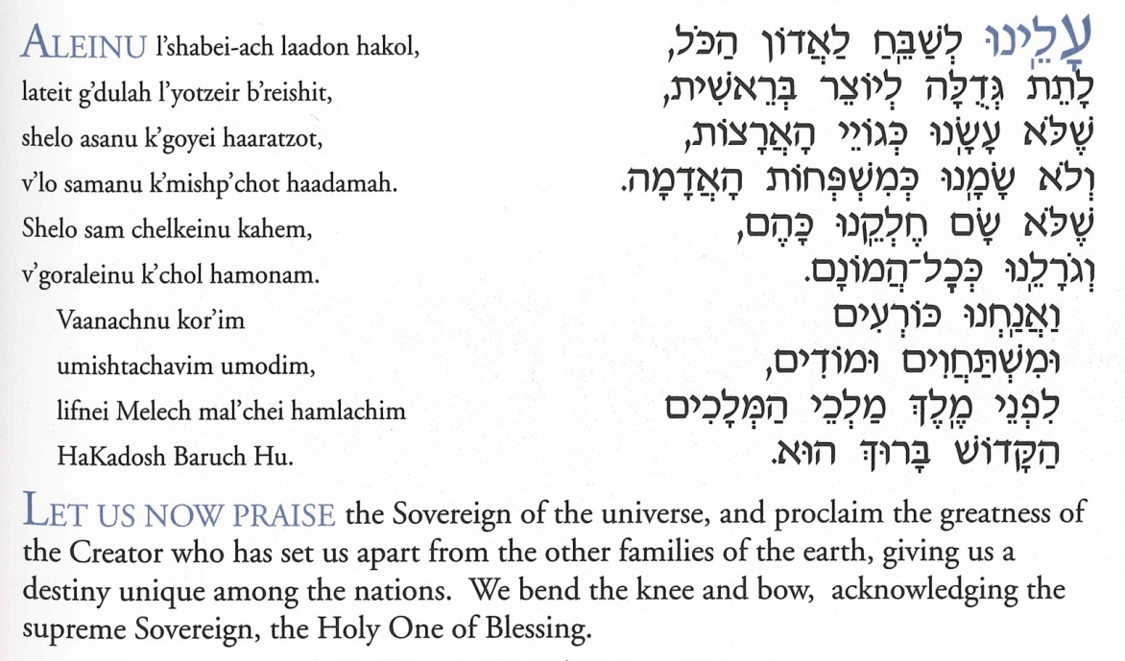

Slide 70
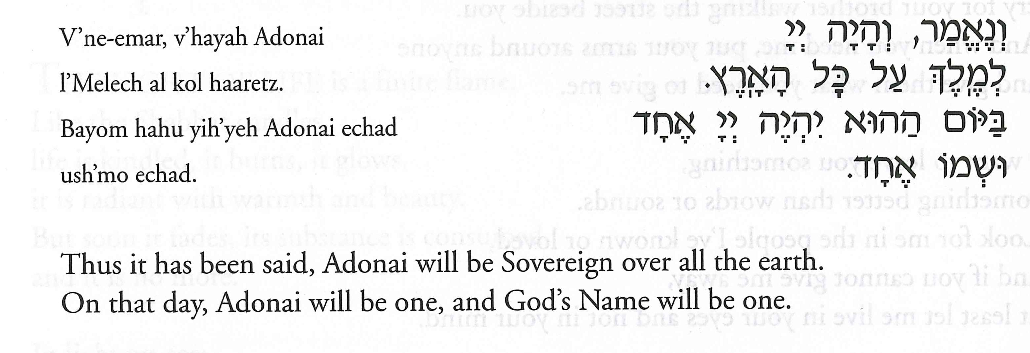
591 – Veneemar

Slide 71
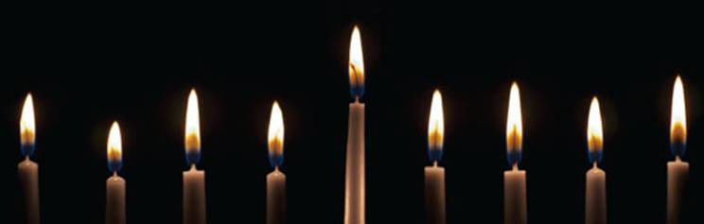
Coming Soon. . .

Slide 72
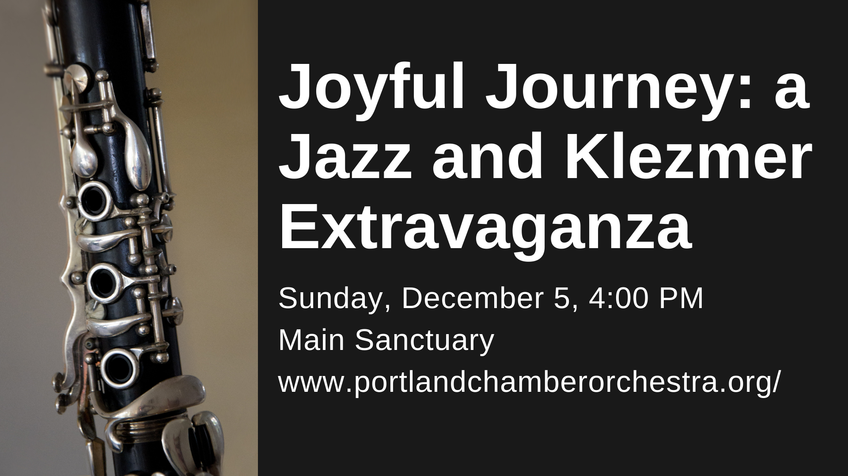

Slide 73


Slide 74
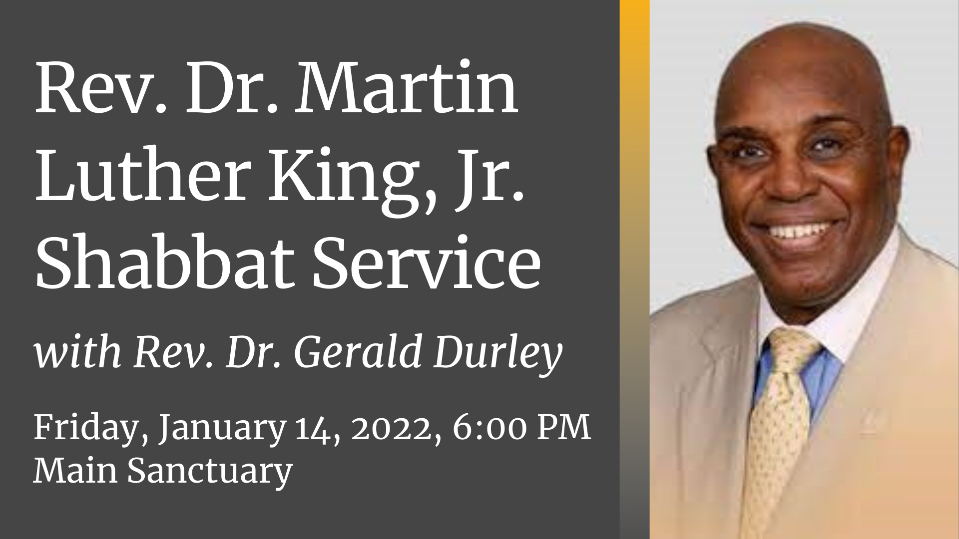

Slide 75


Slide 76
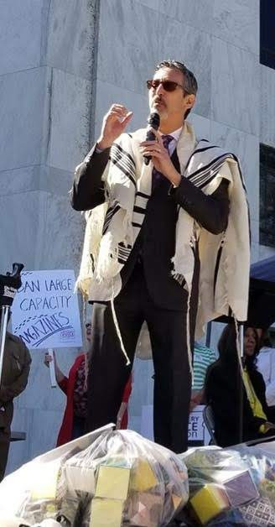
Lift Every Voice Oregon
is collecting signatures for two statewide initiative petitions for Oregon’s Nov 2022 ballot to
Reduce Gun Violence
in Oregon
Prohibiting the Sale of
Assault Weapons and
Large-Capacity Magazines

Slide 77
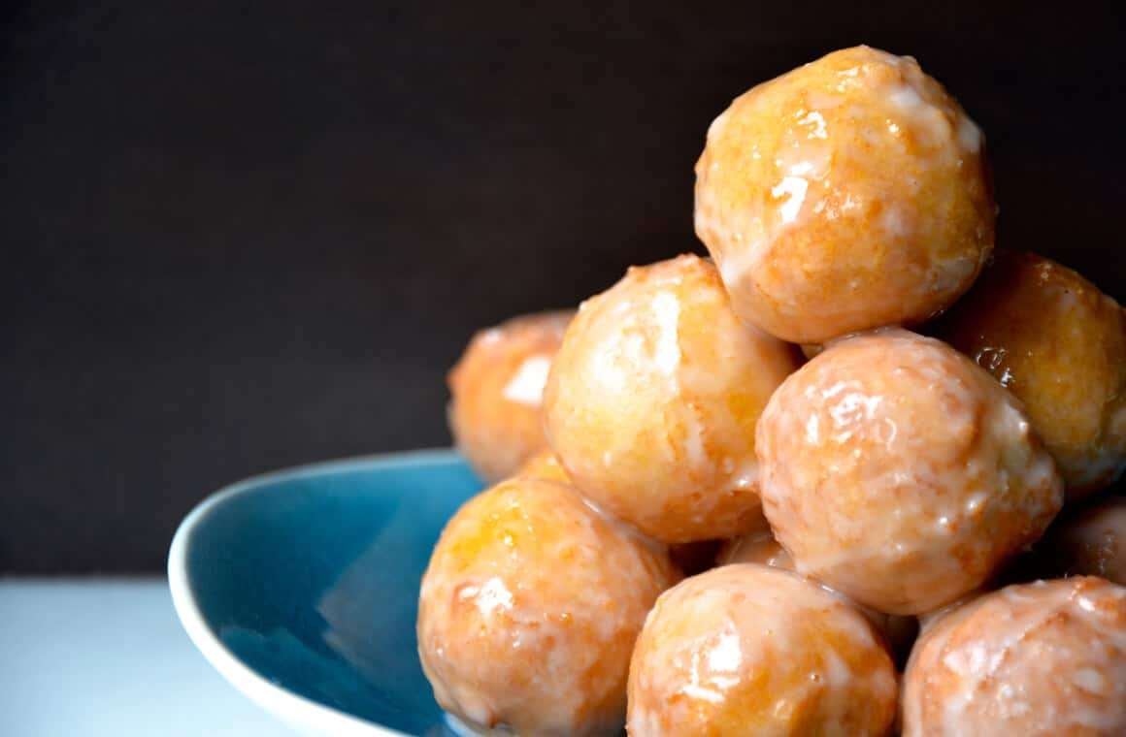
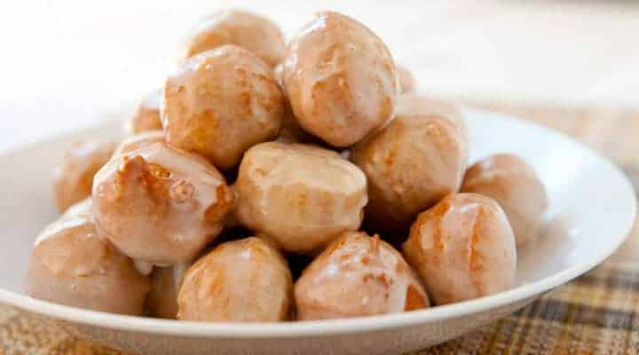
Happy
Hannukah!

Slide 78

Hanukkah, Oh, Hanukkah
Let's light the menorah
Let's have a party
We'll all dance the hora
Gather 'round the table,
we'll give you a treat
Sevivon to play with and latkes to eat
1 of 2

Slide 79
And while we are playing
The candles are burning low
One for each night,
they shed a sweet light
To remind us of days long ago
2 of 2

Slide 80
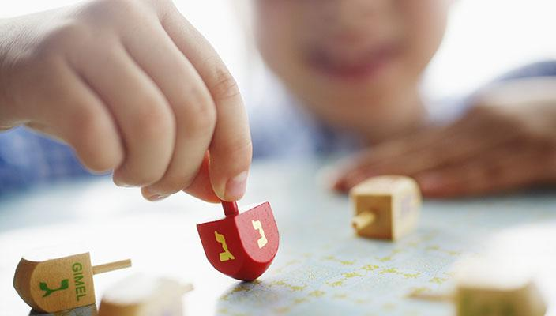
I Have a Little Dreidl
S.E. Goldfarb & S. S. Grossman
I have a little dreidel. I made it out of clay.
And when it's dry and ready, then dreidel I shall play.
Oh dreidel, dreidel, dreidel, I made it out of clay.
Oh dreidel, dreidel, dreidel, then dreidel I shall play.
It has a lovely body,
with legs so short and thin.
When it gets all tired,
it drops and then I win!
Dreidel, dreidel, dreidel,
with leg so short and thin.
Oh dreidel, dreidel, dreidel,
it drops and then I win!

Slide 81

Sivivon, sov, sov, sov
Chanukah, hu chag tov
Chanukah, hu chag tov
Sivivon, sov, sov, sov!
Chag simcha hu la-am
Nes gadol haya sham
Nes gadol haya sham
Chag simcha hu la-am.

Slide 82
Happy Hannukah

Slide 84
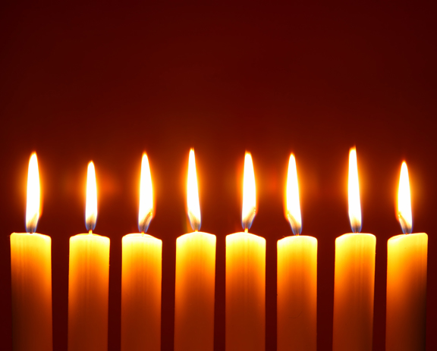

Happy Chanukah

