Slide 1
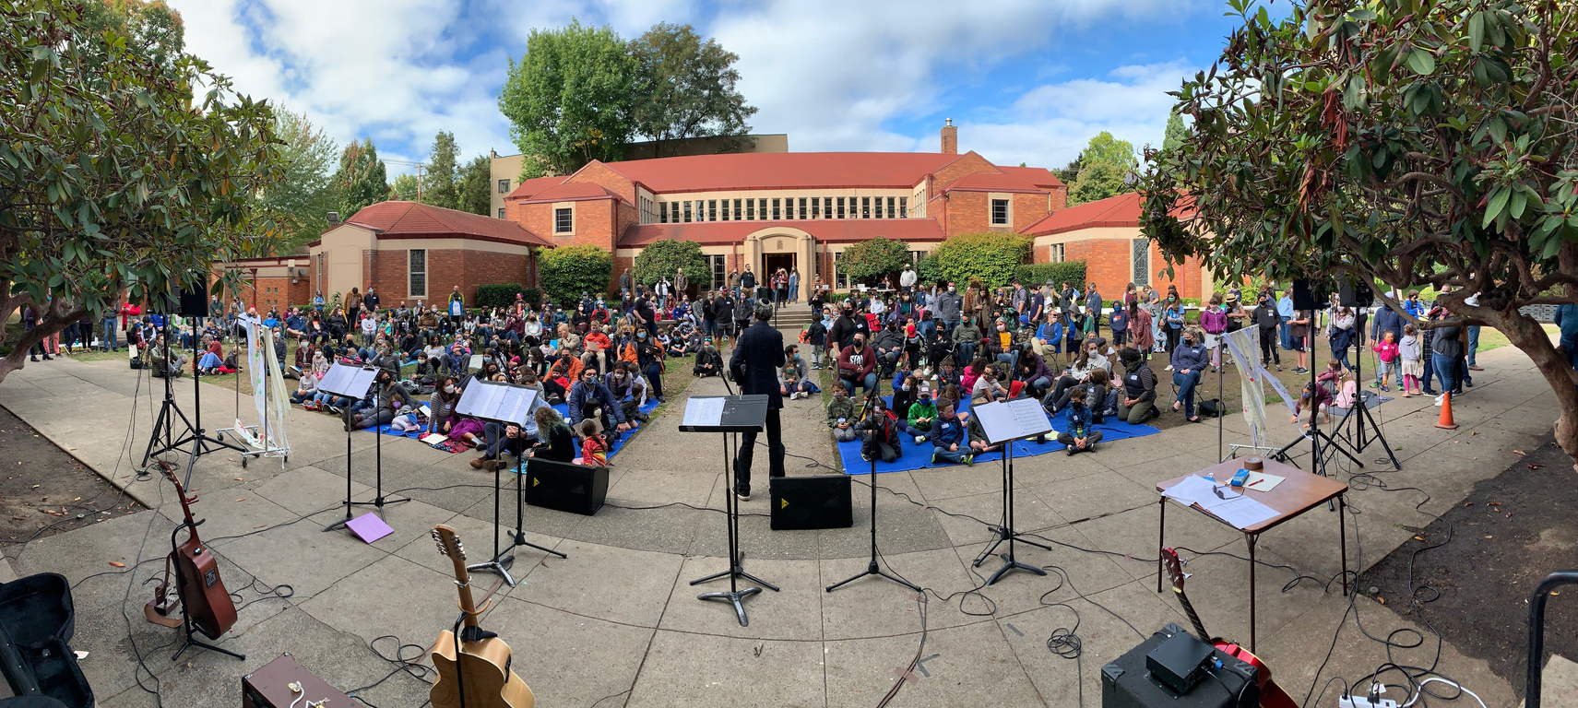
164th Annual Meeting of
Congregation Beth
Israel
May 26, 2022
25 Iyyar 5782
Religious School Opening Day

Slide 2
Agenda
I. Welcome............................................................................................................................................................................... Tony Urdes
II. Opening Prayer.............................................................................................................................Rabbi Cahana
III. Azkara (Remembrance).............................................................................................................................................CBI Clergy
of Mark Peterman, Eric Flamm, and Dan Hurwitz
IV. Approval of Minutes from 163rd Annual Meeting...............................................................................Tony Urdes
V. CBI Year in Review...............................................................................................................................................Josh Kashinsky
VI. Honoring Retiring Board Members................................................................................................................Tony Urdes
Bonnie Davis, David Goldwyn, and Tony Urdes
VII. Nominating Committee Report..............................................................................................................Libby Schwartz
VIII. Election of New Board Members..................................................................................................................Tony Urdes
  For Election to a New Two Year Term for 2022 - 2024
    Susan Berniker, Gail Mandel, Susan Milstein, Elana Pirtle-Guiney
  For Reelection to Two Year Term for 2022 - 2024
    Naomi Derner, Meryl Haber, Bill June, Shoshanna Lansberg, Sandy Lewis, Sarah Pitman
  Continuing Two Year Term for 2022 - 2024
    Jeff Capen, Janet Hoffman,Christie Moore, Josh Remick, Sally Rosenfeld, Libby Schwartz
IX. Blessing of the CBI Board ......................................................................................................................................Tony Urdes
X. Closing .....................................................................................................................................................................................CBI Clergy

Slide 3
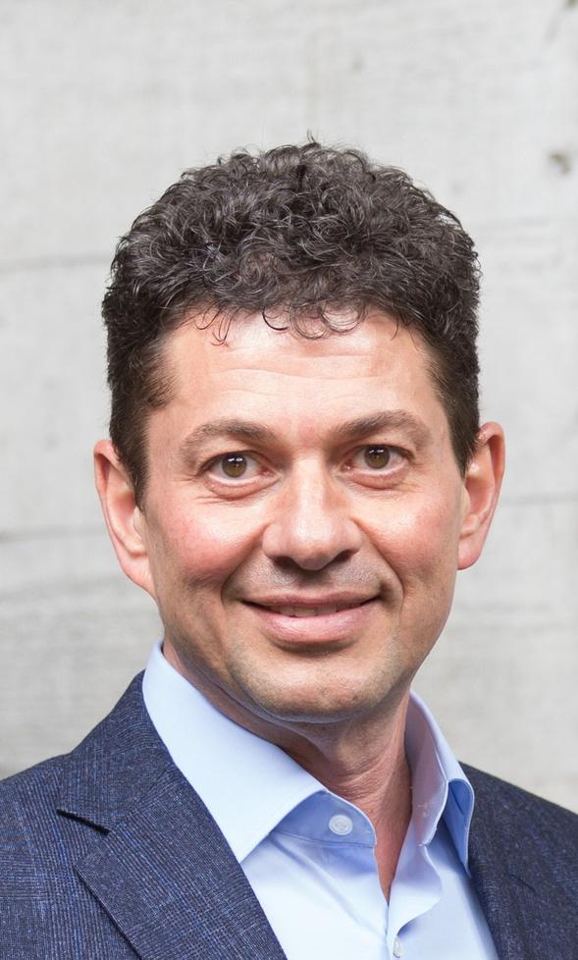
Welcome
Tony Urdes
President, CBI Board of Trustees
Tony Urdes
www.bethisraell-pdx.org

Slide 4
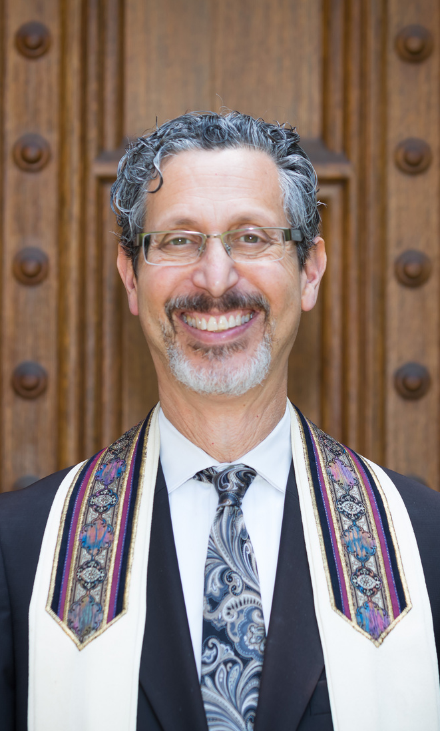
Opening
Prayer
Rabbi Michael Z. Cahana
Rabbi Cahana
www.bethisraell-pdx.org

Slide 5
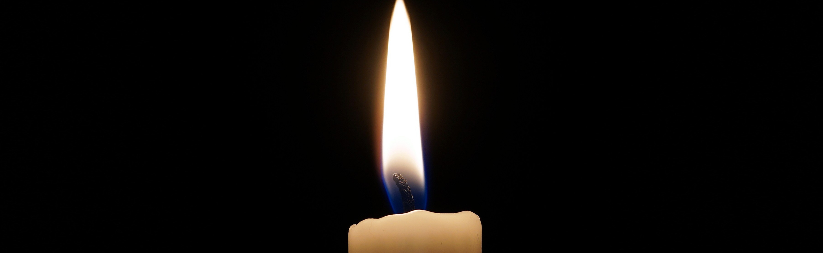
Azkara
Remembrance of
Eric Flamm
Dan Hurwitz
Mark Peterman
www.bethisrael-pdx.org

Slide 6
Approval of Minutes
For the 163rd Annual Meeting
of Congregation Beth Israel
Tony Urdes
President, CBI Board of Trustees
www.bethisrael-pdx.org

Slide 7
Minutes
for the 163rd Annual Meeting of Congregation Beth Israel
Josh Kashinsky, Executive Director, called the Annual Meeting of Congregation Beth Israel to order at 5:33 PM. We met the quorum with over 10 membership units present.
Rabbi Cahana led the group with a D’var.
A video was played of the Kol Echad choir coming together to sing for the first time since the pandemic began.
Tony Urdes, President, addressed the group. He spoke of what we learned this year and how it can strengthen us. He talked about the benefits of virtual programming and a need to learn from these opportunities and as we move forward and come together in person again.
Upon a motion made by Sally Rosenfeld and second made by Naomi Derner, the minutes from the 162nd Annual meeting were unanimously approved as written.
Josh Kashinsky presented an overview of the past year. He summarized the financial status and our fundraising efforts, membership numbers and religious school enrollment, highlights from the past year’s programming.
Tony Urdes thanked the trustees for their service this past year and honored Glen Levy, whose term is expiring, for his dedication and years of service.
Tony Urdes advised the members that the Nominating Committee has recommended the following slate of trustees for two year terms 2021-2023:
  New to the Board: Josh Remick
  For re-election to the Board: Sally Rosenfeld, Janet Hoffman, Jeff Capen, Christie Moore, Libby Schwartz, Dan Hurwitz
Susan Milstein made a motion to approve the above slate for election to the Board of Trustees. Naomi Derner seconded. The motion passed unanimously.
Cantor Cahana spoke of finding gratitude and honored John Strege with a message from her and CBI members thanking him for his decades of service as a musician at CBI.
Rabbi Cahana shared the plan for re-opening and returning to in-person Shabbat services. CBI will begin in-person services while staying committed to providing virtual programming.
Josh Kashinsky opened the floor to questions and answered questions from members.
Rabbi Joseph led us in a closing prayer on the week’s Torah portion.
There being no further business, the meeting was adjourned at 6:34 PM.
Respectfully submitted by Chelsea Ferguson

Slide 8
OurYear in Review
2021 - 2022
5781 - 5782
Josh Kashinsky
Executive Director

Slide 9
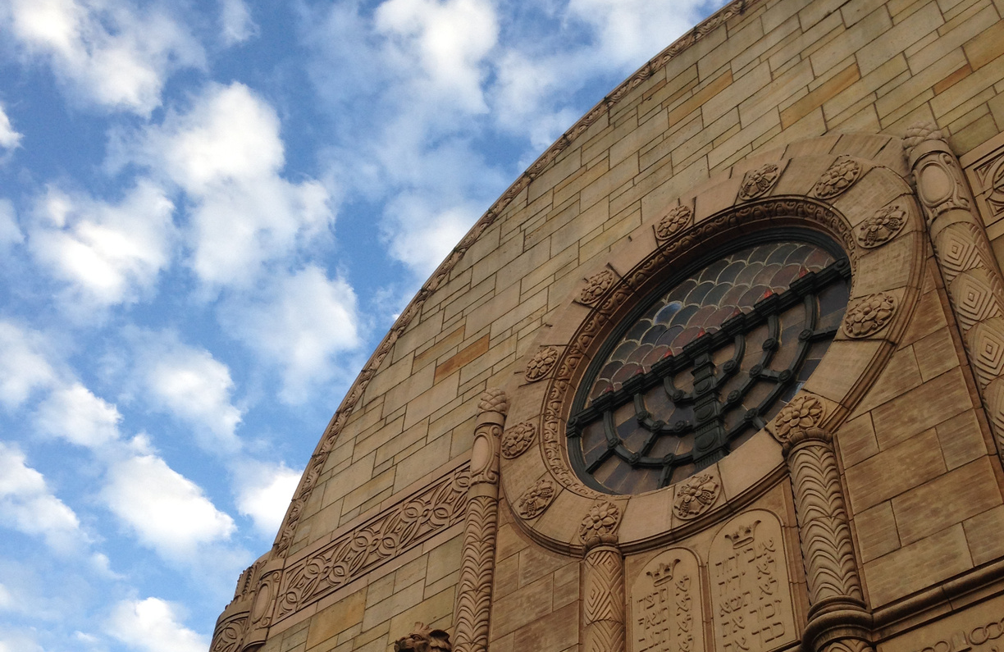
This year, our CBI community...
Main Sanctuary
www.bethisrael-pdx.org

Slide 10
  Grew by thirty-nine membership units
www.bethisrael-pdx.org

Slide 11
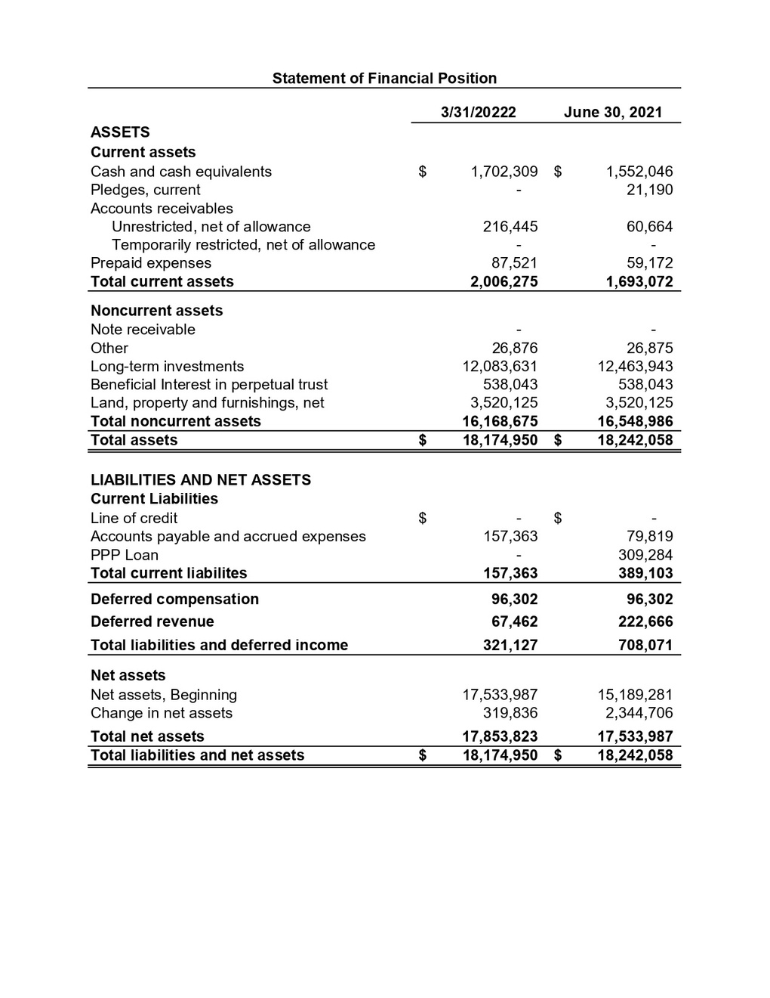
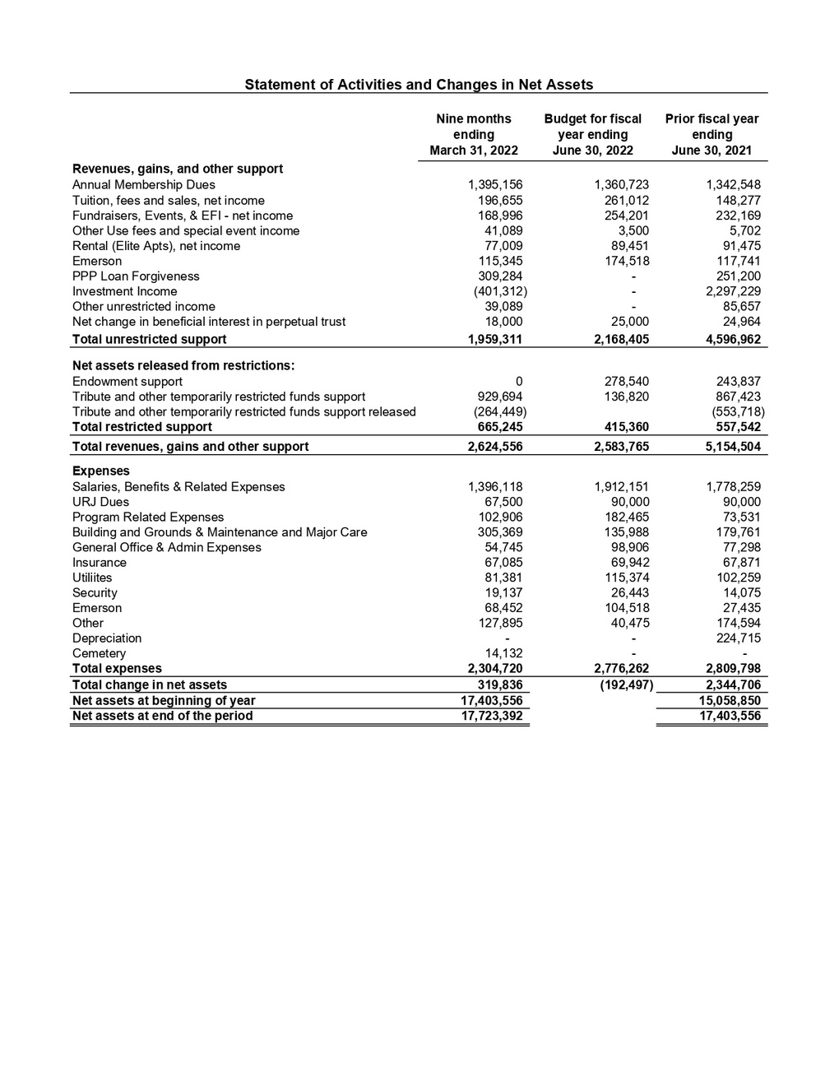
www.bethisrael-pdx.org

Slide 12
Financial Highlights
  Year End 6/30/21 resulted in an increase of net assets of $2,344,706 and an operational budget surplus of $44,697
  Our FY22 membership revenue is projected to be a 4% increase over FY21. FY22 membership revenue is down approximately 2-3% from historical, pre-COVID dues.
  Religious school enrollment and tuition was about 86% of historical amount.
  The 2nd round PPP loan we received in April 2021 was fully forgiven for $309,284.
Development
  Taste of temple raised approximately $146,000 and netted $130,000. We received $95,000 in sponsorships from 55 donors.
  Social Action has raised over $61,000 this year. Through April, SAC has distributed $54,000 to organizations in need (not including donations to CBI’s Aid for Ukraine Fund).
  We received a gift of $264,000 to be used for URJ Camp Scholarships.
  CBI was the recipient of a $150,000 Federal Security Grant.
www.bethisrael-pdx.org

Slide 13
  Saw a joyful (if stop-and-start) return to favorite in-person programs
www.bethisrael-pdx.org

Slide 14
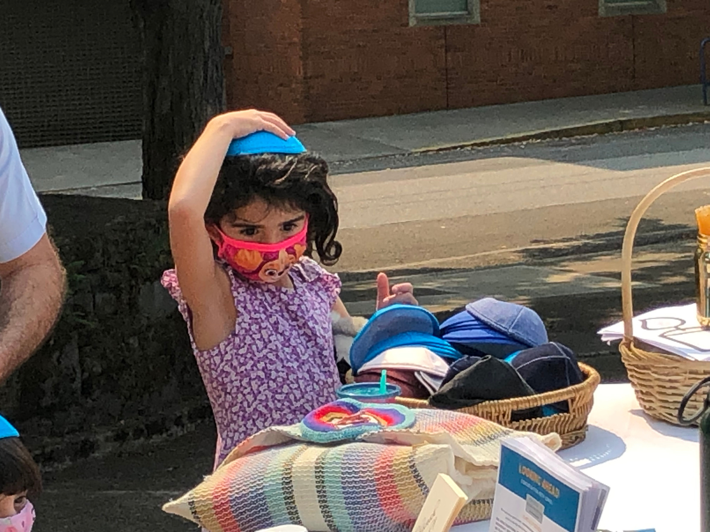
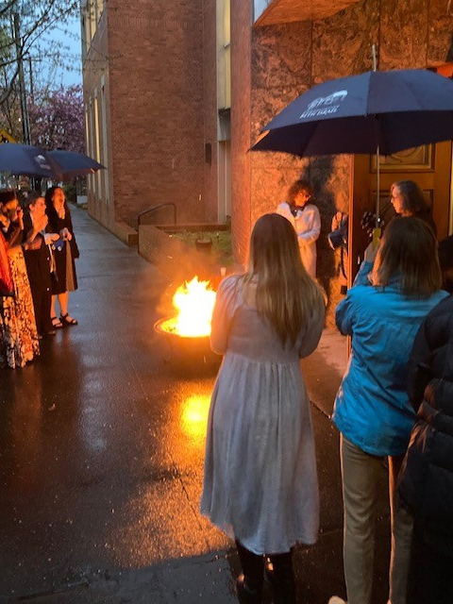
Women's Seder,
Burning "Emotional Chametz"
High Holidays 5782
www.bethisrael-pdx.org

Slide 15
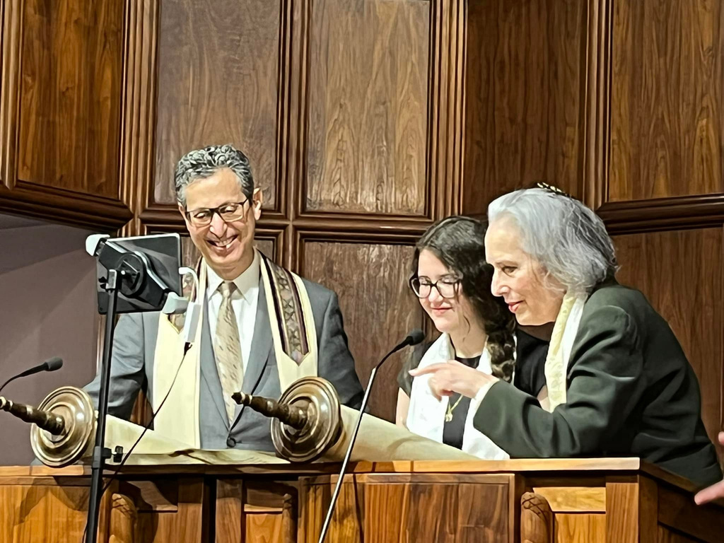
  Celebrated 48 B'nei Mitzvah
Bat Mitzvah
www.bethisrael-pdx.org

Slide 16
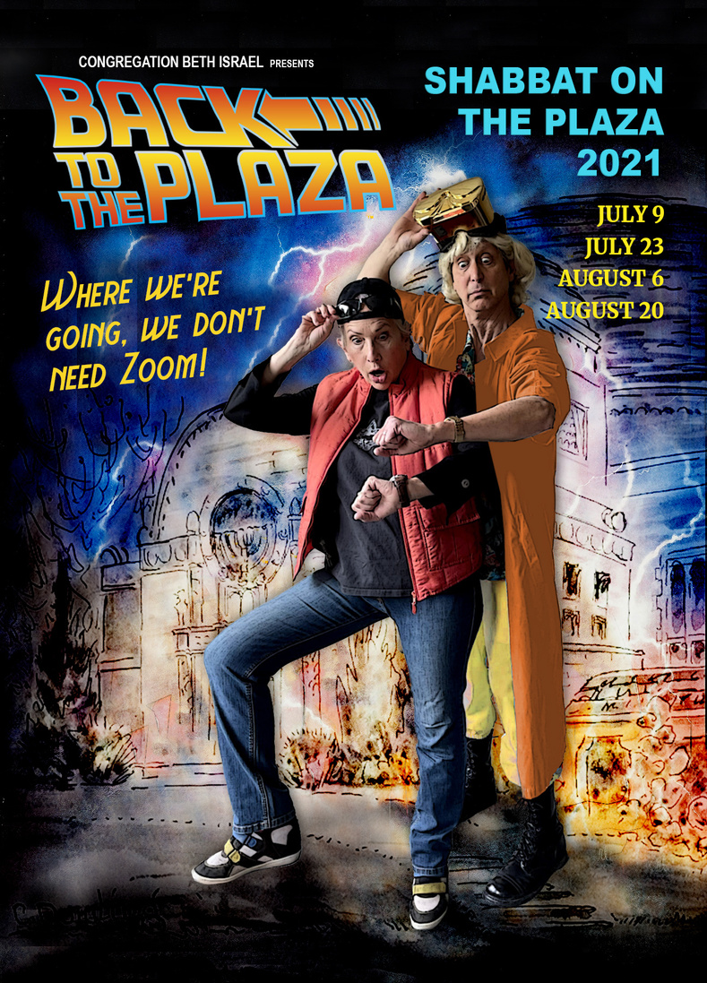
  Held Shabbat on the Plaza services throughout summer of 2021, with three more on the calendar for summer of 2022!
"Back to the Plaza" Promotional Poster
www.bethisrael-pdx.org

Slide 17
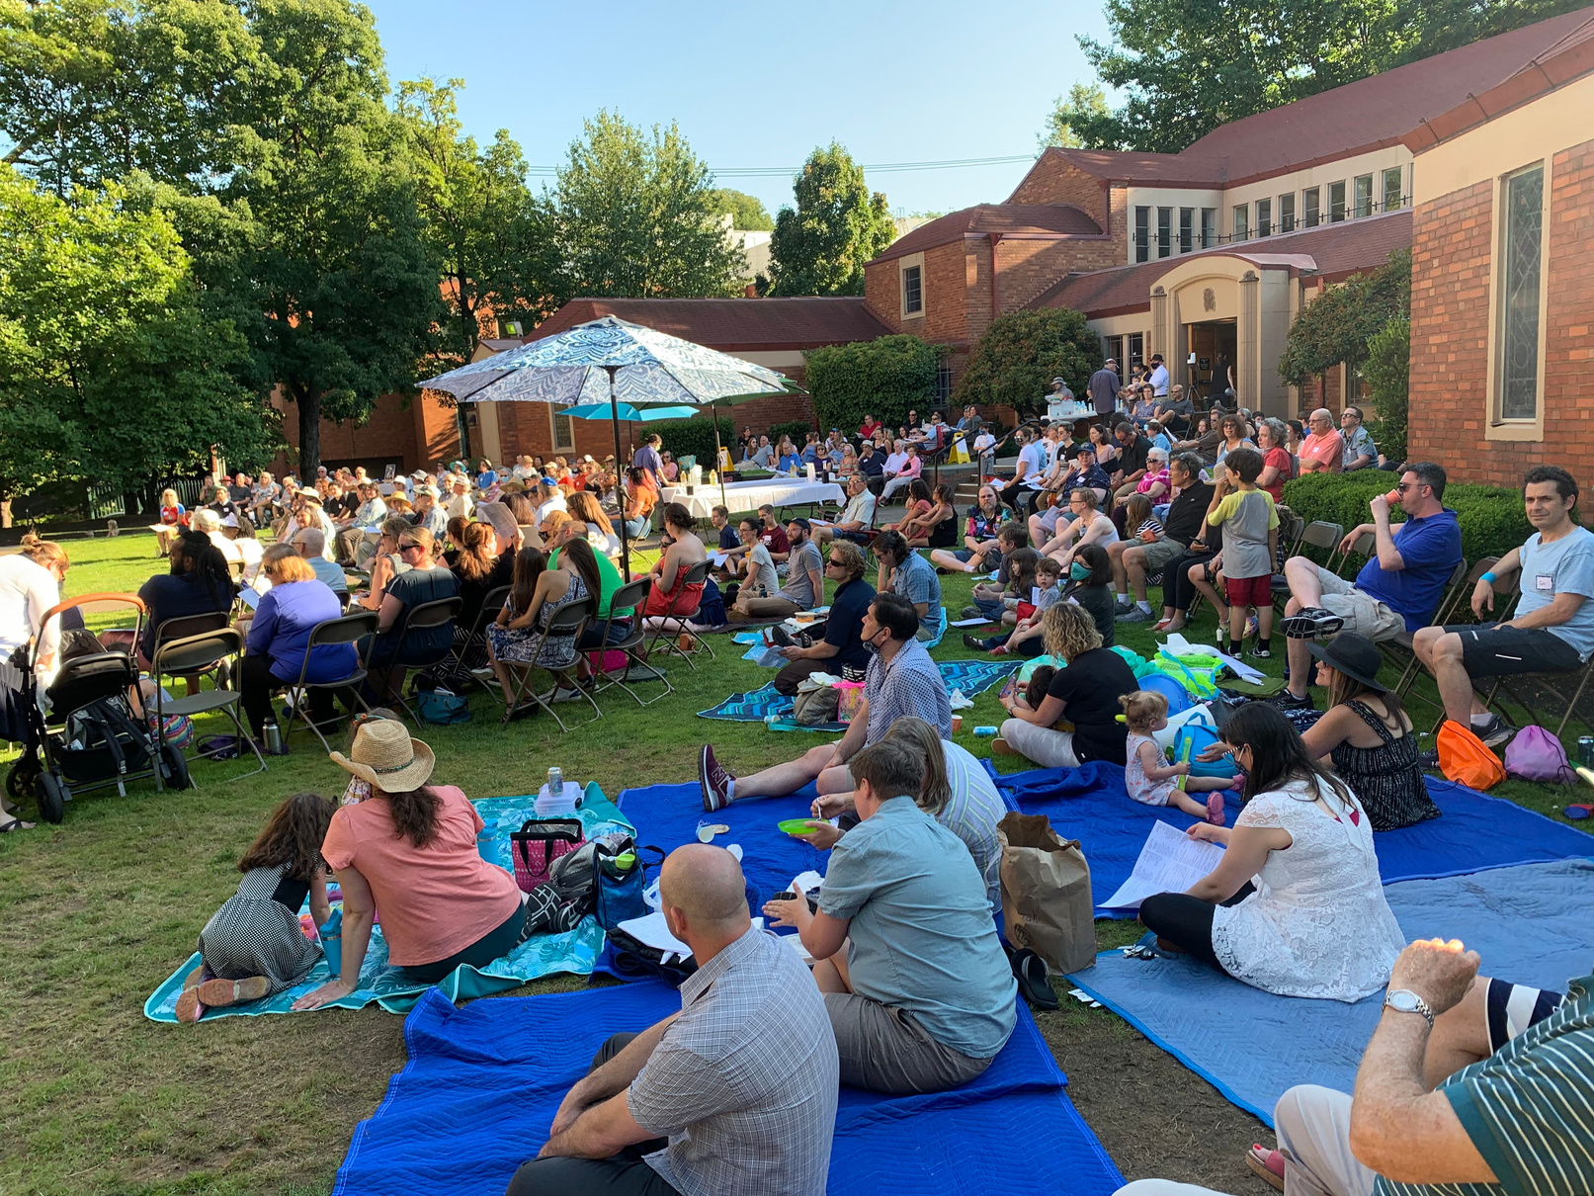
  Join us for Shabbat on the Plaza this Friday, July 15, Friday, August 19, and Friday, September 2
Shabbat on the Plaza
Shabbat on the Plaza
www.bethisrael-pdx.org

Slide 18
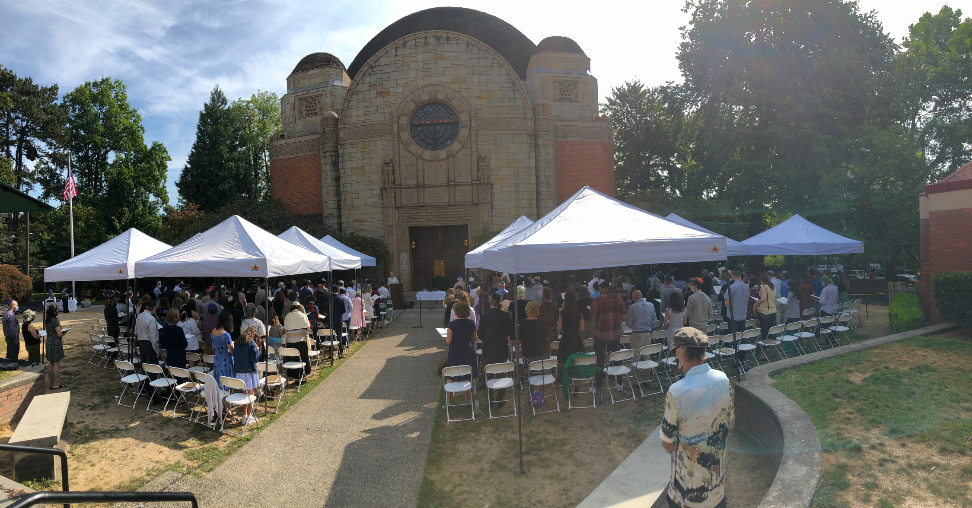
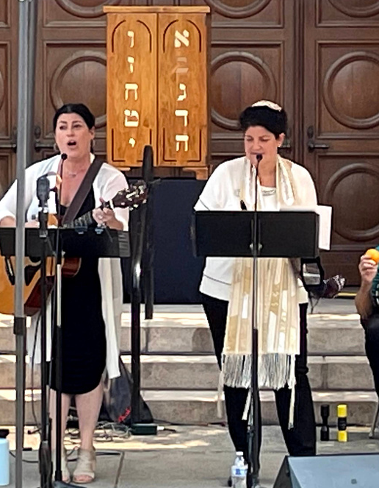
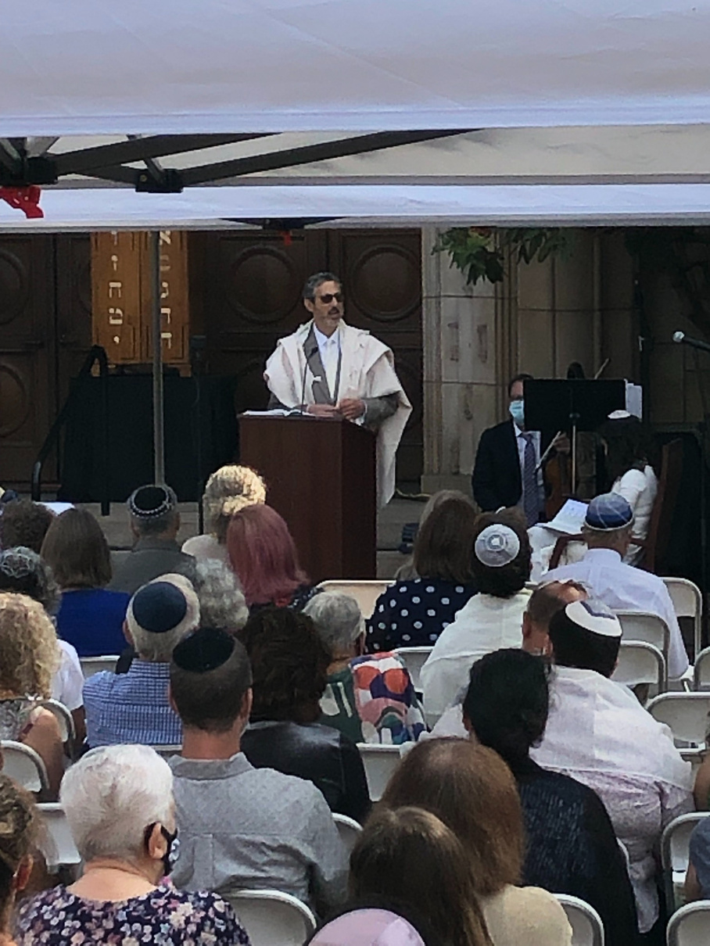
  Came together for the High Holidays (outside!)
High Holidays 5782
Kim Schneiderman and Rabbi Joseph
Rabbi Cahana
www.bethisrael-pdx.org

Slide 19
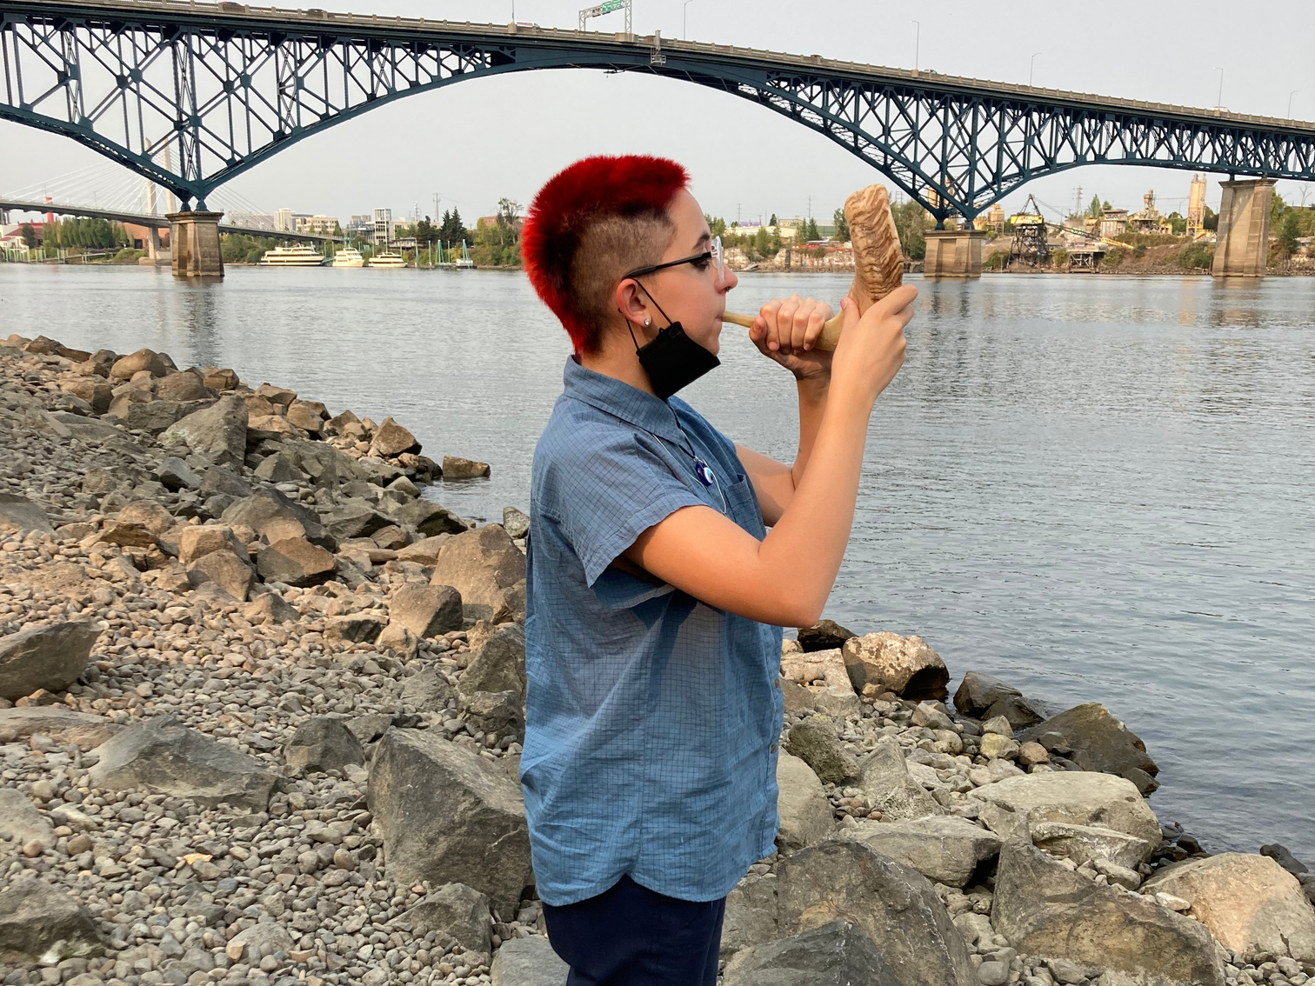
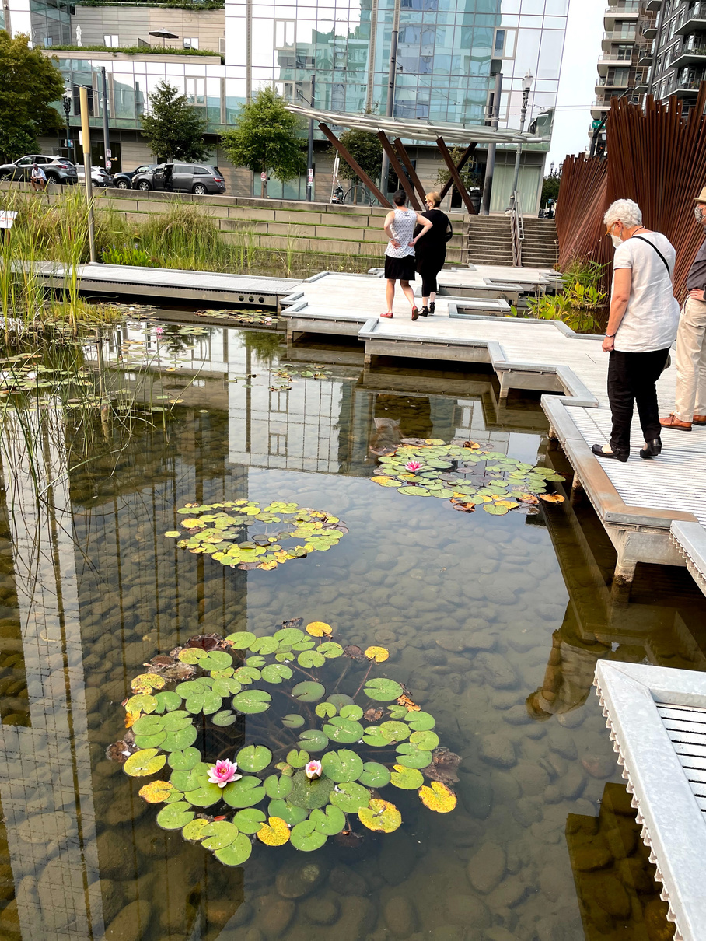
Tashlich 5782
Tashlich 5782
www.bethisrael-pdx.org

Slide 20
  Resumed in-person learning at our arts-integrated Religious School Program with 270 enrolled students in grades pre-k through twelve!
www.bethisrael-pdx.org

Slide 21
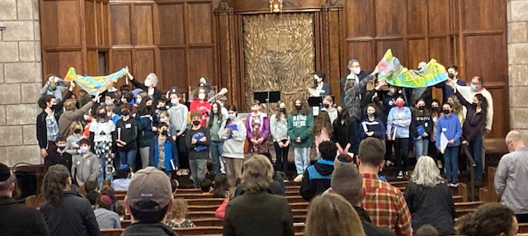
Mishpacha Minyan
www.bethisrael-pdx.org

Slide 22
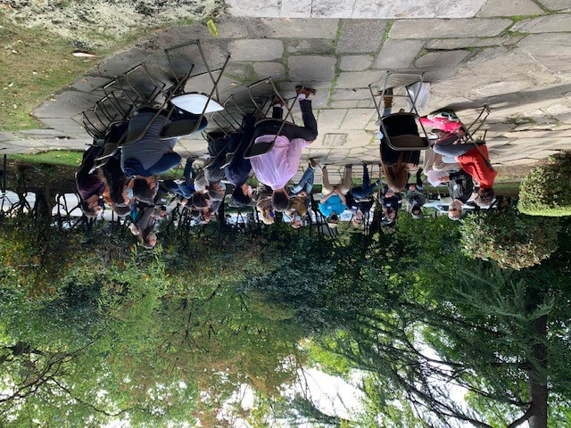
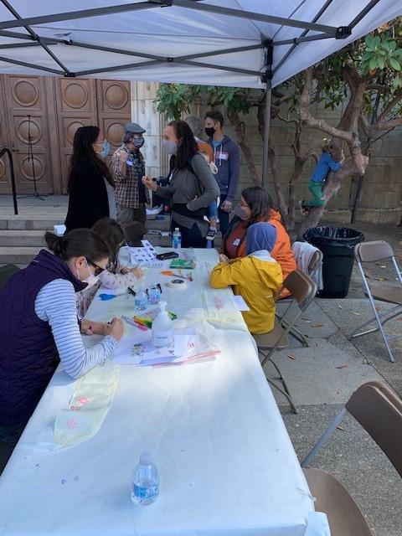
Wimple Making
Family Learning in Session
www.bethisrael-pdx.org

Slide 23
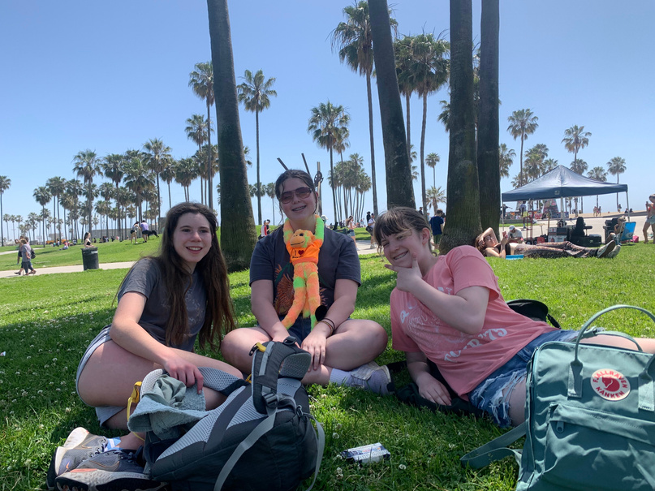
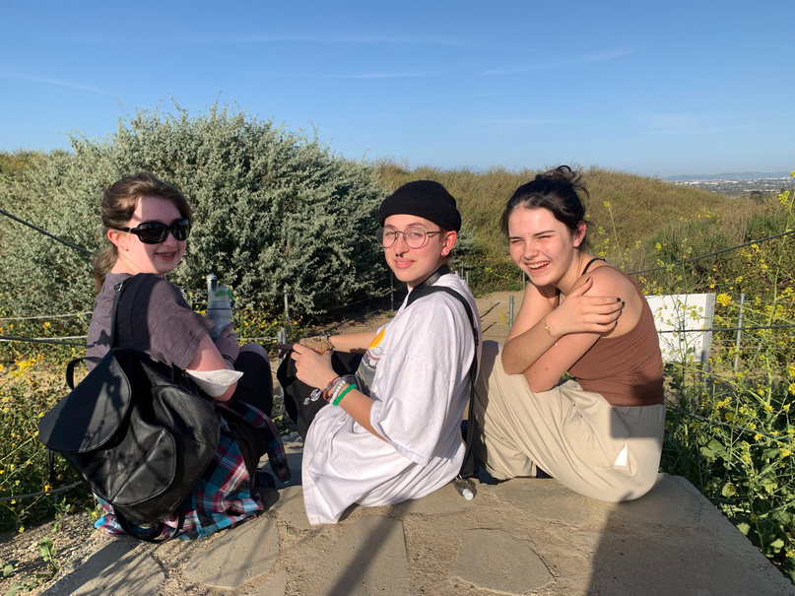
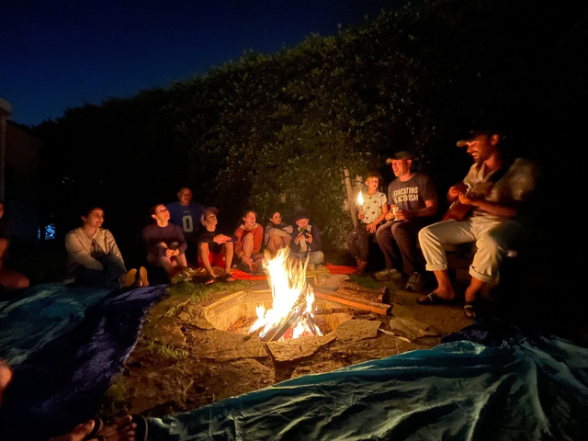
  Resumed travel with our youth groups with a social action-focused trip to Los Angeles this spring, and plans for Washington, DC and Southern Civil Rights trips in the coming year!
Los Angeles Trip
Los Angeles Trip
Los Angeles Trip
www.bethisrael-pdx.org

Slide 24
  Welcomed world-class (and Grammy-winning) musicians for concerts under our dome and a cine-concert experience at the MJCC
www.bethisrael-pdx.org

Slide 25
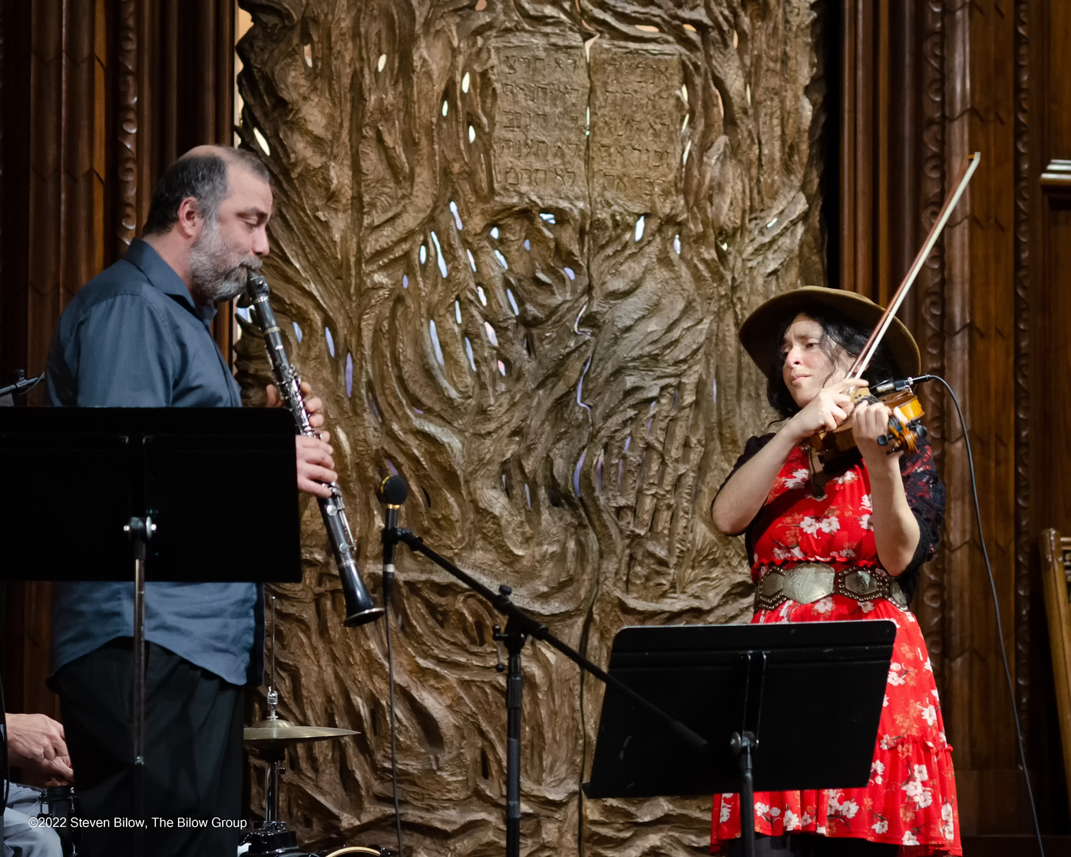
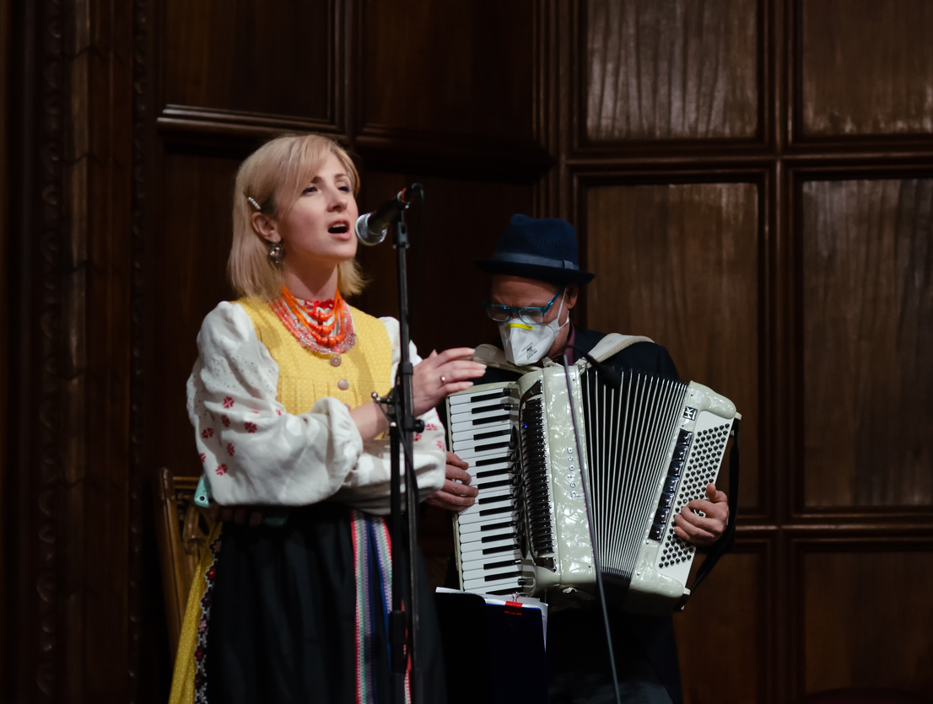
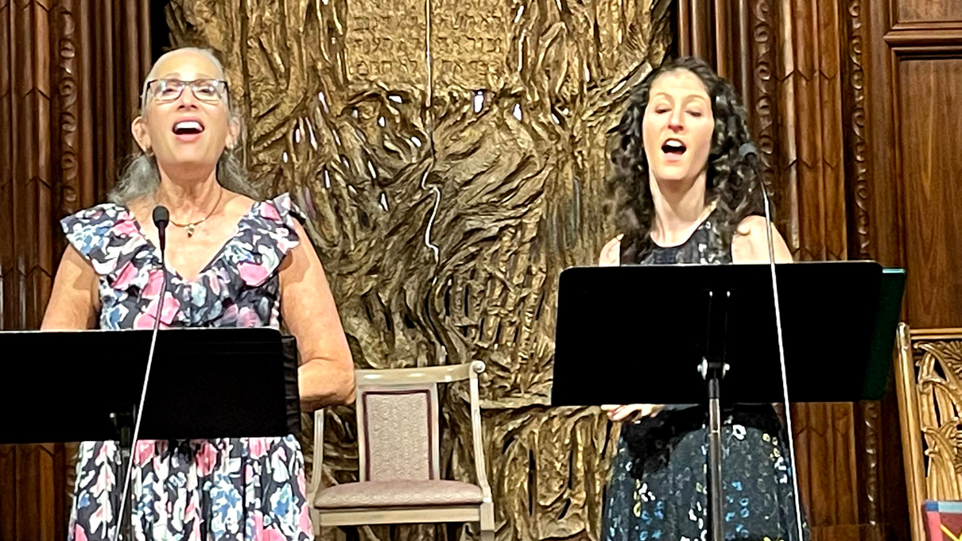
United for Ukraine - photo by Steve Bilow
Cantors Cahana and Green
United for Ukraine - photo by Steve Bilow
www.bethisrael-pdx.org

Slide 26
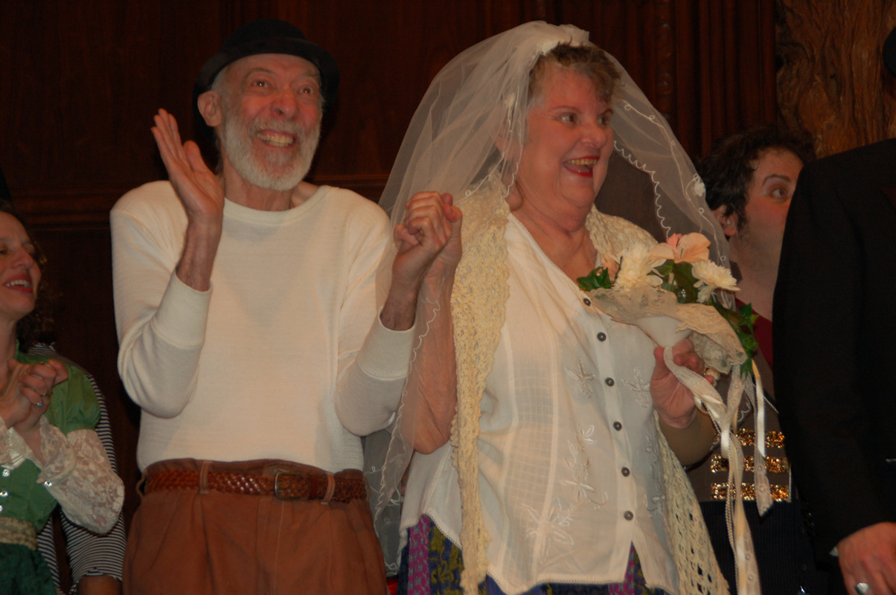
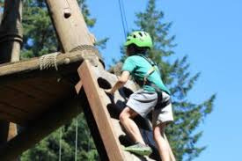
  Announced the Anese and Bernard Klein URJ Camp Scholarship Fund, which in its inaugural year will provide $1,000 scholarships to all CBI students attending URJ summer camp...and fourteen excited campers have signed up (so far)!
Anese and Bernard Klein (z''l)
URJ Camp Kalsman
www.bethisrael-pdx.org

Slide 27
  Introduced two new platforms so that our administrative team can keep our community better supported and connected:
    Shulcloud, our online membership portal, which streamlines communications, payments, and congregant support,
    and Cemify, which organizes, digitizes, and secures Beth Israel Cemetery burial records, plot ownership, and mapping
www.bethisrael-pdx.org

Slide 28
  Received a $150,000 Federal grant to improve the safety and security of our historic campus
www.bethisrael-pdx.org

Slide 29
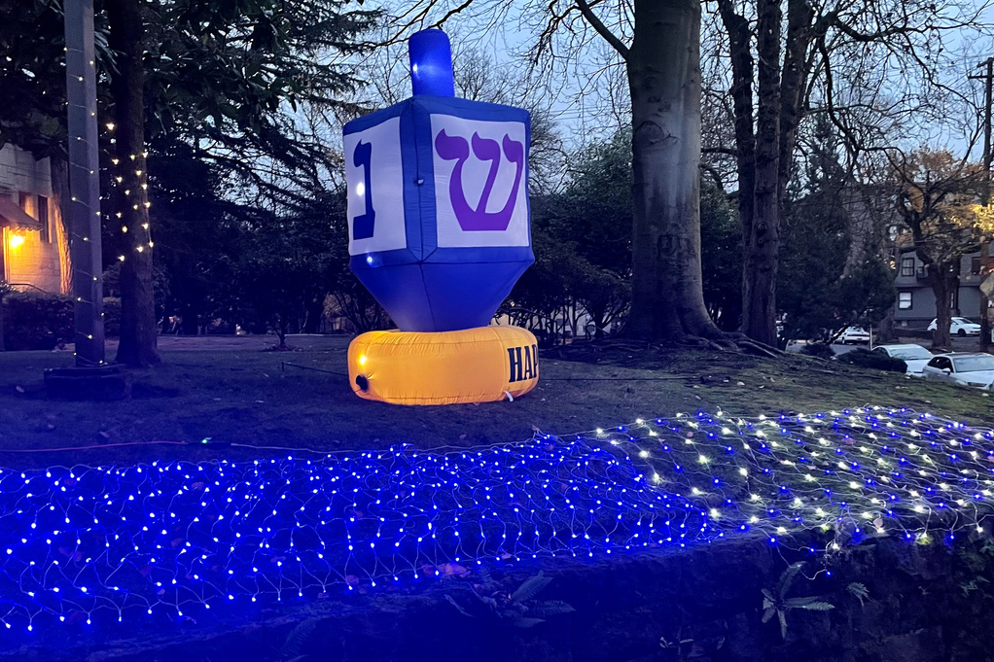
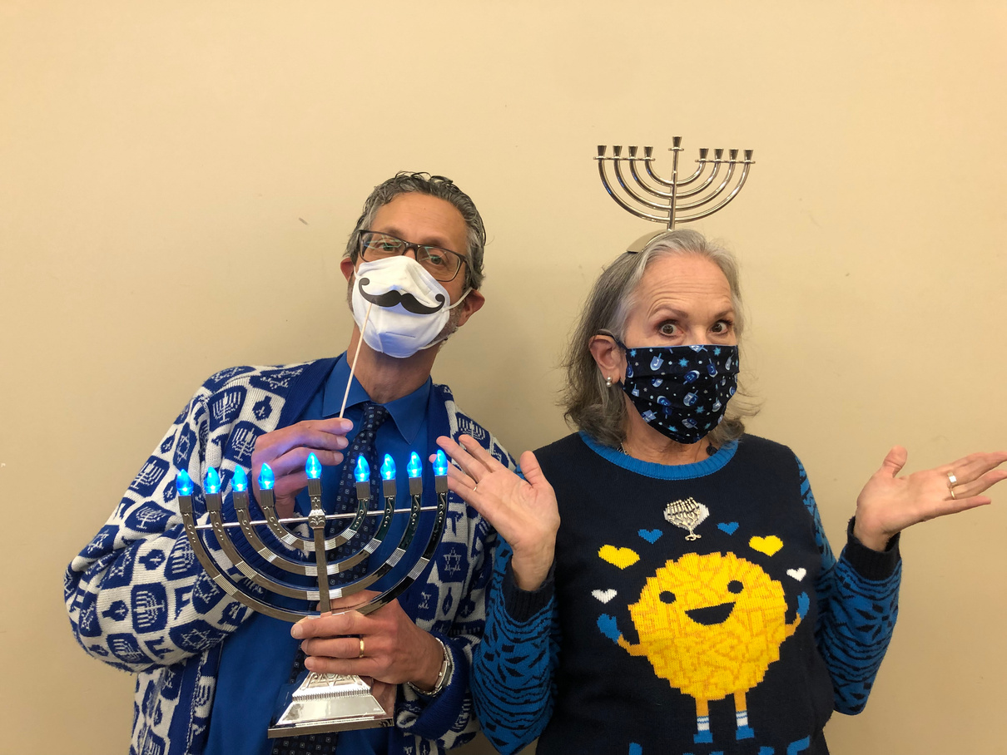
  We gathered for our Chanukah Family Service, complete with outdoor lights, and a “Donuts for Dinner” for our littlest congregants!
Chanukah Lights Drive Through
Chanukah
www.bethisrael-pdx.org

Slide 30
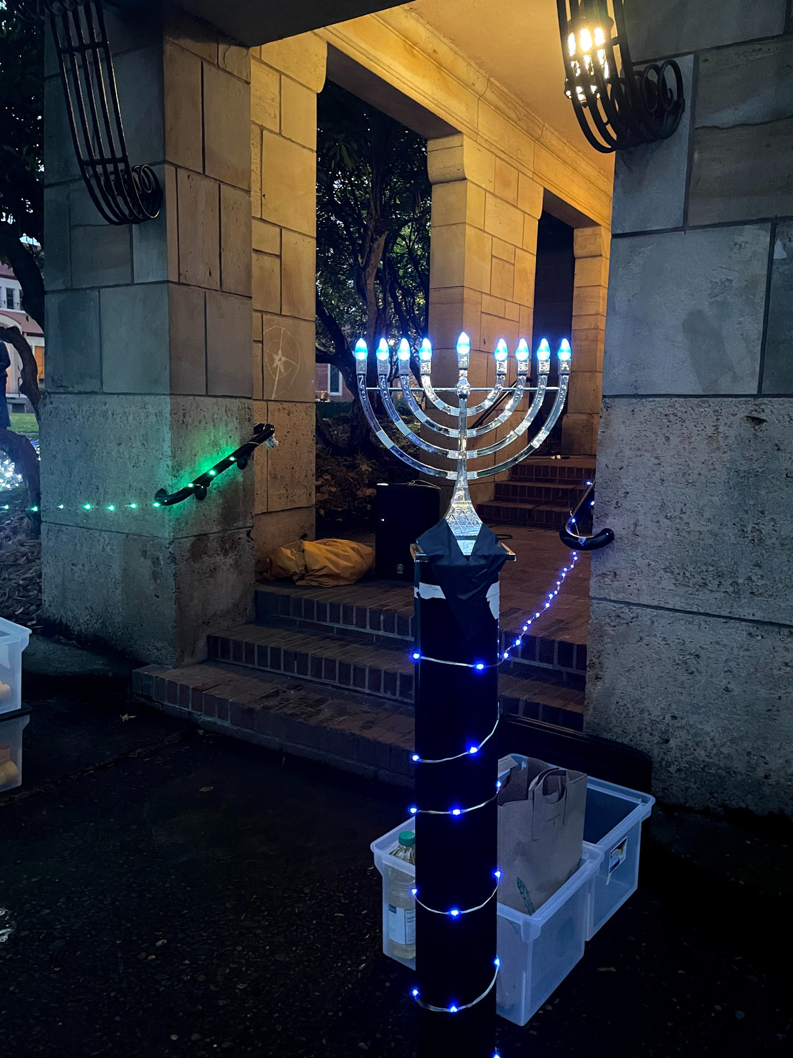
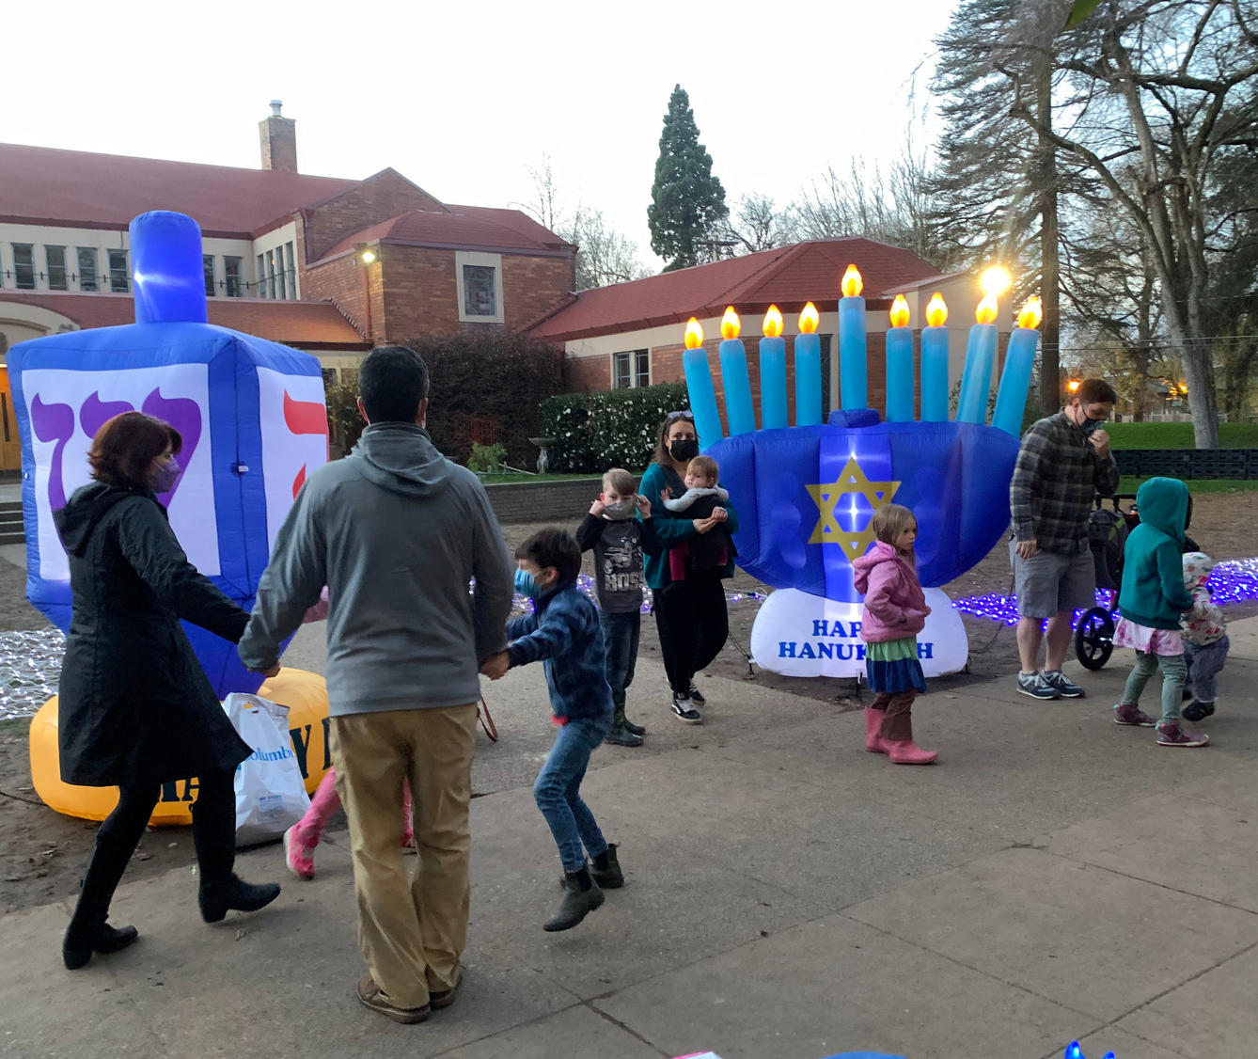
Chanukah Family Celebration
Chanukah Family Celebration
www.bethisrael-pdx.org

Slide 31
  Social Action efforts at CBI continued with focus on supporting refugees, gun violence prevention, and combating food insecurity.
www.bethisrael-pdx.org

Slide 32
  We supported Ukrainians, and other refugees, immigrants and asylum seekers with your donations of funds and goods. Generous contributions from our congregation traveled with Rabbi Cahana to Krakow. We donated $10,000 from the Social Action Food Fund to World Central Kitchen for their food programs in Ukraine and the neighboring countries. Local organizations active in resettling recent Afghan arrivals IRCO, Portland Refugee Support Group, and the Refugee Care Collective, received our donations of winter coats and household items, and allocations from our Social Action Funds. HIAS also received our support
www.bethisrael-pdx.org

Slide 33
  We continued to combat food insecurity by raising over $25,000 for the Robert Peltz (z’l) High Holidays Funds for Food drive, supporting local organizations providing food assistance, and continuing our partnership with Northwest Towers residents in their Sunday Food Pantry.
www.bethisrael-pdx.org

Slide 34
  We continue to work to prevent gun violence by participating in Lift Every Voice Oregon's campaign to move IP 17 to the Oregon November 2022 Ballot. This measure would require completion of a background check and safety training before a permit is issued to purchase a gun, and would ban Oregon sales and manufacture of high capacity magazines.
www.bethisrael-pdx.org

Slide 35
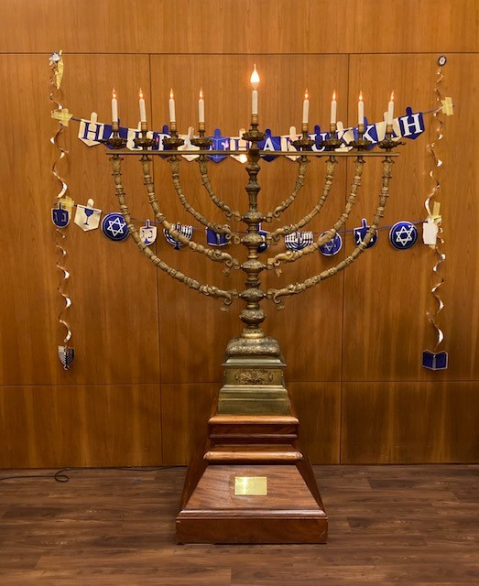
  CBI youth climate activists shared their informed and passionate voices for climate justice in this year's Chanukah "Share the Light" program. US Congresswoman Suzanne Bonamici also participated in the discussion
CBI Chanukiah
www.bethisrael-pdx.org

Slide 36
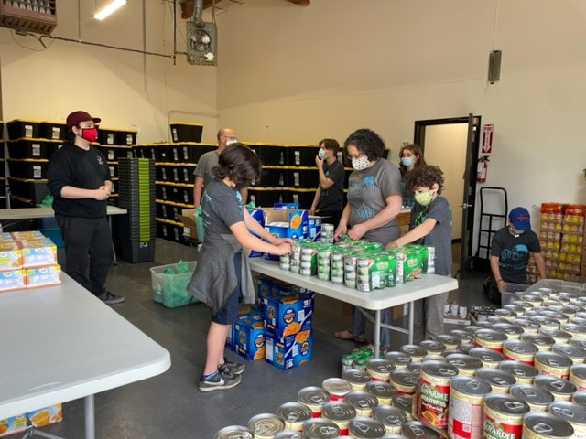
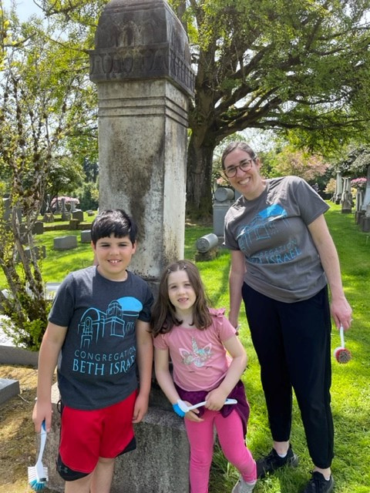
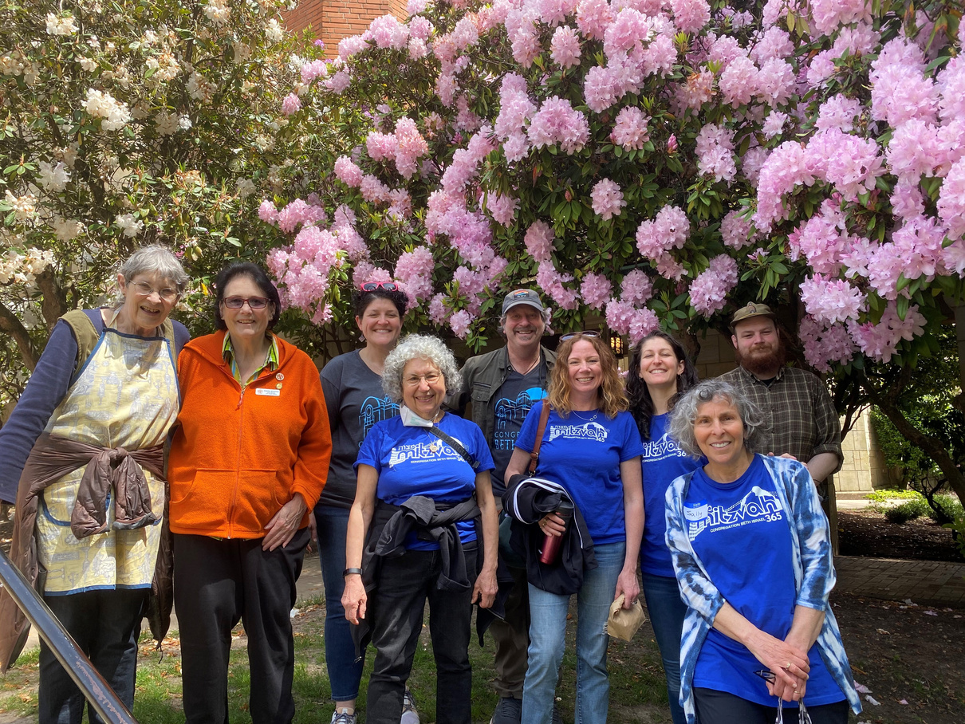
Mitzvah Day resumed in person with fourteen exciting service projects!
Mitzvah Day
Mitzvah Day
Mitzvah Day
www.bethisrael-pdx.org

Slide 37
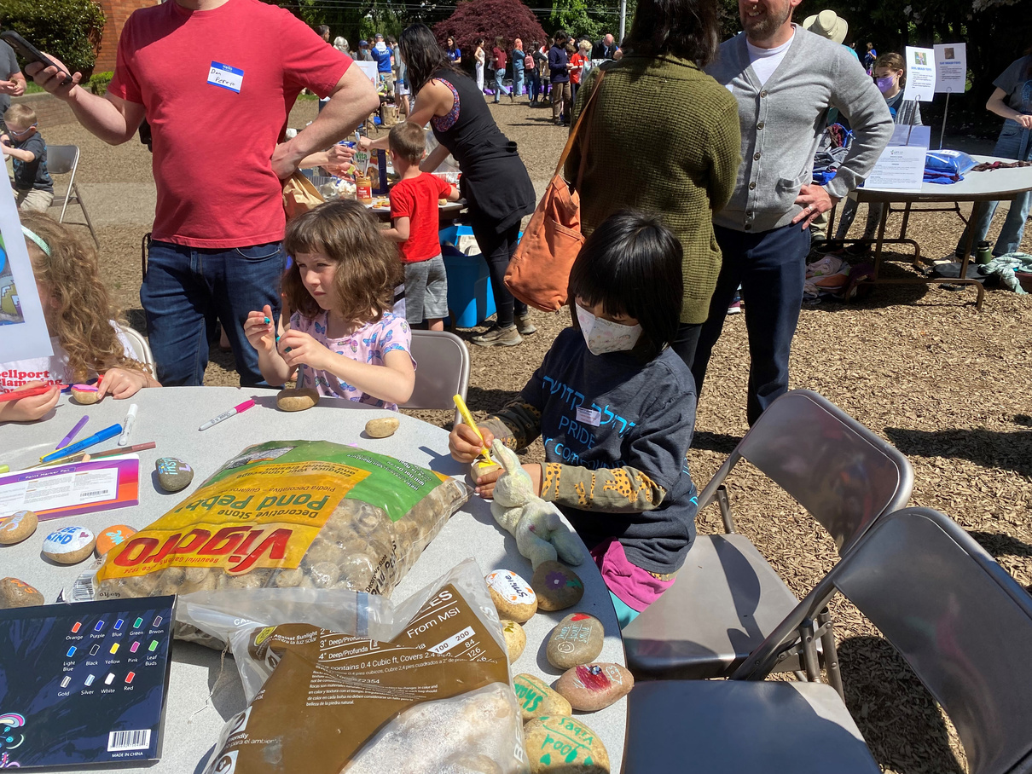
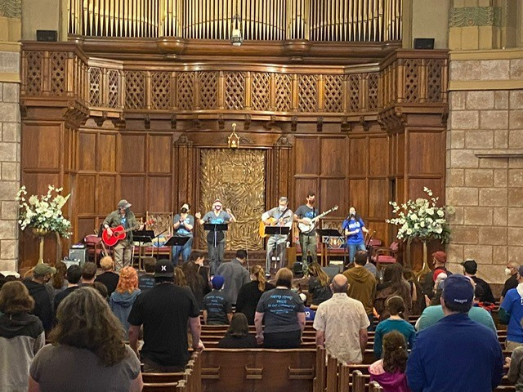
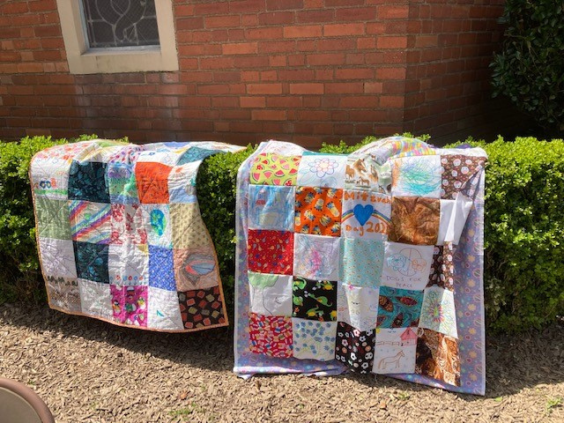
Mitzvah Day
Mitzvah Day
Mitzvah Day
www.bethisrael-pdx.org

Slide 38
  We launched Mitzvah Day 365 groups, focused on year round service and activism relating to Climate Action; Refugee, Immigrant and Asylum Seeker Support; Food Insecurity; and CBI participation in Portland Communities Active in Disaster (COAD).
www.bethisrael-pdx.org

Slide 39
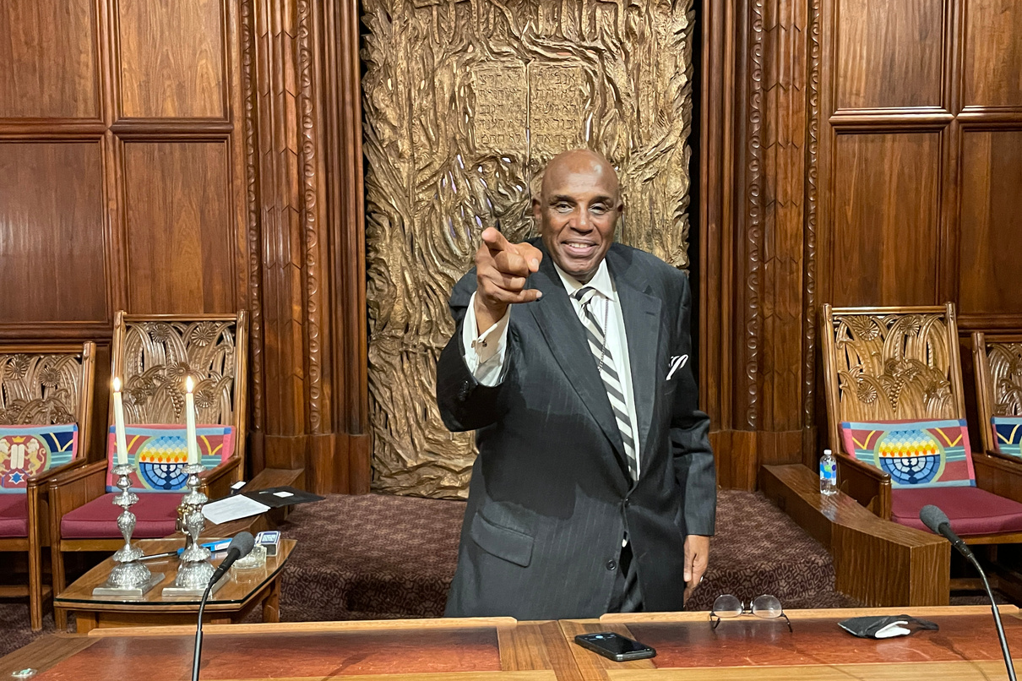
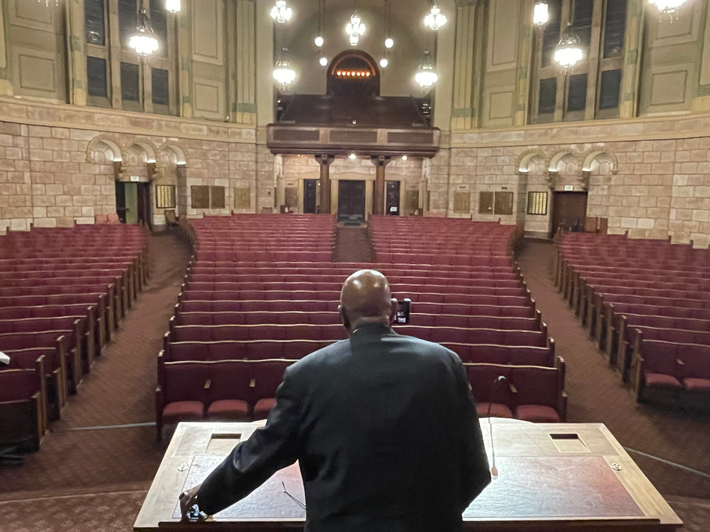
  We welcomed Rev. Dr. Gerald Durley for our annual Rev. Dr. Martin Luther King, Jr. Shabbat Service
Rev. Dr. Durley at our MLK Shabbat
Rev. Dr. Durley at our MLK Shabbat
www.bethisrael-pdx.org

Slide 40
  Connected online with international scholars for weekly Torah Study sessions, building a thriving community of adult learners
www.bethisrael-pdx.org

Slide 41
  Held a four-part series on reparations, sponsored by CBI’s Adult Education Committee, bringing in speakers, artists, and experts from the Black, Native American, and Japanese-American communities
www.bethisrael-pdx.org

Slide 42

  Laughed (and booed Haman) together in-person at My Fair Esther, this year’s hilarious Purim Schpiel
My Fair Esther Promotional Poster
www.bethisrael-pdx.org

Slide 43
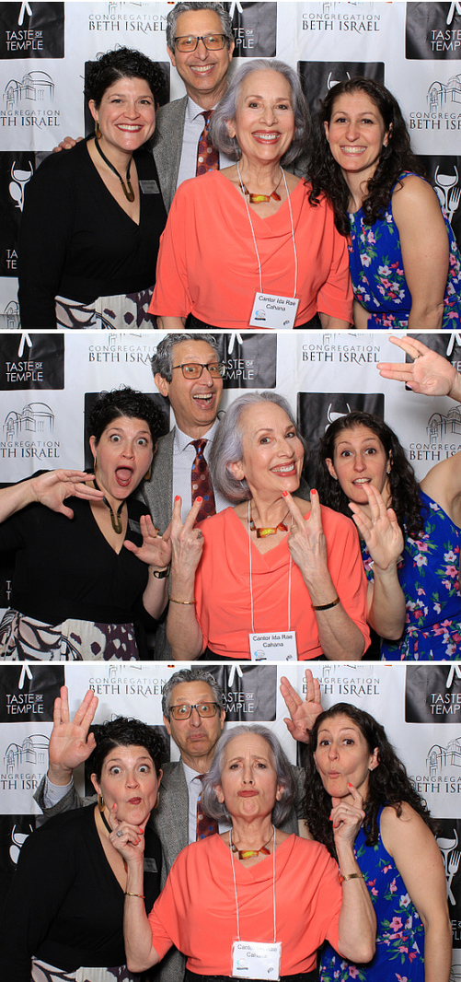
  Ate, drank, and connected at our 10'th Annual Taste of Temple (at which we raised over $146,000!)
CBI Clergy at Taste of Temple
www.bethisrael-pdx.org

Slide 44
  Celebrated conversions for ten babies born to gay Israeli dads via gestational surrogacy—something which, until very recently, was not allowed at home to gay male Israelis
www.bethisrael-pdx.org

Slide 45
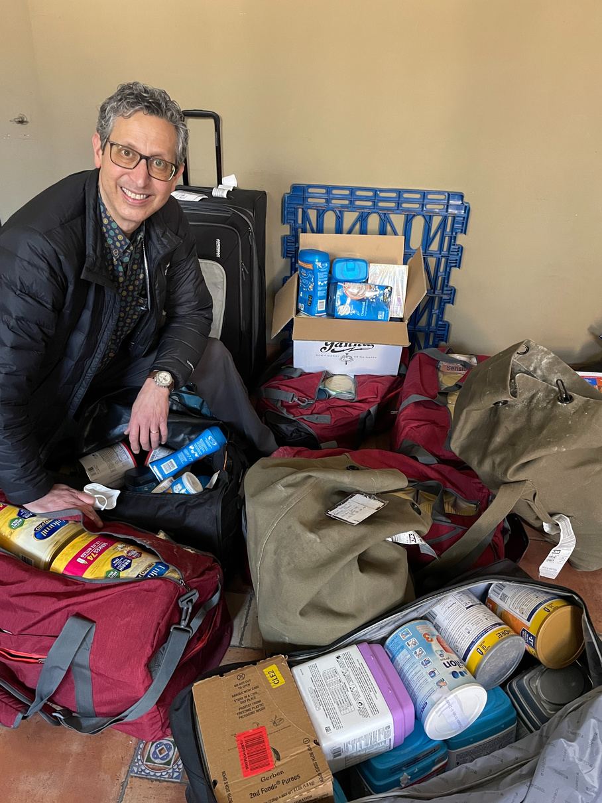
  Raised, in well under a month, nearly $65,000 (and more supplies than Rabbi Cahana could possibly carry on his aid trip) for Ukrainian refugees
Rabbi Cahana unpacks supplies in Krakow
www.bethisrael-pdx.org

Slide 46
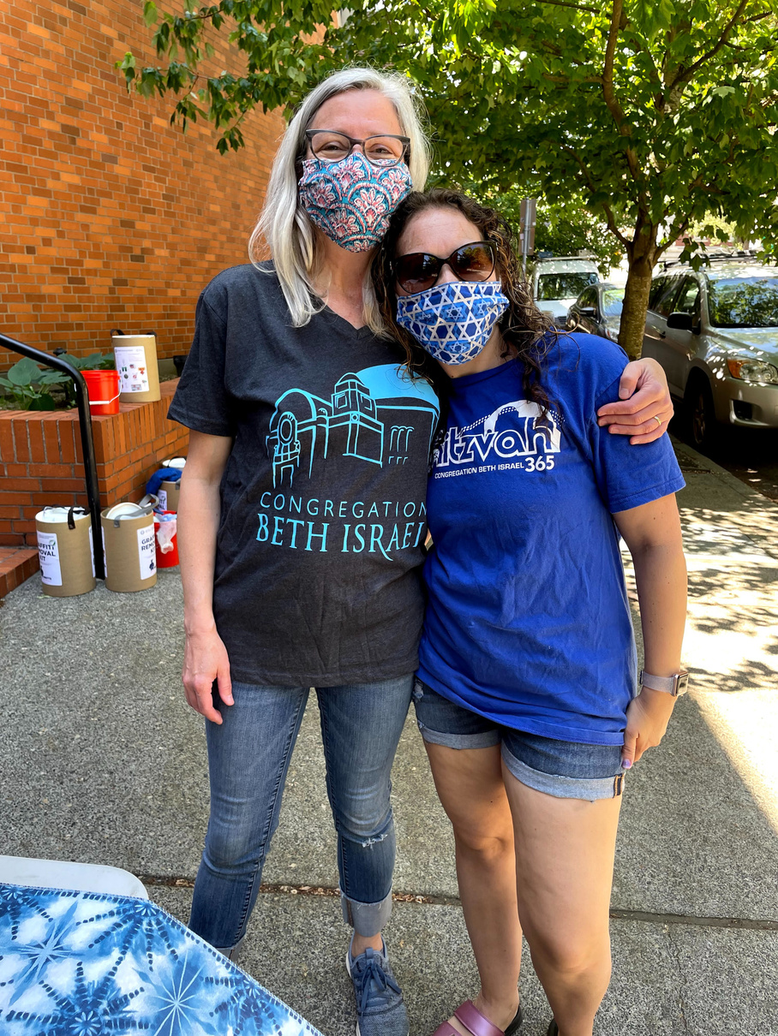
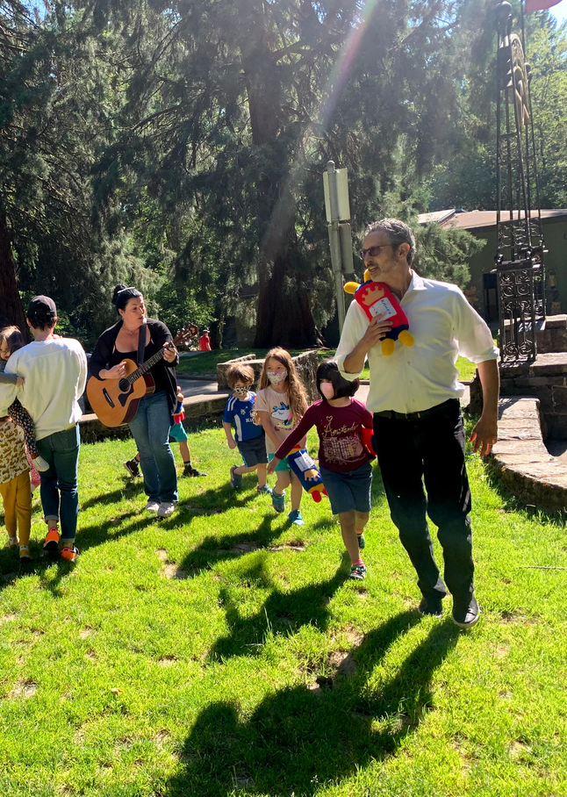
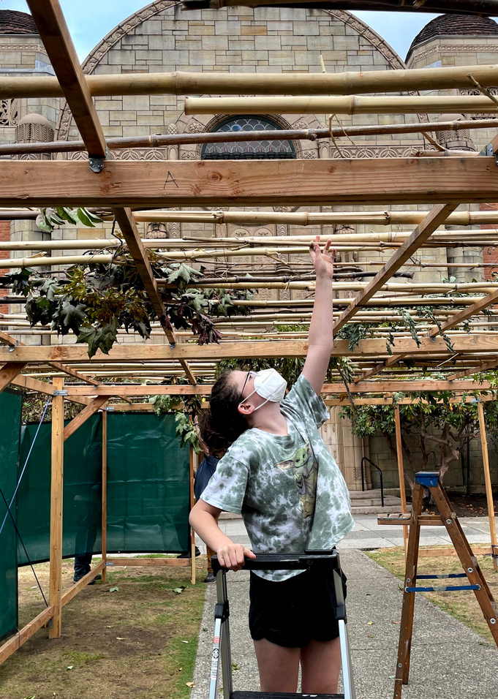
Thank
you.
High Holidays
Mitzvah Day
Mini Mensches
Sukkah Building
www.bethisrael-pdx.org

Slide 47
Honoring Retiring
Board Members
Bonnie Davis
David Goldwyn
Tony Urdes
www.bethisrael-pdx.org

Slide 48
Thank you, Greeters!
Our appreciation to Judith Pakosinski and Tammy Kramer for making everyone feel welcome at CBI.
www.bethisrael-pdx.org

Slide 49
Nominating
Committee
Report
Libby Schwartz
www.bethisrael-pdx.org

Slide 50
Election of New
Board Members
Susan Berniker
Gail Mandel
Susan Milstein
Elana Pirtle-Guiney
www.bethisrael-pdx.org

Slide 51
Reelection of
Board Members
Naomi Derner
Meryl Haber
Bill June
Shoshanna Lansberg
Sandy Lewis
Sarah Pitman
www.bethisrael-pdx.org

Slide 52
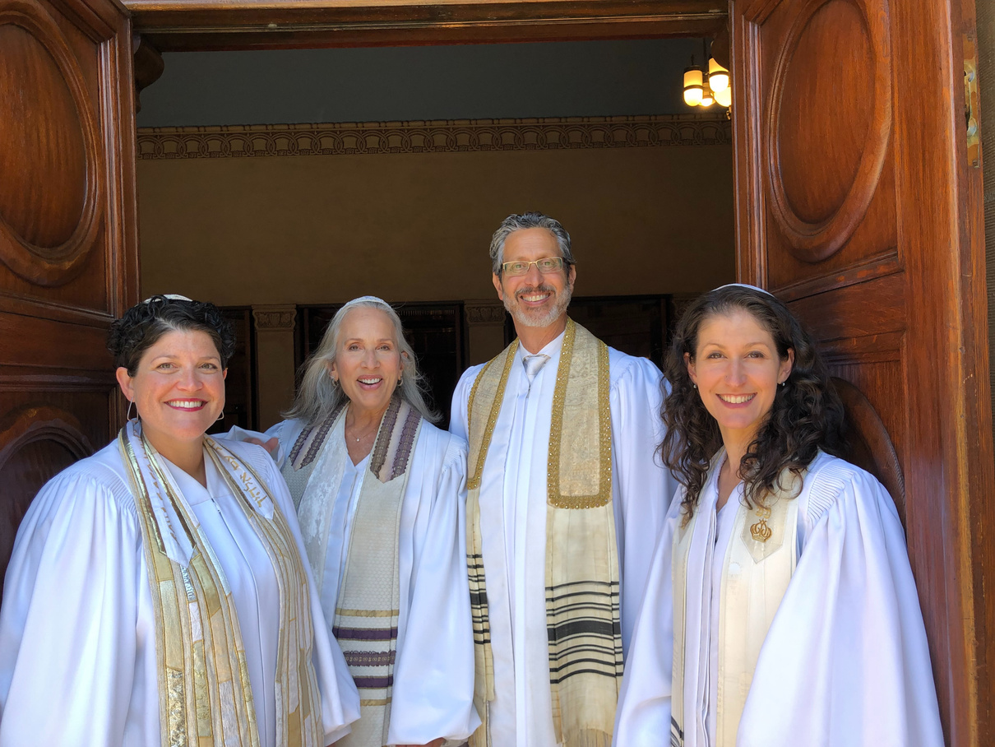
Blessing of the CBI Board
Congregation Beth Israel Clergy
www.bethisraell-pdx.org

Slide 53
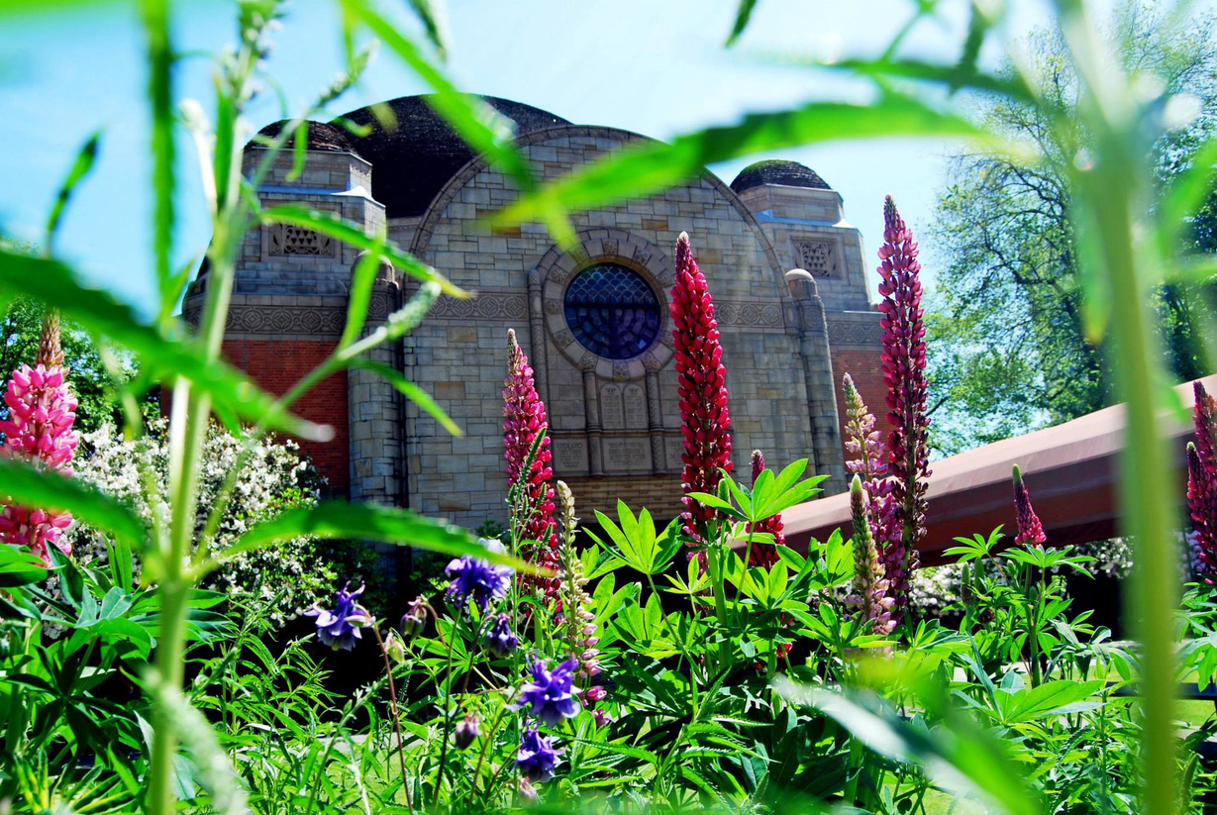
Closing
Tony Urdes
President, CBI Board
of Trustees
www.bethisraell-pdx.org

