Slide 1
Indian Nations, the Doctrine of Discovery, and American Manifest Destiny [and Reparations?]
July 7, 2022
© Prof. Robert J. Miller (Eastern Shawnee)
Sandra Day O’Connor College of Law, Az. St. Univ.
Director, Rosette LLP Am. Ind. Econ. Dev. Program
Willard H. Pedrick Distinguished Research Scholar
Chief Justice, Pascua Yaqui Tribe Court of Appeals
American Philosophical Society (elected 2014)

Slide 2
Johnson v. McIntosh, 21 U.S. 543 (1823).
Country settled on Discovery & Conquest
Discovery limited tribal real property rights
Discovery limited tribal sovereign rights

Slide 3
Elements of Discovery
1. First discovery
2. Actual occupancy
3. Preemption/European title
4. Native title
5. Sovereign and commercial rights
6. Contiguity
7. Terra nullius
8. Conquest 9. Christianity
10. Civilization

Slide 4
International law of colonialism
Romanus Pontifex 1436 – Portugal
Nicholas V Jan. 8, 1455, “invade, search out, capture, vanquish, and subdue all Saracens [Muslims] and pagans whatsoever, and other enemies of Christ ... and the kingdoms, dukedoms, principalities, dominions, possessions, and all movable and immovable goods ... reduce their persons to perpetual slavery ... and to convert them to his ... use and profit ... possess, these islands, lands, harbors, and seas.”

Slide 5
Pope Alexander VI
Inter caetera divinai, May 1493, new lands “undiscovered by others” [Natives?] belonged to Spain.
Also granted Spain lands it might discover in the future if they were “not previously possessed by any Christian owner.”

Slide 6
Inter caetera II, Pope Alexander line from pole to pole, west of the Azores, granted Spain title under the authority of God to all the lands discovered or to be discovered west of the line. Portugal was granted the same east of the line. Spain was to carry out this “holy and laudable work” to contribute to “the expansion of the Christian rule.”

Slide 7
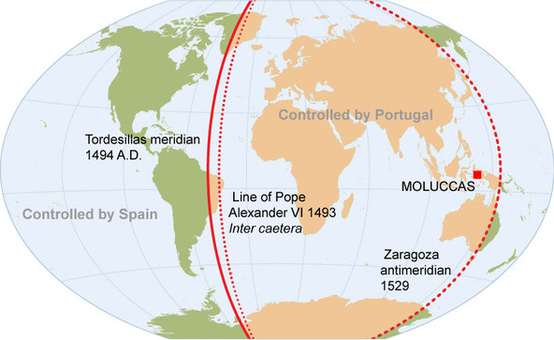

Slide 8
England
Henry VII - 1496-98 & Elizabeth I - 1587
James I Charters – religion & contiguity
English settlers inferred from plague that God was on their side. James I mentioned.
John Winthrop Mass. Bay colony Gov. - 1634 - smallpox killing Indians – “God hathe hereby cleered our title to this place.”

Slide 9
Founders’ favorite scripture?
“Be fruitful, and multiply, and replenish the earth, and subdue it . . . .” Genesis 1:28 (King James).

Slide 10
George Washington September 7, 1783
“Indians ... retreat as our Settlements advance upon them and they will be as ready to sell, as we are to buy; That it is the cheapest . . . .
Settlemt of the Western Country and making a Peace with the Indians are so analogous that there can be no definition of the one without involving considerations of the other. . . .
policy and oeconomy point very strongly to the expediency of being upon good terms with the Indians, and . . . purchasing their Lands in preference to attempting to drive them by force of arms out of their Country; which as we have already experienced is like driving the Wild Beasts of the Forest . . . when the gradual extension of our Settlements will as certainly cause the Savage as the Wolf to retire; both being beasts of prey tho’ they differ in shape. In a word there is nothing to be obtained by an Indian War but the Soil they live on and this can be had by purchase at less expence, and without that bloodshed . . . .”

Slide 11
Congressional Enforcement of the Doctrine of Discovery
1790 - “No sale of lands made by any Indians, or any nation or tribe of Indians . . . shall be valid to any person or to any state . . . unless made and executed at some public treaty, held under the authority of the U.S.”
Still the law today - 25 U.S.C. § 177.

Slide 12
Jefferson’s Discovery policies
1792 – U.S. Right of Preemption
1802-08 – Tribes own land; U.S. will buy
1804 – Limits of LA - Discovery principles
1808 wrote Congress U.S. has to buy the land from the “native proprietors”

Slide 13
Jefferson’s Discovery policies
1792 U.S. exclusive control of tribal trade & political interactions
1804 Letter to Meriwether Lewis - “Being now become sovereigns of the [Louisiana Terr.] country” – but subject to “Indian rights of occupancy”

Slide 14
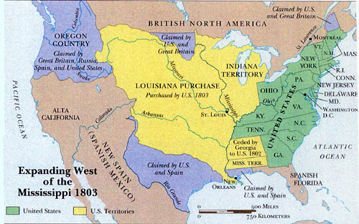
Louisiana Purchase - 1803
From Ambrose & Axtell, L&C Voyage of Discovery (1998)

Slide 15
American Manifest Destiny
Special virtues of Americans & institutions
Mission to remake the world in our image
Divine destiny under God’s direction to accomplish this wonderful task
Chile - the “Southern Destiny”
Argentina- the “Conquest of the Desert”
Brazil - “the last frontier” & natives were “last bulwark against the advance of civilization.”

Slide 16
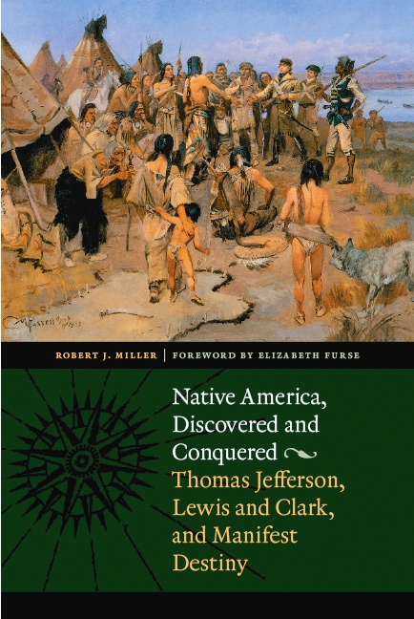

Slide 18
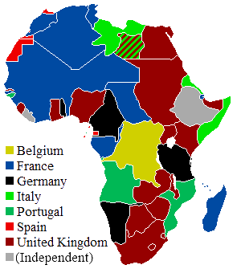

Slide 19
Indian Claims Commission 1946
Legal or equitable claims under fed law
Other legal/equitable claims including torts
Claims which would result if treaties were revised due to fraud, duress, mistake, etc.
Takings by the U.S. of land w/o payment
Claims based on fair & honorable dealings not recognized by existing law or equity
$800 million paid out

Slide 20
Cobell v. Salazar
1996 – $2-$40 billion. Federal violations of trustee duties manage Indian and tribal lands
10+ federal court decisions.
Contempt of court sanctions for two Cabinet Secretaries [first ever?]
Unable to account. Trustee’s primary duty
Congress-Obama $3.4 billion settlement. $1.5 Billion for individuals & $1.9 Billion for 10-year land buy back for tribal governments.
https://www.doi.gov/buybackprogram

